Slide 1
البيانات الخاصة بإنشاء نظام تكييف الهواء
Computer Applications
4th Stage
Presented By
Assist. Lecturer Hawraa Tayyeh

Slide 11
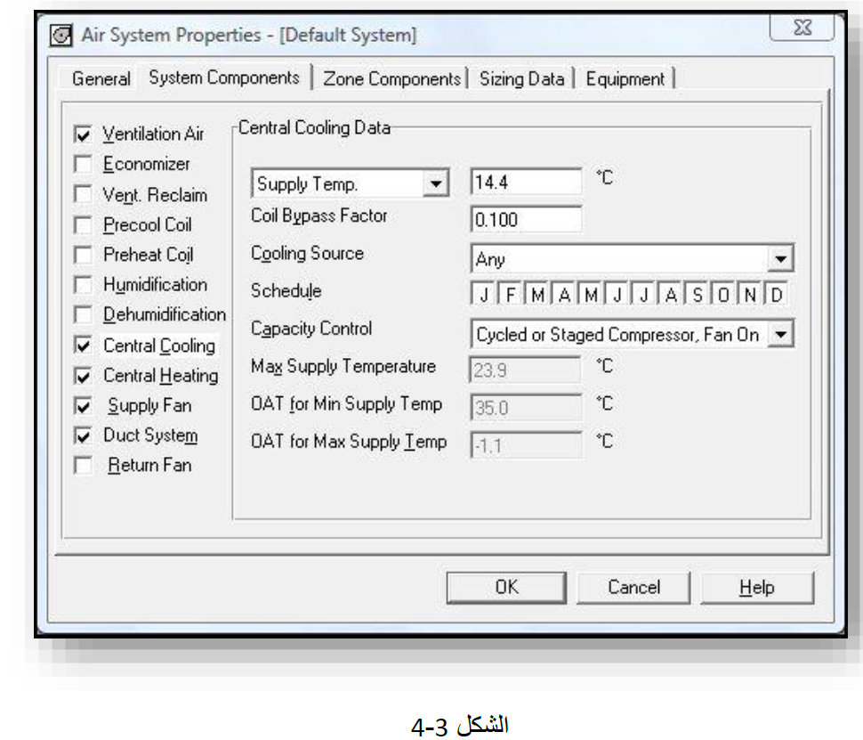

Slide 13
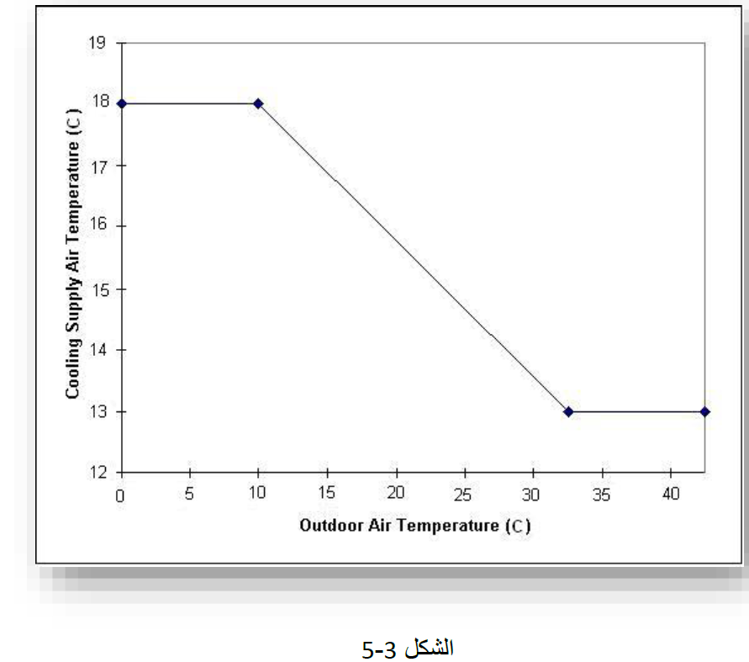

Slide 19
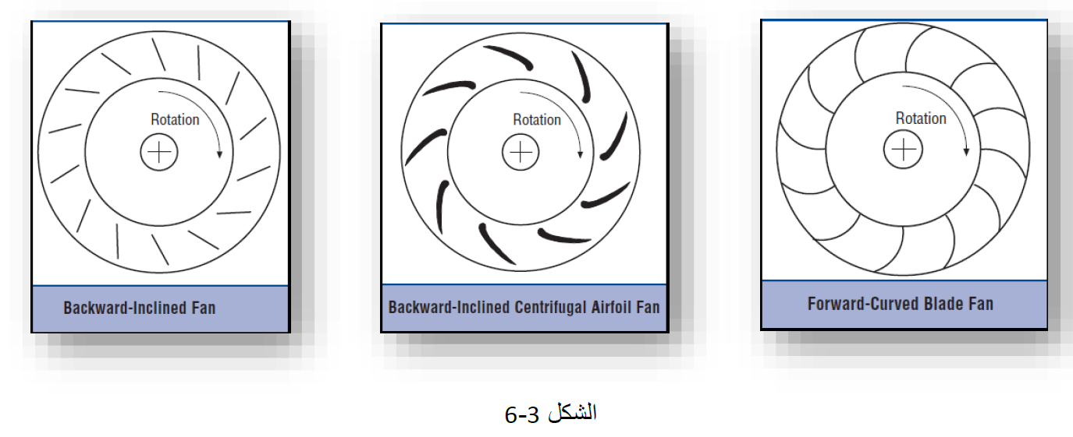

Slide 22
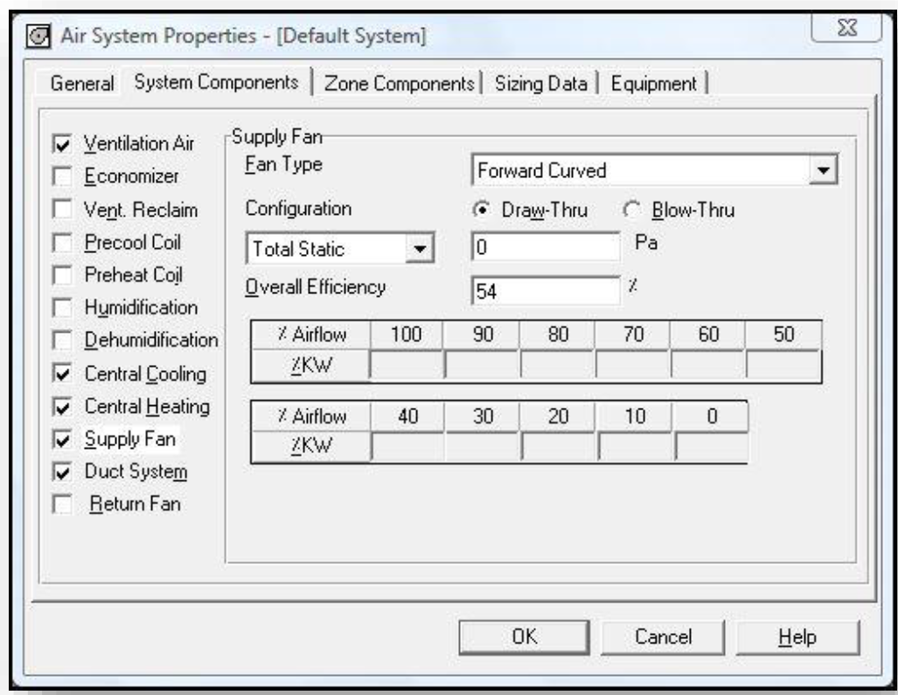

Slide 24
Thank You For Listening

