Slide 1
البيانات الخاصة بإنشاء نظام تكييف الهواء
Computer Applications
4th Stage
Presented By
Assist. Lecturer Hawraa Tayyeh

Slide 3
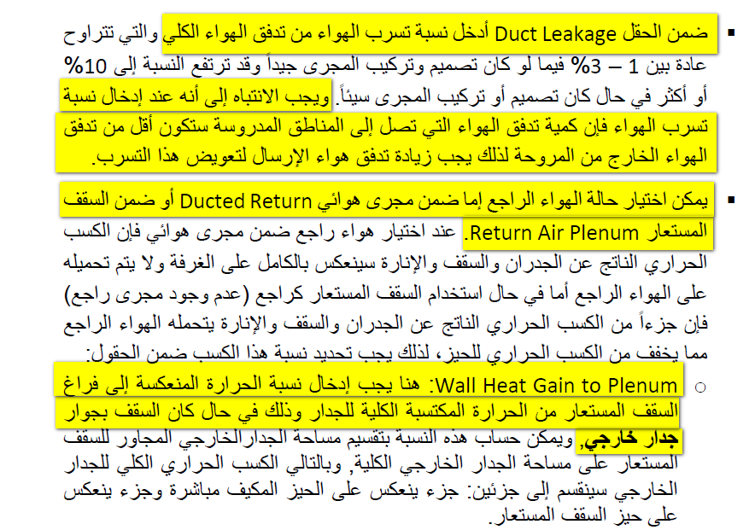

Slide 5
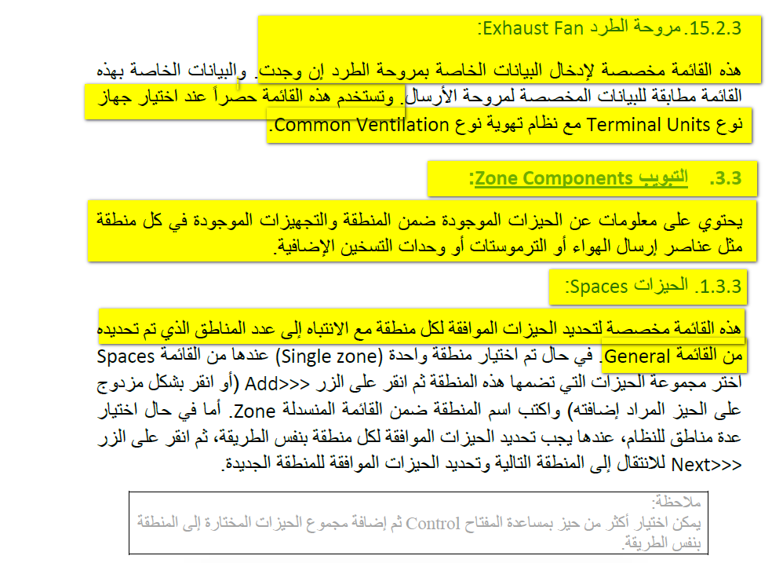

Slide 8
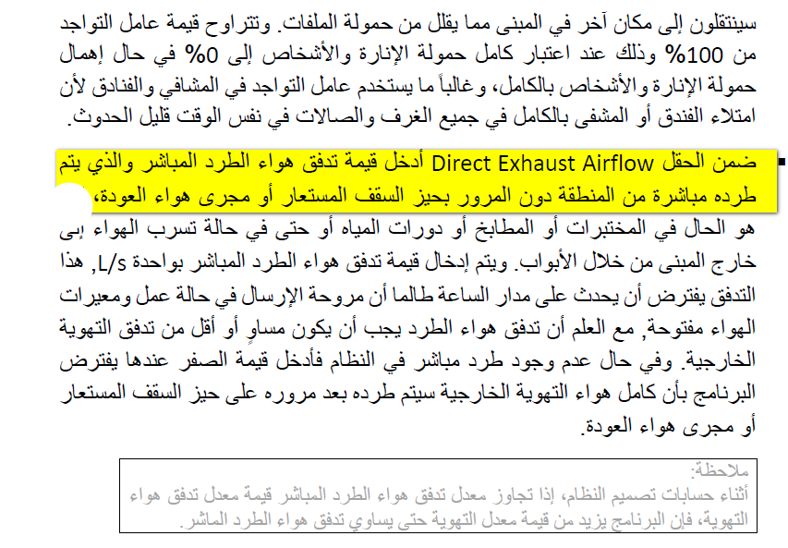

Slide 14
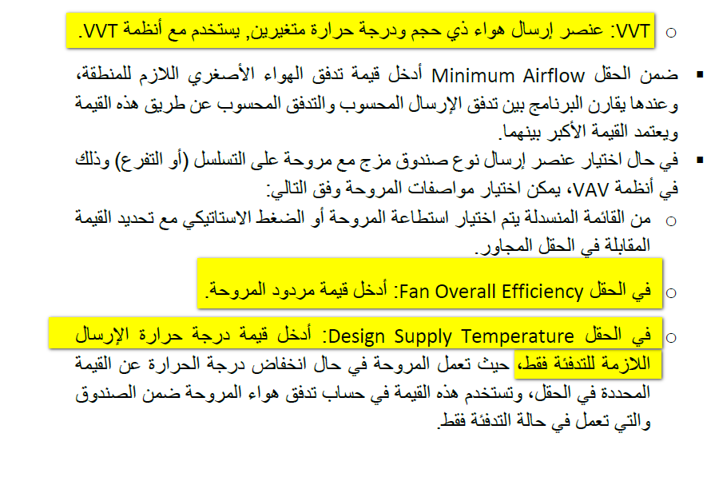

Slide 18
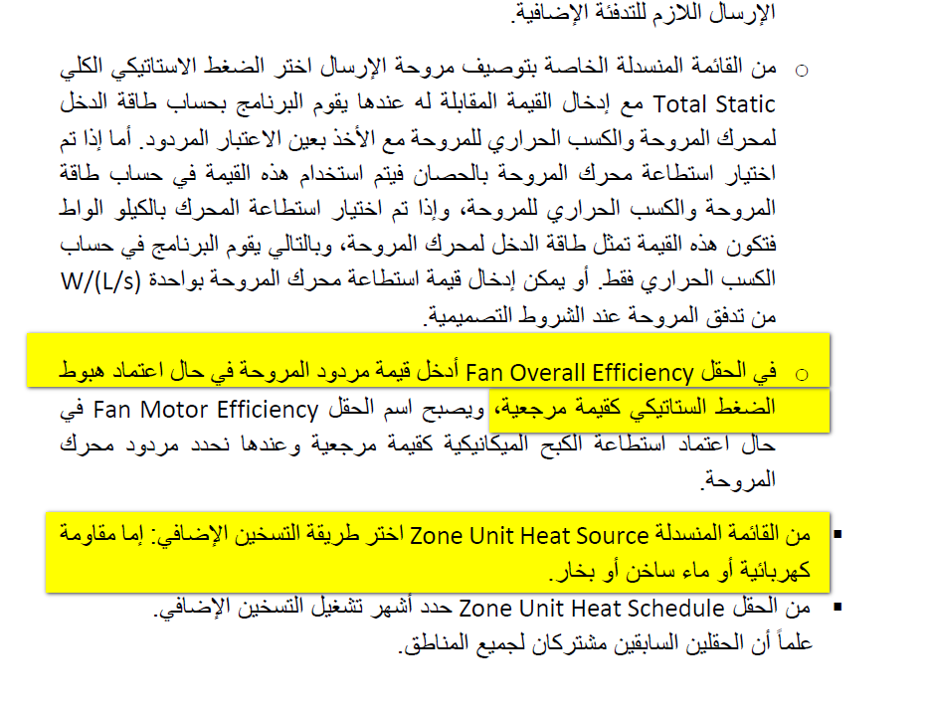

Slide 20
Thank You For Listening

