Slide 1
The Endocrine System
Lecture :10
Dr. Shaimaa Munther

Slide 2
The Endocrine System
The Endocrine System is a second messenger system of the body
Uses chemical messages (hormones) that are released into the blood
Hormones control several major processes
Reproduction
Growth and development
Mobilization of body defenses
Maintenance of much of homeostasis
Regulation of metabolism

Slide 3
The Endocrine System
regulates
Growth
Water balance
Reproduction
Metabolism
Calcium and glucose levels
Response to stress
by means of the
by means of the
by means of the
by means of the
by means of the
by means of the
Pituitary
Testes
Thyroid
Pancreas
Adrenals
Ovaries
Parathyroids

Slide 4
The Endocrine System Composed of :
Glands : Release products to bloodstream directly.
Horomones : Products deliver messages to body
Target cells : Have specific receptors for specific hormones

Slide 5
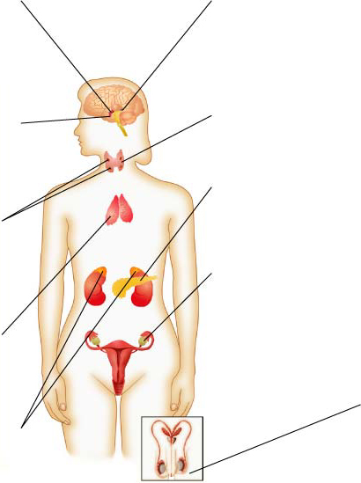
Endocrine Glands
Section 39-1
Hypothalamus
The hypothalamus makes hormones that control the pituitary gland. In addition, it makes hormones that are stored in the pituitary gland.
Pineal gland
The pineal gland releases melatonin, which is involved in rhythmic activities, such as daily sleep-wake cycles.
Thyroid
The thyroid produces thyroxine, which regulates metabolism.
Pituitary gland
The pituitary gland produces hormones that regulate many of the other endocrine glands.
Pancreas
The pancreas produces insulin and glucagon, which regulate the level of glucose in the blood.
Parathyroid glands
These four glands release parathyroid hormone, which regulate the level of calcium in the blood.
Ovary
The ovaries produce estrogen and progesterone. Estrogen is required for the development of secondary sex characteristics and for the development of eggs. Progesterone prepares the uterus for a fertilized egg.
Thymus
During childhood, the thymus releases thymosin, which stimulates Tcell development.
Testis
The testes produce testosterone, which is responsible for sperm production and the development of male secondary sex characteristics
Adrenal glands
The adrenal glands release epinephrine and nonepinephrine, which help the body deal with stress.

Slide 6
Hormone Overview
Hormones are produced by specialized cells
Cells secrete hormones into extracellular fluids
Blood transfers hormones to target sites
These hormones regulate the activity of other cells

Slide 7
Hormone Chemistry
Protein or Peptide Hormones
Protein or peptide hormones constitute the majority of hormones. These are molecules ranging from 3 to 200 amino acid residues. They are synthesized as pre- prohormones and undergo post-translational processing. They are stored in secretory granules before being released by exocytosis .
Steroid Hormones
Steroid hormones are derived from cholesterol and are synthesized in the adrenal cortex, gonads, and placenta. Vitamin D and its metabolites are also considered steroid hormones.
Amino Acid–Derived Hormones
Amino acid–derived hormones are synthesized from the amino acid tyrosine and include the catecholamines norepinephrine, epinephrine, and dopamine; as well as the thyroid hormones, derived from the combination of 2 iodinated tyrosine amino acid residues

Slide 8
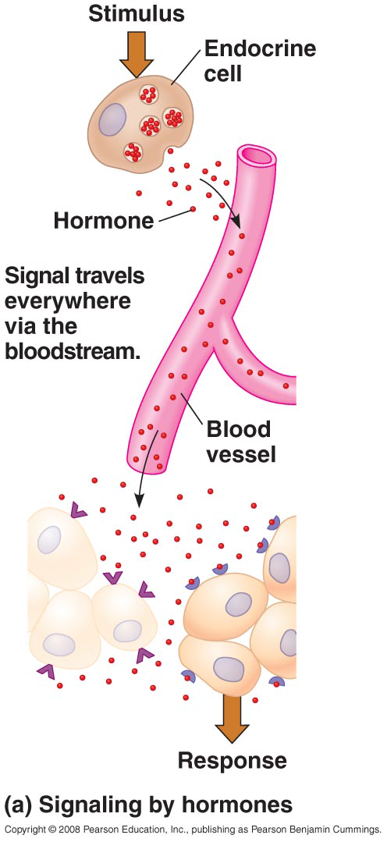
Hormone Signaling

Slide 9
Mechanisms of Hormone Action
Hormones affect only certain tissues or organs (target cells or organs)
Target cells must have specific protein receptors
Hormone binding influences the working of the cells

Slide 10
Effects Caused by Hormones
Changes in plasma membrane permeability or electrical state
Synthesis of proteins, such as enzymes
Activation or inactivation of enzymes
Stimulation of mitosis

Slide 11
Hormone Signaling

Slide 12
Steroid Hormone Action
Diffuse through the plasma membrane of target cells
Enter the nucleus
Bind to a specific protein within the nucleus
Bind to specific sites on the cell’s DNA
Activate genes that result in synthesis of new proteins.
Because steroids work by triggering gene activity, the response is slower than peptide hormones.

Slide 13
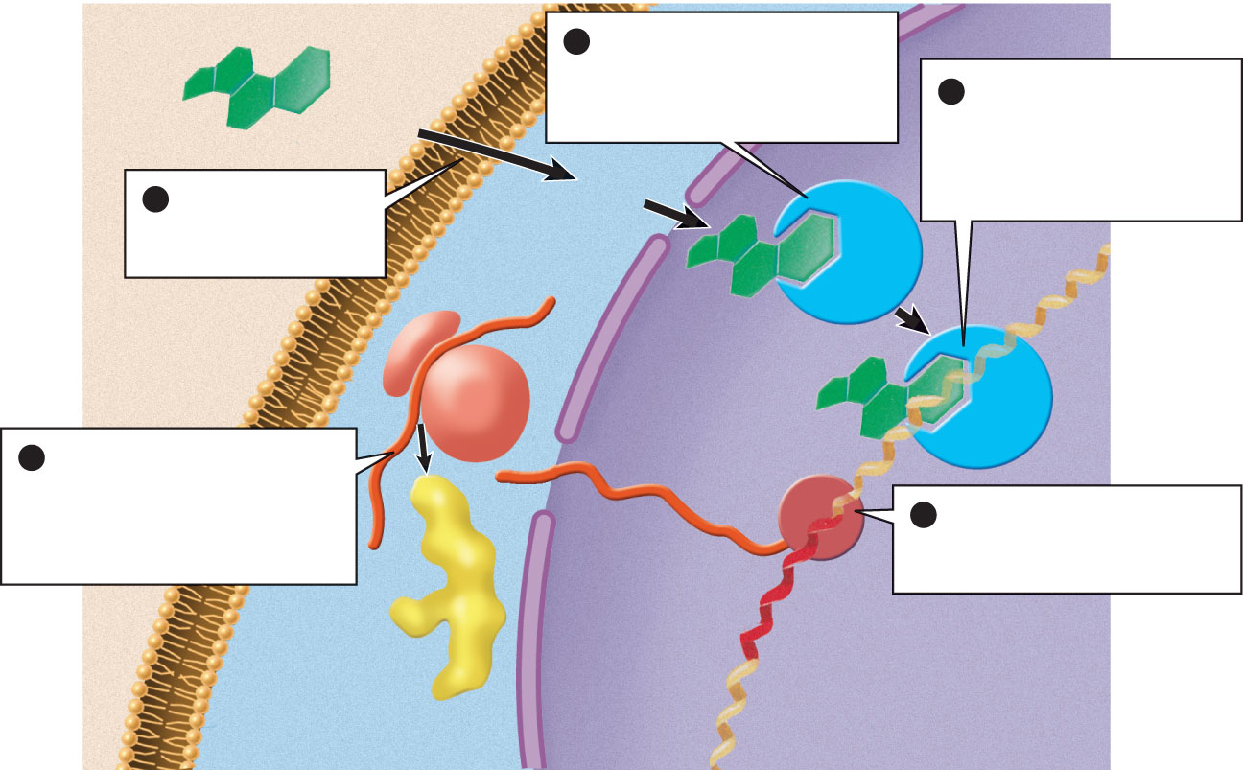
steroid hormone
(extracellular
fluid)
The hormone binds to a
receptor in the nucleus or to
a receptor in the cytoplasm
that carries it into the nucleus
2
The hormone–receptor
complex binds to DNA and
causes RNA polymerase to
bind to a nearby promoter
site for a specific gene
3
1
A steroid hormone
diffuses through the
plasma membrane
plasma
membrane
hormone receptor
DNA
ribosome
5
RNA polymerase
The mRNA leaves the
nucleus, then attaches to a
ribosome and directs the
synthesis of a specific protein
product
4
RNA polymerase catalyzes
the transcription of DNA into
messenger RNA (mRNA)
mRNA
new protein
gene
nuclear
envelope
(cytoplasm)
(nucleus)
Steroid Hormone Action

Slide 14
Peptide Hormones
Peptide hormones do not enter the cell directly. These hormones bind to receptor proteins in the cell membrane.
When the hormone binds with the receptor protein, a secondary messenger molecule initiates the cell response.
Because peptide hormones are water soluble, they often produce fast responses.

Slide 15
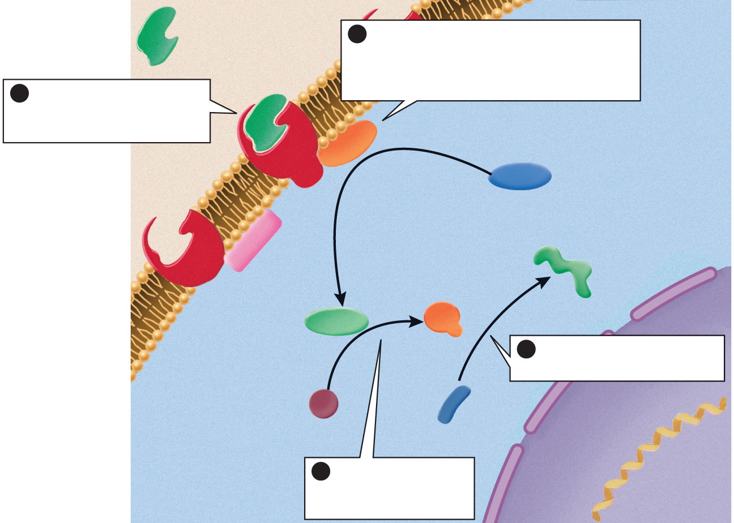
peptide or amino
acid-derived
hormone
(first messenger)
2
Hormone–receptor binding
activates an enzyme that catalyzes
the synthesis of a second messenger,
such as cyclic AMP
1
The hormone binds to
a receptor on the plasma
membrane of a target cell
cyclic AMP-
synthesizing
enzyme
(cytoplasm)
(extracellular
fluid)
ATP
active
enzyme
receptor
cyclic AMP
product
(second messenger)
4
The activated enzymes
catalyze specific reactions
plasma membrane
inactive
enzyme
reactant
3
The second
messenger activates
other enzymes
nuclear
envelope
(nucleus)
Peptide Hormone Action

Slide 16
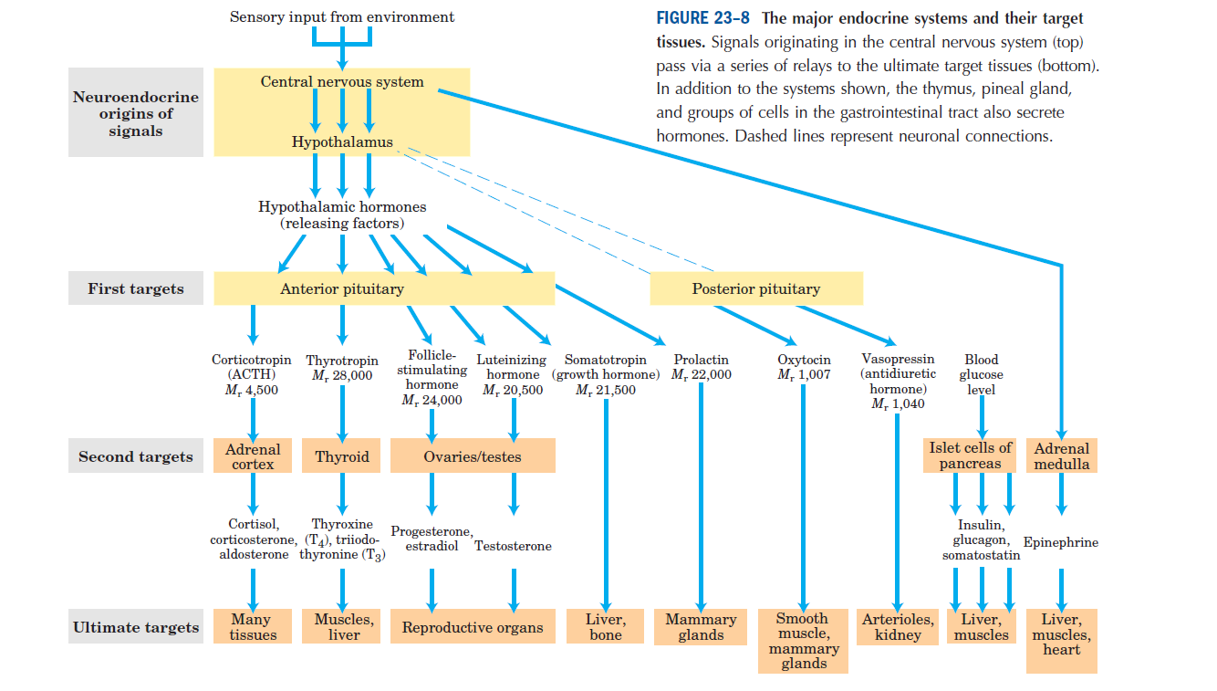

Slide 17
HORMONES CAN BE CLASSIFIED IN SEVERAL WAYS
Hormones can be classified according to:
Chemical composition
Solubility properties
Location of receptors
The nature of the signal used to mediate hormonal action within the cell.
A classification based on the last two properties is illustrated in the following slides with illustration to the general features of each group .

Slide 18
Classification of hormones by Location of receptors
Group 1 Hormones:

Slide 19
Classification of hormones by Location of receptors
Group 2 Hormones:

Slide 20
Classification of hormones by Location of receptors
Group 2 Hormones:

Slide 21
Classification of hormones by Location of receptors
Group 2 Hormones:

Slide 22
GENERAL FEATURE OF HORMONE CLASSES

Slide 23
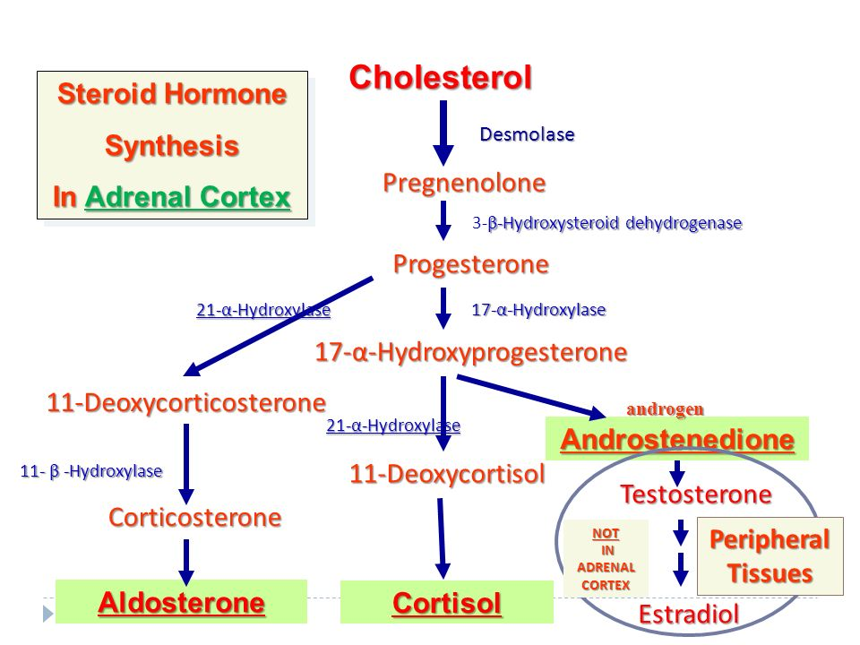
Steroid Hormones Biosynthesis

Slide 27
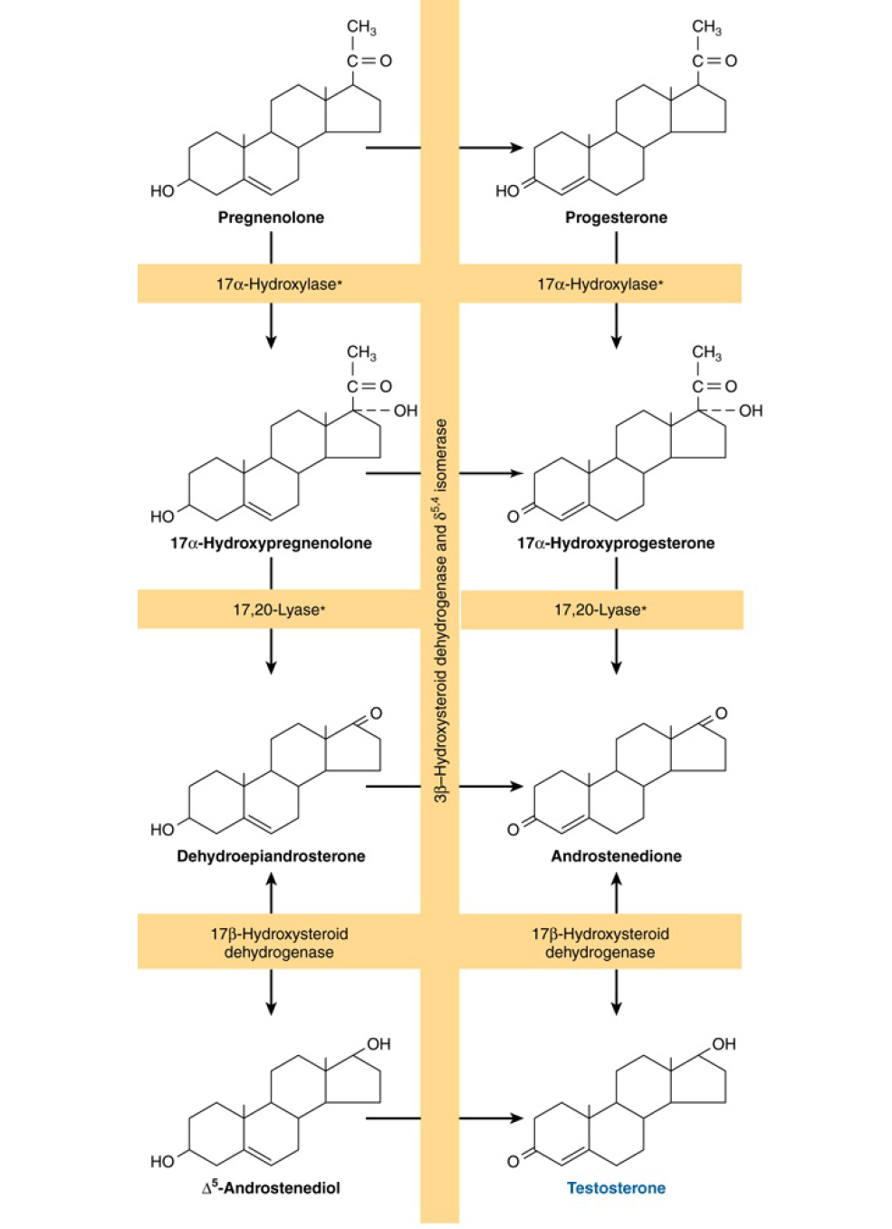

Slide 30
Catecholamine Biosynthesis
Notes:
Biosynthysis I the chromaffine cells of adrenal medulla

Slide 31
Thyroid Hormones Biosynthesis

Slide 32
1, 25 (OH)- D3 (Calcitriol) Biosynthesis

