Slide 2
v Glomerulus Disorders
v Tubules and interstitium Disorders
v Blood vessels Disorders

Slide 3
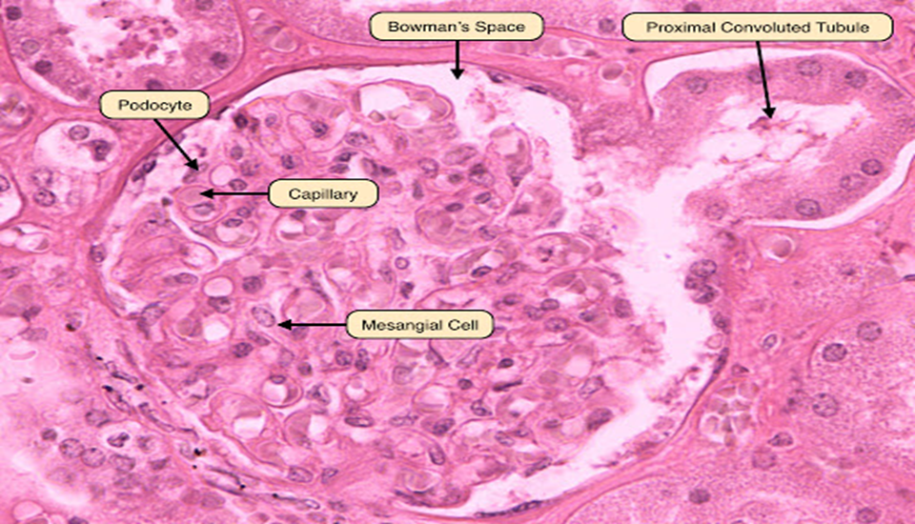

Figure (1) high-power light microscope of rat glomerulus, basement membrane, capillary lumen; endothelium; Ep, visceral epithelial cells (podocytes) with foot processes;, mesangium, urinary space.

Slide 4
Glomerular diseases may be focal, showing abnormality in some but not all the glomeruli; or diffuse, where all glomeruli are affected. In segmental glomerular involvement, only a portion of each individual glomerulus is affected, in contrast to a global change, which involves entire glomeruli. Combinations of these terms are commonly used, in focal segmental involvement the abnormality is present in some but not all glomeruli and the affected glomeruli are only partially involved.
Identification of exact morphologic changes in the glomerulus in renal biopsy specimens is important in the differential diagnosis of glomerular diseases

Slide 5
Focal segmental Glomerulosclerosis
characterized by a sclerosis of segments of some glomerulus. It is likely to present as a nephrotic syndrome. This form of glomerulonephritis may be associated with conditions such as HIV and heroin or inherited . On microscopy, affected glomerules may show an increase in hyalin, a pink and homogenous material, fat cells, an increase in the mesangial matrix and collagen. Treatment may involve corticosteroids, but up to half of people with focal segmental glomerulonephritis continue to have progressive deterioration of kidney function, ending in kidney failure.

Slide 6
Microscopic (histologic) description
-Hypercellularity: due to cellular proliferation (mesangial, endothelial, parietal epithelial cells); white blood cells (acute and chronic) or crescents (white blood cells and epithelial cells)
-Basement membrane thickening is highlighted by PAS stain and electron microscopy; EM also shows electron dense deposits (usually immune complexes) in or adjacent to basement membrane (subepithelial is most common)
-Hyalinization and sclerosis of glomeruli are the end result of glomerular damage from various causes

Slide 7
Rapidly Progressive Glomerulonephritis (crescent )
is a syndrome of the kidney that is characterized by a rapid loss of kidney function, presents with an acute reduction in renal function resulting in acute renal failure in a few weeks or months (usually a 50% decline in the glomerular filtration rate (GFR) within 3 months) . It is characterized by formation of ‘crescents’ ( crescent GN) outside the glomerular capillaries (extra capillary GN). ‘Crescents’ are formed from the proliferation of parietal epithelial cells lining Bowman’s capsule and the invading mononuclear cells. The stimulus for crescent formation appears to be the presence of fibrin in the capsular space

Slide 8
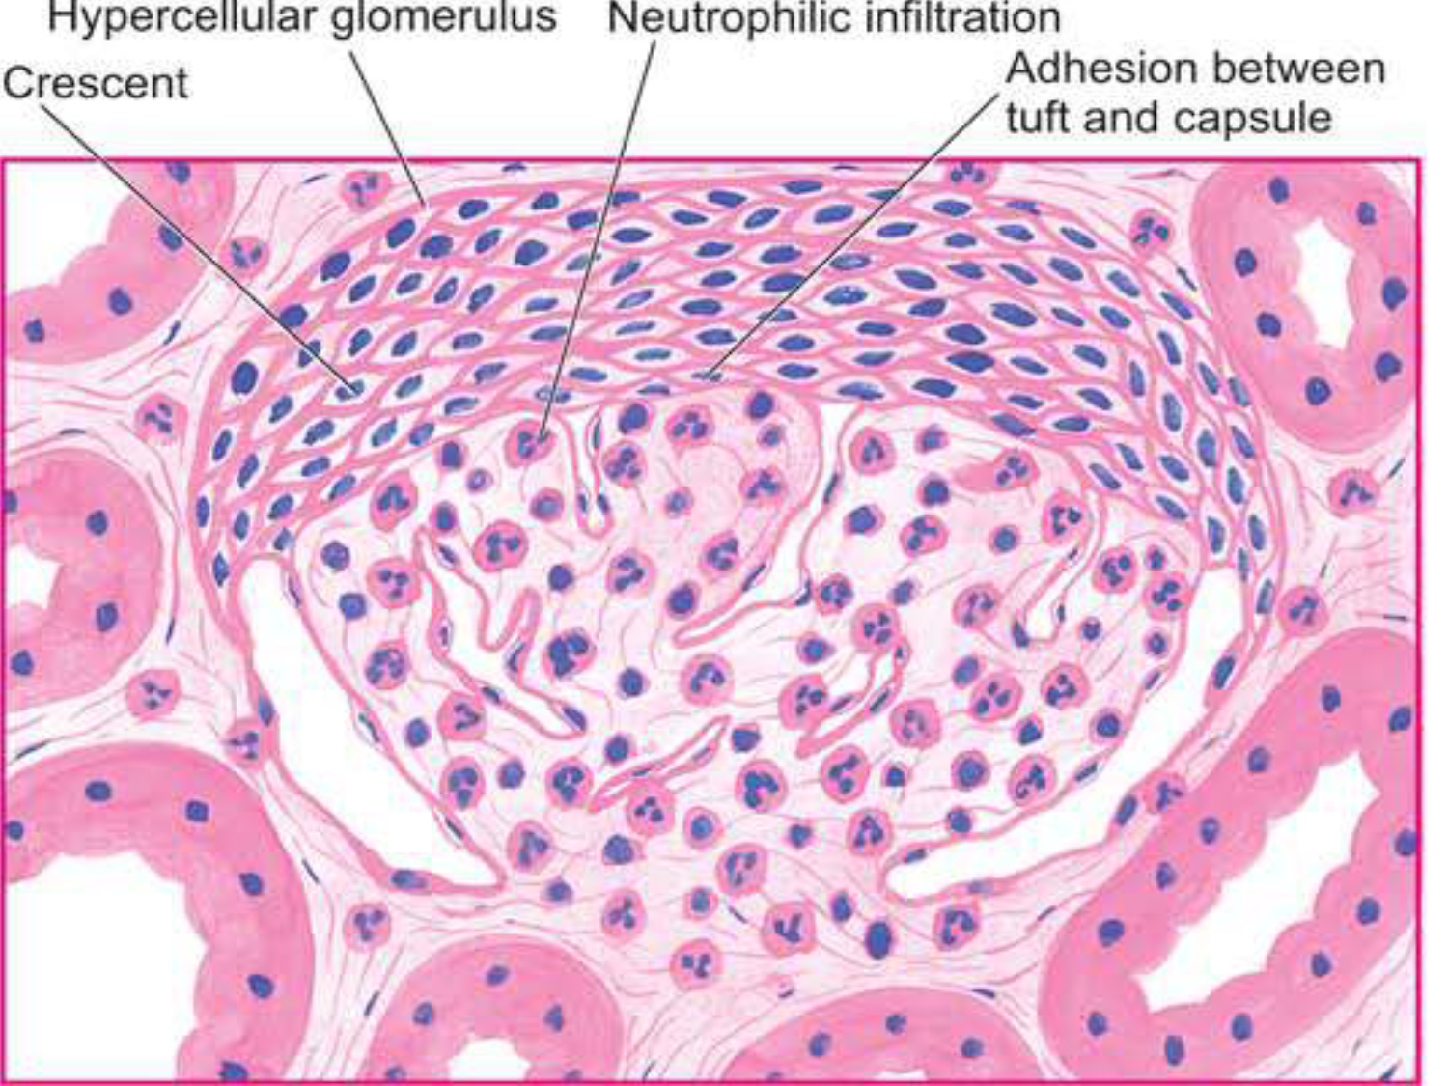

Slide 9
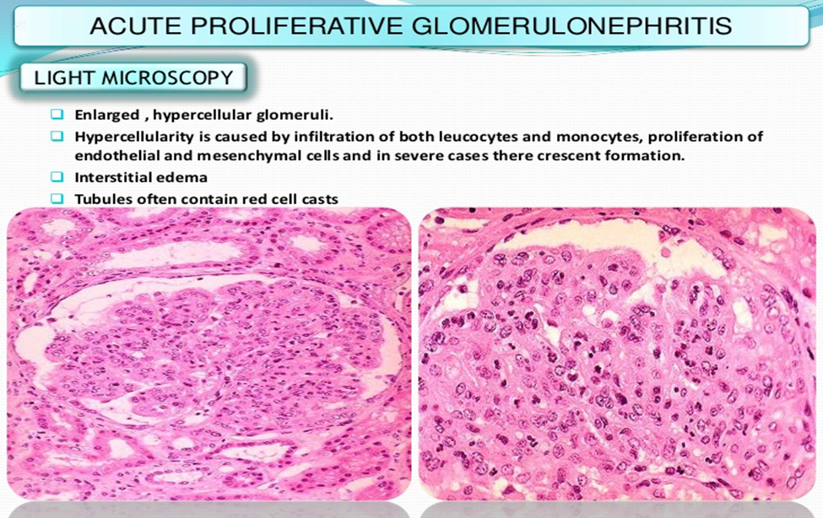

Slide 10
