Slide 1
Amino acid and protein metabolism
(Nutritionally Essential & Nutritionally Non Essential Amino Acids )
Lecture : 4
Dr. Shaimaa Munther

Slide 2
Nutritionally Essential & Nutritionally Non Essential Amino Acids
Introduction:
As applied to amino acids, the terms "essential" and "nonessential" are misleading since all 20 common amino acids are essential to ensure health.
Of these 20 amino acids, 10 must be present in the human diet, and thus are best termed "nutritionally essential." The other 10 amino acids are "nutritionally nonessential" since they need not be present in the diet (Table 1).

Slide 4
Biosynthesis of the Nutritionally Non Essential Amino Acids:
All vertebrates can form certain amino acids from amphibolic intermediates derived from intermediates of glycolysis, citric acid cycle or the pentose phosphate pathway or from other dietary amino acids.
Thus amino acids biosynthesis could be grouped according to their metabolic precursors as the following:

Slide 5
Biosynthesis of the Nutritionally Non Essential Amino Acids:
Alpha - ketoglutarate : Glutamate, Glutamine & Proline.
Pyruvate : Alanine
Oxaloacetate: Aspartate, Aspargine .
3- phosphoglycerate: Serine, Glycine & Cysteine
Nutritionally essential amino acids: are required for Tyrosine, Hydroxyproline and hydroxylysine biosynthesis.

Slide 6
Catabolism of Proteins & of Amino Acid Nitrogen

Slide 7
Introduction:
Unlike fats and carbohydrates, amino acids are not stored by the body.
Amino acids must be obtained from the diet, synthesized de novo, or produced from normal protein degradation. Any amino acids in excess of the biosynthetic needs of the cell are rapidly degraded.
Protein obtained from the diet or from body protein during prolonged fasting or starvation may be used as an energy source (10-15% ).
Body protein is catabolized primarily in muscle and in liver, in which, amino acids released from proteins usually lose their amino group through transamination or deamination, yielding the carbon skeletons , which can be converted in the liver to glucose (in case of glucogenic amino acids), acetyl CoA, and ketone bodies (in case of ketogenic amino acids ).

Slide 8

Catabolism of amino acids
Amino group
Carbon skeleton

Slide 9
Concept of amino acid degradation
Protein Toxic
Amino acids carbon skeleton + NH₃ 1- urea cycle
2-as is (kidney)
Energy
Synthesis of other compounds

Slide 10
Catabolism of amino acids
1- The first phase of catabolism involves the removal of the α-amino groups (usually by transamination and subsequent oxidative deamination forming ammonia and the corresponding α- ketoacid, the "carbon skeletons" of amino acids). A portion of the free ammonia is excreted in the urine, but most is used in the synthesis of urea.
2- The second phase of amino acid catabolism, the carbon skeletons of the α- ketoacids are converted to common intermediates of energy producing, metabolic pathways. These compounds can be metabolized to CO₂ and water, glucose, fatty acids, or ketone bodies by the central pathways of metabolism.

Slide 11
CONVERSION OF AMINO ACIDS TO SPECIALIZED PRODUCTS

Slide 12
CONVERSION OF AMINO ACIDS TO SPECIALIZED PRODUCTS
In addition to serving as building blocks for proteins, amino acids are precursors of many nitrogen-containing compounds that have important physiologic functions.
These molecules include
  porphyrins,
  neurotransmitters,
  hormones,
  purines, and pyrimidines,
  Creatine ,
  Biologically active peptides

Slide 13
Alanine
Alanine serves as a carrier of ammonia and of the carbons of pyruvate from skeletal muscle to liver, and together with glycine & glutamine constitutes a major fraction of the free amino acids in plasma.

Slide 14
Arginine
Serving as a carrier of nitrogen atoms in urea biosynthesis
The guanidino group of arginine is incorporated into creatine.
Following conversion to ornithine, its carbon skeleton becomes that of the polyamines.
Precursore for nitric oxide synthesis

Slide 15
Glycine
Glycine is used for Heme, Purine and Creatin synthesis
1. α − carbon and nitrogen atoms of glycine are used for synthesis of porphyrine, prosthetic group of heme.
2. Glycine is incorporated into creatine.
3- The entire glycine molecule becomes atoms 4, 5, and 7of purines .

Slide 16
Creatine and Creatinine
Creatine – nitrogenous organic acid - helps to supply energy to muscle.
Creatine phosphate (also called phosphocreatine), the phosphorylated derivative of creatine found in muscle, is a high-energy compound that can reversibly donate a phosphate group to ADP to form ATP.
Creatine phosphate provides a small but rapidly mobilized reserve of high-energy phosphates that can be used to maintain the intracellular level of adenosine triphosphate (ATP) during the first few minutes of intense muscular contraction.
Note:
The amount of creatine phosphate in the body is proportional to the muscle mass.

Slide 17
Synthesis of creatine
Creatine is synthesized from glycine and the guanidino group of arginine, plus a methyl group from S-adenosylmethionine.
Creatine is reversibly phosphorylated to creatine phosphate by creatine kinase, using ATP as the phosphate donor.
[Note: The presence of creatine kinase in the plasma is indicative of tissue damage, and is used in the diagnosis of myocardial infarction]

Slide 18
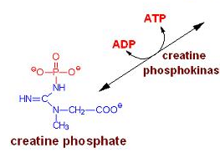
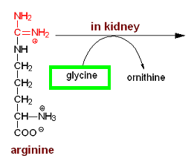
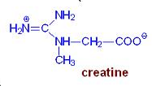
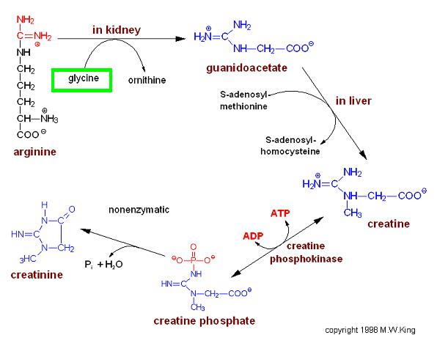
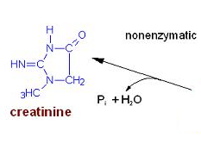
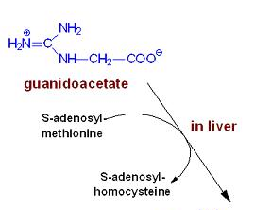

Slide 19
Tyrosine
The majority of tyrosine that does not get incorporated into proteins:
    Is catabolized for energy production.
    Is conversion to the catecholamines.
The catecholamine neurotransmitters are dopamine norepinephrine, and epinephrine.
Norepinephrine is the principal neurotransmitter of sympathetic postganglionic endings.
Catecholamines are stored in synaptic knobs of neurons that secrete it.
Tyrosine is transported into catecholamine-secreting neurons and adrenal medullary cells where catecholamine synthesis takes place.

Slide 20
Synthesis of the Catecholamines from Tyrosine
Using Tyrosine hydroxylase , tyrosine is converted to DOPA (3,4-dihydrophenylalanine). The hydroxylation reaction requires tetrahydrobiopterin as cofactor.
DOPA decarboxylase converts DOPA to dopamine.
Dopamine β-hydroxylase converts dopamine to norepinephrine.
Phenylethanolamine N-methyltransferase converts norepinephrine to epinephrine.

Slide 21
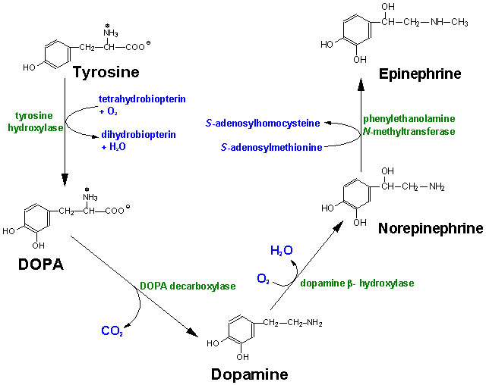

Slide 22
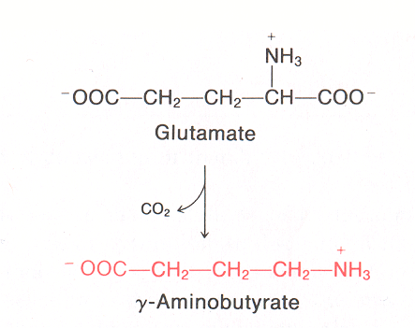
Glutamate
Glutamate is used for the synthesis of γ-aminobutyric acid (GABA)
γ-aminobutyric acid (GABA)is an inhibitory neurotransmitter (CNS).
also its directly regulates muscle tone.
Its lack leads to convulsions, epilepsia.
furthermore, its involved in mechanism of memory.

Slide 23


