Slide 1
وزاره التعليم العالي والبحث العلمي كليه المستقبل الجامعه
Histopathology
المحاضره الاولى/ المرحله الرابعة-الجزء العملي
Lung Atelectasis
مدرسه الماده /م.م سرمد جاسم محمد

Slide 2
Atelectasis is defined as the collapse or closure of the lung resulting in reduced or absent gas exchange. It may affect part or all of one lung.
- Atelectasis is the collapse of alveoli or lung tissue.
-It develops when the alveoli becomes airless from absorption of their air without replacement of the air with breathing.

Slide 3
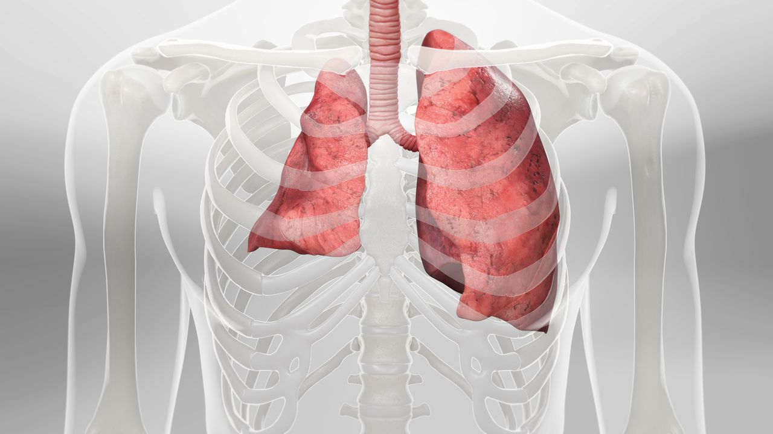

Slide 4
Atelectasis classified into three form :
1.Resorption atelectasis : it occurs when an obstruction prevents , Causes
obstruction of bronchus by a mucous or mucopurulent substance .
(Bronchiectasis , Bronchial asthma , Chronic bronchitis and Foreign body aspiration) .
2.Compression atelectasis: sometimes called relaxation atelectasis , is usually associated with accumulation of fluid blood, or air within pleural cavity, causes (Bedridden patients , After surgery and Accident).
3.Contraction atelectasis: occurs when either local or generalized fibrotic changes in the lung or pleura.

Slide 6
Causes of obstructive atelectasis Obstructive atelectasis happens when a blockage develops in one of your airways. This prevents air from getting to your alveoli, so they collapse. Things that can block your airway include: v inhalation of a foreign object, such as a small toy or small pieces of food, in an airway v mucus plug (buildup of mucus) in an airway v tumor growing within an airway v tumor in the lung tissue that presses on the airway

Slide 7
Common causes of non-obstructive atelectasis include: v Surgery v Pleural effusion v Pneumothorax v Lung scarring v Chest tumor v Surfactant deficiency

Slide 8
What are the symptoms? The symptoms of atelectasis range from nonexistent to very serious, depending on how much of your lung is affected and how fast it develops. If only a few alveoli are involved or it happens slowly, you might not have any symptoms. When atelectasis involves a lot of alveoli or comes on quickly, it’ hard to get enough oxygen to your blood. Having low blood oxygen can lead to: · trouble breathing · sharp chest pain, especially when taking a deep breath or coughing · rapid breathing · increased heart rate · blue-colored skin, lips, fingernails, or toenails

Slide 9
How is it diagnosed? To diagnose atelectasis, your doctor starts by reviewing your medical history. They look for any previous lung conditions you’ve had or any recent surgeries. Next, they try to get a better idea of how well your lungs are working. To do this, they might: · check your blood oxygen level with an oximeter, a small device that fits on the end of your finger · order a chest X-ray

Slide 10
• order a CT scan to check for infections or blockages, such as a tumor in your lung or airway • perform a bronchoscopy, which involves inserting a camera, located on the end of a thin, flexible tube, through your nose or mouth and into your lungs • take blood from an artery, usually in your wrist, and check its oxygen, carbon dioxide levels, and blood chemistry with a blood gas test

Slide 11
Thank You

