Slide 1


Histopathology
المرحله الرابعة-الجزء العملي
عنوان المحاضره
Stomach Gastritis ,peptic ulcer
مدرسه الماده /م.م سرمد جاسم محمد

Slide 2
Gastritis
is inflammation of the lining of the stomach. It may occur as a short time or may be of a long duration. There may be no symptoms but when symptoms are present, the most common is upper abdominal pain. Other possible symptoms include nausea and vomiting, bloating, loss of appetite and heartburn. Complications may include stomach bleeding, stomach ulcers, and stomach tumors. When due to autoimmune problems, low red blood cells due to not enough vitamin B12 may occur, a condition known as pernicious anemia. Common causes include infection with Helicobacter pylori and use of non steroidal anti-inflammatory drugs (NSAIDs). Less common causes include alcohol, smoking, cocaine, severe illness, autoimmune problems, radiation therapy and Crohn's disease

Slide 3
Classification of gastritis
Acute:
transient acute inflammatory involvement of the stomach, mainly mucosa .Acute erosive gastritis typically involves discrete foci of surface necrosis due to damage to mucosal defenses, which increases the possibility of peptic ulcers forming.

Slide 4
Morphology
Mild Mucosal hyperemia
▪ Lamina propria edema & congestion
▪ Surface epithelium intact,
▪ Scattered intraepithelial & intraluminal neutrophils (activity)

Slide 5
Severe –Mucosal erosion & hemorrhage
■ Erosion denotes loss of surface epithelium generating defect in mucosa that does not cross muscularis mucosae
■ Rich inflammatory infiltrate
■ Fibrinous purulent exudate into lumen
■ Hemorrhage –punctate dark spots in hyperemic mucosa Concurrent erosion & hemorrhage called acute erosive hemorrhagic gastritis large areas of mucosa may be denuded seen in alcoholics and NASIDs ingestion

Slide 6
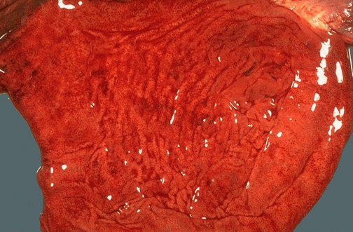
Organ : stomach lesion : diagnosis : Gastritis

Slide 7
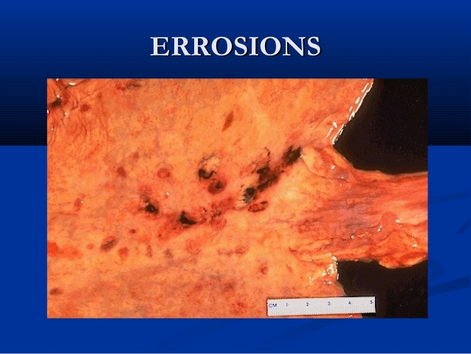

Slide 8
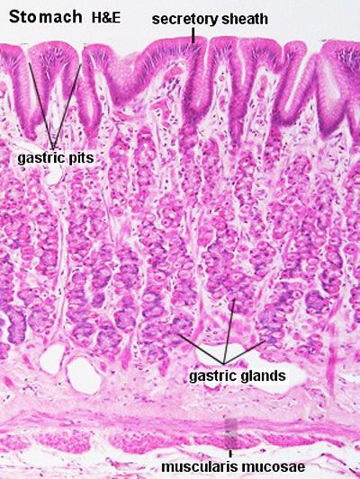

Slide 9
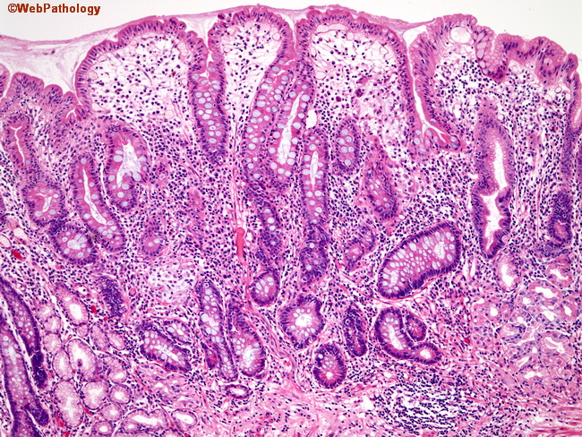
Acute gastritis: Infiltration of mucosal and submucosal lymphocytes with pockets of polymorphonuclear cells, accompanied by mild mucosal defects and edema.

Slide 10
Chronic Gastritis
refers to a wide range of problems of the gastric tissues. . Gastritis may also be caused Reflux of duodenal contents into the stomach, Infection with H. pylori is strongly implicated in the etiology of chronic gastritis., Chronic hypochromic anemia,. Immunological factors such as autoantibodies to gastric parietal cells in atrophic gastritis and autoantibodies against intrinsic factor.

Slide 11
chronic mucosal inflammatory changes leading to eventually mucosal atrophy and intestinal metaplasia usually in the absence of erosions Epithelial changes may become dysplastic provide background for development of carcinoma

Slide 12
CHRONIC GASTRITIS HISTOLOGICAL CLASSIFICATION
■ Chronic superficial gastritis
■ Chronic atrophic gastritis
■ Gastric atrophy

Slide 13
CHRONIC GASTRITISCHRONIC SUPERFICIAL GASTRITIS:
■ Inflammatory infiltrate limited to foveolar region, no glandular atrophy
■ ↓ cytoplasmic mucin, ↑ nuclear and nucleolar size and some ↑ in foveolar mitosis—may be seen
CHRONIC ATROPHIC GASTRITIS:
■ Extensive inflammation, glandular atrophy
■ Grade: mild, moderate, severe—estimated by thickness of glands to whole mucosal thickness
■ ↑ in distance between glands
GASTRIC ATROPHY:
■ Thinning of mucosa in absence of inflammation
■ End stage of chronic atrophic gastritis

Slide 14
Endoscopically: Thin, smooth mucosa with prominent submucosal vessels— atrophic gastritis and gastric atrophy

Slide 15
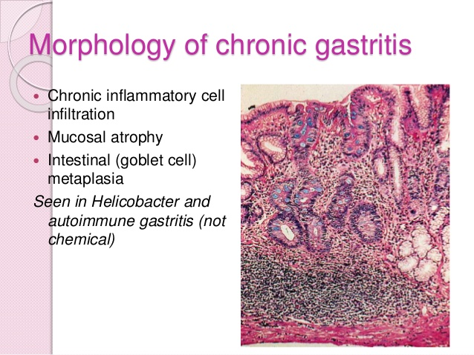

Slide 16
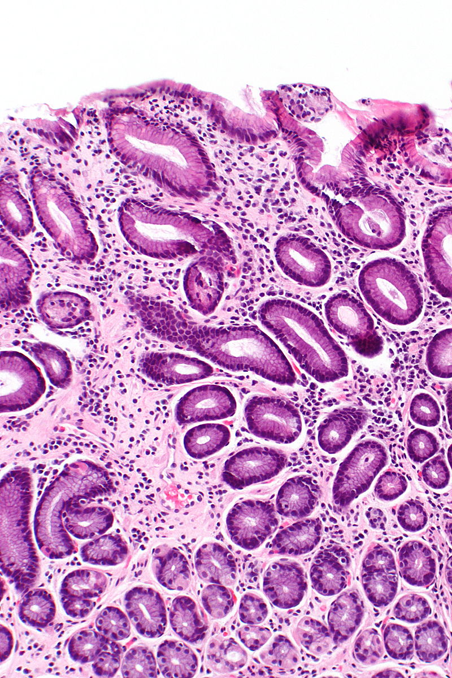
Chronic gastritis: Moderate to severe inflammation with marked epithelial defects including gland dilatation and mineralization

Slide 17
Peptic ulcers ( stomach ulcer)
is a break in the inner lining of the stomach , the areas of degeneration and necrosis of gastrointestinal mucosa exposed to acid-peptic secretions. An ulcer in the stomach is called a gastric ulcer , they occur most commonly (98-99%) in either the duodenum or the stomach , Peptic ulcers are present in around 4% of the population , New ulcers were found in around 87.4 million people worldwide during 2017. Peptic ulcers resulted in 267,500 deaths in 2015, down from 327,000 in 1990. Each of the two main types of ulcer may be acute or chronic.

Slide 18
Organ : stomach lesion : Partial gastroectomy specimen showing a punched out round to oval ulcer on the mucosa
Diagnosis : chronic peptic ulcer

Slide 20
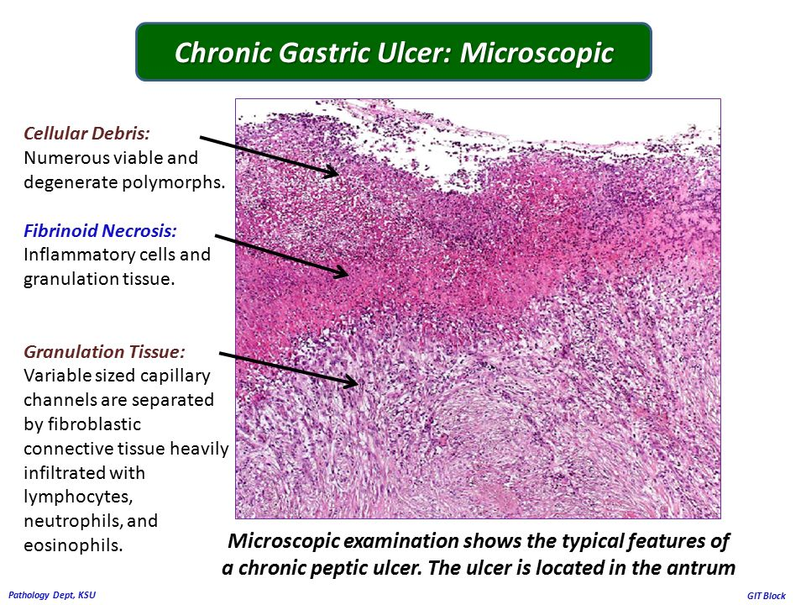

Slide 21
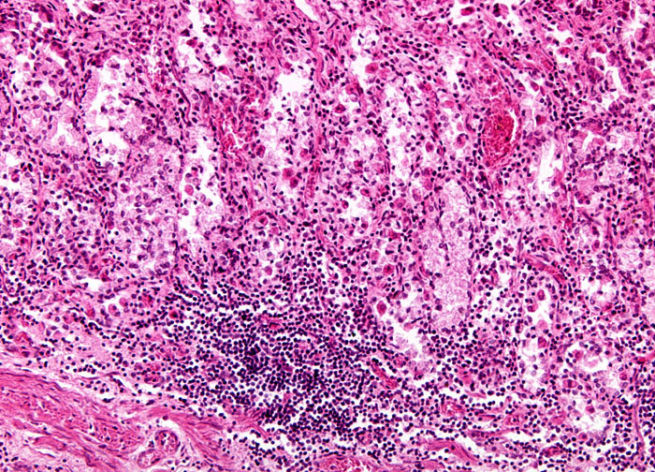
Organ : stomach lesion : diagnosis : peptic ulcer

Slide 22
Normal: Histology of the body of the stomach. Acute gastritis: Infiltration of mucosal and submucosal lymphocytes with pockets of polymorphonuclear cells, accompanied by mild mucosal defects and edema. Chronic gastritis: Moderate to severe inflammation with marked epithelial defects including gland dilatation and mineralization. Atrophic gastritis: Chronic inflammation with focal fibrosis and complete loss of oxyntic parietal and chief cells. Intestinal metaplasia: Gastric epithelial metaplasia to an intestinal phenotype characterized by columnar elongation, mucous droplets occasionally forming goblet cells, and production of mixed acidic (blue, intestinal-type) and neutral (red, gastric-type) mucins as shown by pH 2.5 Alcian blue/PAS stain (inset). Dysplasia: High-grade glandular dysplasia characterized by irregular size and shape, infolding, branching and cell piling, and marked cellular and nuclear atypia. Cancer: Gastric intraepithelial neoplasia, here with intramucosal invasion

Slide 23
