Slide 1
Nutritionally Essential & Nutritionally Non Essential Amino Acids
Lecture : 5
Dr. Shaimaa Munther

Slide 2
Nutritionally Essential & Nutritionally Non Essential Amino Acids
Introduction:
As applied to amino acids, the terms "essential" and "nonessential" are misleading since all 20 common amino acids are essential to ensure health.
Of these 20 amino acids, 10 must be present in the human diet, and thus are best termed "nutritionally essential." The other 10 amino acids are "nutritionally nonessential" since they need not be present in the diet (Table 1).

Slide 4
Biosynthesis of the Nutritionally Non Essential Amino Acids:
All vertebrates can form certain amino acids from amphibolic intermediates derived from intermediates of glycolysis, citric acid cycle or the pentose phosphate pathway or from other dietary amino acids.
Thus amino acids biosynthesis could be grouped according to their metabolic precursors as the following:

Slide 5
Biosynthesis of the Nutritionally Non Essential Amino Acids:
Alpha - ketoglutarate : Glutamate, Glutamine & Proline.
Pyruvate : Alanine
Oxaloacetate: Aspartate, Aspargine .
3- phosphoglycerate: Serine, Glycine & Cysteine
Nutritionally essential amino acids: are required for Tyrosine, Hydroxyproline and hydroxylysine biosynthesis.

Slide 6
Amino acids synthesized from α- ketoglutaric acids precursors :
1- Glutamate:
The first reaction in biosynthesis of the "glutamate family" of amino acids is the reductive amidation of α-ketoglutarate catalyzed by glutamate dehydrogenase . The reaction is shown as unidirectional in the direction of glutamate synthesis because the reaction strongly favors glutamate. This is physiologically important because high concentrations of ammonium ion are cytotoxic.

Slide 7
Amino acids synthesized from α- ketoglutaric acids precursors :
2- Glutamine
The amidation of glutamate to glutamine catalyzed by glutamine synthetase involves the intermediate formation of γ-glutamyl phosphate thus; the reaction is catalysed by ATP .

Slide 8
Amino acids synthesized from α- ketoglutaric acids precursors :
3- Proline
The initial reaction of proline biosynthesis converts the γ-carboxyl group of glutamate to the mixed acid anhydride of glutamate γ-phosphate.
Subsequent reduction forms glutamate γ-semialdehyde, which follow spontaneously cyclization is reduced to L-proline.

Slide 9
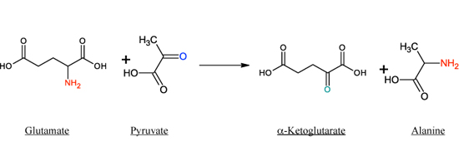
Amino acids synthesized from Pyruvate precursor :
Alanine:
Alanine is formed by transamination of pyruvate by the enzyme Alanine Transaminase (ALT) also known, Glutamate-Pyruvate Transaminase (GPT),
In this reaction glutamate will act as the amine donor .

Slide 10
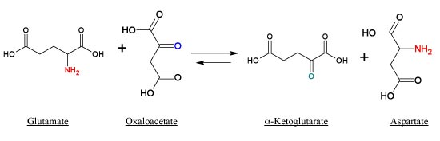
Amino acids synthesized from Oxaloacetate precursor :
Aspartate:
Transamination of oxaloacetate forms aspartate by the enzyme Aspartate Transaminase (AST) or called Glutamate-Oxaloacetate Transaminase (GOT), Glutamine will act as the amine donor .

Slide 11
Amino acids synthesized from Oxaloacetate precursor :
2- Asparagine
The conversion of aspartate to asparagine, catalyzed by asparagine synthetase , resembles the glutamine synthetase reaction , but glutamine, rather than ammonium ion, provides the nitrogen.
The reaction involves the intermediate formation of aspartyl phosphate and catalysed by ATP .
Notes:
Bacterial asparagine synthetases can, however, also use ammonium ion.

Slide 12
Amino acids synthesized from 3- phosphoglycerate precursor :
1- Serine
Oxidation of the α-hydroxyl group of the glycolytic intermediate ( 3-phosphoglycerate ) by 3-phosphoglycerate dehydrogenase converts it to 3-phosphohydroxypyruvate.
Transamination and subsequent dephosphorylation then form serine .

Slide 13
Amino acids synthesized from 3- phosphoglycerate precursor :
2- Glycine
The important mammalian routes for glycine formation are from choline and from serine .

Slide 14
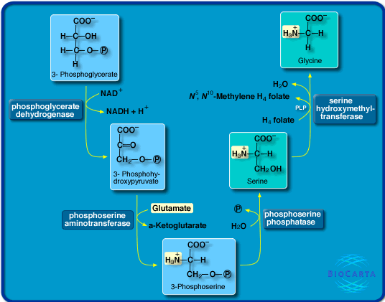

Slide 15
Amino acids synthesized from 3- phosphoglycerate precursor :
3- Cysteine
While not nutritionally essential, cysteine is formed from methionine, which is nutritionally essential.
Following conversion of methionine to homocysteine, homocysteine and serine form cystathionine, whose hydrolysis forms cysteine and homoserine .
Note that the sulfur of cystein is derived from methionine , while the carbon skeleton is from serine.

Slide 16
Tyrosine Biosynthesis:
Phenylalanine hydroxylase converts phenylalanine to tyrosine
The reaction require molecular oxygen and the coenzyme: tetrahydrobiopeterin (BH4)
Mixed-function oxygenase incorporates one atom of O2 into the para position of phenylalanine and reduces the other atom to water.

Slide 17
Hydroxyproline & Hydroxylysine Biosynthesis:
Hydroxyproline and hydroxylysine occur principally in collagen.
Since there is no tRNA for either hydroxylated amino acid, neither dietary hydroxyproline nor dietary hydroxylysine is incorporated during protein synthesis.
Peptidyl hydroxyproline and hydroxylysine arise from proline and lysine, but only after these amino acids have been incorporated into peptides.
Hydroxylation of peptidyl prolyl and peptidyl lysyl residues, catalyzed by prolyl hydroxylase and lysyl hydroxylase of skin, skeletal muscle, and granulating wounds requires, in addition to the substrate, molecular O2, ascorbate, Fe2+, and α-ketoglutarate .

Slide 18
Valine, Leucine & Isoleucine Biosynthesis:
While leucine, valine, and isoleucine are all nutritionally essential amino acids, tissue aminotransferases reversibly interconvert all three amino acids and their corresponding α –keto acids. These α-keto acids thus can replace their amino acids in the diet.

Slide 19
Catabolism of Proteins & of Amino Acid Nitrogen
Lecture : 6
Dr. Shaimaa Munther

Slide 20
Introduction:
Unlike fats and carbohydrates, amino acids are not stored by the body.
Amino acids must be obtained from the diet, synthesized de novo, or produced from normal protein degradation. Any amino acids in excess of the biosynthetic needs of the cell are rapidly degraded.
Protein obtained from the diet or from body protein during prolonged fasting or starvation may be used as an energy source (10-15% ).
Body protein is catabolized primarily in muscle and in liver, in which, amino acids released from proteins usually lose their amino group through transamination or deamination, yielding the carbon skeletons , which can be converted in the liver to glucose (in case of glucogenic amino acids), acetyl CoA, and ketone bodies (in case of ketogenic amino acids ).

Slide 21
Concept of amino acid degradation
Protein Toxic
Amino acids carbon skeleton + NH₃ 1- urea cycle
2-as is (kidney)
Energy
Synthesis of other compounds

Slide 22
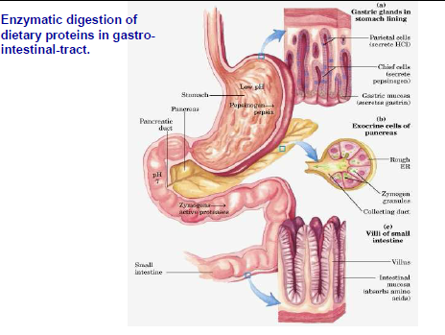
DIGESTION OF DIETARY PROTEINS

Slide 23
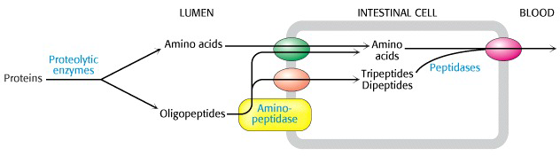
DIGESTION OF DIETARY PROTEINS
Dietary protein a.as portal circulation liver

Slide 24
PROTEIN TURNOVER
Protein turnover : The continuous degradation and synthesis of cellular proteins occur in all forms of life permitting the removal of abnormal or unneeded proteins.
Each day, humans turn over 1–2% of their total body protein, principally muscle protein.
High rates of protein degradation occur in tissues that are undergoing structural rearrangement, for example, uterine tissue during pregnancy and skeletal muscle in starvation.
Approximately 75% of the amino acids liberated by protein degradation are reutilized.
Excess free amino acids are, however, not stored. Those not immediately incorporated into new protein are rapidly degraded.
The major portion of the carbon skeletons of the amino acids is converted to amphibolic intermediates, while in humans the amino nitrogen is converted to urea and excreted in the urine.

Slide 25
Protein Degradation
There are two major enzyme systems responsible for degrading damaged or unneeded proteins:
The energy-dependent upiquitin proteasom mechanism
The non-energy-dependent degradative enzymes of the lysosomes.
Notes:
Proteasomes mainly degrade endogenous proteins, that is, proteins that were synthesized within the cell. Lysosomes primarily degrade extracellular proteins, such as plasma proteins that are taken into the cell by endocytosis, and cell-surface membrane proteins that are used in receptor-mediated endocytosis.

Slide 26
1- Mechanism of Ubiquitin-proteasome proteolytic pathway
Degradation of regulatory proteins with short half-lives and of abnormal or misfolded proteins occurs in the cytosol, and requires ATP and ubiquitin.
Ubiquitin, is a small polypeptide that targets many intracellular proteins for degradation.
Ubiquitin molecules are attached by non – peptide bonds formed between the carboxyl terminal of ubiquitin and the ε-amino groups of lysyl residues in the target protein, this followed by consecutive addition of ubiquitin moieties generating a polyubiquitin chain.
Proteins tagged with ubiquitin are then recognized by the proteasome, where subsequent degradation of ubiquitin-tagged proteins takes place by cutting the target protein into fragments that are then further degraded to amino acids.

Slide 27
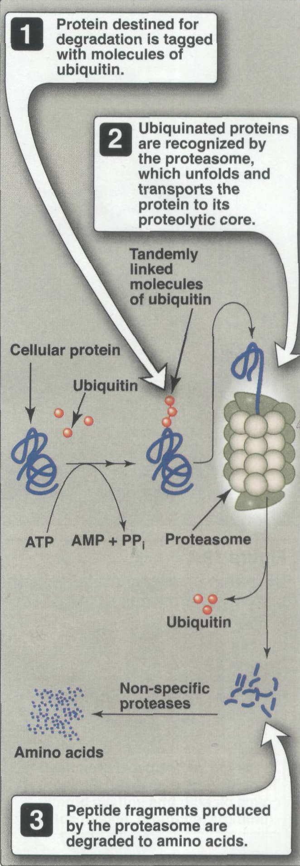

Slide 28
2- ATP-Independent Degradation :
Extracellular, membrane-associated, and long-lived intracellular proteins are degraded in lysosomes by ATP-independent processes.

Slide 29

Catabolism of amino acids
Amino group
Carbon skeleton

Slide 30
Catabolism of amino acids
1- The first phase of catabolism involves the removal of the α-amino groups (usually by transamination and subsequent oxidative deamination forming ammonia and the corresponding α- ketoacid, the "carbon skeletons" of amino acids). A portion of the free ammonia is excreted in the urine, but most is used in the synthesis of urea.
2- The second phase of amino acid catabolism, the carbon skeletons of the α- ketoacids are converted to common intermediates of energy producing, metabolic pathways. These compounds can be metabolized to CO₂ and water, glucose, fatty acids, or ketone bodies by the central pathways of metabolism.

Slide 31
Concept of amino acid degradation
Protein Toxic
Amino acids carbon skeleton + NH₃ 1- urea cycle
2-as it (kidney)
Energy
Synthesis of other compounds

Slide 32
The first phase
REMOVAL AND EXCRETION OF AMINO GROUPS
Amino groups released by deamination reactions from ammonium ion (NH4+)' which must not escape into the peripheral blood.
An elevated concentration of ammonium ion in the blood, hyperammonemia, has toxic effects in the brain (cerebral edema, convulsions, coma, and death).
Most tissues add excess nitrogen to the blood as glutamine. Muscle sends nitrogen to the liver as alanine and smaller quantities of other amino acids, in addition to glutamine.
Excess nitrogen is eliminated from the body in the urine. The kidney adds small quantities of ammonium ion to the urine in part to regulate acid-base balance, but nitrogen is also eliminated in this process.
Most excess nitrogen is converted to urea in the liver and goes through the blood to the kidney.
Notes:
Bacterial asparagine synthetases can, however, also use ammonium ion.

Slide 33
The first phase
REMOVAL AND EXCRETION OF AMINO GROUPS
Notes:
Bacterial asparagine synthetases can, however, also use ammonium ion.

Slide 34
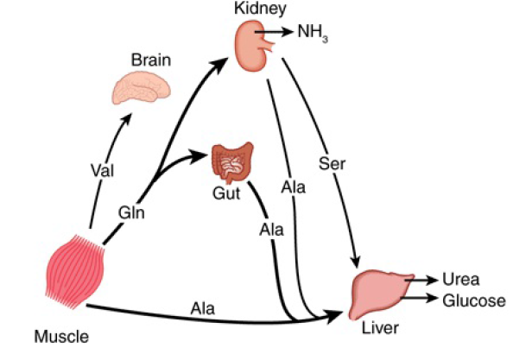
INTERORGAN EXCHANGE MAINTAINS CIRCULATING LEVELS OF AMINO ACIDS
Muscle and liver thus play major roles in maintaining circulating amino acid levels.
Muscle generates over half of the total body pool of free amino acids, and liver is the site of the urea cycle enzymes necessary for disposal of excess nitrogen
The most important reactions dealing with amino acids interorgan exchange are : Transamination & Oxidative deamination

Slide 35
1- Transamination
Transamination : Transfers -Amino Nitrogen to α-Ketoglutarate, Forming Glutamate
All of the common amino acids except lysine, threonine, proline, and hydroxyproline participate in transamination.
Transaminases or aminotransferases require pyridoxal-5’-phophate PLP (vitamine B6 derivative) as cofactor for many enzymatic reactions .
Both muscle and liver have aminotransferases, which, unlike deaminases, do not release the amino groups as free ammonium ion.

Slide 36
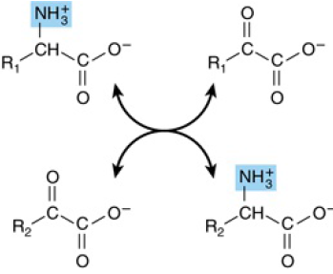

Slide 37
2- Oxidative deamination:
In liver the amino gp of glutamate is released as ammonia, regenerating α-ketoglutarate, by an enzyme glutamate dehydrogenase.
Glutamate dehydrogenase requires NAD+ or NADP+ as cofactor. This is the only enzyme known that has specificity for both type of cofactor.
This enzyme is allosterically inhibited by GTP, ATP and NADH and activated by ADP.

Slide 38
Ammonia Transport :
Two mechanisms are available in humans for the transport of ammonia from the peripheral tissues either to the liver for its ultimate conversion to urea or to other organs.
The first, found in most tissues, uses glutamine synthase to combine ammonia with glutamate to form glutamine, a non toxic transport form of ammonia . The glutamine is ported in the blood to:
Liver & kidney: where is is cleaved by glutaminase to form glutamate and free ammonia, which in the liver its safely enter the urea synthesis pathway , and in the kidney the ammonia formed is excreated as it with urine
Intestine: ammonia librated by the action of glutaminase together with that formed by the action of enteric bacteria is transformed to liver for urea synthesis via portal blood .

Slide 39
Ammonia Transport :
The second transport mechanism, used primarily by muscle, involves transamination of pyruvate to form alanine .
Alanine is transported by the blood to the liver, where it is converted to pyruvate, again by transamination.
In the liver , the pathway of gluconeogenesis can use pyruvate to synthesize glucose, which can enter the blood and be used by the muscle.
This pathway called (The glucose-alanine cycle)

Slide 40
The glucose-alanine cycle

Slide 41
The first phase
REMOVAL AND EXCRETION OF AMINO GROUPS
Notes:
Bacterial asparagine synthetases can, however, also use ammonium ion.

Slide 42
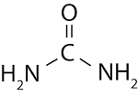
Urea cycle:
Urea is the major disposal form of amino groups derived from amino acids, and accounts for about ninety percent of the nitrogen-containing components of urine.
Urea, which contains two nitrogens and one carbon atom, is synthesized in the liver from aspartate and carbamoyl phosphate, which in turn is produced from ammonium ion and carbon dioxide by mitochondrial carbamoyl phosphate synthetase I.
After production by the liver, urea then is transported in the blood to the kidneys for excretion in the urine.

Slide 43
Important considerations of urea cycle
The urea cycle, like the citric acid cycle, acts catalytically. Small quantities of the intermediates are sufficient to synthesize large amounts of urea. The cycle occurs partially in the mitochondria and partially in the cytoplasm, in that :
Synthesis of 1 mol of urea requires 3 mol of ATP, 1 mol each of ammonium ion and of aspartate, and employs five enzymes & 6 amino acids
Of the six participating amino acids, N-acetylglutamate functions solely as an enzyme activator. The others serve as carriers of the atoms that ultimately become urea
Urea synthesis is a cyclic process. While ammonium ion, CO2, ATP, and aspartate are consumed, the ornithine consumed in reaction 2 is regenerated in reaction 5.
Aspartate enters the cycle in the cytoplasm and leaves the cycle (minus its amino group) as fumarate. If gluconeogenesis is active, fumarate can be converted to glucose.

Slide 45
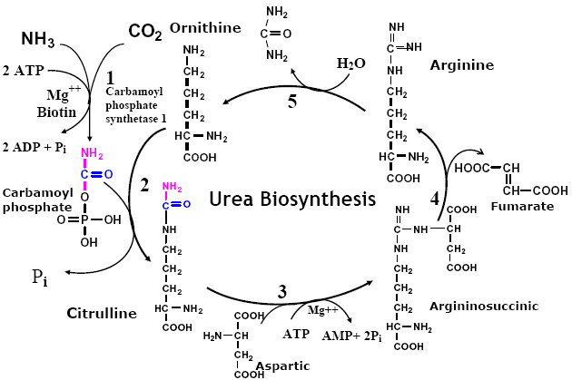

Slide 46
Steps of urea cycle :
Carbamoyl Phosphate Synthase I Initiates Urea Biosynthesis:
Condensation of CO2, ammonia, and ATP to form carbamoyl phosphate is catalyzed by mitochondrial carbamoyl phosphate synthase I. A cytosolic form of this enzyme, carbamoyl phosphate synthase II, uses glutamine rather than ammonia as the nitrogen donor and functions in pyrimidine biosynthesis.
2. Carbamoyl Phosphate Plus Ornithine Forms Citrulline:
L-Ornithine transcarbamoylase catalyzes transfer of the carbamoyl group of carbamoyl phosphate to ornithine, forming citrulline and orthophosphate . While the reaction occurs in the mitochondrial matrix, both the formation of ornithine and the subsequent metabolism of citrulline take place in the cytosol.
3. Citrulline Plus Aspartate Forms Argininosuccinate:
Argininosuccinate synthase links aspartate and citrulline via the amino group of aspartate and provides the second nitrogen of urea, this reaction results in the formation of argininosuccinate.

Slide 47
Steps of urea cycle :
4. Cleavage of Argininosuccinate Forms Arginine & Fumarate:
Cleavage of argininosuccinate is catalyzed by argininosuccinate lyase. The reaction proceeds with retention of all three nitrogens in arginine and release of the aspartate skeleton as fumarate . Subsequent addition of water to fumarate forms L-malate, whose subsequent NAD+-dependent oxidation forms oxaloacetate. These two reactions are analogous to reactions of the citric acid cycle, but are catalyzed by cytosolic fumarase and malate dehydrogenase.
Transamination of oxaloacetate by glutamate aminotransferase then re-forms aspartate. The carbon skeleton of aspartate-fumarate thus acts as a carrier of the nitrogen of glutamate into a precursor of urea.
5. Cleavage of Arginine Releases Urea & Re-Forms Ornithine:
Hydrolytic cleavage of the guanidino group of arginine, catalyzed by liver arginase, releases urea. The other product, ornithine, reenters liver mitochondria and participates in additional rounds of urea synthesis.

Slide 48
2- The Second Phase: Catabolism of the Carbon Skeleton of Amino Acids
The second phase of amino acid catabolism, the carbon skeletons of the α- ketoacids are converted to common intermediates of energy producing, metabolic pathways.
These compounds can be metabolized to CO₂ and water, glucose, fatty acids, or ketone bodies by the central pathways of metabolism.
The carbon skeleton of every amino acid is convertible either to:
  carbohydrate (13 amino acids)
  fat (one amino acid)
  both fat and carbohydrate (five amino acids)

Slide 49
Glucogenic vs ketogenic amino acids
Glucogenic amino acids can supply gluconeogenesis pathway via pyruvate or citric acid cycle intermediates.
Ketogenicamino acids can contribute to synthesis of fatty acids or ketone bodies.
Some amino acids are both glucogenic and ketogenic.

Slide 50
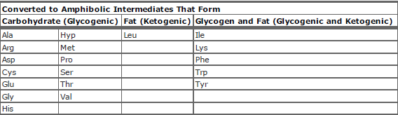
Fate of the Carbon Skeleton of L- Amino Acids

Slide 51
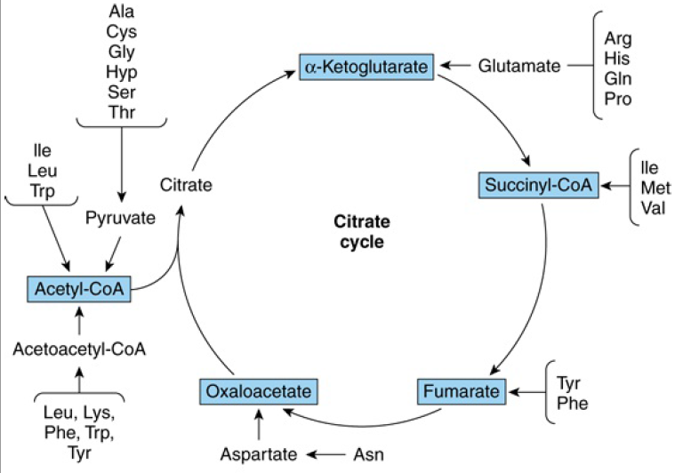

Slide 52


