Slide 1
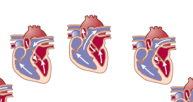
Cardiovascular System
Lecture 2
Dr. Shaimaa Munther

Slide 2
Objectives:
Define contractility, inotropism, preload, and afterload.
Define heart rate and Stroke volume.
Summarize the factors that regulate heart rate and Stroke volume.
Describe how EDV, total peripheral resistance interact to control stroke volume.
State the factors that affect cardiac contractility.
State Frank-Starling law with its clinical significance in heart failure and hypertension (shift to right or left).

Slide 3
CARDIAC OUTPUT AND BLOOD PRESSURE CONTROL
The pumping ability of the heart is a function of the beats per minute (cardiac rate) and the volume of blood ejected per beat (stroke volume).
The cardiac rate and stroke volume are regulated by autonomic nerves and by mechanisms intrinsic to the cardiovascular system.
The cardiac output is the volume of blood pumped per minute by each ventricle.
The average resting cardiac rate in an adult is 70 beats per minute; the average stroke volume (volume of blood pumped per beat by each ventricle) is 70 to 80 ml per beat.
The product of these two variables gives an average cardiac output of 5,500 ml (5.5 L) per minute:
Cardiac output = Stroke volume × cardiac rate
An increase in cardiac output, as occurs during exercise, must thus be accompanied by an increased rate of blood flow through the circulation. This is accomplished by factors that regulate the cardiac rate and stroke volume.

Slide 5
Heart Rate
The heart rate refers to the ventricular rate of beating per minute.
Normally, it averages 72 beats/minute (range 60-100 beats/minute).
Tachycardia….higher than 100 beats/min.
Bradycardia… lower than 60 beats/min.

Slide 6
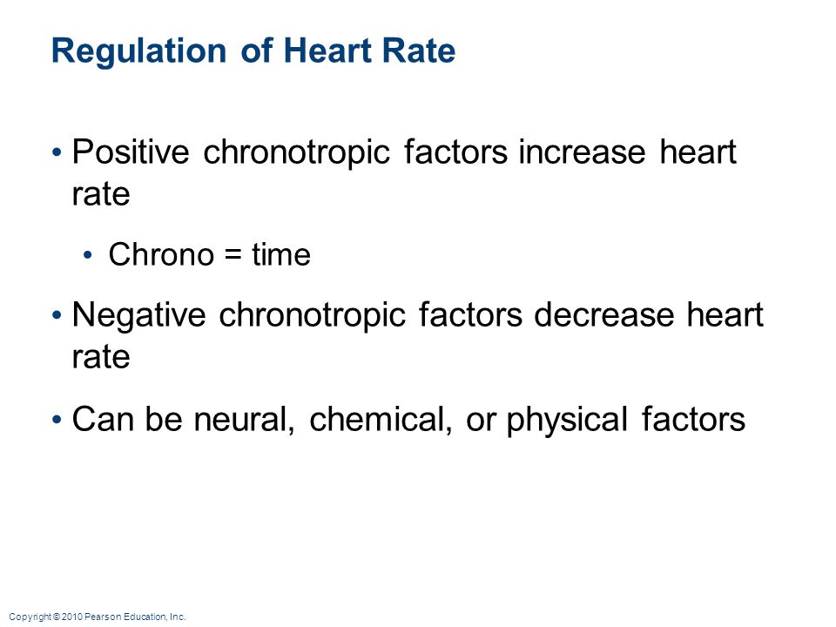

Slide 7
Regulation of Cardiac Rate
In the complete absence of neural influences, the heart will continue to beat as long as the myocardial cells are alive. This automatic rhythm is a result of a spontaneous, diastolic depolarization of the pacemaker cells in the SA node.
Autonomic innervation of the SA node is the major means by which cardiac rate is regulated. Sympathetic endings in the musculature of the atria and ventricles by adrenergic neurotransmitter NE increase the strength of contraction & the cardiac rate increases such phenomena known as (Tachycardia) ,on the other hand vagal or parasympathetic lead to decreased contractility and heart rate (bradycardia)
The activity of the autonomic innervation of the heart is coordinated by the cardiac control center in the medulla oblongata of the brain stem.
The cardiac control center, in turn, is affected by higher brain areas and by sensory feedback from pressure receptors, or baroreceptors, in the aorta and carotid arteries. In this way, a fall in blood pressure can produce a reflex increase in the heart rate

Slide 8
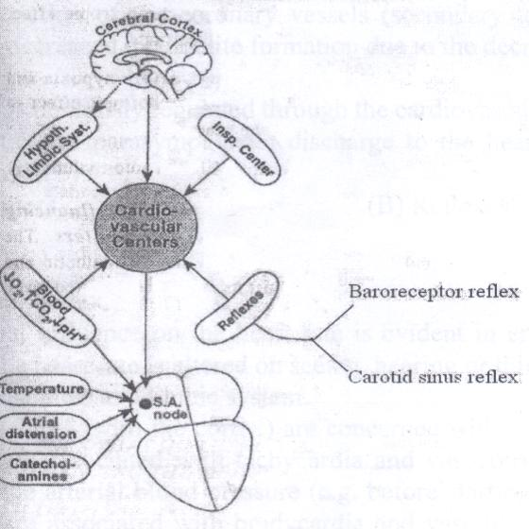
Regulation of Heart rate

Slide 9
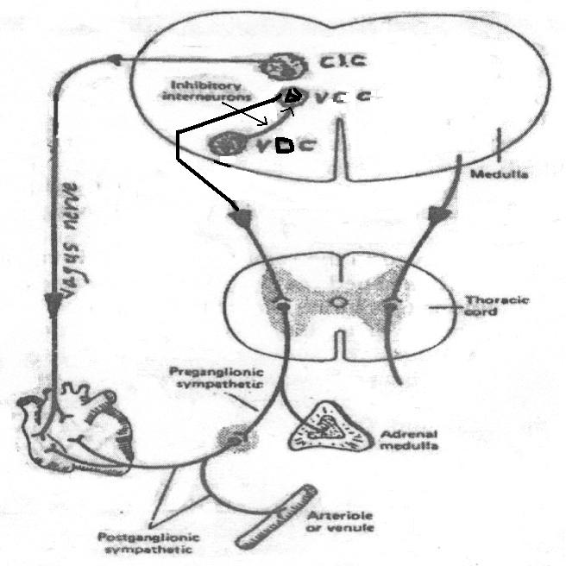
Cardiovascular centers
1- Vasomotor center (VMC):
A- Vasoconstrictor center (VCC):
The blood vessels (leading to generalized vasoconstriction (VC)).
The adrenal medullae (leading to secretion of Catecholamines).
The heart (increasing heart rate).
B- Vasodilator center (VDC):
inhibiting the activity of VCC causing generalized vasodilatation.
2- Cardioinhibitory center (CIC).
Decreasing heart rate.

Slide 10
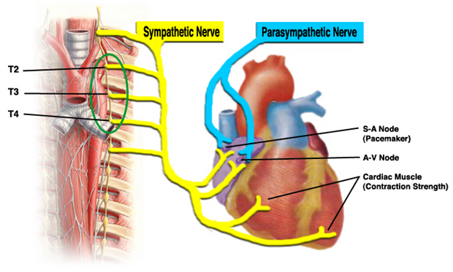
Neural regulation of the heart rate
Sympathetic nerves: supply all parts of the heart (atria, ventricles, and conduction system). When activated they increase Heart rate (+ve chronotropic effect).
Parasympathetic nerves: supply atria, SA & AV nodes but not the ventricles. When activated, they decrease Heart rate (-ve chronotropic effect).

Slide 11
Reflexes
Bainbridge reflex (atrial stretch reflex)
Right atrial pressure or distention leads to heart acceleration through medullary VCC.
Baroreceptor reflex
Stretch receptors, carotid sinus and aortic arch, glossopharyngeal and vagus nerves, inhibit the VCC and excite the vagal center (CIC) resulting in vasodilation, and decreased heart rate.
The carotid sinus reflex
Pressure on carotid sinus area, reflex slowing of heart rate and vasodilation. reflex increase in the vagal tone (bradycardia) and decrease in the sympathetic vasoconstrictor tone (vasodilation).

Slide 12
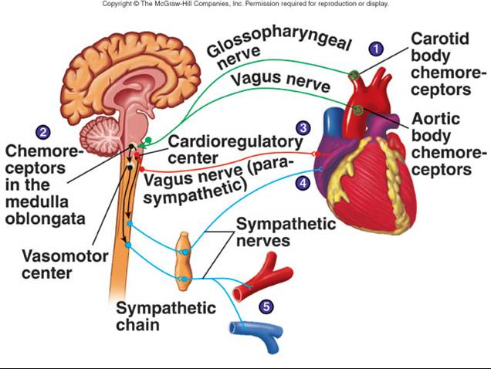

Slide 13
SA node activity
Factors directly affect SA node activity:
Physical factors: Body temperature; 1 °C increases the heart rate by 10-20 beats/minute.
Mechanical factors; Right atrial distension may directly excite the SA node leading to tachycardia.

Slide 14
Stroke Volume (SV)
Stroke volume (SV) is defined as Volume of blood ejected by each ventricle per one beat.
It is about 70 ml/beat at rest but may increase to 150 ml/beat with exercise.
the ventricles don’t completely empty themselves of blood during contraction.
2/3 of blood is ejected (ejection fraction), 1/3 is left there.

Slide 15
Stroke Volume
SV = EDV - ESV.
EDV: volume of blood in ventricles at end of diastole (110 to 120 ml).
ESV: volume of blood in ventricles at end of systole (40 ml).
SV = 70 to 80 ml.
SV = End-diastolic volume - End-systolic volume
130 ml - 60 ml
= 70 ml.

Slide 16
Regulation of Stroke Volume
The stroke volume is regulated by three variables:
The end-diastolic volume (EDV), which is the volume of blood in the ventricles at the end of diastole
The total peripheral resistance, which is the frictional resistance, or impedance to blood flow, in the arteries
The contractility, or strength, of ventricular contraction.
The end-diastolic volume is the amount of blood in the ventricles immediately before they begin to contract. This is a workload imposed on the ventricles prior to contraction, and thus is sometimes called a (preload) .
The stroke volume is directly proportional to the preload; an increase in EDV results in an increase in stroke volume. (This relationship is known as the Frank-Starling law of the heart )

Slide 17
The stroke volume is also directly proportional to contractility; when the ventricles contract more forcefully, they pump more blood.
In order to eject blood, the pressure generated in a ventricle when it contracts must be greater than the pressure in the arteries (because blood flows only from higher pressure to lower pressure).

Slide 18
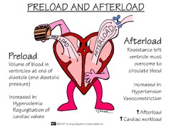
Regulation of Stroke Volume
  End diastolic volume
  (EDV). It is workload
  on heart prior to
  contraction (preload).
  Total peripheral resistance (TPR) = which impedes ejection from ventricle; impedance to blood flow in arteries (afterload).

Slide 19
Regulation of Stroke Volume
SV = EDV - ESV
Determined by 3 variables:
Preload: affects mainly EDV.
Afterload: affects mainly ESV.
Inotropy: affects mainly ESV.

Slide 20
The pressure in the arterial system
Before the ventricle contracts is, in turn, a function of the total peripheral resistance—the higher the peripheral resistance, the higher the pressure.
The total peripheral resistance thus presents impedance to the ejection of blood from the ventricle, or an after contraction has begun known as (After load)
In summary, the stroke volume is inversely proportional to the total peripheral resistance; the greater the peripheral resistance, the lower the stroke volume.

Slide 21
Preload (venous return)
Preload : It is the amount of blood coming into the heart from superior and inferior vena cava; i.e., venous return (VR) to LV through LA.
Volume of blood in the ventricles at end of diastole (end-diastolic volume (EDV)). i.e., Preload = ventricular load before contraction begins.
It is the load that determines the initial length of the resting ventricular muscle fiber before contraction.
It affects the tension developed in the muscle. When the VR (EDV) increases, the strength of ventricular contraction increases too, leading to an increase in the stroke volume which is the blood ejected from the ventricles per beat; Frank-Starling law.

Slide 22
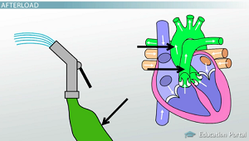
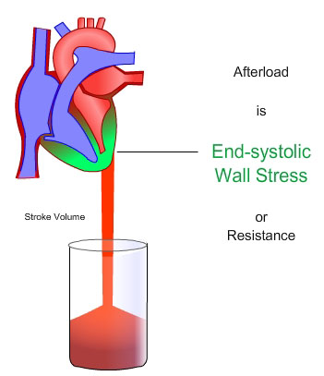
Afterload
Afterload is the resistance that the ventricles have to overcome to pump out the blood through the aorta (increases end systolic volume (ESV) .
It is the load that the ventricular muscle
faces when it begins to contract = Aortic
Pressure = aortic impedance.
Afterload is determined by:
Aortic pressure (systolic pressure).
Arterial wall rigidity (arteriosclerosis).
Blood viscosity (polycythemia).

Slide 23
Contractility
Contractility:
  Ability of the cardiac muscle to contract.
Inotropism:
  Effect of various factors on contractility (Neural, Drugs, …etc).
Positive (+ve) inotropic effect:
  Increase in myocardial contractility (sympathetic stimulation).
Negative (-ve) inotropic effect:
  Decrease in myocardial contractility.

Slide 24
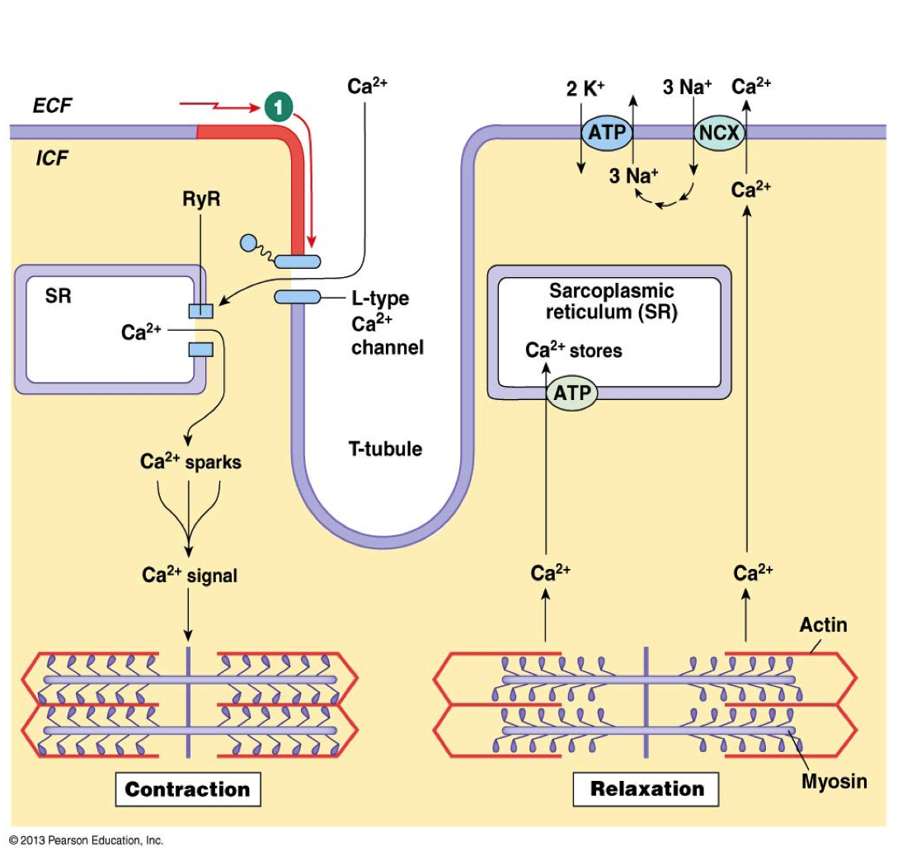
Excitation-Contraction coupling in the cardiac muscle
Depolarization of myocardial cell stimulates opening of Ca²⁺ channels in the T-tubule membrane and sarcolema (dCa⁺²).
dCa⁺² acts as a signal for the opening of Ca²⁺ channels in SR to release large amount of activator Ca⁺² from its cisternae.
Cytosolic Ca²⁺ binds to troponin C of actin and stimulates contraction.
Thus, Myocardial cells contract when they are excited (depolarized).

Slide 25
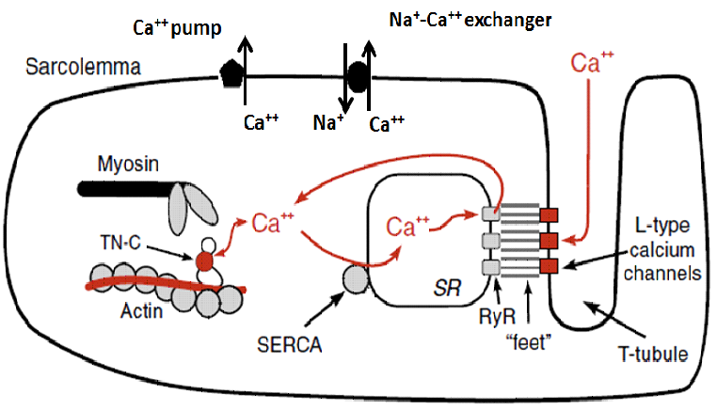
Relaxation of cardiac muscle
Active re-uptake of Ca⁺² into the sarcoplasmic reticulum by Ca⁺² pump.
Active pumping of excess Ca⁺² outside the fibbers by Na⁺- Ca⁺² exchanger carrier protein.

Slide 26
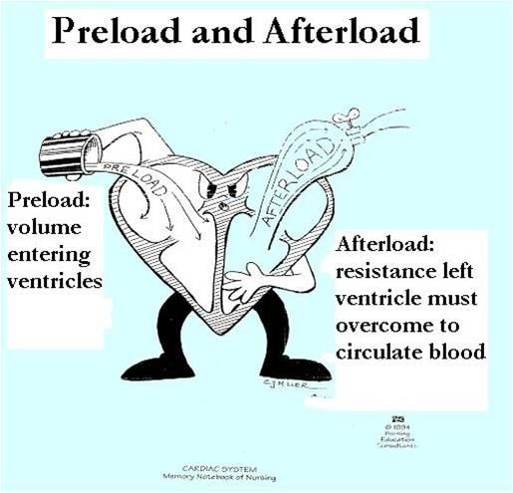
Factors that affect cardiac contractility
Four major factors affect
cardiac performance:
1- Preload.
2- Afterload.
3- Inotropic state (contractility).
4- Frequency of stimulation… contraction…. (Heart rate).

Slide 27
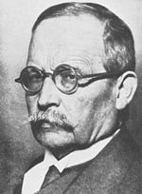
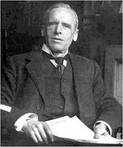
Frank-Starling's law of the heart:
The length-tension relationship in muscles: the force of myocardial contraction is directly proportional to the initial length of the cardiac muscle fibers i.e. the returned blood to heart will distend the ventricles so the ventricles will produce more powerful contraction to pump the returned blood.
The preload (VR)-force of contraction relationship.
Ventricular EDV-stroke volume relationship.

Slide 28
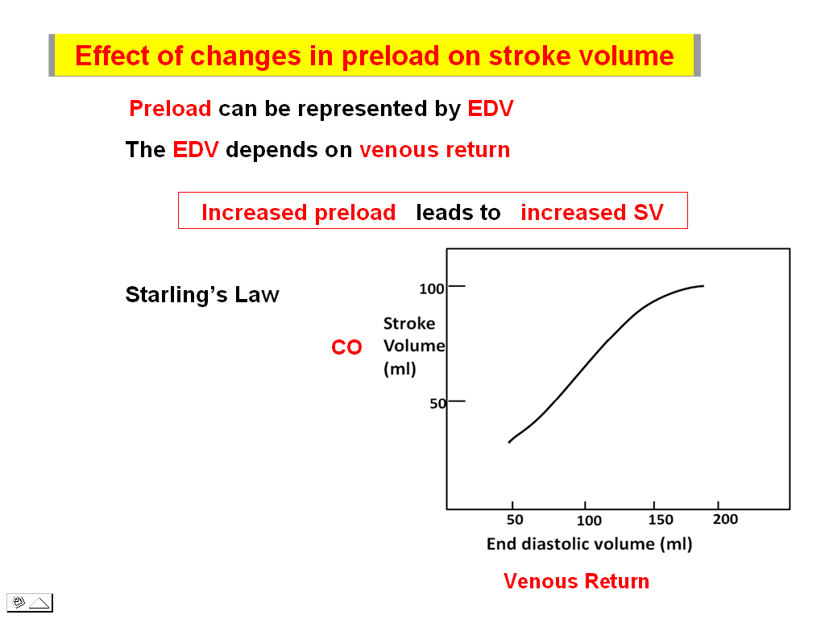
State Frank-Starling Relationships??

Slide 29
Frank-Starling Law
The Frank-Starling Law of the Heart describes the:
intrinsic relationship between end-diastolic volume and stoke volume.
effect of increased work load on cardiac output.

Slide 30
Frank-Starling Law; the strength of ventricular
contraction is:
  directly proportional to the end-systolic volume.
  directly proportional to the end-diastolic volume.
  inversely proportional to the end-diastolic volume.
  Independent of end diastolic volume.

Slide 31
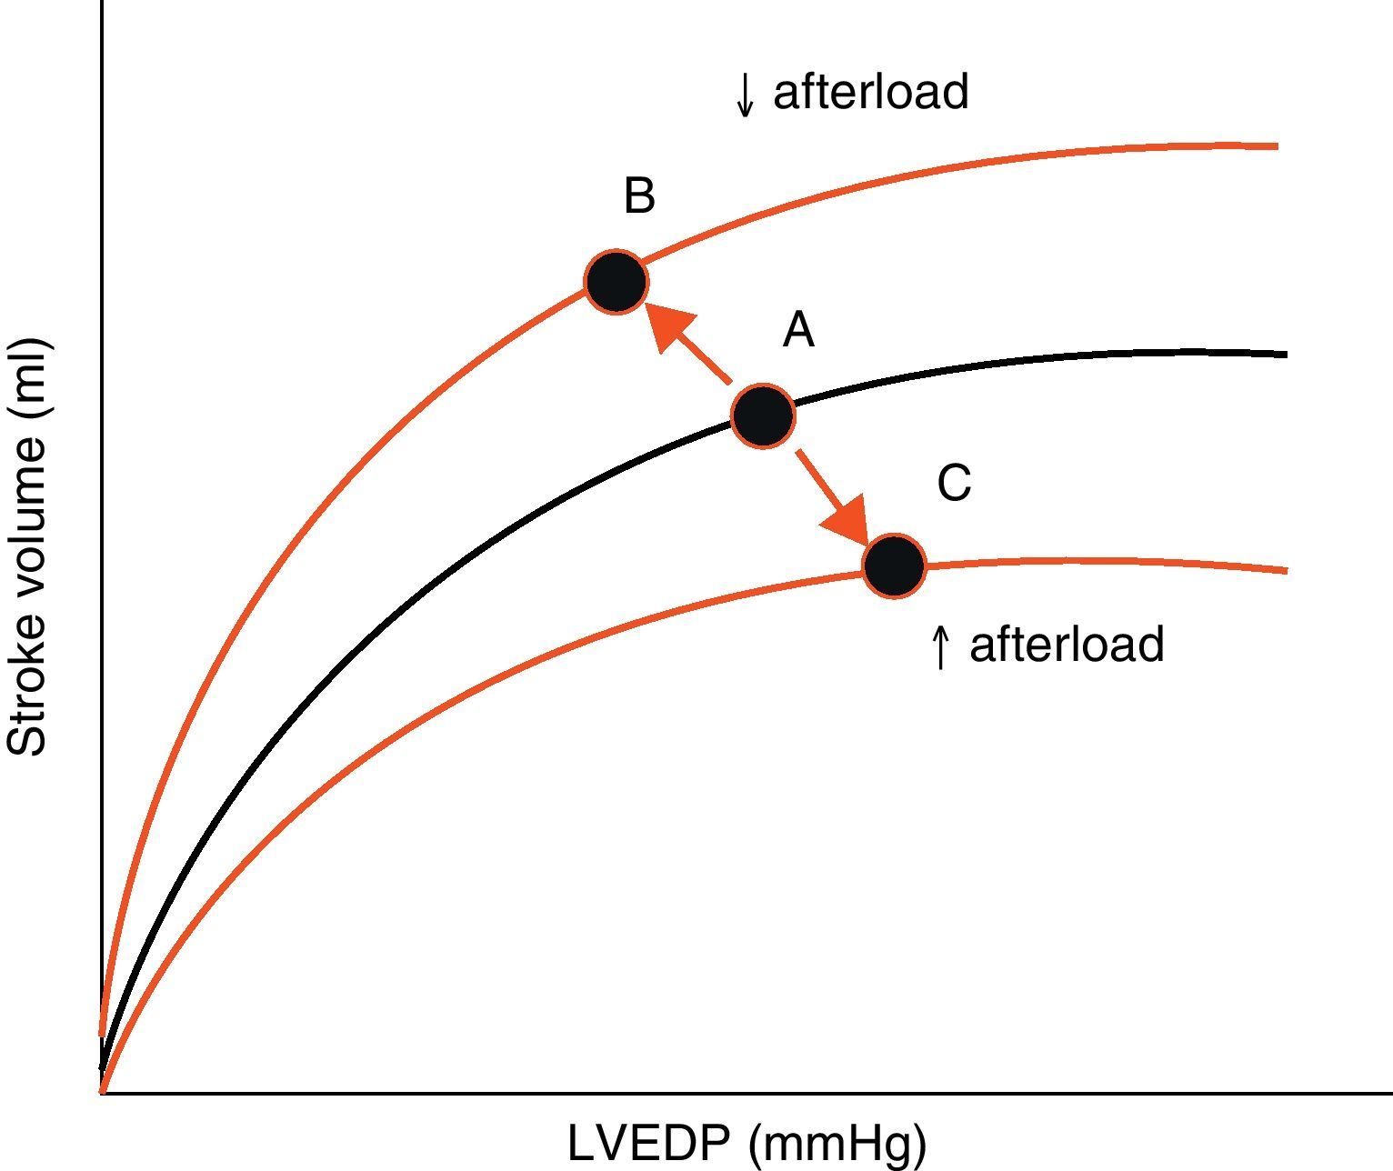
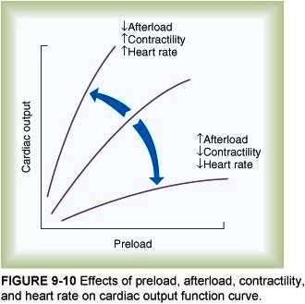
Frank-Starling Relationships

Slide 32
Heart rate & myocardial contractility
The heart rate refers to the ventricular rate of beating per minute. Normally, it averages 72 beats/minute (range 60-100 beats/minute).
An increase in the frequency of stimulation causes a proportional increase in the force of contraction.
increased Heart rate = increase in the number of depolarization (Ca⁺² influx … contraction).
  tachycardia exerts a +ve inotropic effect.
  bradycardia exerts a -ve inotropic action.
mechanism: increases the intracellular Ca⁺² content which bind the contractile proteins (troponin C).

Slide 33
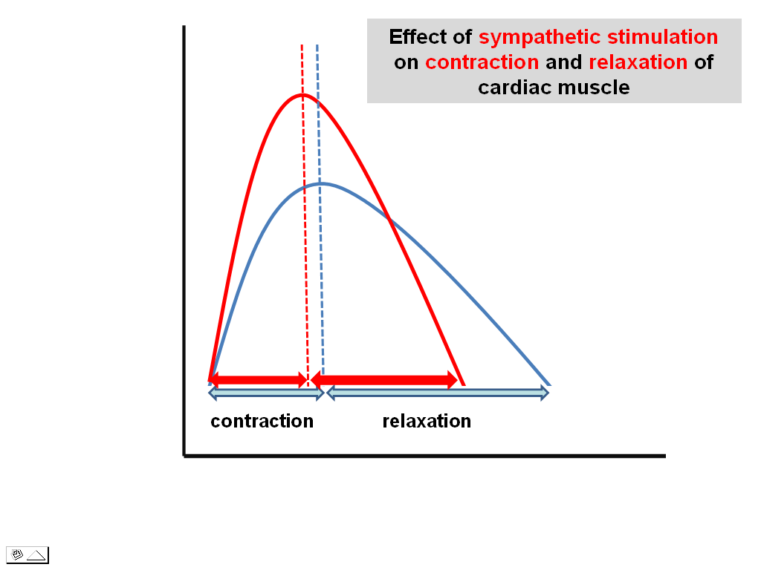
Neural factors ….cardiac contractility
Sympathetic stimulation (noradrenaline) exert a +ve inotropic effect by increasing; Cyclic-AMP in the cardiac muscle fibers which activate Ca⁺² channels inducing more Ca⁺² influx from the ECF.
parasympathetic stimulation (acetylcholine) exert a -ve inotropic effect (How?????).

Slide 34
Extra cardiac factors that affect cardiac contractility
Physical factors:
A moderate rise of the body temperature strengthens cardiac contractility. Excessive rise of the body temperature (e.g. in fever) decreases contractility. How?
Hypothermia also decreases cardiac contractility.
Inorganic ions: Sodium (Na⁺ (Natrium)):
Hypernatraemia exerts -ve inotropic effect (Na⁺- Ca⁺² exchanger carrier protein).
Hyponatraemia exerts +ve inotropic effect.

Slide 35
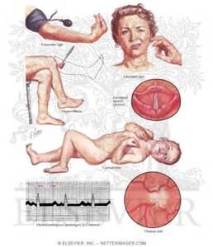
Inorganic ions: Calcium (Ca⁺²):
Hypercalcaemia exerts a +ve inotropic effect as a result of more cytosolic Ca⁺².
Hypocalcaemia has a little (or no) -ve inotropic effect, since it causes fatal tetany before affecting the heart.

Slide 36
Inorganic ions: Potasium (K⁺):
Hyperkalaemia:
It has a -ve inotropic effect.
decreases the resting membrane potential (more positive resting membrane potential; closer to the threshold).
the amplitude of the action potential is reduced leading to less influx of depolarizing Ca⁺² and less release of activator Ca⁺².
Hypokalaemia:
It produces a +ve inotropic effect.

Slide 37
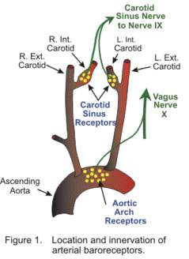
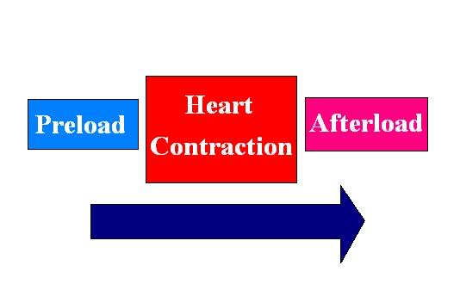

Slide 38
Summary
(Regulation of Stroke Volume)
End-diastolic volume (EDV): SV is directly proportional to preload; an increase in EDV results in an increase in stroke volume (Frank-Starling law).
The total peripheral resistance: SV is inversely proportional to TPR (afterload); it is the aortic impedance; higher peripheral resistance; higher arterial pressure) that reduce the stroke volume.
Sympathetic input (Inotropy): Strength of contraction varies directly with EDV; myocardial contractility is directly proportional with SV.

Slide 39


Slide 40
The Electrocardiogram (ECG)
The body is a good conductor of electricity because tissue fluids have a high concentration of ions that move (creating a current) in response to potential differences.
Potential differences generated by the heart are conducted to the body surface, where they can be recorded by surface electrodes placed on the skin.
The recording thus obtained is called an electrocardiogram ( ECG or EKG ); the recording device is called an electrocardiograph.
Each cardiac cycle produces three distinct ECG waves, designated P, QRS, and T.
Atrial depolarization creates the P wave
Ventricle depolarization creates the QRS and thus to contraction of the ventricles.
The plateau phase of the cardiac action potential is related to the S-T segment of the ECG .
Finally, repolarization of the ventricles produces the T wave

Slide 41
Heart Sounds
Closing of the AV and semilunar valves produces sounds that can be heard by listening through a stethoscope placed on the chest. These sounds are often verbalized as “lub-dub.” The “lub,” or first sound, is produced by closing of the AV valves during isovolumetric contraction of the ventricles
The “dub,” or second sound, is produced by closing of the semilunar valves when the pressure in the ventricles falls below the pressure in the arteries. The first sound is thus heard when the ventricles contract at systole, and the second sound is heard when the ventricles relax at the beginning of diastole.
Murmurs are abnormal heart sounds produced by abnormal patterns of blood flow in the heart. Many murmurs are caused by defective heart valves. Defective heart valves may be congenital, or they may occur as a result of rheumatic endocarditis , mitral stenosis (mitral valve becomes thickened and calcified )
Notes:
Part of the PNS (Somatic)
Lie in intervertebral foramina
Send lateral branches to body
Named according to their point of issue from the vertebral column
8 pairs of cervical spinal nerves; C₁-C₈
12 pairs of thoracic spinal nerves; T₁-T₁₂
5 pairs of lumbar spinal nerves; L₁-L₅
5 pairs of sacral spinal nerves; S₁-S₅
1 pair of coccygeal spinal nerves; C₀₁

