Slide 1
Blended Learning
Academic Year: 2020 – 2021
Refrigeration Systems
Air conditioning and Refrigeration Techniques Engineering Department, Al-Mustaqbal University College, Babylon, Iraq
Class: 4th Stage
Ammar Abdulkadhim Fathi
B.Sc., M.Sc. (Mech. Eng.)

Slide 2
Lecture One
Basic Principles of Refrigeration Systems

Slide 3
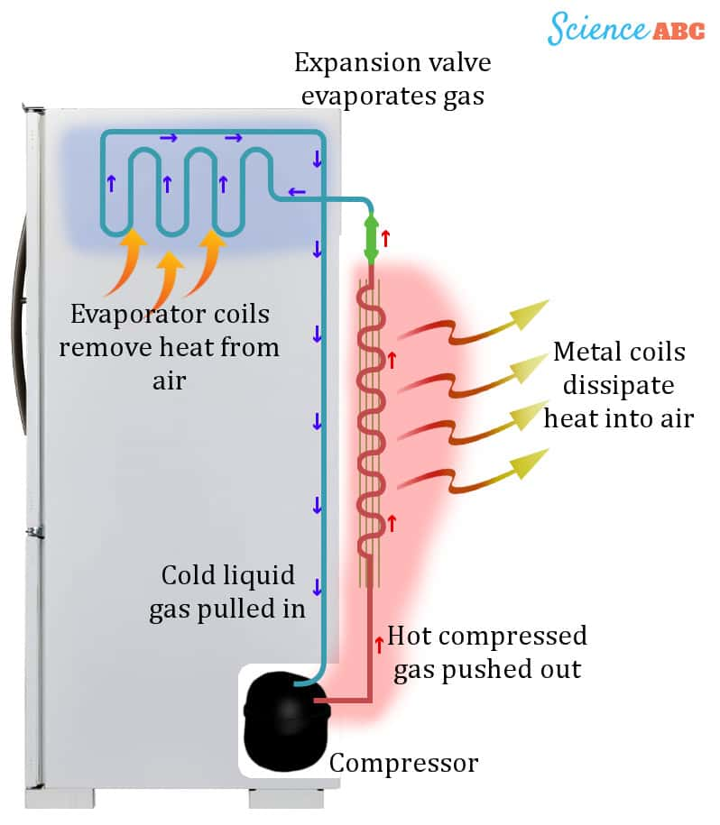
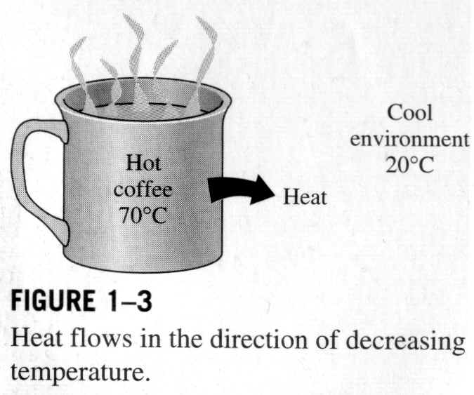
1.1 Basic of Refrigeration Principles
If you were to place a hot cup of coffee on a table and leave it for a while, the heat in the coffee would be transferred to the materials in contact with the coffee, i.e. the cup, the table and the surrounding air.
As the heat is transferred, the coffee in time cools. Using the same principle, refrigeration works by removing heat from a product and transferring that heat to the outside air.

Slide 4
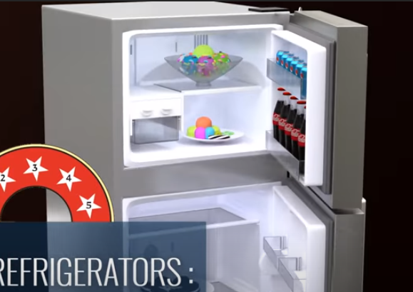
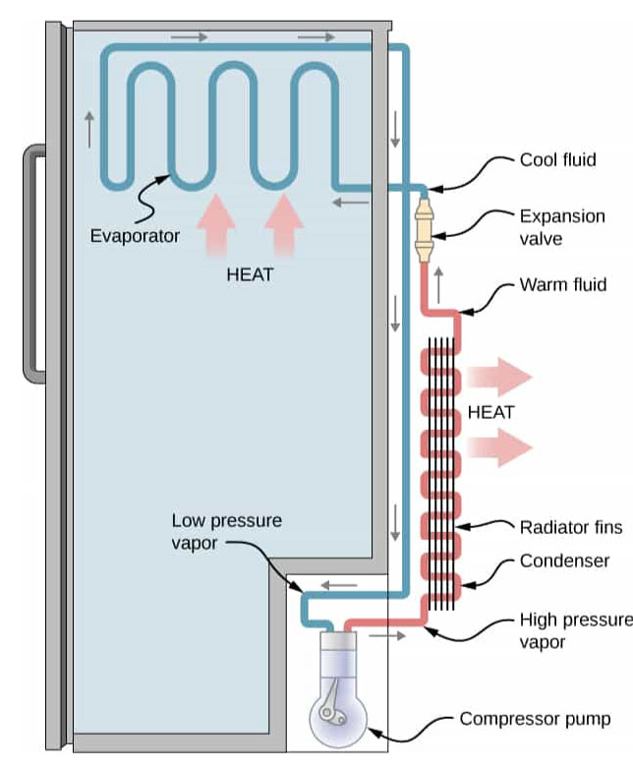
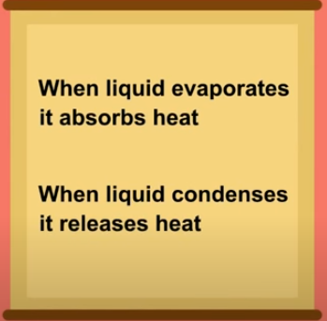

Slide 5
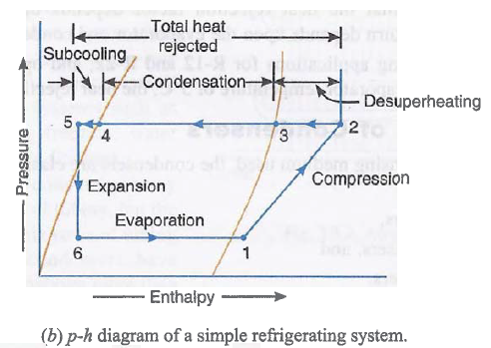
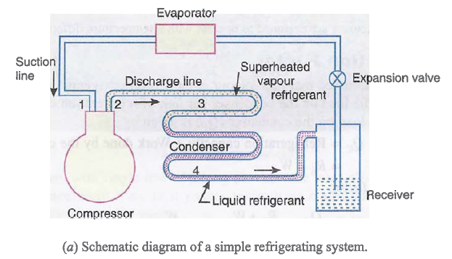
Refrigeration System Components
There are five basic components of a refrigeration system, these are:
1. Evaporator
2. Compressor
3. Condenser
4. Expansion Valve
5. Refrigerant; to conduct the heat from the product.
In order for The refrigeration cycle to operate successfully each component must be present within the refrigeration system.

Slide 6
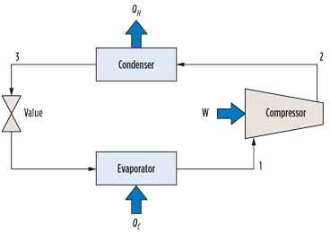
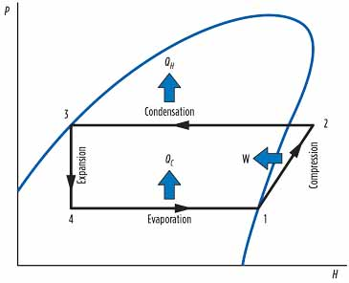


Slide 8
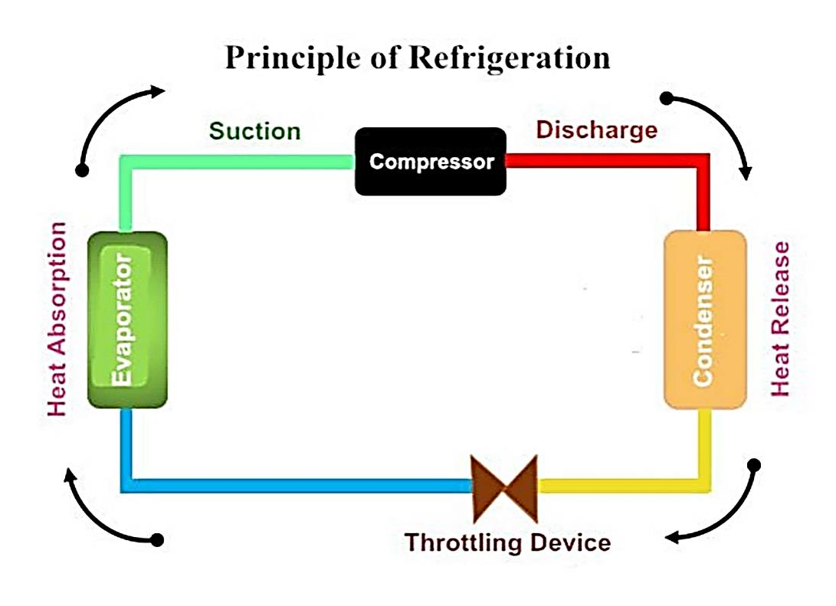
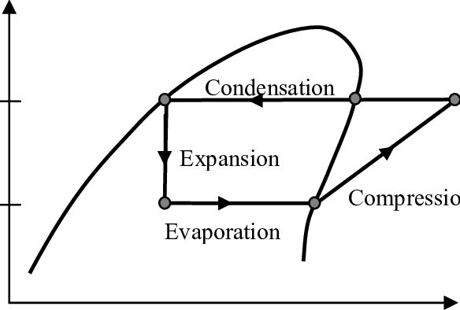
Compressor
The purpose of the compressor is to draw the low-temperature, low-pressure vapour from the evaporator via the suction line. Once drawn, the vapour is compressed. When vapour is compressed it rises in temperature. Therefore, the compressor transforms the vapour from a low-temperature vapour to a high-temperature vapour, in turn increasing the pressure. The vapour is then released from the compressor in to the discharge line.

Slide 9
Condenser
The purpose of the condenser is to extract heat from the refrigerant to the outside air. The condenser is usually installed on the reinforced roof of the building, which enables the transfer of heat.
Fans mounted above the condenser unit are used to draw air through the condenser coils.
The temperature of the high-pressure vapour determines the temperature at which the condensation begins. As heat has to flow from the condenser to the air, the condensation temperature must be higher than that of the air; usually between - 12°C and -1°C. The high-pressure vapour within the condenser is then cooled to the point where it becomes a liquid refrigerant once more, whilst retaining some heat. The liquid refrigerant then flows from the condenser in to the liquid line.

Slide 10
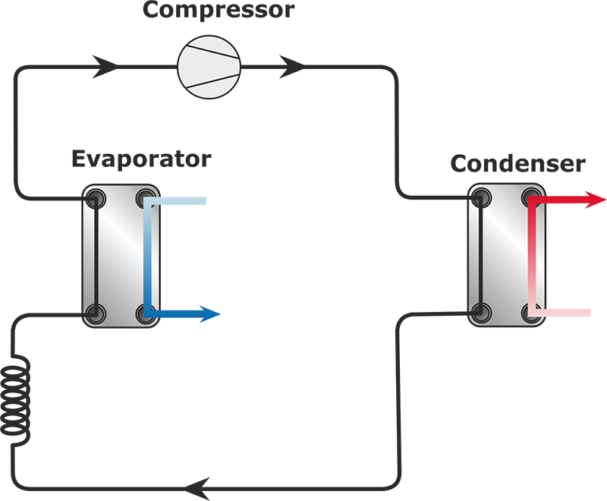
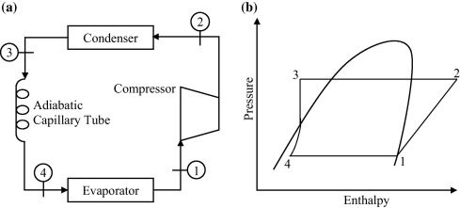
Expansion Device
The purpose of the capillary tube is to reduce the condenser high pressure, temperature into lower pressure and colder two – phase refrigerant.

Slide 11
The Evaporator
The purpose of the evaporator is to remove unwanted heat from the product, via the liquid refrigerant. The liquid refrigerant contained within the evaporator is boiling at a low-pressure.
The level of this pressure is determined by two factors:
The rate at which the heat is absorbed from the product to the liquid refrigerant in the evaporator
The rate at which the low-pressure vapour is removed from the evaporator by the compressor
To enable the transfer of heat, the temperature of the liquid refrigerant must be lower than the temperature of the product being cooled. Once transferred, the liquid refrigerant is drawn from the evaporator by the compressor via the suction line. When leaving the evaporator coil the liquid refrigerant is in vapour form

Slide 12
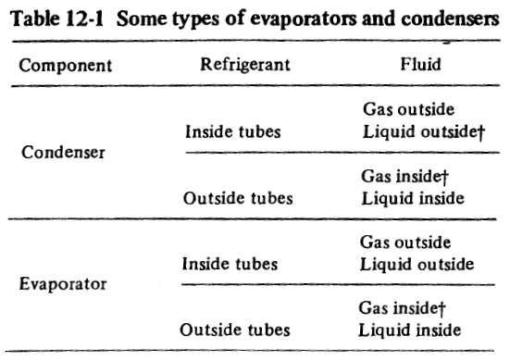
Condensers and Evaporators
Condensers and evaporators as heat exchangers Since both the condenser and evaporator are heat exchangers, they have certain features in common.
One classification of condensers and evaporators (Table 12-1) is according to whether the refrigerant is on the inside or outside of the tubes and whether the fluid cooling the condenser or being refrigerated is a gas or a liquid. The gas referred to in Table 12-1 is usually air, and the liquid is usually water, but other substances are used as well.
The most widely used types of condensers and evaporators are shell-and-tube heat exchangers (Fig. 12-1) and finned-coil heat exchangers (Fig. 12-2).

Slide 13
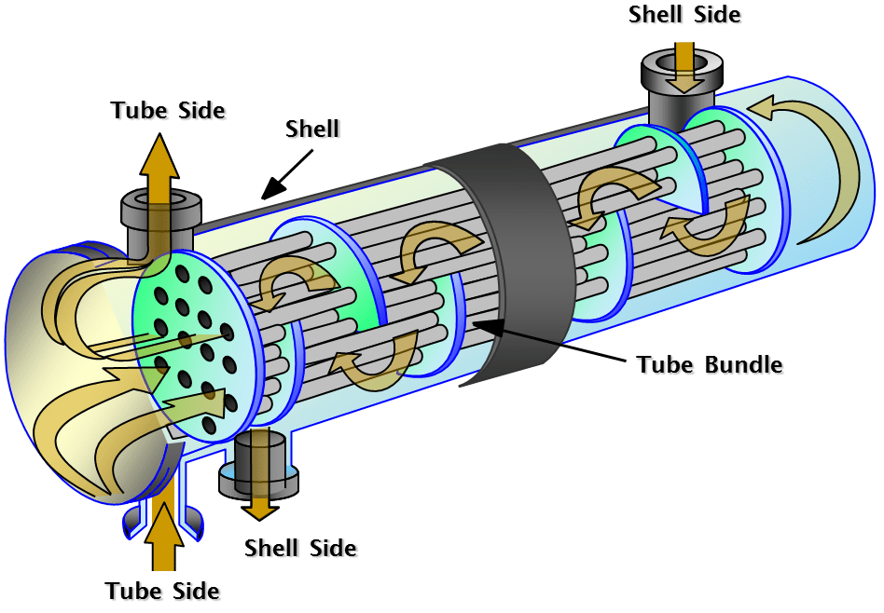
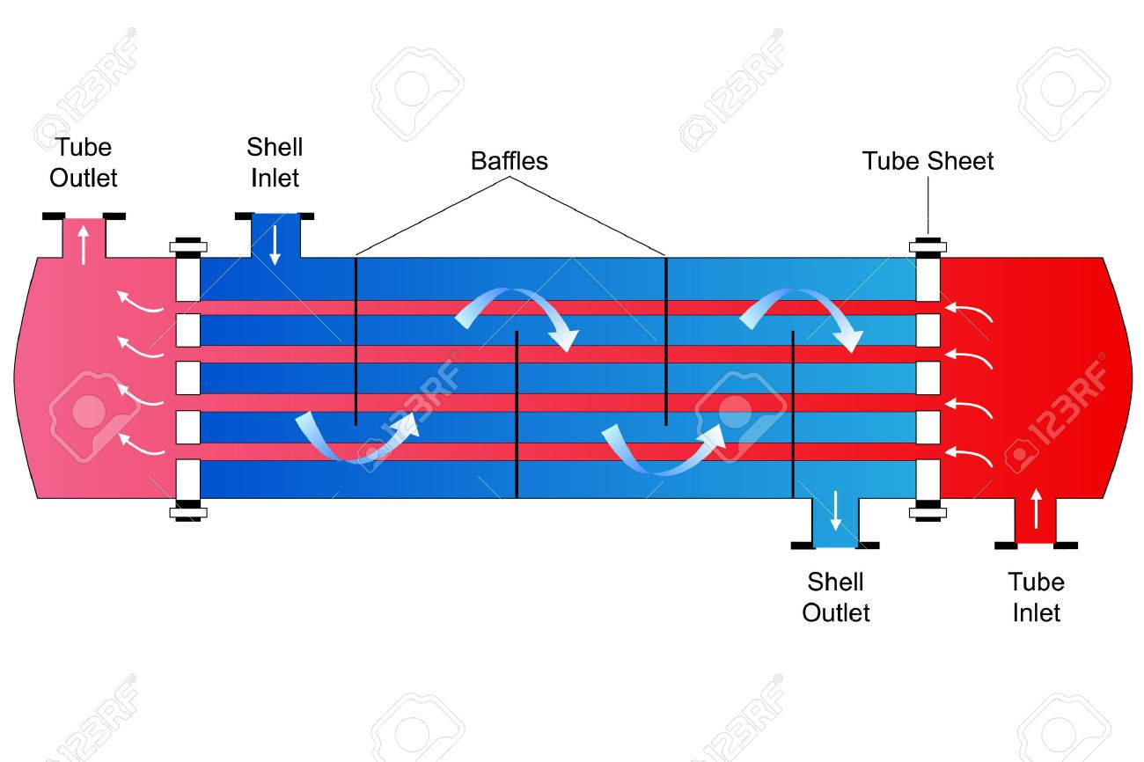
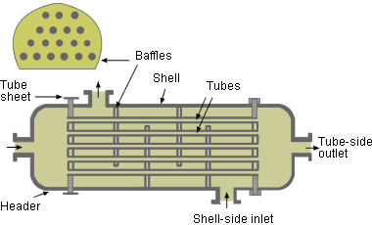
Shell-and-tube water-cooled condenser

Slide 14
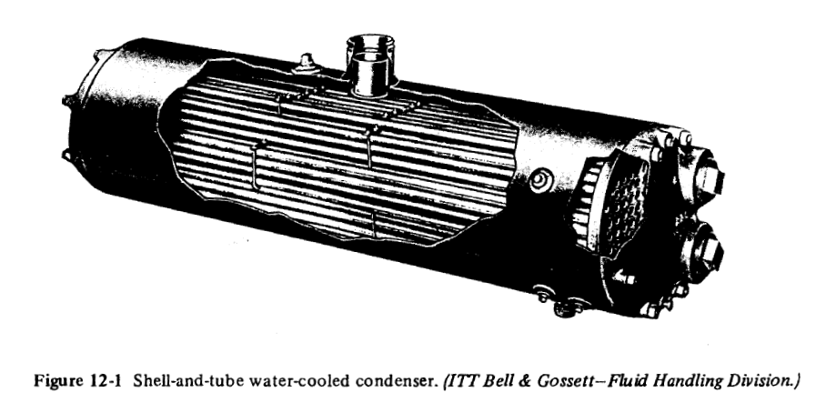
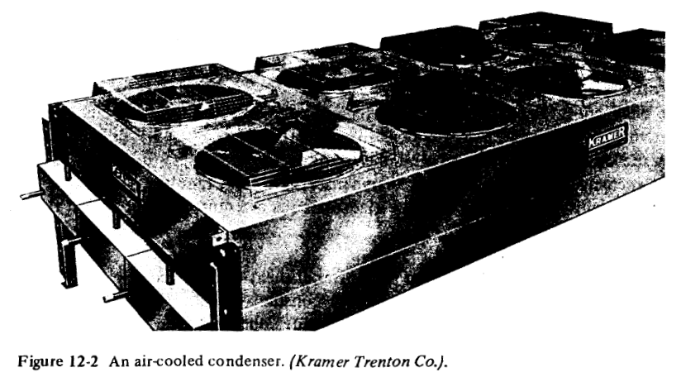
condensers and evaporators
The most widely used types of condensers and evaporators are shell-and-tube heat exchangers (Fig. 12-1) and finned-coil heat exchangers (Fig. 12-2).

Slide 15
Condensers and evaporators are basically heat exchangers in which the refrigerant undergoes a phase change.
In condensers the refrigerant vapour condenses by rejecting heat to an external fluid, which acts as a heat sink.
In evaporators, the liquid refrigerant evaporates by extracting heat from an external fluid

Slide 16
Condensers
In a typical refrigerant condenser, the refrigerant enters the condenser in a superheated state.
It is first de-superheated and then condensed by rejecting heat to an external medium.
During condensation process, during which the temperature of the refrigerant remains constant as it undergoes a phase change process
The refrigerant may leave the condenser as a saturated or a sub-cooled liquid, depending upon the temperature of the external medium and design of the condenser

Slide 17
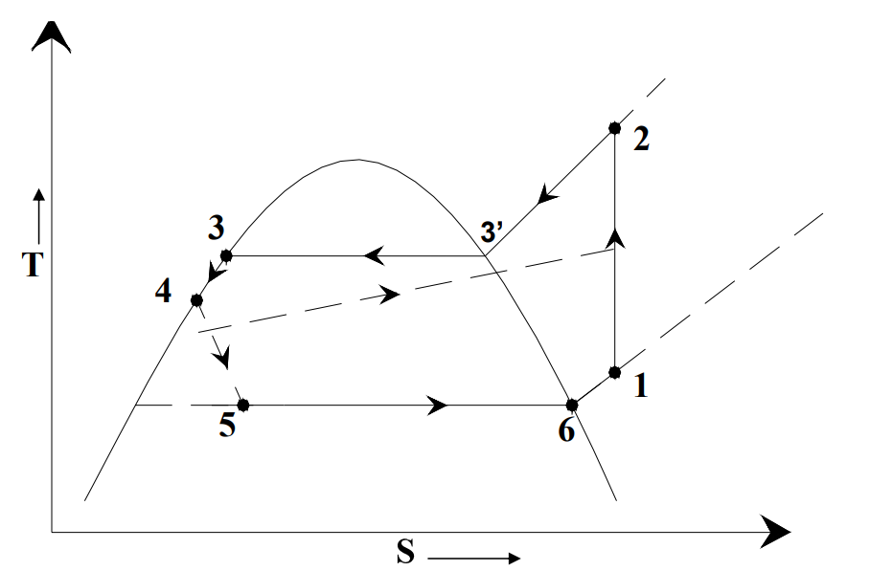

Slide 18
Based on the external fluid, condensers can be classified as:
Air cooled condensers
Water cooled condensers,
c) Evaporative condensers
Classification of condensers
Air-cooled condensers
Air-cooled condensers:
As the name implies, in air-cooled condensers air is the external fluid, i.e., the refrigerant rejects heat to air flowing over the condenser. Air-cooled condensers can be further classified into natural convection type or forced convection type.
The natural convection type condensers are either plate surface type or finned tube type.

Slide 19
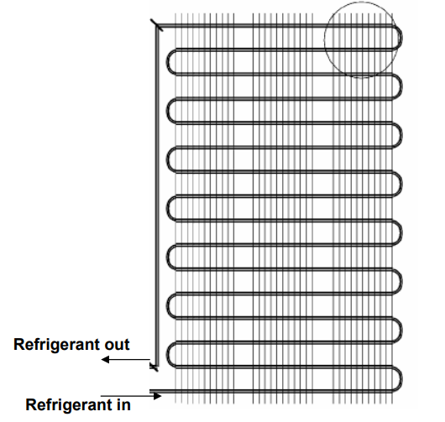
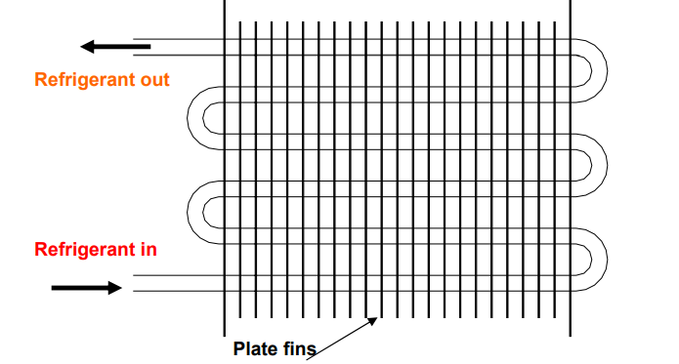
Schematic of a wire-and-tube type condenser used in small refrigeration systems
Forced convection, plate fin-and-tube type condenser

Slide 20
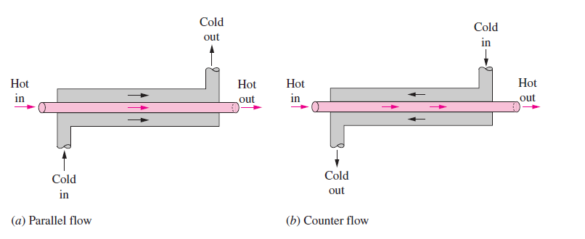
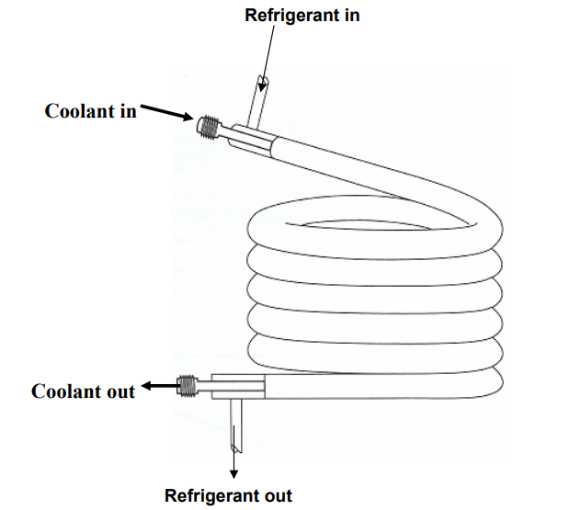
Water-cooled condensers
Water Cooled Condensers: In water cooled condensers water is the external fluid. Depending upon the construction, water cooled condensers can be further classified into:
Double pipe or tube-in-tube type
Shell-and-coil type
Shell-and-tube type
1. Double pipe or tube-in-tube type

Slide 21
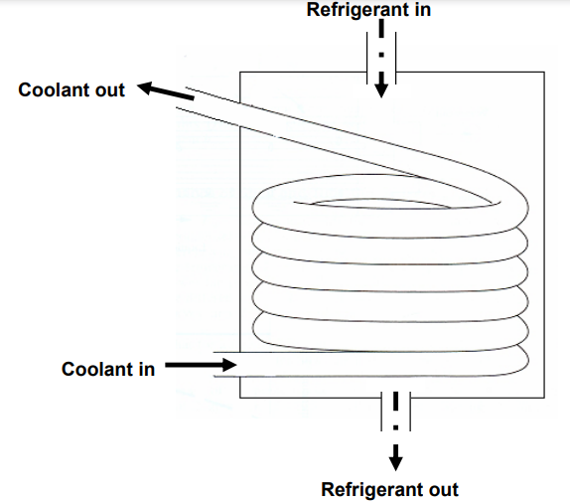
2. Shell-and-coil type condenser

Slide 22
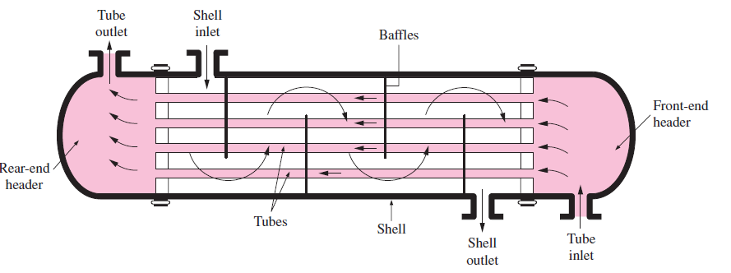
Shell-and-tube type
The schematic of a shell-and-tube heat exchanger (one-shell pass and one-tube pass).

Slide 23
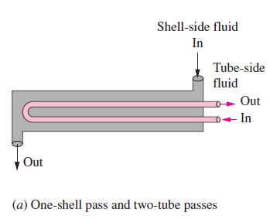
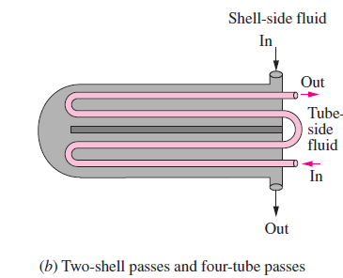
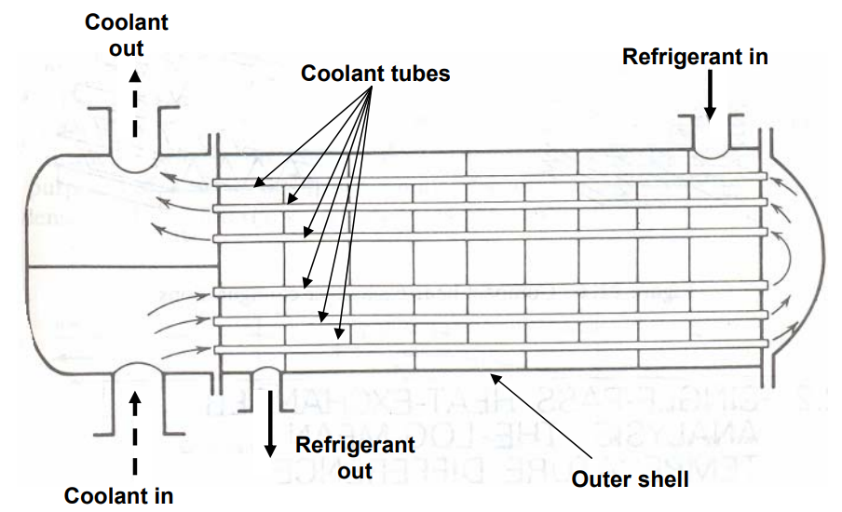
A two-pass, shell-and-tube type condenser

Slide 24
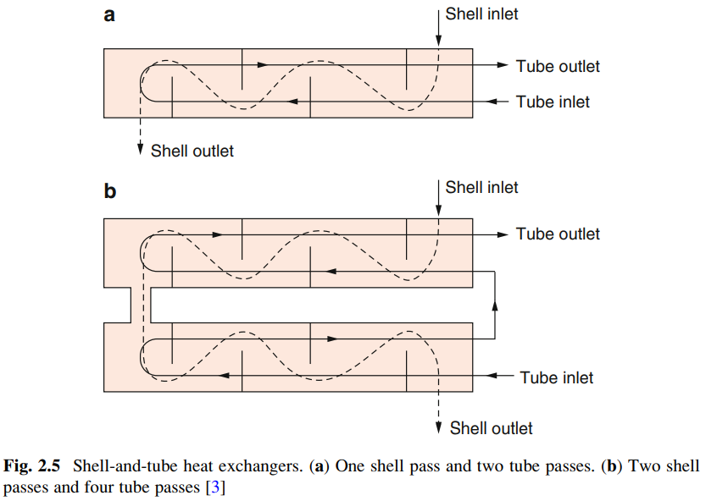

Slide 25
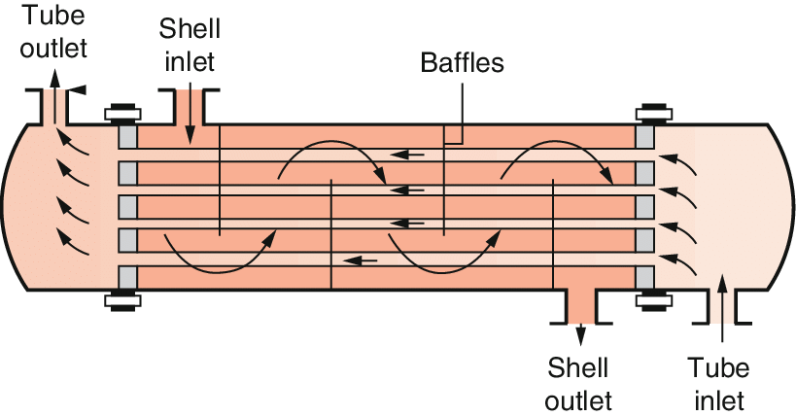
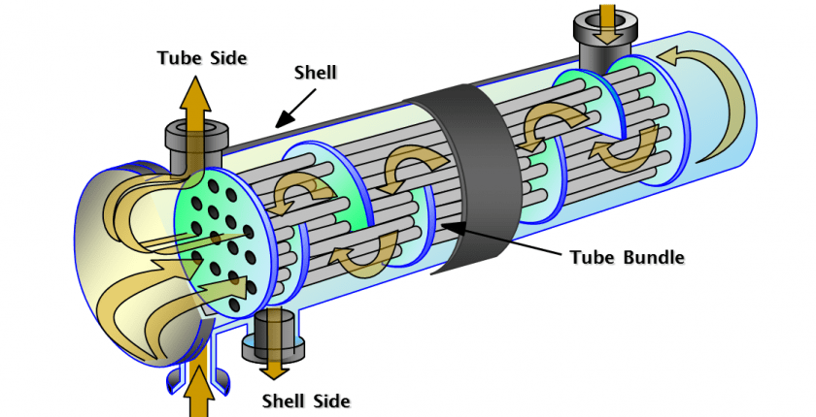
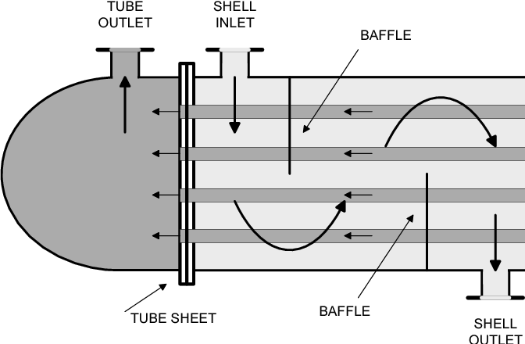
The most widely used types of heat exchangers in condenser and evaporator are
1. Shell and tube heat exchanger
2. Finned coil heat exchanger

Slide 26
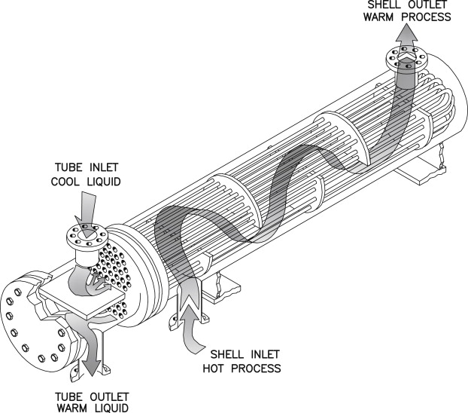

Slide 27
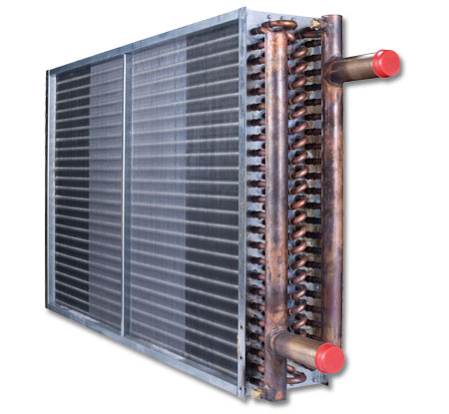
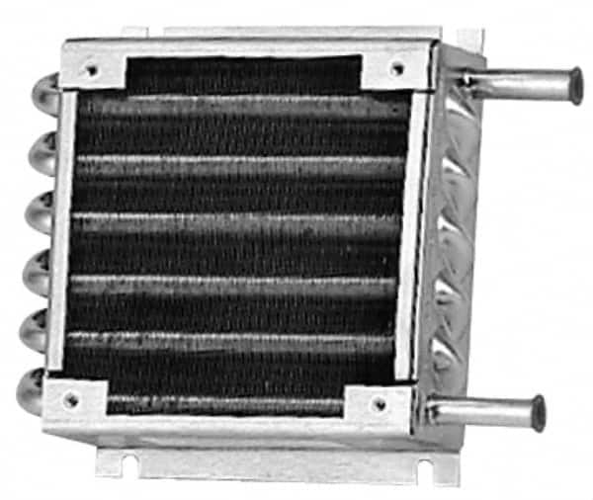
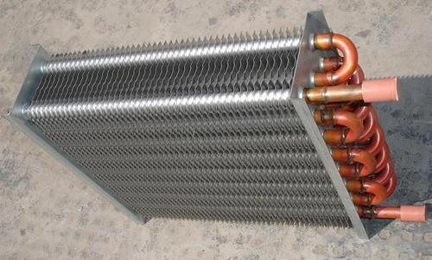
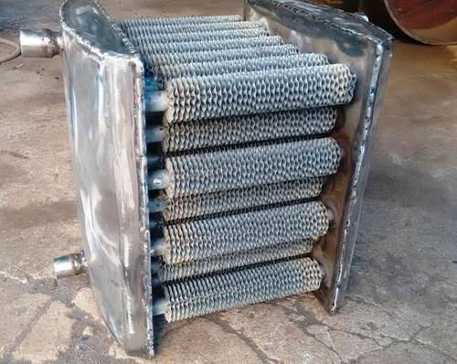
Shell-and-Finned - Tube HX

Slide 28
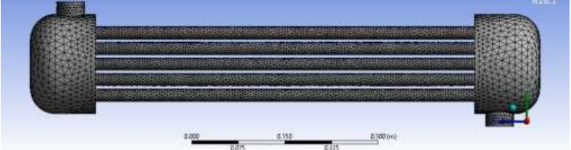
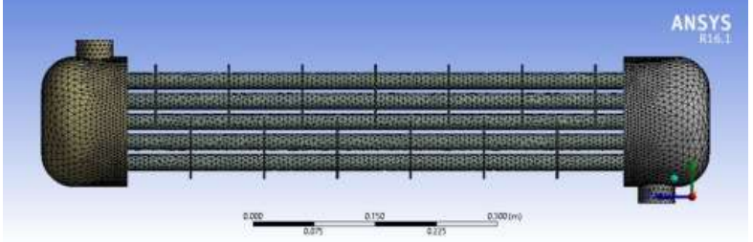
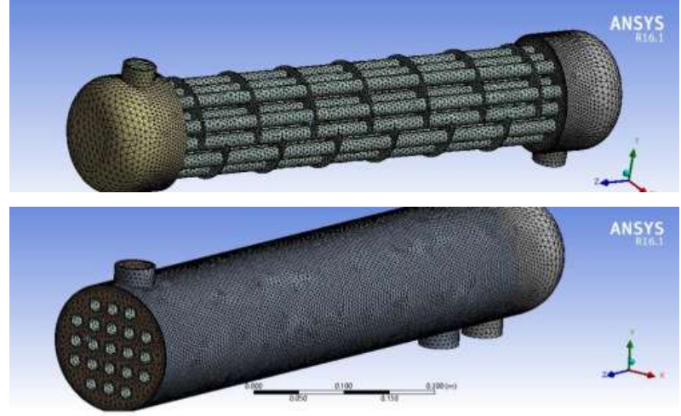
CFD of Heat Exchanger

Slide 29
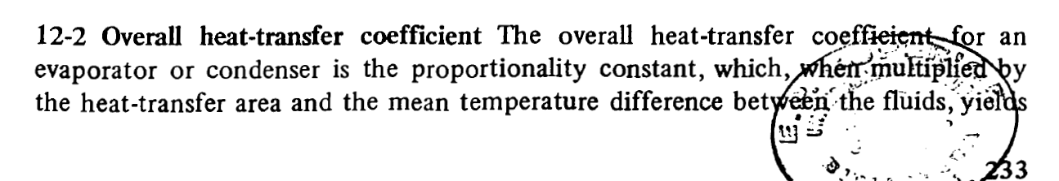
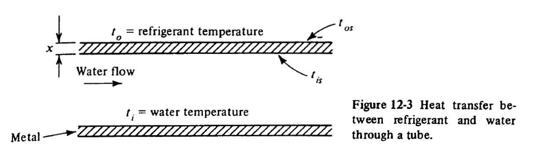
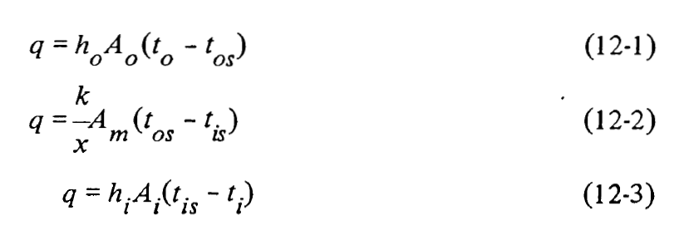

Slide 30
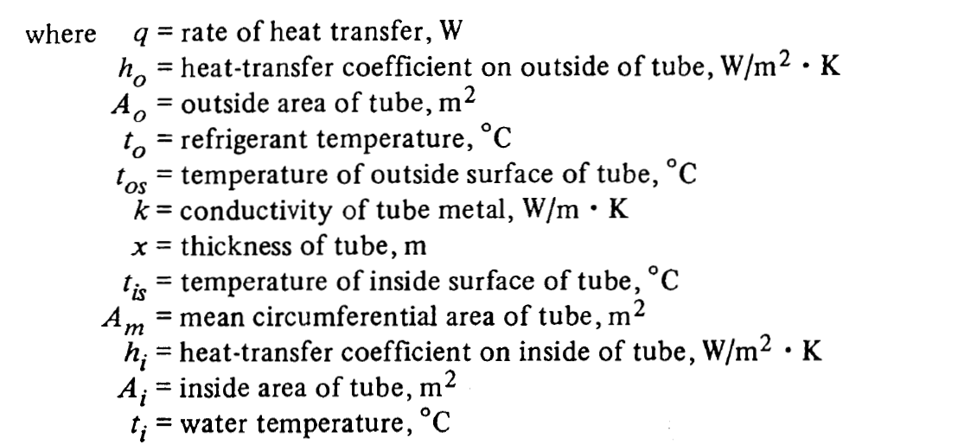
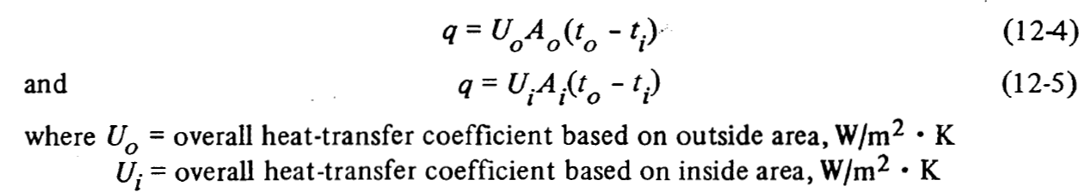

Slide 31
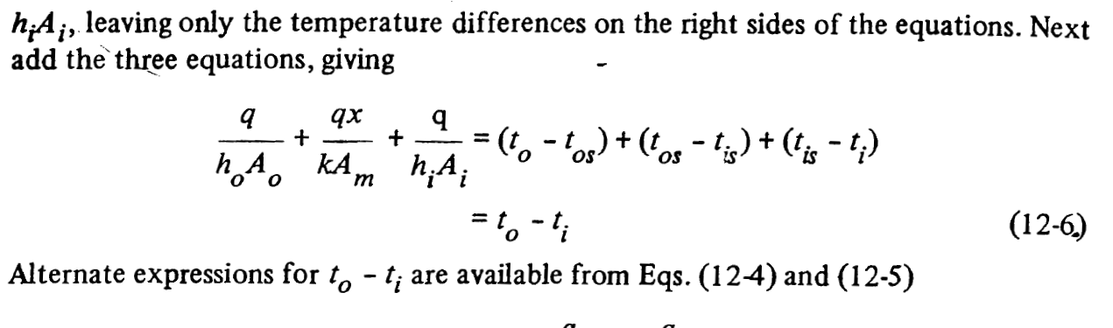
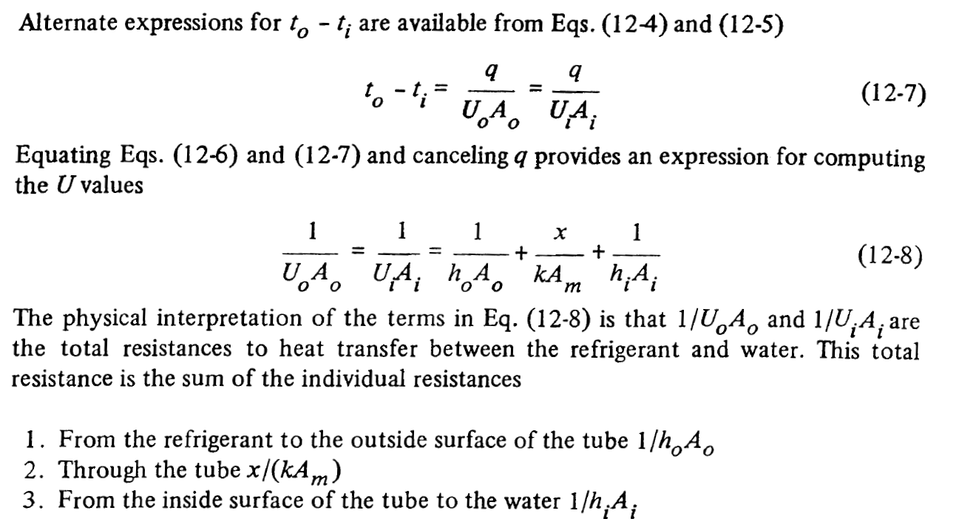

Slide 32
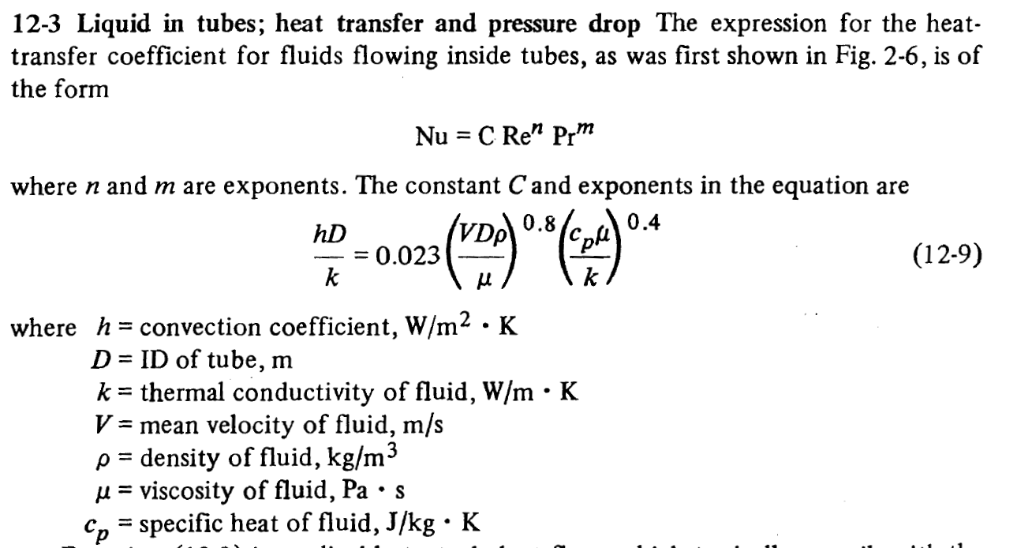

Slide 33
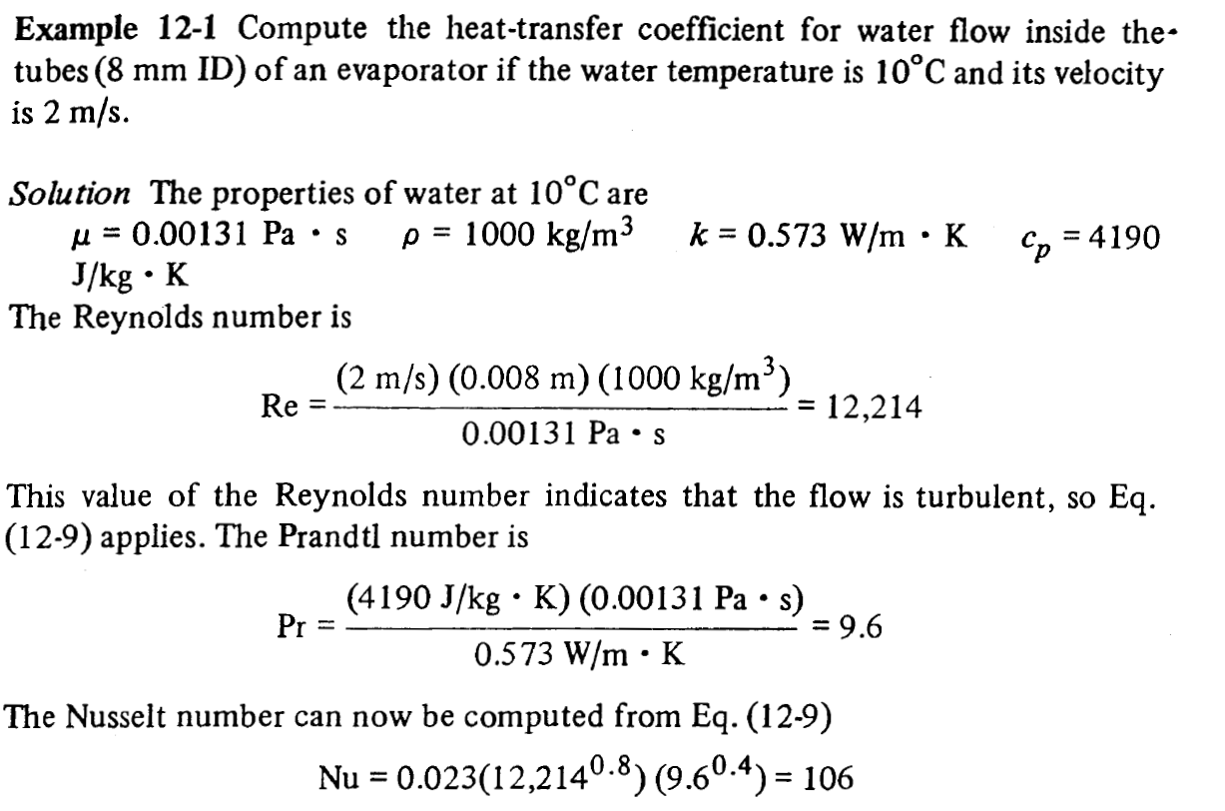


Slide 34





Slide 35


Slide 36


Slide 37

12-5 Extended surface

Slide 38


Slide 39



Slide 40



Slide 41



Slide 42


Slide 43
    Thank You Very Much for Your Attention

