Slide 1
AL-Mustaqbal University College Medical laboratory Techniques Department Practical General Chemistry Lecture four (Preparation Solution from Solid)

Slide 2
SOLUTION PREPARATION
A solution is a homogeneous mixture created by dissolving one or more solutes in a solvent. The chemical present in a smaller amount, the solute, is soluble in the solvent (the chemical present in a larger amount). Solutions with accurately known concentrations can be referred to as standard (stock) solutions. These solutions are bought directly from the manufacturer or formed by dissolving the desired amount of solute into a volumetric flask of a specific volume.
Stock solutions are frequently diluted to solutions of lesser concentration for experimental use in the laboratory.

Slide 3
Preparing a Standard Solution from a Solid
A solution of known concentration can be prepared from solids by two similar methods. Although inherent errors exist with each of the methods, with careful technique either will suffice for making solutions in General Chemistry Laboratory.

Slide 4
Glassware and Tools:–
Watch glass –Stirrer –Beaker –Spatula –
funnel – volumetric Flask – Washing bottle –
Balance.

Slide 5
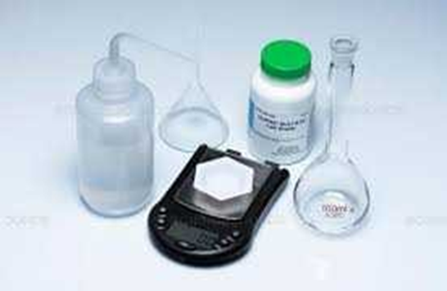

Slide 6
Chemicals:–
Sodium carbonate Na₂CO₃ to prepare 0.1 M in 100 ml of D.W.

Slide 7
Procedure:
Weight the solid substance in a watch glass.
Transfer to a beaker and add a small amount of solvent to the beaker and stirred the solution until the solid substance is dissolved.
Transfer the solution to the volumetric flask.
Put a funnel into the slim neck of the volumetric flask.

Slide 8
Complete the additional of solvent to required volume (add solvent
until the liquid level reaches the calibration mark).
Capped the volumetric flask and inverted until the contents are thoroughly mixed and completely dissolved.

Slide 9
The Calculations:-
Molarity(M) = mass(g) *1000/ M.wt * V(ml)
Molar mass for Na=23 , C=12 , O=16
M.wt of (Na2CO3) =(2*23)+12+(3*16)
=106
Molarity(M) *M.wt*V(ml) /1000 Mass(g)=
1000 / 0.1 *106 *100 =

Slide 10
Standard Result:
1.06 g of Na₂CO₃ dissolve in 100 ml D.W.

Slide 11
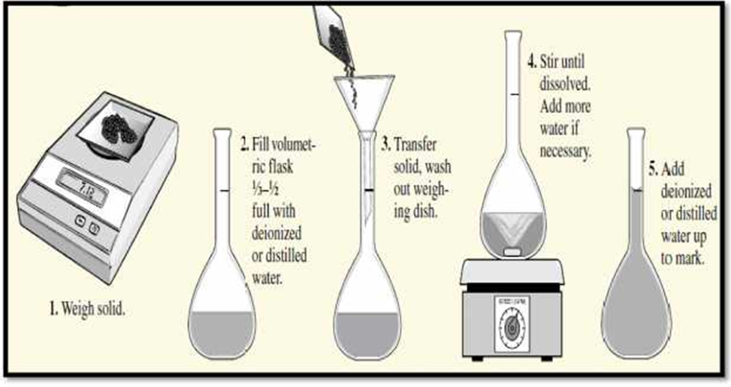
Figure: Explained how to make a solution

