Slide 1
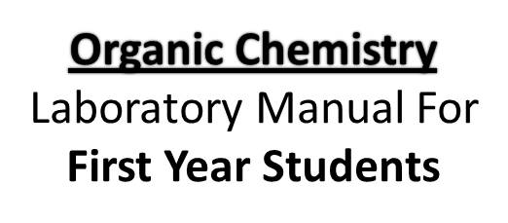
Duha Adnan Mahmood

Slide 2
Experiment name / Determination of Boiling point
Purpose:
The purpose of this experiment is to determine the boiling points of various organic compounds and to use these to identify unknowns

Slide 3
Boiling point Definition
The boiling point of an organic liquid is the temperature at which its vapour pressure equals the atmospheric pressure over the liquid or it is the temperature at which the vapour and liquid phases are in equilibrium at agiven pressure.
the boiling point is considered as a criterion of purity of a compound and is useful for identification of organic compounds. Similar to the melting point the boiling point may be sharp or may vary over a temperature range. Pure liquids have sharp boiling points while mixtures show a boiling point range.
The atmospheric pressure plays an important role in determination of the boiling point correctly. Reduction of the pressure leads to a decrease or a depression in the boiling point and vice versa.

Slide 4
Experimental Procedures Boiling Point
1- Obtain a liquid unknown from your instructor. Record the sample number.
2- Attach a clean and empty test tube to a thermometer with sewing thread. Put an empty capillary tube in the test tube so that the open end of capillary is down.
3- Ensure that the temperature of the paraffin oil is below 50 °C. Place 2‐3 mL of sample in the test tube.
4- Turn on the hot plate and use a clean glass rod to stir the paraffin oil to ensure a uniform heat distribution.
5- Record the temperature when rapid air bubbles come out from the capillary. At this stage, the vapor pressure of the unknown inside the capillary is higher than the atmospheric pressure.

Slide 5
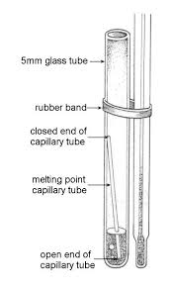
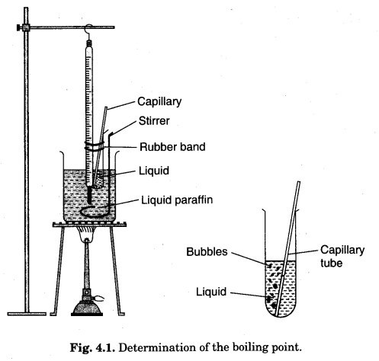
6- Turn off the hot plate and carefully insert a ceramic tile between the beaker and the hotplate. Alternatively, you may replace the hot plate with the one that has not been used. However, the thermometer bulb and the content in the test tube should be submerged in the paraffin oil at all times.
7- As the temperature decreases, air bubbling will gradually slow down. Record the temperature when you see the last bubble come out and some liquid goes into the capillary.

Slide 6
Questions
1- What effect has a change in The atmospheric pressure on the boiling point ?
2- What is the definition of boiling point ?
3- What is the purpose of determining the boiling point ?
https://youtu.be/8b5Ha-8QGhY

