Slide 1
Buffer system
Msc . Samah Sajad Kadhim

Slide 2
pH
•pH is a measure of how acidic/basic water is.
•The range goes from 0 to 14, with 7 being neutral.
•pH of less than 7 indicate acidity, whereas a pH of greater than 7 indicates a base

Slide 3
Buffer
•A buffer solution(more precisely, pH buffer or hydrogen ion buffer) is an aqueous solution consisting of a mixture of a weak acid and its conjugate base, or vice versa.
•Its pH changes very little when a small amount of strong acid or base is added to it.

Slide 5
Physiological buffers
•Physiological buffers are chemicals used by the body to prevent large changes in the pH of a bodily fluid.
•All about to maintain equilibrium
•The four physiological buffers are the bicarbonate, phosphate, hemoglobin, and protein systems

Slide 7
Physiological buffers
•Protein buffer system –regulate pH of ECF & ICF
•Carbonic acid –bicarbonate buffer system –buffers ECF
•Phosphate buffer system –buffers pH of ICF & Urine

Slide 8
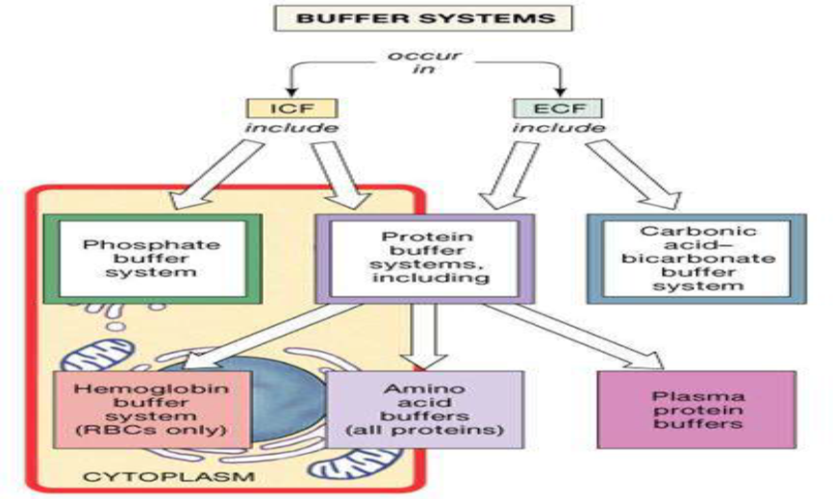

Slide 10
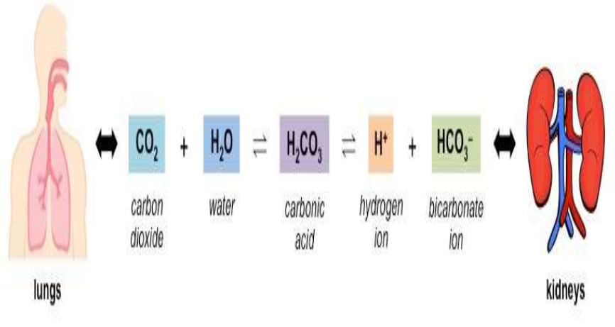

Slide 11
Blood acid base buffer system
•pH of blood is maintained by acid base buffer systems
•These systems prevent large pH changes and keep blood pH within the necessary range under abnormal circumstances.
•The most important buffer system in the blood is a carbonic acid-bicarbonate buffer system.
•In this system, bicarbonate ions (HCO3-) and hydrogen ions (H+) are in equilibrium with carbonic acid (H2CO3).
•Bicarbonate and carbonic acid are found naturally within the blood. In addition, carbonic acid can decompose into CO2 and H2O with the enzyme carbonic anhydrase, creating equilibrium

Slide 12
•The strength of a base in defined by its concentration of OH-ions. If the blood becomes too basic, the acid in the buffer (H2CO3) neutralizes hydroxide (OH-), producing H+, which reacts with the OH-to form water, andHCO3-.
•Acid strength is defined by H+ concentration. If the blood becomes too acidic, the base in the buffer (HCO3−) neutralizes hydrogen ions (H+), producing H2CO3
•The goal of these reactions is to return the system to equilibrium.
•By effectively balancing the amounts of H+/OH-, the buffer restrains pH within the necessary range.
•the blood’s pH is partially maintained via four main organs: the skeleton, the kidneys, the lungs, and the brain

Slide 13
Blood buffer system -Calcium
•Bones can help maintain pH via the minerals calcium and phosphorus.
•When the blood becomes too acidic, the bones release calcium (which is alkaline) to raise pH .
•When the blood becomes too basic, calcium is deposited into bones to lower pH; since calcium is balanced by phosphorus (which is acidic), phosphorus can instead be released into the bloodstream

Slide 15
Blood buffer system –kidney
•The kidneys also play a role in pH regulation.
•If the blood becomes too acidic, they can reabsorb bicarbonate (HCO3-) that has been previously filtered or produce more. This bicarbonate reacts with the excessive H+ ions (acid) to maintain equilibrium with carbonic acid and raise pH back toward the optimal value.
•Alternatively, H+ ions can be secreted in the urine.

Slide 16
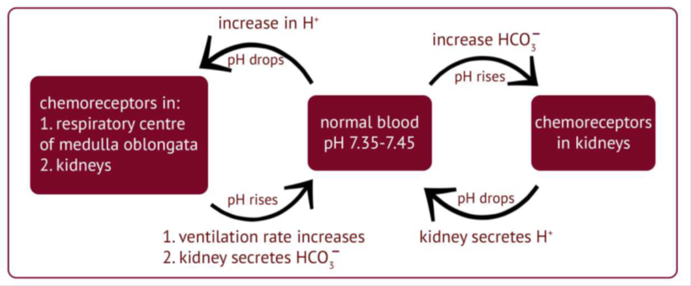

Slide 17
•If the blood becomes too basic, the kidneys excrete bicarbonate in urine, leaving free H+ ions with no way to convert back to H2CO3 and subsequently lowering the pH .
•These processes are relatively slow, which make them more suited for routine management than reaction to sudden changes

Slide 18
Blood buffer system –lungs
•In terms of fast-acting responses to pH change, the lungs are much more effective.
•It is common knowledge that we inhale oxygen (O2) and exhale carbon dioxide (CO2). This is because our cells use O2 as fuel for cellular respiration, a metabolic process which provides energy.
•CO2 is a slightly acidic waste product of this process. It enters the bloodstream to be transported to the lungs and exhaled.
•The brain controls the rate of ventilation, or breathing. By controlling the amount and rate of CO2 exhalation, the brain and lungs help prevent its build up

Slide 19
Change in pH while exercise
•Examine the body’s responses to pH changes due to exercise.
•When we exercise, our bodies require more energy than normal, so metabolism must work overtime

Slide 20
The increased demand for O2 for cellular respiration can be difficult to meet, which is why we inhale and exhale more frequently. This results in a much larger amount of waste CO2.
•If exercise becomes especially strenuous, oxygen deprivation may cause muscle cells to switch from aerobic (requiring oxygen) respiration to anaerobic fermentation, which produces lactic acid.
•These factors temporarily lower blood pH, and this is where the second reaction from above (H2CO3 ⇌H2O + CO2) becomes relevant.

Slide 21
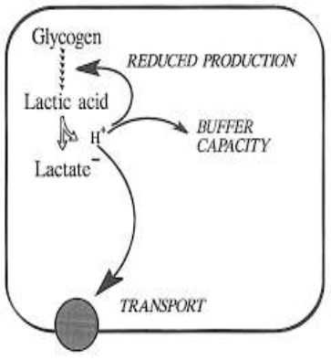
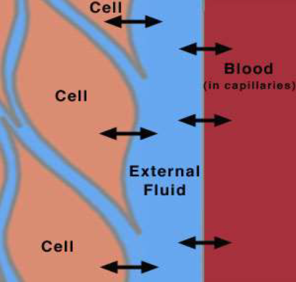

Slide 22
The excess CO2 will cause an imbalance in the reaction’s equilibrium, leading to above average production of carbonic acid (which will then produce more H+ ions due to the first reaction) until equilibrium is re-established.
•The buffer system will combat as much acidity as possible, but if the acidity exceeds this system’s capacity, it will be removed over time by the lungs (exhalation of excess CO2) and the kidneys (excretion of H+). •Lactic acid is broken down later, its components used in metabolic processes

Slide 23
Bicarbonate buffer system
•Removes CO2 from blood –increases pH
•Removes HCO3 from blood –lowers pH

Slide 24
