Slide 1
Chemical analysis of urine
Msc . Samah Sajad Kadhim

Slide 2
B-Chemical analysis of urine
The chemical analysis of urine under taken to evaluate the levels of the following component:-
* Urobilinogen
* Glucose
* Bilirubin
* Ketones
* Blood
* Protein

Slide 3
B-Chemical analysis
* The presence of normal and abnormal chemical elements in the urine are detected using dry reagent strips called dipsticks
* When the tests trip is dipped in urine the reagents are activated and a chemical reaction occurs.
* The chemical reaction results in a specific color change .
After 60 seconds ,this color change is compared against are ference color chart.

Slide 4
Determination of Urinary Sugar (Glucose):
* Glucose is the sugar most commonly found in the urine, although other sugars , such as lactose, fructose , galactose , and pentose, may be found under certain condition. Normally, urine does not contain a sufficient amount of sugar to react with any of the popular enzyme or reducing tests. Causes of Glycosuria • Physiological • Pathological

Slide 5
Physiological : Sometimes under physiological situations, glycosuria can occur a. After large ingestion of carbohydrates b. Anything that stimulates sympathetic nervous system such as excitement, stress etc. c. 15 to 20% cases of pregnancy may be associated with physiological glycosuria. d. Renal Glycosuria: In some persons, glycosuria is found when blood glucose is in normal range. This is known as renal glycosuria. This is again due to lowered renal threshold. Usually this is a benign condition.

Slide 6
Pathological : A. Diabetes mellitus * The most common condition for glycosuria is diabetes mellitus, a metabolic disorder due to deficiencies of insulin. *Glucose is not properly metabolized and blood glucose concentration rises, and when it is in range of 170 - 180 mg /dl , glucose starts appearing in urine.

Slide 7
B. Glycosuria due to other endocrine disorders Deranged function of a number of endocrine disorders can cause hyperglycemia and this may result in glycosuria, e.g. - Hyperthyroidism - Hyperadrenalis
- Hyperpitutarism - Some diseases of pancreas

Slide 8
Dipstick chemical analysis
* Urine dipstick is a narrow plastic strip which has several squares of different colors attached to it.
* Each small square represents a component of the test used to interpret urinalysis.
* Colors generated by each pad are visually compared against a range of colors on brand-specific color charts

Slide 9
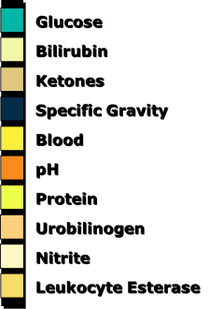
The entire strip is dipped in the urine sample and color changes in each square are noted.

Slide 10
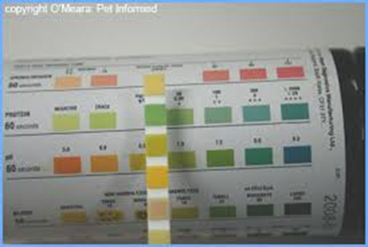

Slide 11
* Nitrite (suggestive of bacteria in urine)
* Bilirubin ( possible liver disease or red blood cell break down) * Urobilinogen ( possible liver disease)

Slide 12
Thank you

