Slide 1
Al-Mustaqbal University College
Computer basics
:By
Buthania Al-khafaji
Lecture 1
2021-2020

Slide 2
Supercomputers
are used to process very large amounts of information including processing information to predict hurricanes ,….
Mainframes
are used by government and businesses to process very large amounts of information.
Mini-Computers
Personal Computers (PC)
They are used in homes, schools, and small businesses.

Slide 3
Introduction
A computer : is a complex system consisting of both hardware and software components.
When talking about computer systems,
hardware: means the physical parts of the computer (electronic and mechanical parts), software: means the programs and data used with the physical computer.

Slide 4
The major hardware components of a computer system are:
Processor
Main memory
Secondary storage
Input devices
Output devices
Hardware is basically anything that you can touch with your fingers.

Slide 5
Input Devices
Input basically means getting data into the
computer to be processed.
Keyboard, Mouse, Trackball,
Touch Pad ,Light Pen,
Laser Scanner, Pointing
Stick ,Touch Screen,
Bar Code Reader, Scanner,
Microphone, Joystick

Slide 6
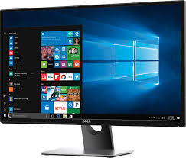
Output Devices
Output means getting data out of the computer.
Monitor
Printer
Speakers
Headphones
Modem
Fax

Slide 7
Storage Devices
Storage devices are both input and output devices in one.
A storage device is a place to keep data that has been processed so that it can be retrieved at a later time to be used again.
Hard Disk
Floppy Disk
CD’s, DVD’s
Magnetic Tape
Flash Memory, Jump Drive

Slide 8
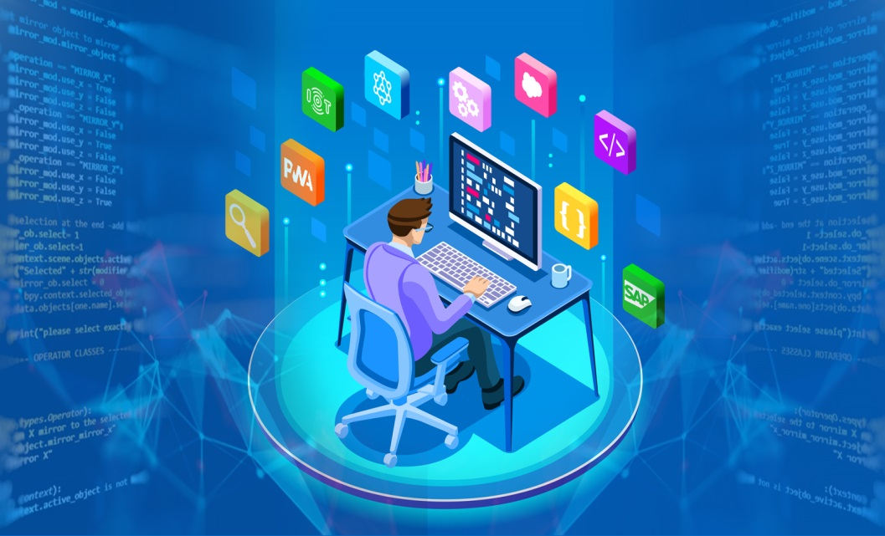
Software
Software: is the programs and applications that tell the computer what to do and how to look.
-Computer programmers write the codes/instructions that make-up software applications/programs.

Slide 9
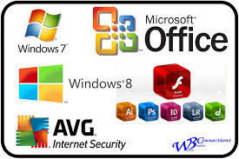
Two Types of Software
Application Software
Operating System Software

Slide 10
Operating System Software
Directs all the activities and sets all the rules for how the hardware and software will work together.
Examples would be:
DOS, Windows 95, 98, NT, XP, Vista, Windows 7
Unix, Linux,
MAC system OS 6,7,8,9,10

Slide 11
Application Software
Programs that work with operating system software to help the computer to do specific types work.
Business software
Communication software
Graphics software
Education software
Integrated software

Slide 12
Any question…..?

