Slide 1
The Complement System
Lec. 7
Dr. Mustafa Jawad

Slide 2
Introduction
The complement system refers to an extremely complex group of proteins present in normal human and animal serum.
It is an integral part of the body's immune system that has ability to:
Lyse red blood cells (hemolytic activity)
Destroy Gram-negative bacteria (bacteriolytic activity)
Kill Gram-positive bacteria without lysis (bactericidal activity)
Inactivate viruses (virus neutralization)
Damage tumor cells
Ag-Ab complexes absorb it nonspecifically and mediate a number of immunological and biological activities.
Paul Ehrlich named this lytic agent as complement as it complemented the action of antibody. Earlier it was known as Alexine.

Slide 3
The properties of complement
Complement is a glycoprotein-constituting approximately 5% to 10% of human serum proteins
Complement as a whole is heat labile.
It undergoes spontaneous denaturation slowly at room temperature and in 30 minutes at 56°C (inactivation)
It does not combine with Ag or Ab alone
• It is destroyed by trypsin

Slide 4
The components of complements
Electrophoretic separation shows nine distinct proteins, C 1 to C9
• C1-heat labile, forms the main bulk of the complement. It is made up of three protein subunits, viz. C1q, C1r and C1s bound together by one molecule of calcium
• C2-heat labile component
• C3-heat stable component, a relatively larger protein which has the ability to combine with yeast cell wall (Zymosan)
• C4-heat stable, susceptible to ammonia and hydrazine
• C5 to C9- These are the terminal components of membrane attack pathway required for the final show of immune cytolysis

Slide 5
The complement activation
• Complement is normally present in an inactive form
• It is activated sequentially in an enzyme cascade manner by:
Ag-Ab complexes (classical pathway)
Other stimuli such as bacterial endotoxin, Aggregated immunoglobulins, cobra venom factor, nephritic factor, initiate (alternate pathway)
Mannose-binding lectin (MBL) is an acute phase protein, which binds mannose, found on microbial surface (e.g. Salmonella species). MBL level can rise rapidly in response to infection and interact with MBL-activated serum protease (MASP). Activation of MASP leads to subsequent activation of components C2, C4 and C3 (Mannan-binding Lectin Pathway)
The initial steps are different in different pathways, the final steps that lead to a membrane attack which produce damage to target cell or lysis causing cell death are same in both pathways

Slide 6
The Classical Pathway
• This pathway involves operation of all nine components (C1 to C9) acting in sequence
It begins with the activation of Cl q (first component) initiated by binding with CH2 domain on the Fc portion of Ab forming complex with Ag
• Fc structures are different in different immunoglobulins and only IgG and IgM possess complement-binding sites
When the C 1q is activated, it acquires the ability to activate several molecules of the next component in a series.
Each of these then acts on next component and so on, producing a cascade effect leading to immune cytolysis

Slide 7
The activation of classical pathway
The activation of complement starts when IgM or IgG combines with the surface membrane of the cell in the presence of complement
• C1q then binds to Fc portion of lg molecule and activates C1r, which is a protease that subsequently cleaves C 1 s and forms an enzymatically active component C 1s esterase
The activated C1s acts on the next component-C4 splitting it into C4a and C4b.
The C4a has anaphylatoxin activity while C4b, which has an active site, binds to cell membrane along with C1
The next component C2 with the help of Mg2+ ions binds to the cell bound C4b and is cleaved into C2a and C2b
C2b is released into fluid medium while C2a binds to the C4b forming C4b2a protease enzyme, which has 'C3 convertase' activity, which cleaves C3 into C3a and C3b

Slide 8
Continue…
C3a released into the fluid medium possesses anaphylatoxin activity and is chemotactic for polymorphonuclear leucocytes and C3b joins the cascade and binds to the surface of the target cell along with C4b2a forming a trimolecular complex C4b2a3b, which has C5 convertase activity " C3b fragments not joining the cascade are scattered over the cell membrane, participate in immune adherence and increase susceptibility to phagocytosis (opsonization)
C5 convertase acts on C5, splits it into C5a and C5b. C5a has anaphylatoxin and chemotactic activity and larger fragment C5b joins the cascade and binds to C6 and C7 forming a trimolecular complex C5b67 which binds to the cell membrane of target cell and prepares it for lysis by C5 and C9
The addition of C5 and C9 accelerates membrane damage and lysis of the cell
• The mechanism of lysis is by punching holes approximately 100 A in diameter on the cell membrane which disrupts the osmotic integrity of the membrane leading to release of the cell contents
• The complex CSb67 also renders unsensitized 'bystander' cells susceptible to lysis by C5 andC9.
The complex also has chemotactic and leucocyte activating properties

Slide 11
The alternate pathway
In classical pathway the C3 activated by C142
In alternate pathway the C3 activated without C1,4,2
Pillemer in 1954 describe the alternate pathway
He demonstrate Mg and properdin and zymosan forms P-Z complex which activate C3 directly

Slide 12
The components of alternate pathway
Properdin (P): glycoprotein normally present in serum, requires Mg2+ ions and other factors for activation of C3
Factor-B: thermolabile normal serum protein, it is C3 proactivator (C3PA) also known as glycine rich betaglobulin (GBG)
Factor-D: C3 proactivator convertase (C3 pase, GBGase), it acts on C3b and factor-B forming convertase, which breaks down the C3
C3b: normally present in serum in trace amount

Slide 13
Activation of C3 in alternate pathway
The factor-B binds to C3b that forms a magnesium dependent C3bB complex, which is cleaved by factor-D into C3bBb and Ba
C3bBb complex has C3 convertase activity but it is extremely labile and looses its activity; but by binding with properdin it forms PC3bBb complex and becomes stable PC3bBb acts on C3 cleaving it into C3a and Disease Research Laboratory activating C6, C7, C8, C9
The steps are same as in classical pathway

Slide 14
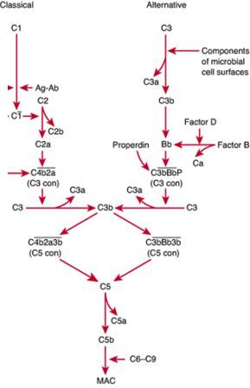

Slide 15
The biological functions of complement
Neutralization of viruses
Chemotaxis: for polymorphonuclear leucocytes and enhance phagocytosis
Bactericidal activity: increase the lysis of lysozyme
Immune adherence: increase phagocytosis
Opsonization: enhance phagocytosis
Anticancer activity: cause death to tumor cell
Anaphylatoxin activity: release histamine from mast cells
Tissue destruction: in autoimmune diseases and hypersensitivity
Haemolysis: of RBCs by classical pathway

Slide 16
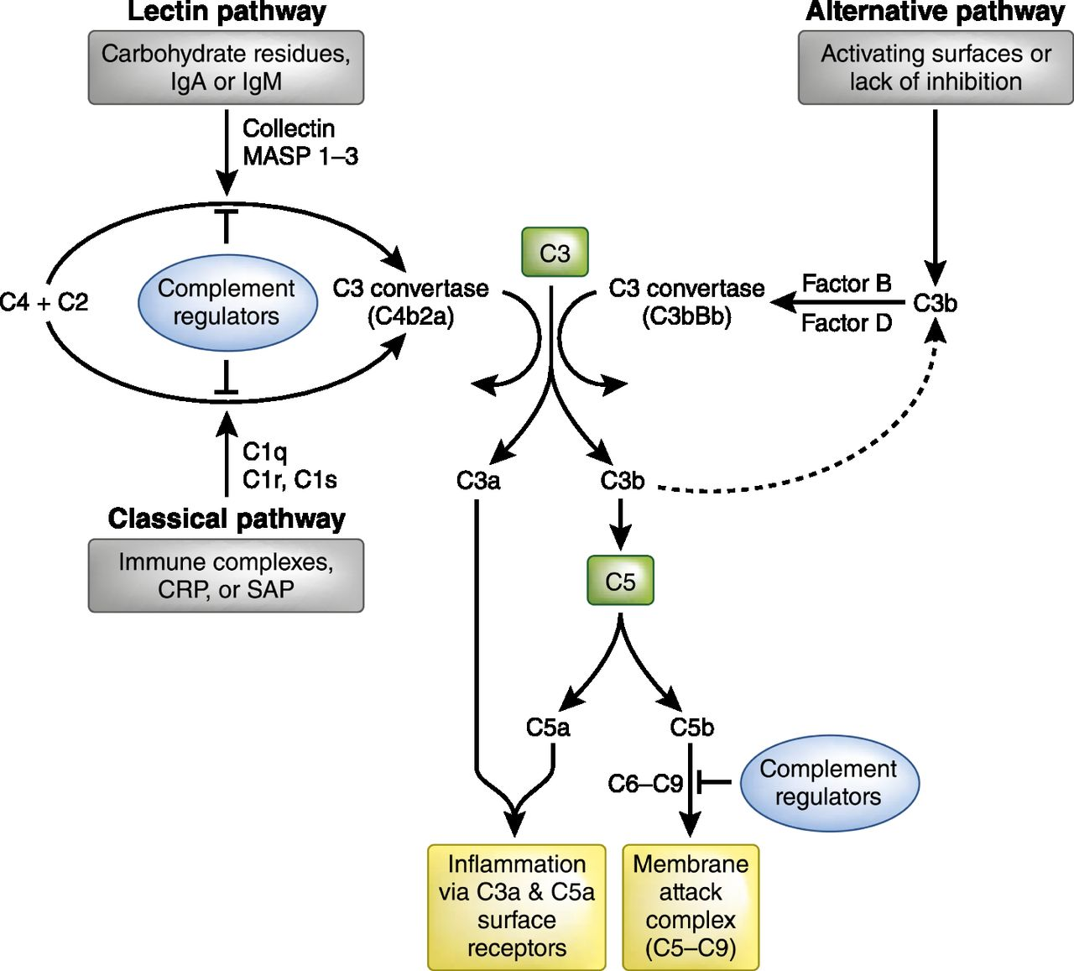

Slide 17
Thank you

