Slide 1
Structure and Functions of
Immune System
(organs)
Dr. Mustafa Jawad

Slide 2
Introduction
The immune system comprises a variety of organs which are concerned with growth and development of immunocompetent cells. These are lymphoid and reticuloendothelial systems
Lymphocytes are the major immunological effector cells. They arise from precursors or stem cells, which originate in fetal life in the yolk sac and are found subsequently in the liver and bone marrow.
They are further differentiated in two different directions. Some of them migrate to
thymus and get differentiated into thymus derived or T lymphocytes, which play an important role in cell- mediated immunity. Other stem cells are processed in the bone marrow or the bursa of Fabricius (in chicken) and get differentiated into B lymphocytes, which play an important role in humoral or antibody-mediated immunity.
Both T and B cells, after maturation, migrate to spleen, lymph nodes and other organs where they initiate and participate in immune response to antigens.

Slide 4
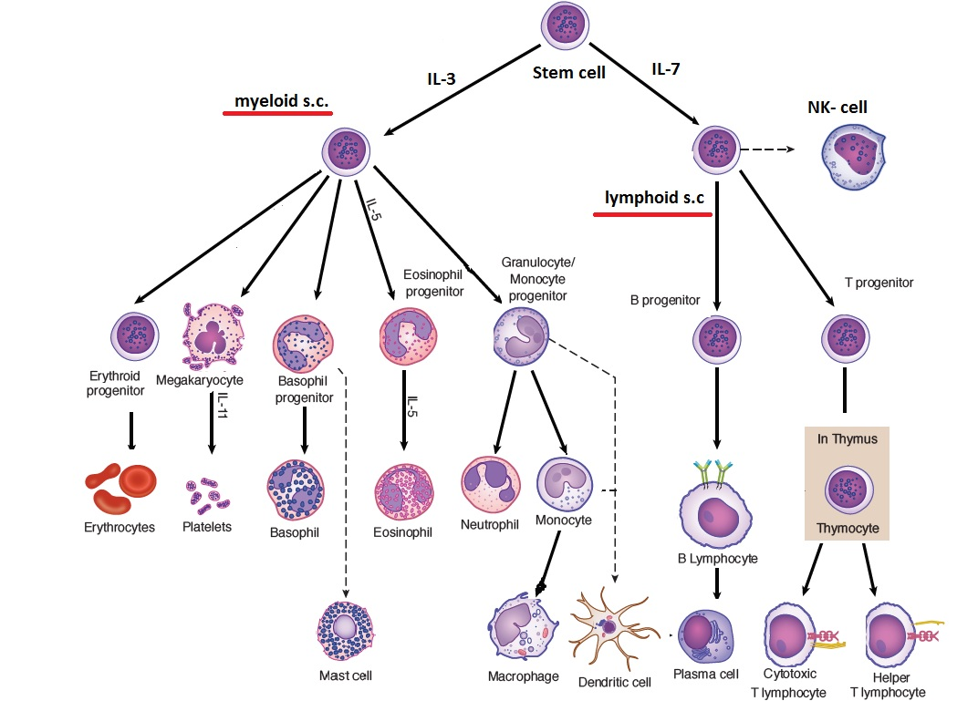

Slide 5
The organs of immune system
Primary lymphoid organs (Central Lymphoid organs) are those organs T lymphocytes and B lymphocytes mature and acquire their antigen specific receptors. Thymus and Bone marrow is the main lymphoid organ where all blood cells including lymphocytes are formed.
Thymus is the site of T lymphocyte maturation and bone marrow is the site of B lymphocytes maturation and are responsible for cellular and humoral immune response respectively.
Secondary Lymphoid organs (Peripheral Lymphoid organs) are lymphnodes, spleen, tonsils, Peyer's patches of the small intestine, appendix and mucousal associated lymphoid tissue (MALT).
After the maturation, B lymphocytes and T lymphocytes migrate via blood vascular system and lymphatic system to the secondary lymphoid organs where they undergo proliferation and differentiation.

Slide 6
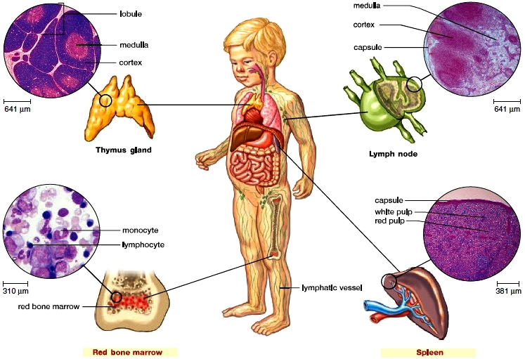

Slide 7
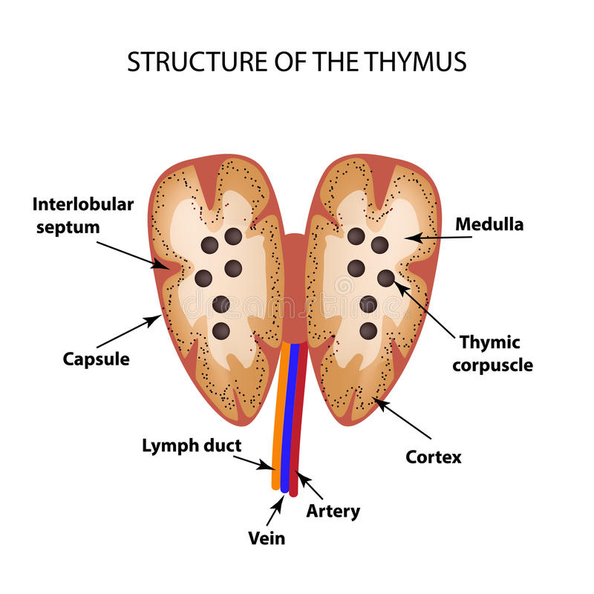
Structure of Thymus gland
The soft, bilobed thymus gland is located in the thoracic cavity between the trachea and the sternum superior to the heart.
The thymus varies in size, but it is largest in children and shrinks as we get older. Connective tissue divides the thymus into lobules, which are filled with lymphocytes.
It is capsulated. The septa arising from the capsule divide the gland into lobules, which are differentiated into an outer cortex and inner medulla
Immature T lymphocytes migrate from the bone marrow through the bloodstream to the thymus, where they mature. Only about 5% of these cells ever leave the thymus. These T lymphocytes have survived a critical test: If any show the ability to react with “self” cells, they die. If they have potential to attack a foreign cell, they leave the thymus.

Slide 8
Functions of Thymus
• It is a major site for lymphocyte proliferation and production of T lymphocytes
It is the center for development and function of the immune system; however, it does not participate in immune reaction
In thymus, lymphocytes acquire new surface antigens (Thy antigens)
The thymus confers immunological competence on the lymphocyte. In the thymus, prethymic lymphocytes are educated by hormone-like humoral factors-thymosin, thymopoietin, etc. produced by thymic epithelial cells, so that they become capable of mounting cellmediated immune response ( CMI)
The thymus gland produces thymic hormones, such as thymosin, that are thought to aid in the maturation of T lymphocytes

Slide 9
Red Bone Marrow structure and function
Red bone marrow is the site of stem cells that are ever capable of dividing and producing blood cells. Some of these cells become the various types of white blood cells: neutrophils, eosinophils, basophils, lymphocytes, and monocytes.
In a child, most bones have red bone marrow, but in an adult it is limited to the sternum, vertebrae, ribs, part of the pelvic girdle, and the proximal heads of the humerus and femur.
The red bone marrow consists of a network of reticular tissue fibers, which support the stem cells and their progeny. They are packed around thin-walled sinuses filled with venous blood. Differentiated blood cells enter the bloodstream at these sinuses.
Bone marrow is not only the source of B lymphocytes, but also the place where B lymphocytes mature.

Slide 10
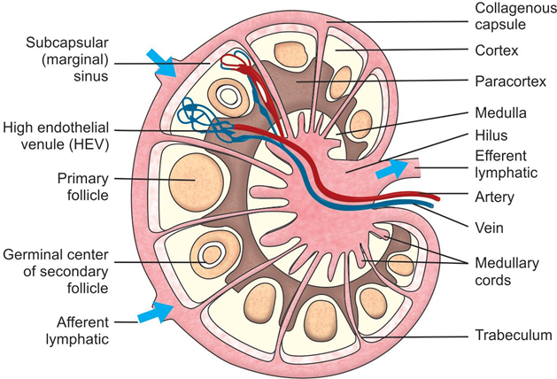
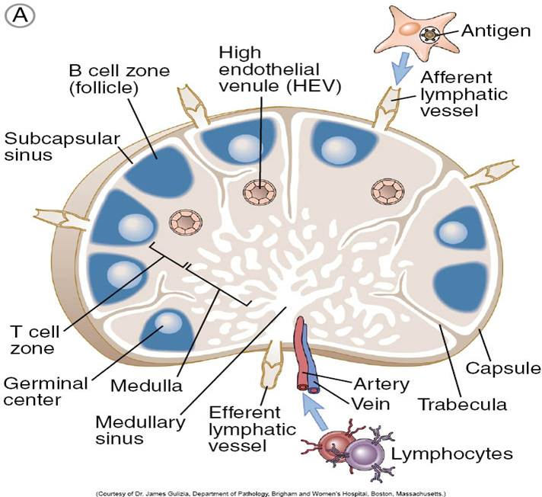
Lymph Nodes
Human lymph are round or kidney-shaped has an indentation called hilus through which blood vessels enter and leave.
Lymph node is surrounded by a fibrous capsule from which trabeculae penetrate into the node.
The lymph node consists of a B cell area (cortex), a T cell area (paracortex) and a central medulla, which has cellular cords that has T cells, B cells, plasma cells and abundant macrophages.
The paracortex contains many APCs, which expresses high levels of MHC class II surface antigens.
The accumulation of lymphocytes in the cortical area is known as primary follicle. Following antigenic stimulation, germinal center appears, which is known as secondary follicle.
Lymph nodes act as a filter from the lymph from foreign antigen, provide a site for phagocytosis and antibody production, each group of nodes draining a specific part of the body, and help in proliferation and circulation of T and B cells. The lymph nodes enlarge following antigenic stimulation.

Slide 11
Spleen
The spleen, the largest lymphatic organ, is located in the upper left region of the abdominal cavity posterior to the stomach.
Connective tissue divides the spleen into partial compartments, each of which contains tissue known as white pulp and red pulp.
The white pulp contains a concentration of lymphocytes in Malpighian corpuscles
The red pulp, which surrounds venous sinuses, is involved in filtering the blood. Blood entering the spleen must pass through the sinuses before exiting.
Spleen function as : systemic filter for blood borne particles, and major site for Ab synthesis against blood borne particles

Slide 12
Mucosa Associated Lymphoid Tissue (MALT)
Lymphocytes producing IgA are present throughout the mucosal lining of alimentary, respiratory, genitourinary and other surfaces as isolated cells or small cell clusters, are called the MALT
Such lymphoid tissues of the gut are known as gut associated lymphoid tissue (GALT) and those in the respiratory tract are called the bronchus associated lymphoid tissue (BALT)
The main GALT structures fa humans are:
Tonsils (lingual, palatine and pharyngeal)
Appendix ( at the junction of small and large intestines)
Peyer's patches of the intestine
Lamina propria of the intestine
The MALT structure contains mixture of B cells, T cells as well as phagocytic cells Secretory IgA is the main immunoglobulin produced by MALT. IgG, IgM and IgE are also produced locally Functions of MALT

