Slide 1
Structure and function of immune system (cells)
Dr. Mustafa Jawad

Slide 2
Cells of immune system
1. Functional cells
a. Lymphocytes.
b. Plasma cells.
c. Phagocytic cells.
 Macrophages
 Neutrophils
 Eosinophils
 Dendritic cells.
2. Structural cells.
a. Reticulum cells.
b. Endothelial cells.
c. Fibroblasts.

Slide 3
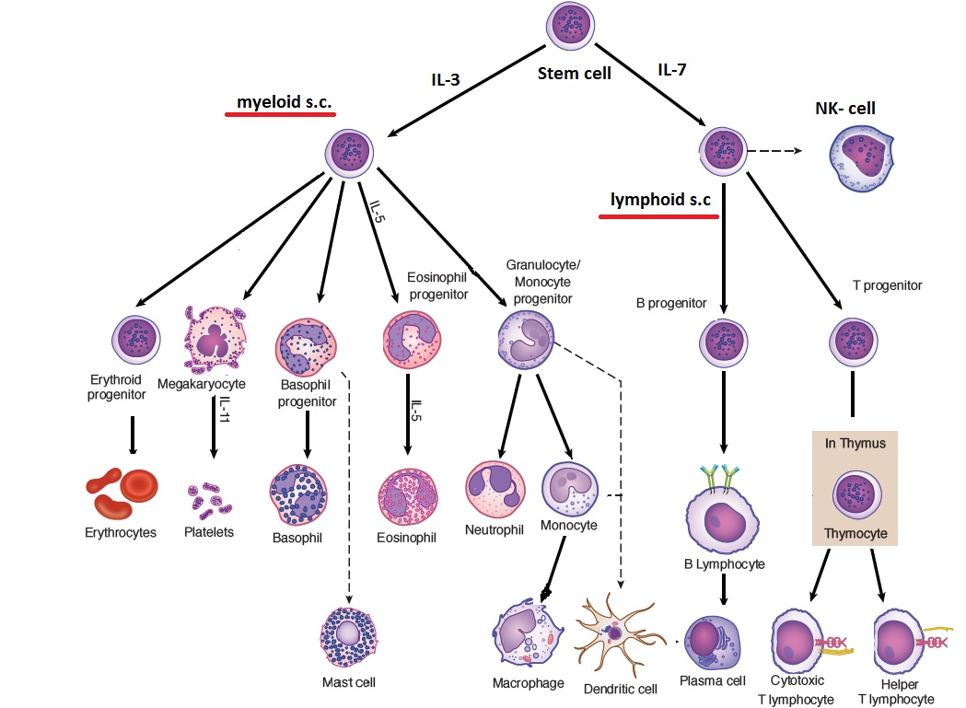

Slide 4
Lymphocytes
These are small, round cells5 to 12 µm in diameter with a spherical nucleus with a thin rim of cytoplasm
found in peripheral blood, lymph, lymphoid organs and many other tissues
In peripheral blood, they constitute 20-45% of the total leucocyte population and are predominant cell type in lymph and lymphoid organs
Several different types of lymphocytes can be distinguished on the basis of their functional properties and by specific surface markers they express.
The most fundamental distinction is the division of these cells into two major lineages known as T (thymus derived) cells and B (bone marrow derived) cells.
The relative proportions of T and B cells vary in tissue to tissue, but in peripheral blood they constitute 75% and 15% respectively. The remaining 10 percent are a special class of granular lymphocytes known as natural killer (NK) cells.

Slide 5
Structure and function of Lymphocytes
Three types of lymphocytes occurs small, medium and large
• The small lymphocytes are necessary for immune response
The properties of small lymphocytes are:
- Size: 5-8 μ in diameter
- Shape: Round
- Nucleus: Spherical with prominent nuclear chromatin
- Cytoplasm: A thin rim of cytoplasm
- Motility: Slowly motile.
Function:
Recognition of Ag and storage of immunological memory
Immune response to specific Ag and resistance to certain infections
Transplantation and tumor immunity
Hypersensitivity

Slide 6
T lymphocyte
T cells originate from precursor cells from bone marrow and migrate to the thymus and mature there to differentiate many different subsets are:
T - helper (CD4) Cells (Th)
• Constitute 55- 70% of the total T cells
• Two subsets Th1 and Th2. Th2 are the principal helper cells Interact with B cell, promote proliferation of B cells and enhance Ab synthesis
They also enhance activation of macrophages and differentiation of cytotoxic T cells
T- suppressor (CD8) Cells (Ts)
Constitute 25-40% of circulating T lymphocytes
They block antibody production by acting on Th cells or by acting directly on B cells by secreting suppressor substances
T- regulator Cells (Tr)or T-reg
T-reg cells are the regulator cells, which regulate the activity of Th and Ts cells

Slide 7
Continue ….
Cytotoxic (Tc) T cells (CD8 Cells)
These cells are responsible for killing of specific target cells whose surface antigens can be recognized by them, e.g. virally infected host cells, tumor cells and allogenic graft cells in transplanted tissues
They possess membrane glycoprotein-CD8 receptors on their surface
They cause destruction of target cells by releasing lymphotoxins and perforin
Delayed Hypersensitivity (DTH) T Cells (TD Cells)
Responsible for delayed type of hypersensitivity reactions
They are indistinguishable from Th-cells on the basis of surface markers
They possess CD4 markers
They secrete different lymphokines, which are responsible for inflammatory response of delayed hypersensitivity and growth factors, which are believed to regulate lymphocyte activity

Slide 8
B lymphocytes
B cells originate from precursor cells of the bone marrow. During the maturation process, the pre- B cell is programmed to produce only one class or subclass of lg after a switch from initial IgM production. On the basis of immunoglobulin which is programmed to synthesize, B lymphocytes can be subdivided into different subsets-IgM, IgG, IgA, IgD and IgE.
Activation of B cells
lg present on the surface of B cell acts as the specific receptor for Ag. When Ag enters into the body, it reacts with B cell with appropriate specificity. This interaction stimulates B cell to undergo blast transformation and convert it into plasma cell.
Each B cell possesses information to produce Ab of unique Ag specificity as a membrane receptor. Once the signal is received, B cells are differentiated into plasma cells, which produce and secrete Abs.

Slide 9
Plasma Cells
Plasma cells are the effector cells of the B lineage, are uniquely specialized to secrete large amount of Ig proteins referred to as antibodies.
Plasma cells are oval or egg-shaped and have abundant cytoplasm and eccentrically placed round nuclei. The cytoplasm contains abundant rough endoplasmic reticulum and a well-developed Golgi apparatus.
Plasma cells have relatively short span of life and are terminally differentiated.
function of Plasma cell is an antibody-producing machinery. It can produce an Ab of a single specificity IgM,IgG, IgA, IgD or IgE.
The main functions of the ‘B’ cells are involvement in the following:
1. Humoral acquired immunity.
2. Antigen processing and presenting.
3. Production of an array of cytokines and other factors that influence the growth and activity of other immunologically important cells.

Slide 10
Natural Killer Cells (NK Cells)
They are so called because they are found in normal animal
They have twice the size of small lymphocytes. They are present naturally and are not formed in response to Ag
They can kill a variety of transformed cells, virally infected host cells and are also involved in allograft rejection
NK cells are present in the spleen and peripheral blood
They do not require Ab and their action is nonspecific. Their activity is increased by interferon and IL- 2
The lysis of cell is because of release of several cytolytic factors which include:
Perforins-resemble complement component C9, cause transmembrane pores through which the cytotoxic factors such as TNF enter the cell and destroy it by apoptosis (programmed cell death)
Lymphotoxin (LT)
Tumour necrosis factor (TNF)
Natural killer cytotoxic factor (NKCF)

Slide 11
dendritic cells
These are the Ag presenting cells (APC)
They are derived from bone marrow and are different from the macrophages and T and B lymphocytes
They have little or no phagocytic activity
They are highly pleomorphic
They are present in peripheral blood and in the peripheral lymphoid organs, especially in the germinal centers of the spleen and lymph nodes
They play an important role in the presentation of antigens to T cells during the primary immune response
Ag capture by the dendritic cells of the lymph node follicles occurs in the presence of preexisting Ab

Slide 12
Macrophages
These are large round or oval cells with kidney or oval-shaped nucleus and abundant cytoplasm
The blood macrophages (monocytes) are 12-15 μ in size while tissue macrophages (histiocytes) are 15-20 μ in size
They are widely distributed throughout the body
They are produced from the stem cells in the bone marrow where they undergo proliferation and are delivered as monocytes in the bloodstream, after a period of maturation ( about 6 days)
The blood monocytes, after few days, migrate to various tissues where they differentiate into Macrophages
Monocytes in blood have half-life of three days while macrophages in tissue survive for months by proliferating locally

Slide 13
Microphages
• These are small non-dividing polymorphonuclear leucocytes or granulocytes present in blood
• Three types-neutrophils (45-60%), eosinophils (1-3%) and basophils (0.3%)
The neutrophils, and to a lesser extent the eosinophils, are phagocytic
They contain granules and a wide range of bactericidal substances
They originate in the bone marrow from stem cells, undergo maturation and finally released into the circulation
They are short-lived cells with half-life of 2 days in circulation and few hours in tissue after penetration
They engulf and digest of foreign particles by phagocytosis.

Slide 14
phagocytosis
Definition :Engulfment and digestion of foreign particles by a single cell is known as phagocytosis. It is the most important means of nonspecific defense mechanism against microorganisms.
Functions of phagocytic cells are:
The primary role is the phagocytosis-engulfment and digestion of foreign particles
Also participate in the development of specific immune response, e.g. trapping of Ag by macrophages and its presentation to lymphocytes in optimal concentration
Macrophages also participate in antitumor activity and graft rejection
Microphages participate in inflammation, opsonization, hypersensitivity reactions and immunity against parasitic infections

Slide 15
the process of phagocytosis
1 . Chemotaxis:
The entry of Microorganisms Ag react with Ab causes release of chemotactic substances derived from the complement system such as chemotactic factors (C3a, C5), which attract microphages
2. Adherence (Attachment)
The phagocytic cell attaches to the infective agent through specific receptors.
3. Ingestion and Digestion
Once the contact is made with a foreign particle, engulfment starts with a deep invagination of the cell membrane, which fuses to form a pouch called phagosome.
Phagosome is transported deep into cytoplasm where it fuses with lysosome to form phagolysosome, The lysosome ruptures and releases its enzymatic contents, which come in contact with the ingested particle. A battery of mechanisms slaughters the ingested particle. Lysosome contains a variety of hydrolytic enzymes

Slide 16
