Slide 1
Structure and function of immune system (proteins)
Dr. Mustafa Jawad

Slide 2
Introduction
The proteins of immune system include : structural proteins, soluble proteins
Structural proteins include: surface proteins such as MHC system (HLA), cytokine receptors, surface antibodies
Soluble proteins include: antibodies, complements, cytokines, lymphokine, monokine
The cytokine include:
1- cytokine affecting lymphocytes
2- cytokine affecting macrophage
3- Cytotoxic cytokine

Slide 3
Cytokines
Cytokines are soluble mediators, glycoprotein in nature, produced by and act on various immune and non immune cells.
They are the intercellular messengers not only regulate immune and inflammatory response, but also wound healing, hematopoiesis, angiogenesis and many other biological processes.
Cytokines exhibit the following properties:
Pleiotropy: has different biological effects on different target cells
Redundancy: two or more cytokines mediate similar function
Synergy: combined effect of two cytokines is greater than the effect of individual cytokine
Antagonism: the effect of one cytokine is inhibited by another cytokine
Cascade induction: action of cytokine on the target cell induces production of cytokines, which in turn may induce other target cells to produce other cytokines

Slide 4
Interleukin-1 (IL-1)
It was previously known as endogenous pyrogen (producing fever), lymphocyte-activating factor (LAF).
IL-1 is produced by many cells such as macrophages, endothelial cells, B cells, fibroblast, but macrophages produce IL-1 abundantly.
It stimulates T and B cells and induces inflammatory responses.
IL-1 together with TNF goes to brain, where they induces fever and act to increase corticosteroid release.
In the liver, it induces production of acute phase proteins.
It mediates a wide range of metabolic, physiological inflammatory and hematological effects by acting on bone marrow, epithelial cells, fibroblasts, osteoclasts, hepatic cells, etc.
Virtually, all cells of the body have receptors for IL-1 and can respond to it

Slide 5
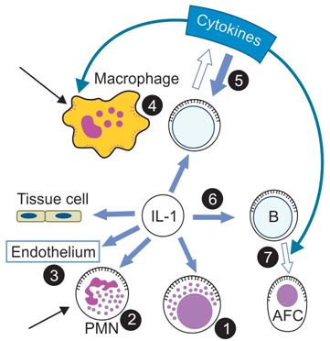
Interleukin-1
IL-1 produced by many cell types in response to damage, infection or antigens.
1- It influences many cells and processes.
2- NK cell-cytocidal activity increases;
3- Polymorphonuclear neutrophils (PMNs) are metabolically activated and move towards the site of IL-1 production by chemotaxis (black arrow);
4- In the endothelium, adhesion molecules and procoagulants are induced and permeability is increased;
5- Prostaglandin production and cytocidal activity increase in macrophages.
Chemotaxis is also stimulated (black arrow);
6- Th cell proliferation, IL-2 receptor expression and cytokine production are all enhanced;
7- B cell proliferation and differentiation into antibody-forming cells (AFCs) is stimulated and regulated By other cytokines

Slide 6
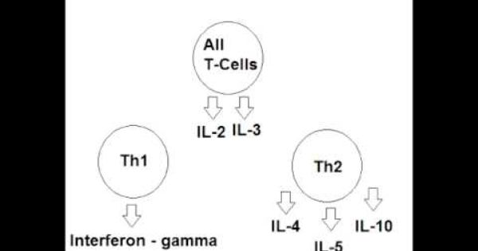
Interleukin-2 (IL-2), Interleukin-3 (IL-3)
Interleukin-2 (IL-2): Previously, it was known as
T-cell growth factor (TCGF).
IL-2 is chiefly produced by Th 1 cell of CD4+ series and also by CD8+ cells.
It has action on restricted range of cells, chiefly on T cells.
It also acts on NK cells and B cells.
It transforms some null cells—large granular lymphocytes (LGL) to lymphokine activated killer cells (LAK cells), which can kill cancer cells.
Interleukin-3 (IL-3):
It is a growth factor for bone marrow stem cells produced by T-cells
It is called multi-colony stimulating factor (CSF), as it stimulates the growth of precursors of all the hematopoietic lineage cells.

Slide 7
Interleukin-4 (IL-4),(IL-5), (IL-6):
Interleukin-4 (IL-4):
Earlier it was called B cell- activator or differentiating factor. It is secreted by activated T cells (Th2). It acts on B cell to induce differentiation to produce IgG1 and IgE. It also acts on T cells as a growth and activation factor for Th2 differentiation. IL-4 is secreted by Th2 cells, mast cells and a subset of NK cells. IL-4 is now best known for the role it plays in allergic diseases by promoting IgE production.
Interleukin-5 (IL-5):
Originally, it was described as a B cell growth factor (BCGF) in mice, but functions mainly as an eosinophil growth and differentiation factor in humans. Th2 cells are the main source of IL-5.
Interleukin 6 (IL-6)
It is produced by stimulated T and B-cells, macrophages and fibroblasts
It promotes differentiation of B-cells into Ab-producing plasma cells and encourages IgG production
It acts as an inflammatory response mediator in host defense against infections

Slide 8
IL-7, IL-8, IL-9, IL-10, IL-11
lnterleukin-7 (IL-7)
• It is produced by the spleen, bone marrow stromal cells (BMSCs)
• It is B and T-cells growth factor
Interleukin-8 (IL-8)
• It is produced by macrophages and other cells
• It acts as neutrophil chemotactic factor
Interleukin-9 (IL-9)
• It is produced by T-cells
• It helps in cell growth and proliferation
Interleukin-10 (IL-10)
• It is produced by T and B-cells and macrophages
• It inhibits interferon production and functions of mononuclear cells
Interleukin-11 (IL-11)
• It is produced by bone marrow stromal cells
• It induces acute phase proteins

Slide 9
IL-12, IL-13, IL-17, IL-18, Transfer factor (TF)
Interleukin-12 (IL-12) It is produced by T-cells, It activates NK cells
lnterleukin-13 (IL-13): It is produced by T-cells, It inhibits functions of mononuclear cells
Interleukin-17 (IL-17): It is produced by activated memory T cells and binds to the receptors on many cells, particularly on cells of the spleen and kidney. IL-17 induces the target cells to express IL-6, IL-8 and granulocyte macrophage colony stimulating factor (GM- CSF). It stimulates neutrophil precursor cells.
Interleukin-18 (IL-18): It is produced by keratinocytes and macrophages. It is structurally related to IL-1. It potentiates IFN-γ and GM- CSF production by T, B and NK cell and promotes Th2 differentiation.
Transfer factor (TF)
It is an extract from specific antigen-sensitized lymphocytes that mediates passive transfer of CMI is known as transfer factor
It is useful in immunocompromised individuals to restore specific CMI, e.g. in T-cell deficiency Disseminated infections associated with deficient CMI ( tuberculosis, lepromatous leprosy, mucocutaneous candidiasis, etc.) Cancer-melanoma, sarcoma, etc.

Slide 10
Interferons (Antiviral Cytokines)
Interferon consists of a large family of secretory proteins that not only share antiviral activity, but also have the ability to inhibit the growth of cells and to modulate immune responses.
There are three classes of interferons: IFN-α, IFN-β and IFN-γ.
Both IFN-α and IFN-β are produced by leukocytes and fibroblasts respectively and have cell growth inhibition and antiviral property.
The IFN-γ is produced by activated T cells and NK cells. It is an immune modulator through weakly antiviral.
IFN-γ induces transformation of ordinary macrophage to activated macrophage, to deal better against the intracellular bacterial infection.
Further, it increases APC function by inducing MHC class II molecules.
Excessive production of IFN-γ can play a part in the induction of autoimmunity.

Slide 11
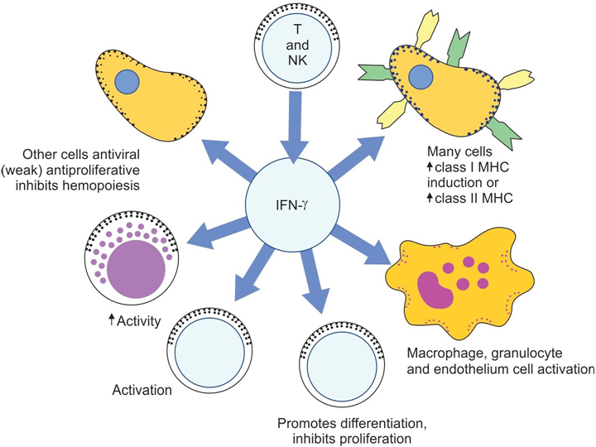
The properties of IFN-g are summarized in this figure

Slide 12
Biological functions of Cytokines
Cytokines are involved in a wide range of biological activities including innate immunity, adaptive immunity, inflammation, wound healing and hematopoiesis.
Presently, the number of proteins with cytokine activity exceeds 100. As the time passes, new ones are added to the list.
Unlike antibody, which acts specifically with its antigen, the cytokines act in an antigen non-specific manner.
That is they affect, whatever cells they encounter that bears appropriate receptors and are in a physiological state that allows them to respond.

Slide 13
NON interleukin cytokine
Major properties of human non-interleukin cytokines
Cytokine | Principal cell source | Principal effects
TNF-α* | Activated macrophages, other somatic cells | IL-1† like effects, vascular thrombosis and tumor necrosis.
TNF-β | Activated Th1 cells | IL-1 like and TNF-α like effects.
IFN-α‡ and β | Macrophage, neutrophils, etc. | Antiviral effect, induction of class I MHC§ on somatic cells, activation of macrophages and NK|| cells
IFN-γ | Activated Th1 and NK cells | Induction of class I MHC on all somatic cells; induction of class II MHC on APCs¶. Activation of macrophages neutrophils and NK cells; promotion of CMI** (inhibits Th2 cells); antiviral effect (weak)
CSF†† (G-CSF, M-CSF, GM-CSF§§, EPO||||, TPO¶¶, SCF***) | Monocytes, macrophages fibroblasts, T lymphocytes | These cytokines help the production of particular mature blood cell types from pluripotent stem cells
TGF†††-B | Activated T lymphocytes, platelets, macrophage, etc. | Anti-inflammation Antiproliferation of stem cell Wound healing by promoting fibroblast proliferation
LIF‡‡‡ | T cells | Proliferation of stem cell Eosinophil chemotaxis

Slide 14
Table 9.2 Major properties of human interleukins
Interleukin | Principal cell source | Principal effects
IL-1∗ | Macrophages, other APCs†, other somatic cells | Costimulation of APCs and T cells; B cell growth and Ig production acute phase response. Phagocytic activation, inflammation and fever; promotes hematopoiesis
IL-2 (TCGF)‡ | Activated T 1 cells NK§ h cells CTL||. Proliferation of activated T cells | Proliferation of activated T cells; apoptosis of T cells after prolonged or repeated activation; NK cell and CTL function; B cell proliferation and IgG2 expression
IL-3 (multi- CSF¶) | T lymphocytes | Growth of early hematopoietic progenitors. B cell proliferation, IgE
IL-4 | Th2 cells, mast cells | B cell proliferation, IgE expression, class II MHC∗∗ expression, Th2 cell and CTL proliferation and eosinophil and mast cell growth function Inhibit monokine production
IL-5 | Th2 cells, mast cells | Eosinophil growth and function
IL-6 | Activated Th2 cells, APCs, other somatic cells | Synergistic effect with IL-1 or TNF††, fever, acute phase response, B cell growth and Ig production, hematopoiesis
IL-7 | Thymic and marrow stromal cells | T and B lymphopoiesis; CTL functions
IL-8 | Macrophages, other somatic cells | Chemoattractants neutrophils and T cells
IL-9 | T cells | Hemopoietic and thymopoietic effects
IL-10 | Activated T 2, CD8‡‡ h T and B lymphocyte, macrophages | Inhibit cytokine production by Th1 cells, NK cells and APCs promote B cell proliferation and antibody responses. Suppresses cell-mediated immunity
IL-11 | Stromal cells | Synergistic effect on hemopoiesis and thrombopoiesis
IL-12 | B cells, macrophages | Proliferation and function of activated CTLs and NK cells; IFN§§-γ production. Promotes T 1 and suppress h Th2 functions; promotes CM9
IL-13 | Th2 cells | Similar to IL-4 effects
IL-15 | Epithelial cells and monocytes, non- lymphocytic cells | Mimic IL-2 T cell effect mast cell and NK activation
IL-16 | CD8 and some CD4 T lymphocytes | Chemoattractants CD4 T cells, eosinophils and monocytes
IL-17 | Activated memory T cells | Promotes T cell proliferation, neutrophil development
IL-18 | Macrophages, keratinocytes | Coinduces IFN-γ production, coactivates T 1 and NK h cell development

Slide 15
Homework
What is cytokine storm?
In bacterial shock
Toxic shock
Viral shock
COVID-19

