Slide 1
كلية المستقبل الجامعة / قسم تقنيات المختبرات الطبية المرحلة الثالثه / مادة التقنيات المختبرية الجزء العملي

Slide 2
Immunofluorescence Assay
Immunofluorescence
is an antigen-antibody reaction where the antibodies are tagged (labelled) with a fluorescent dye and the antigen-antibody complex is visualized using ultra-violet (fluoresceent) microscope
PRINCIPLE
Fluorescence and phosphorescence are both types of luminescence. • In fluorescence the emission of light occurs extremely rapidly after the absorption of excitation light. • phosphorescence emission continues for milliseconds to minutes after the energy source has been removed.
Fluorochromes are dyes that absorb ultra- violet rays and emit visible light. This process is called fluorescence. The fluorochromes commonly used in immunofluorescence are fluorescein isothiocyanate (green) and and tetramethyl rhodamine isothiocyanate (red).

Slide 3
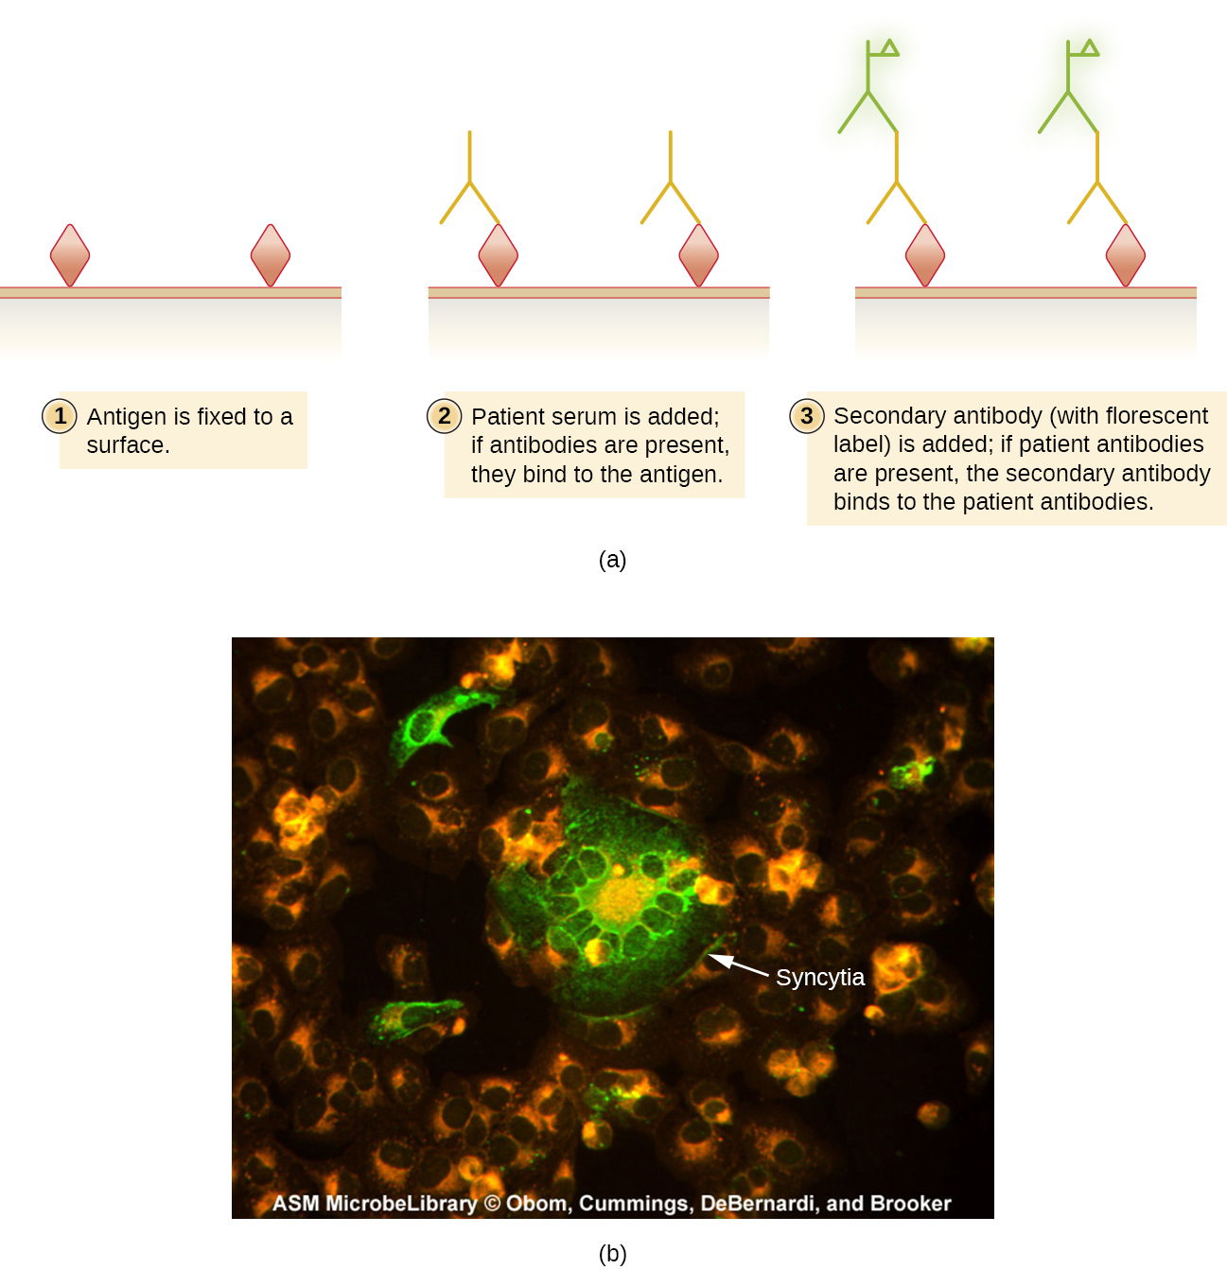
01
NEW SECTION

Slide 4
Types of immunofluorescence
Direct immunofluorescence: •
This is the one step histological staining process for identifying in vivo antibodies that are bound to tissues antigen. • This technique is used to detect antigen in clinical specimens using specific fluorochrome labeled antibody. The steps involved are: • Fixation of smear on the slide, treating with labeled antibody, incubation, washing to remove unbound excess labeled antibody and visualization under fluorescent microscope. When viewed under fluorescent microscope, the field is dark and areas with bound antibody fluorensce green.

Slide 5
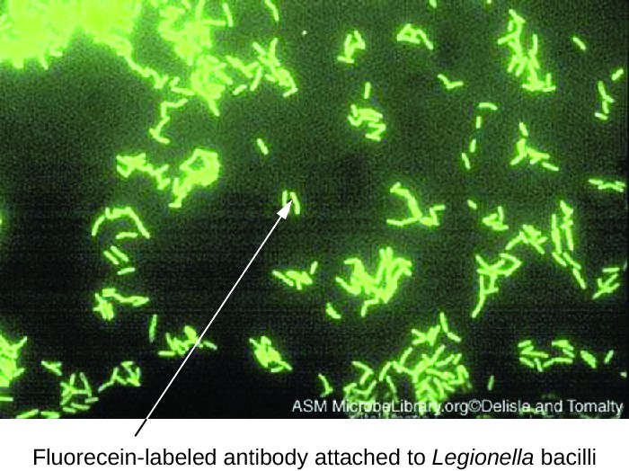

Slide 6
Uses of Direct immunoflourescence
-This technique can be used to detect viral, parasitic, tumor antigens from patient specimens or monolayer of cells.
-Another application is identification of anatomic distribution of an antigen within a tissue or within compartments of a cell.

Slide 7
Indirect Immunofluorescence •
It is considered as the Standard technique for the Detection of the Autoantibodies. • Indirect immunofluorescence is employed to detect antibodies in patient serum. The antigen on smear are made to react with specific unlabeled antibody (raised in mouse) and washed. The unbound antibody gets washed off. • The presence of specific mouse antibody bound to the antigen on smear is detected by adding another antibody. • The second antibody is labeled anti-gamma globulin (rabbit antibody against mouse antibody) antibodies. This antibody binds to Fc portion of first antibody and persists despite washing. • The presence of the second antibody is detecting by observing under fluorescent microscope.

Slide 10
Homework what the different between the ELISA assay & Immunoflorsence assay

Slide 11
THANKS!
Please keep this slide for attribution

