Slide 1
Al-Mustaqbal University College – Department of English A Webinar in English Conversation Speaking and Listening
Al-Mustaqbal University College Department of English
By
Asst. Lect. Hasan Imad Kadhim

Slide 2
The Objects
The students will be able to:
Improve their listening and speaking skills.
Learn how take their roles in daily English conversation, i.e. turn taking.
Manage the situation in a polite way.
Know how to manage things at the airport.
Learn new vocabularies.

Slide 3
The Outline
Review of the previous lecture.
Conversation “At the airport”
Talking to the clerk.

Slide 5
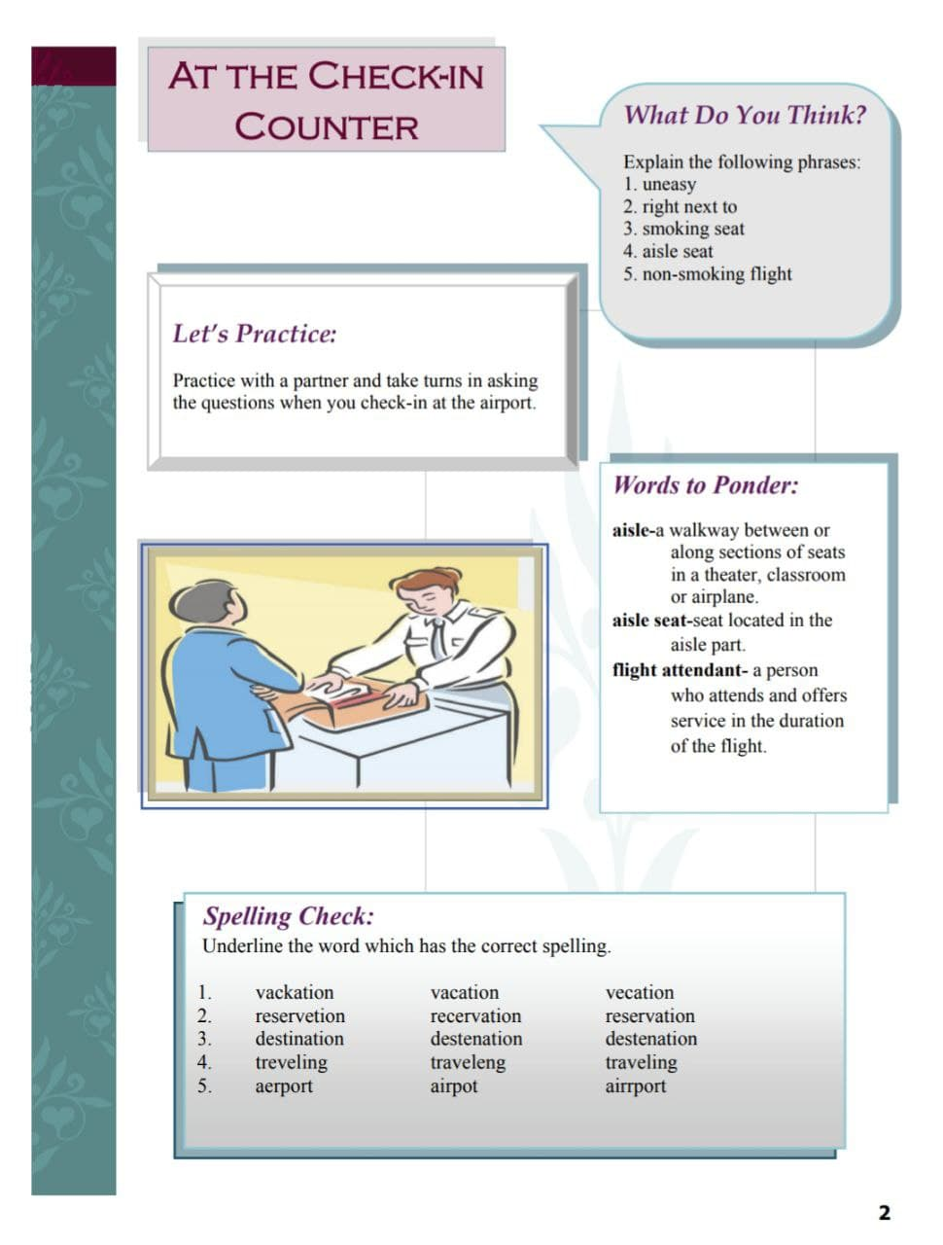

Slide 6
Summary
Learning the skills of conversation are extremely significant in terms of language learning.
Turn-taking strategy is rather too important to keep pace with the partner so as to deliver the massage clearly without interference.
Learning how to manage yourself at the airport is very significant to achieve the goals of the speech “politely”.

Slide 7
If you have any question, please contact me.

Slide 8
Thank You

