Slide 1
Al-Mustaqbal University. College of Engineering and Engineering Technologies. Biomedical Engineering Department.
Subject: laboratory instrumentation
Class : 4th
Lecture: 4
By: Zainab Sattar Jabbar M.SC. IN BME
BME

Slide 2
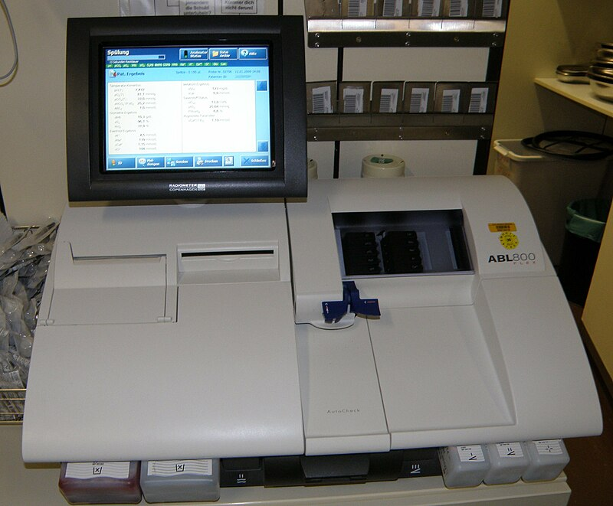
Blood gas analyzer
Also called Arterial Blood Gas (ABG) analyzer.
Blood gas analyzers are used to measure the pH, partial pressure of carbon dioxide (pCO2) and partial pressure of oxygen (pO2) of the body fluids with special reference to the human blood.
The measurement of these parameters are essential to determine the acid-base balance in the body.

Slide 3
Blood gas analyzer
An ABG test requires that a small volume of blood be drawn from the radial artery with a syringe and a thin needle.

Slide 4
Importance of blood gas analyzer
A sudden change in the pH and pCO2 could result in cardiac arrhythmias, ventricular hypotension and even death.
This shows the importance of the maintenance of physiological neutrality in blood, and consequently the crucial role that the blood gas analyzers play in clinical medicine.

Slide 5
Acid Base Balance
The normal pH of the extracellular fluid lies in the range of 7.35 to 7.45, indicating that the body fluid is slightly alkaline. When the pH exceeds 7.45, the body is considered to be in a state of alkalosis. A body pH below 7.35 indicates acidosis.
Both acidosis or alkalosis are disease conditions widely encountered in clinical medicine. Any tendency of the pH of blood to deviate towards these conditions is dealt with by the following three physiological mechanisms:
buffering by chemical means.
Respiration.
Excretion, into the urine by kidneys

Slide 6
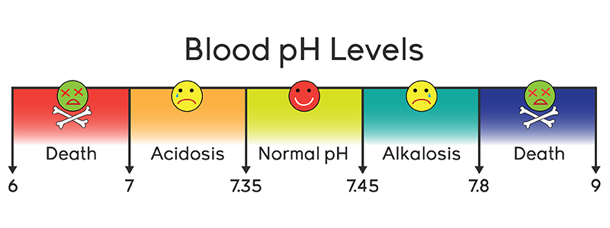
Acid Base Balance
Blood respond to changes in carbon dioxide concentration in seconds. The respiratory system can adjust sudden changes in carbon dioxide tension back to normal levels in just a few minutes. Carbon dioxide can be removed by increased breathing and therefore, hydrogen concentration of the blood can be effectively modified. The kidney requires many hours to readjust hydrogen ion concentration by excreting highly acidic or alkaline urine to enable body conditions to return towards normal.

Slide 7
Blood pH Measurement

Slide 8
Blood pH Measurement
The acidity or alkalinity of a solution depends on its concentration of hydrogen ions. Increasing the concentration of hydrogen ions makes a solution more acidic, decreasing the concentration of hydrogen ions makes it more alkaline. The amount of hydrogen ions generally encountered in solutions of interest is extremely small and, therefore, the figure is usually represented in the more convenient system of pH notation. pH is thus a measure of hydrogen ion concentration, expressed logarithmically.
If the hydrogen ion concentration increases then the pH falls and when the hydrogen ion concentration falls the pH increases.

Slide 9
Used
Respiratory (breathing) therapy departments.
Clinical and cardiopulmonary (heart and the lungs) labs.
Critical care units, surgical suites.

Slide 10
Purpose
Blood gas/pH analyzers measure:
1. The partial pressure of oxygen (O2) → po2
2. Carbon dioxide (CO2) gases → pco2
3. The (hydrogen ion concentration) p(h+)
4. Sodium, potassium, and calcium concentrations
•Values for PO2, PCO2 and PH reflect the concentrations of these gases in arterial blood as well as the concentration of hydrogenions (H+)
•hence, the state of respiration, metabolism and body’s acid production of a patient can be diagnosed.

Slide 11
Working principle of BGA
Blood gas and ph analyzers use electrodes to determine ph partial pressure of carbon dioxide and partial pressure of oxygen in the blood.
chemistry analyzers use a dry reagent pad system in which a filter pad impregnated with all reagents required for a particular reaction is placed on a thin plastic strip.
Electrolyte analyzers use the ion selective electrode (ISE) methodology in which measurements of the ion activity in the Solution are made potention metrically using an external reference electrode and an (ISE) containing an internal reference electrode.

Slide 12
Working principle of BGA
Whole blood samples are placed in test strips and loaded into the analyzer.
The operator may select the tests being performed on the sample using keypads or connected computer.
Operators should be aware of the risk of exposure potentially infectious blood -borne pathogens during testing procedures and should use universal precautions including wearing gloves, face Shields or masks and gowns.
It uses 3 electrodes to test arterial blood.

Slide 13
BGA Device

Slide 14
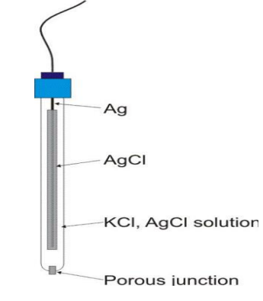
Reference Electrode
The reference electrode is used in the measurement of pH and electrolyte parameters, located in the pH/Blood Gas module.
Components
1. Pole: AgCl
2. Electrolyte: KCl
3. Permeable seal

Slide 15
Ph Electrode
The pH measurement is performed using two
separate electrodes:
1. Ph-measuring Electrode
2. Reference Electrode
The pH-sensitive glass membrane is located at the tip and seals the inner buffer solution with a constant and known pH.
A saturated electrolyte solution (Potassium Chloride) in the reference electrode and a leaky membrane permit current flow from the reference electrode through the sample in the measurement chamber to the measuring electrode.
The potential difference is displayed on a voltmeter calibrated in pH units.

Slide 16
Ph Electrode

Slide 17
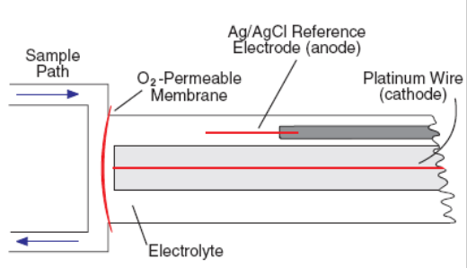
pO2 electrode
Oxygen electrode measures the oxygen partial pressure in a blood or gas sample.
1. Cathode: platinum
2. Anode: a silver/silver chloride
3. Electrolyte Solution: sodium chloride, Cathode and anode are placed in the electrolyte
4. Permeable membrane: (Plastic) designed to allow only O2 to leak

Slide 18
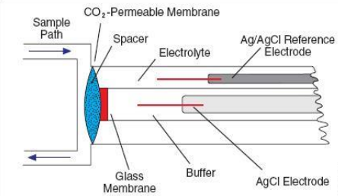
Pco2 Electrode
The pCO2 electrode is a combined pH and Ag/AgCl reference electrode mounted in a plastic jacket, which is filled with a bicarbonate electrolyte.
The PCO2 electrode also contains a spacer (usually a porous membrane of nylon) that acts as a support.
→ As CO2 diffuses through the membrane and into the support,
The pH of the electrolyte changes
→ The output of this modified pH electrode is proportional to the PCO2 present in the sample.

Slide 21
Electrode Cartridges

Slide 22
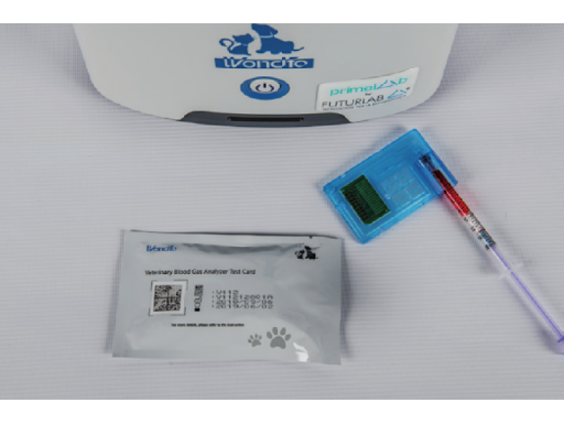
Types of BGA
Standalone conventional BGA analyzer :- The machine consist of two major things. one is the reagents pack and the second is a sensor cassette where reagent packs provide necessary reagents to measure the BGA values along with mixing in blood samples. The sensor cassettes have all the electrodes which calculate the values of different parameters in blood.

Slide 23
Types of BGA
portable or handheld ABG analyzers :- This type of BGA analyzer consists of simple Cassettes which consist of different electrodes or sensors which determine the ABG values directly interacting with the device. This type of device doesn't need any type of reagents or supplies only disposable cassettes are used to determine the BGA values for each patient. This type of a machine is very helpful for intra-hospital transport different departments of the hospital.

Slide 24
Basic Safety Consideration
When analysis is complete, the blood specimen is disposed of in one of two ways:-
Most analyzers pump the specimen into a waste container, and the system is flushed with a rinse or wash solution.
Some newer units retain the specimen in the disposable sealed reaction cartridge which is then discarded.

Slide 25
Basic Work Specifications
The equipment should possess electrodes with long life at least 2 years
Assessment of the instrument should be provided by the company.
All results should be available within 3 min.
The results should be microprocessor controlled and of latest technology version.
The instrument should have facilities like monitor screen, external keyboard, mouse, and barcode reader.
The instrument should have the capability to interface a computer and a computer should be supplied for data acquisition and patient record with recommended software.
Display language should have English

Slide 26
Thank you

