Slide 1

التصوير الطبي
Medical Imaging
Introduction to X-Ray
Properties of X-Ray
Uses of X-Ray
Components of X-ray generator
Generate X-rays
Types of radiography using X-rays
X-Ray
Dr. Ameen Alwan Dr. Forat Hamzah

Slide 2
Introduction to X-Ray
X-ray is electromagnetic radiation with short wavelength of 10⁻¹⁰m and high frequency
of 10¹⁸ Hz, which is able to pass through many materials.
In 1895, Wilhelm Roentgen, a German physicist, discovered radiation, which he called X-rays that could be used to look into the human body.
يمكن استخدامها للنظر في جسم الإنسان
Wilhelm Roentgen
The first use of X-rays was in medical diagnosis by Henri Becquerel within six months of their discovery in 1895,
Henri Becquerel

Slide 3
Properties of X-Ray
X-ray is a type of electromagnetic radiation with frequency of 10¹⁸ Hz and wavelength of 10⁻¹⁰ m
X-ray has the ability to pass through liquids, solids, gases and many materials.
X-ray is traveling in a straight line.
X-ray is invisible to the eye.
Long x-ray exposure can be harmful to living organisms, and short exposure to x-rays may be is not harmful. يكون التعرض الطويل للأشعة السينية

Slide 4
Uses of X-Ray
Medical image: X-rays are used to view images of the different parts in the human body (Uses in medical images) because that the X-rays penetrate different materials
Radiation therapy: X-rays play an important role in the fight cancer, with high energy radiation used to kill cancer cells.
Airport security: x-ray security system that scans baggage to check for dangerous items and full body x-ray scans.

Slide 5
Components of X-ray generator
Glass tube
Anode
+
x-ray tube
-
Cathode
X-rays generated by an X-ray tube
X-ray production
x-ray tube
The x-ray tube is an electrical device used for generation of X-ray , which constant from many parts:
Glass tube : It is a vacuum glass tube (pyrex glass) that contains the anode and cathode
Cathode : It consists of a tungsten wire that has a high melting point of 3410°C
Anode : It is a copper rod made with an tilted surface

Slide 6
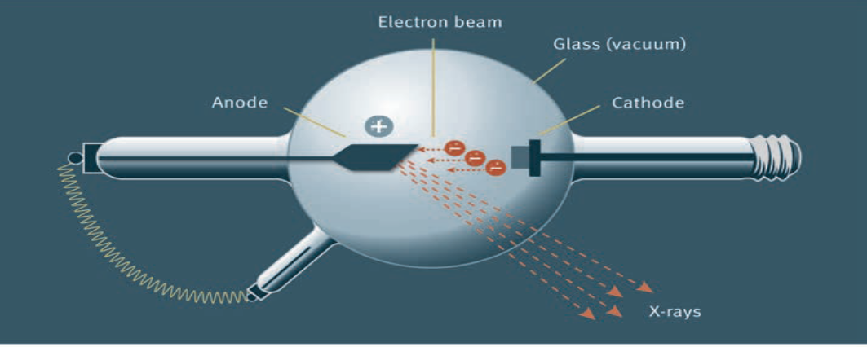
Generate X-rays
Anode
Cathode
+
-
- When the current passes through cathode (tungsten wire), the temperature in the -----------cathode will increase so that it can release electrons towards the anode.
- Therefore, according to the excited-state atom; X-rays are generated from the------------- interaction of the high-energy electrons that come from the cathode and then anode

Slide 7
Types of radiography using X-rays
(1) Plain X-rays
(2) Computed Tomography (CT)
(3) Fluoroscopy
(4) Mammography
(5) Angiography

Slide 8
Who discovered radiation in 1895?
- A) Wilhelm Roentgen. - B) Henri Becquerel - C) Marie Curie - D) Albert Einstein E) None of them
3. Which of the following statements about X-rays is true?
A) X-rays cannot pass through solids B) X-rays are visible to the human eye.
C) X-rays travel in a zigzag pattern D) X-rays have harmful effects only in long exposures.
E) All of them
What happens when current passes through the cathode (tungsten wire) in X-ray production?
- A) Anode B) Cathode. C) Filament D) Vacuum E) Insulator
2. How are X-rays generated according to the excited-state atom?
- A) Chemical B) Thermal C) Electrical. - D) Magnetic E) Nuclear

