Slide 1
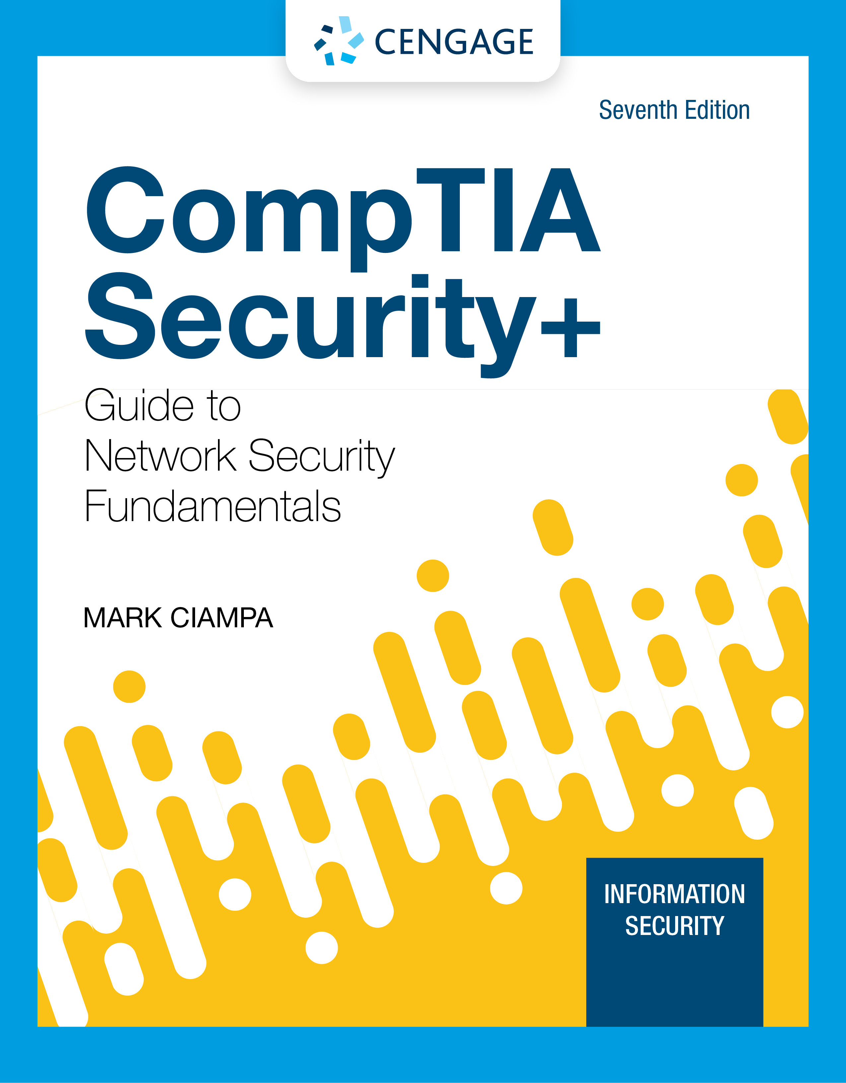
Lecture 08: Traditional Ciphers_II
Principles of Cyber Security
Dr. Muamer Mohammed

Slide 2
Objectives
8.1 Describe the traditional ciphers algorithms (Columnar Transpositions).

Slide 3
Simple Columnar Transpositions
Where the message is written horizontally in a fixed and agreed upon number of columns and then described letter by letter from the columns proceeding from left to right. The rail fence cipher is a special example.

Slide 4
Simple Columnar Transpositions
Plain Text
Cipher Text
T H I S I
S A M E S
S A G E T
O S H O W
H O W A C
O L U M N
A R T R A
N S P O S
I T I O N
W O R K S
T S S O H
O A N I W
H A A S O
L R S T O
I M G H W
U T P I R
S E E O A
M R O O K
I S T W C
N A S N S

Slide 5
Simple Columnar Transpositions
Example 3: Encipher “THE JOKER SAID THAT IT WAS ALL PART OF THE PLAN” using a simple 5 column transposition cipher.
Solution:

Slide 6
Simple Columnar Transpositions
Example 4: Suppose we want to decipher “TOTBA AUJAA KMHKO ANTAU FKEEE LTTYR SRLHJ RDMHO ETEII ”
Solution:

Slide 7
Summary
Columnar Transposition has the security of a transposition cipher with the extra benefit of utilizing a keyword.
Columnar Transposition involves writing the plaintext out in rows, and then reading the ciphertext off in columns one by one.

Slide 8
Thank you

