Slide 1
Lecture 09: Traditional Ciphers_III
Principles of Cyber Security
Dr. Muamer Mohammed

Slide 2
Objectives
9.1 Describe symmetric, and asymmetric cryptographic algorithms.

Slide 3
Symmetric Cryptographic Algorithms
Symmetric cryptographic algorithms use the same single key to encrypt and decrypt a document.
Common algorithms include:
Data Encryption Standard (DES)
Triple Data Encryption Standard (3DES)
Advanced Encryption Standard (AES)

Slide 4
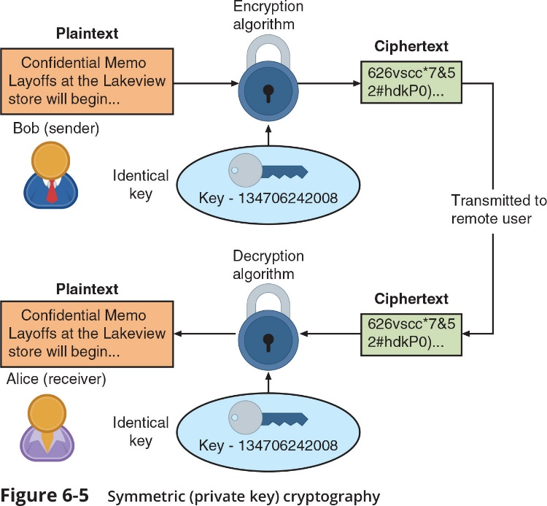
Symmetric Cryptographic Algorithms

Slide 5
Asymmetric Cryptographic Algorithms
The primary weakness of symmetric algorithms:
distributing and maintaining a secure single key among multiple users distributed geographically poses challenges
Asymmetric cryptographic algorithms use two mathematically related keys.
Also known as public key cryptography
Public key available to everyone and freely distributed
Private key known only to individual to whom it belongs

Slide 6
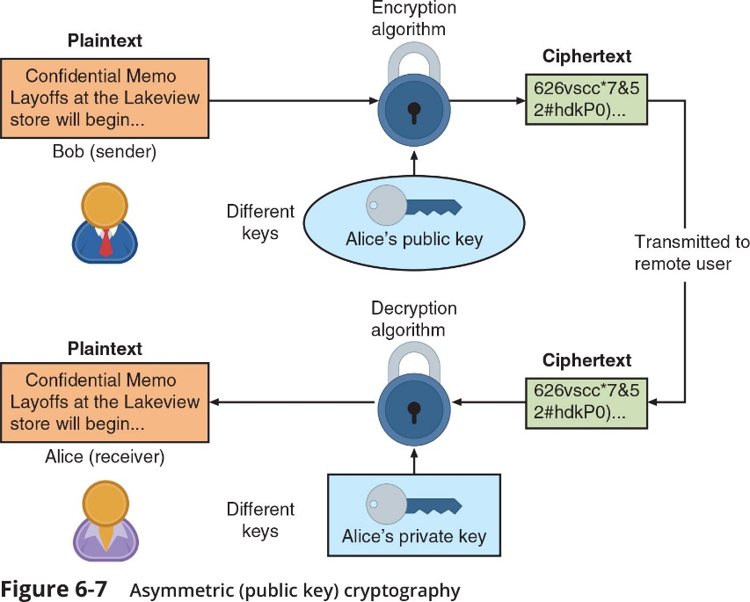
Asymmetric Cryptographic Algorithms

Slide 7
Summary
Symmetric cryptography (also called private key cryptography) uses a single key to encrypt and decrypt a message.
Asymmetric cryptography (also known as public key cryptography) uses two keys instead of one.

Slide 8
Thank you

