Slide 1
Type of bacteria(surgical microbiology)
Dr. Adel Al-Najjar
Consultant Urologist

Slide 2
Bacteria
Bacteria are very small (usually single-cell) organisms.
They are one of the first life forms to exist on Earth and have been around for approximately three billion years.
Various sources suggest there maybe as many as one trillion species – although the vast majority of these have not yet been discovered.
Most individual bacterial cells – an individual ‘bacterium’– are too small to be seen with the human eye. Although, the colonies they form are visible.

Slide 3
Gram-positive and Gram-negative bacteria
Bacteria are either classified as Gram-positive or Gram-negative. Their classification is based on the outcome of a test called the ‘Gram stain’. This test is named after the inventor Danish scientist Hans Christian Gram (1853–1938).
The cells are stained with a purple dye (‘crystal violet’), which only binds to a substance called peptidoglycan. The cells are then rinsed, and stained with a red dye (safranin).
If the cells take on the purple colour → Gram positive and have a high proportion of peptidoglycan in their cell wall.
If the cells take on the red colour → Gram negative .

Slide 4
Gram positive examples
• Streptococcus
• Staphylococcus
• Clostridium botulinum
Gram negative examples
• Cholera
• Gonorrhea
• Escherichia coli (E. coli)
• Pseudomonas aeruginosa
• Acinetobacter baumannii

Slide 5
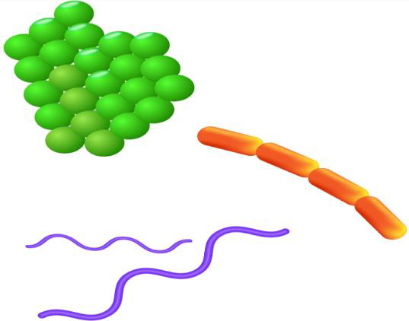
Different shapes of bacteria
There are three primary shapes: spheres, rods and spirals.
In some cases, you can tell the shape of the bacteria from the name:
round often have ‘coccus’ in the name,
Rods → ‘bacillus’
spirals → ‘spirillum’.
The way that round bacteria join together as a colony can also be used to categorise them

Slide 6
Treatment
The type of bacteria causing an infection will usually influence the type of treatment given. Find out more about antibiotics, and about
multidrug-resistant ‘superbugs’, which are very difficult to treat.

Slide 7
Surgical microbiology
They are microorganisms such as parasites, viruses, fungi, or bacterial infections.
Patients who have undergone surgical procedures may become infected from the first to the 30th day after the operation.

Slide 8
Type of Bactria
1. Aerobic organisms require oxygen for survival. Examples include: Bacillus anthracis, which causes anthrax.
2. Anaerobic organisms do not need oxygen to survive. Examples include:
Clostridium perfringens, the most common cause of gas gangrene.

Slide 9
How does infection occur after surgery?
Post-operative infection is very possible, and the
patient is exposed to stages through the surgical
operation, which is the final solution for treatment,
whether it is emergency, elective or plastic surgery.
Infection varies from patient to patient according to
the type of operation, the length of the operation, the
operation environment, and the care of the wound site
before and after the operation.

Slide 10
Common Causes of Surgical Site Infection
1. The use of insufficiently-sterilized tools and supplies.
2. Unsterile surgical environment.
3. Poor preparation of surgical instruments and few of surgeons.
4. Inadequate ventilation of the operating room.
5. Insufficient cleaning of surgical site.
6. Poor post-surgery care. Daily sterilization and dressing change, no more
than 48 hours.
7. The patient is discharged early from the hospital after the surgery.
8. Prolonged duration of surgery.
9. Antibiotic-resistant bacteria.

Slide 11
Risk Factors
• Age (very young or very old)
• Diabetes
• Nicotine use
• Steroid use
• Compromised immune system (HIV, AIDS, etc.)
• Obesity
• Poor circulation
• Poor nutritional status

Slide 12
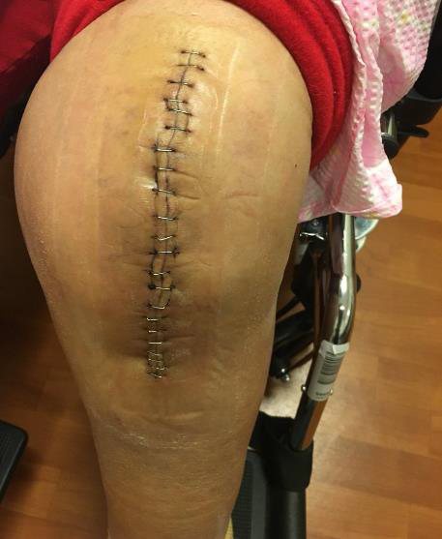
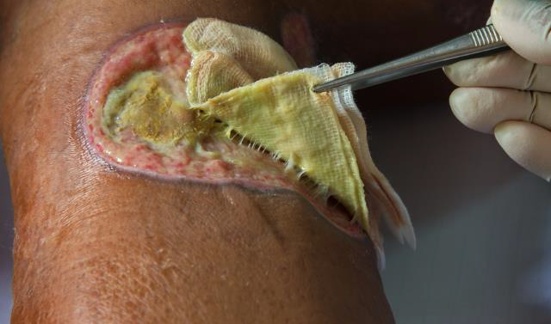
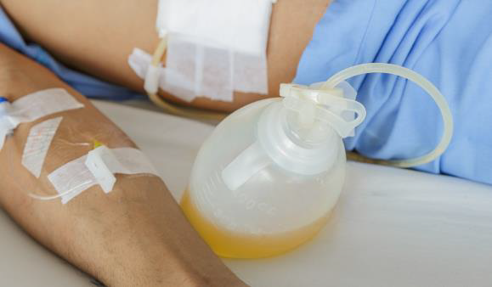
Symptoms of infection after surgery
1. Redness and swelling at the incision site.
2. Fever.
3-Drainage of yellow or cloudy pus from the
incision site.

Slide 13
Preventing infections
-Before surgery:
1. Wash with an antiseptic cleanser from your before you head to the hospital.
2. Don’t shave, as shaving irritates your skin and can introduce
infection under your skin.
3. Quit smoking before you have surgery, as smokers develop more infections Trusted Source. Quitting can be very difficult, but it’s possible. Speak to a doctor, who can help you develop a quit smoking plan that’s right for you.

Slide 14
-After your surgery:
1. Maintain the sterile dressing that your surgeon applies to your wound for at least 48 hours.
2. Take preventive antibiotics, if prescribed.
3. Make sure patient understand how to take care of wound, asking
questions if patient need clarification.
4. Always wash your hands with soap and water before touching your
wound and ask anyone who may assist in your care to do the same.
5. The patient should know in the event of infection of his wound through the signs to refer to the hospital, the surgeon or the nurse to evaluate the wound.

