Slide 1
Lecture 02: Requirements for computer protection
Principles of Cyber Security
Dr. Muamer Mohammed

Slide 2
Objectives
2.1 Identify the types of attackers that are common today
2.2 Describe the five basic principles of defense

Slide 3
Understanding the Importance of Information Security
Information security can be helpful in:
Preventing data theft
Thwarting identity theft
Avoiding the legal consequences of not securing information
Maintaining productivity
Foiling cyberterrorism

Slide 4
Who Are the Threat Actors?
Threat actor :a generic term used to describe individuals who launch attacks against other users and their computers
Most have a goal of financial gain

Slide 5
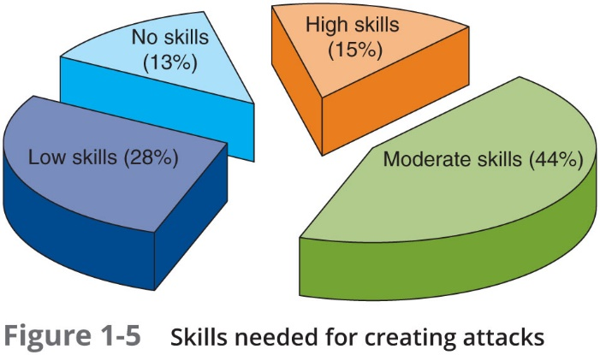
Script Kiddies
Figure 2-1: Skills needed for creating attack

Slide 6
Insiders
Employees, contractors, and business partners
Over 58 percent of breaches attributed to insiders
Examples of insider attacks:
Health care worker may publicize celebrities’ health records.
Stock trader might conceal losses through fake transactions.
Employees may be bribed or coerced into stealing data before moving to a new job.

Slide 7
Defending Against Attacks
Five fundamental security principles for defenses:
Layering
Limiting
Diversity
Obscurity
Simplicity

Slide 8
Layering
Information security must be created in layers.
A single defense mechanism may be easy to circumvent

Slide 9
Limiting
Limiting access to information:
Reduces the threat against it
Only those who must use data should be granted access
Should be limited to only what they need to do their job

Slide 10
Diversity
Closely related to layering
Layers must be different (diverse)
If attackers penetrate one layer:
Same techniques will be unsuccessful in breaking through other layers

Slide 11
Obscurity
Obscuring inside details to outsiders.
Example: not revealing details.
Type of computer.
Operating system version.
Brand of software used.
Difficult for attacker to devise attack if system details are unknown.

Slide 12
Simplicity
Nature of information security is complex
Complex security systems:
Can be difficult to understand and troubleshoot
A secure system should be simple from the inside But complex from the outside

Slide 13
Chapter Summary
Main goals of information security
Prevent data theft
Thwart identity theft
Avoid legal consequences of not securing information
Maintain productivity
Foil cyberterrorism
Threat actors fall into several categories and exhibit different attributes
Although multiple defenses may be necessary to withstand the steps of an attack, these defenses should be based on five security principles:
Layering, limiting, diversity, obscurity, and simplicity

Slide 14
Thank you

