Slide 1
Computer - S1 Lecture 5 Computer Network
Al-Mustaqal University Collage of Pharmacy
By Ass. lect. Sajjad Ibrahim Ismael

Slide 2
Contents
Introduction
Types of network
Network basic terminology
Types of network architecture

Slide 3
Introduction
Network – Computer Network – Advantages

Slide 4
Network
WHAT?
A group or system of interconnected people or things.
Why?
Connection
Communication
Where?
When we need to transfer anything.

Slide 5
Computer Network
A computer network is a set of devices (often referred to as node) connected by communication links.
A node can be a computer, printer or any other device capable of sending or receiving data generated by other nodes on the network.

Slide 6
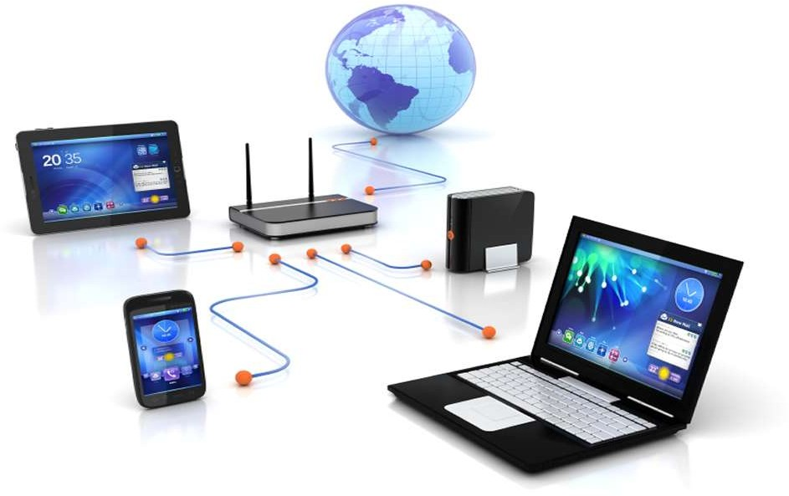
Computer Network

Slide 7
Networking
Networking is a process of communication between two or more remote parties, that involves the connection of computers, media and networking devices.

Slide 8
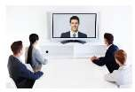
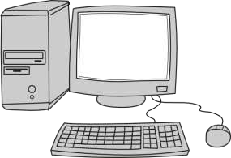
Network Applications
Network
Application

Slide 9
Advantages of Networking
Easy communication
File, data and information sharing
Resource sharing (hardware)
Increase storage capacity
Reduce cost
Save time

Slide 10
Types of Networks
Physical Structure – LAN – WAN – MAN

Slide 11
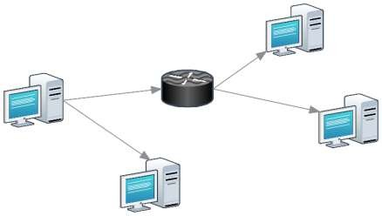
Types of Network
1. Point to Point:
2. Multipoint:

Slide 12
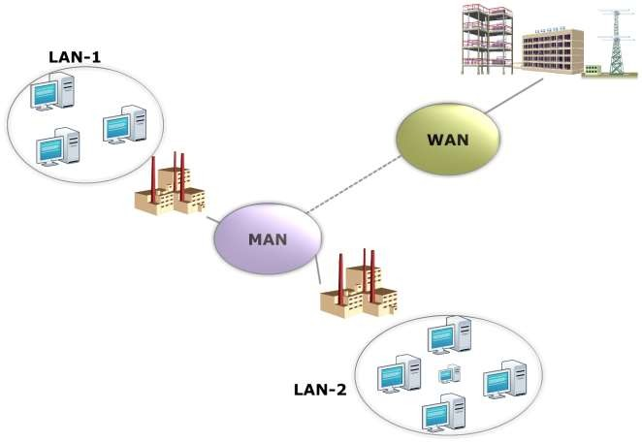
Categories of Network

Slide 13
Network Criteria
Performance
Transit Time
Response Time
Reliability
Recovery from a failure
Security
Protecting data from:
Unauthorized User
Damage

Slide 14
Network Terms
Host– Workstation– Server– Client– Node

Slide 15
Host
A network host is a computer or other device connected to a computer network.
A network host may offer information resources, services, and applications to users or others nodes on the network.

Slide 16
Workstation
A workstation (WS) is a computer dedicated to a user or group of users engaged in business or professional work.
It includes one or more high resolution displays and a faster processor than a personal computer (PC).
Useful for Distributed Computing.
Different from PC:
Faster
More capable

Slide 17
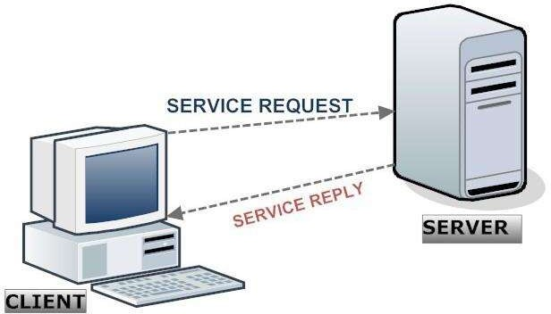
Client and Server

Slide 18
Client and Server
For process to process commutation we need Client Server Paradigm.
A process on local host, called a client, needs services from a process usually on the remote host called a server.
So, a server is an a computer program that accepts and responds to requests made by another program, known as a client.

Slide 19
Node
A node can be a computer or some other device such as printer that can receive, create, store or send data along distributed network routes.

Slide 20
Types of Network Architecture
Peer to Peer – Client Server Model

Slide 21
Peer-to-Peer Network
A peer-to-peer network is one in which two or more PCs share files and access to devices such as printers without requiring a separate server computer or server software.
Client-Server Network
In client-server model, where client request for a service to a server and server replies according to client request.

Slide 22
Data Flow
Simplex – Half Duplex – Full Duplex

Slide 23
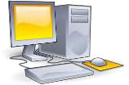
Simplex Mode
In Simplex mode:
Communication is unidirectional,
Only one can transmit and other can receive.
Ex: keyboard and monitor
Direction of Data
Simplex Communication Structure

Slide 24
Half-Duplex Mode
In Half Duplex mode:
Both can transmit and receive,
But not at a same time.
At a time, only one can send or receive.
Ex: Walkie-talkies
Direction of Data at time 1
Direction of Data at time 2
Half Duplex Communication Structure

Slide 25
Full-Duplex (Duplex) Mode
In Full Duplex mode:
Both station can transmit and receive simultaneously,
But at a same time.
Ex: Telephone Networks
Direction of Data
Full Duplex Communication Structure

