Slide 1

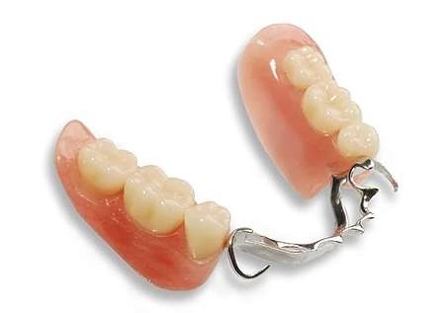
Mandibular Major Connectors

Slide 2
In general, mandibular major connectors are long and relatively narrow. Therefore, special consideration must be given to the design of such connectors.
Mandibular connectors must be rigid without being so bulky that they compromise patient comfort. Furthermore, mandibular major connectors must not impinge upon the movable floor of the mouth, the associated frena, or mandibular tori.

Slide 3
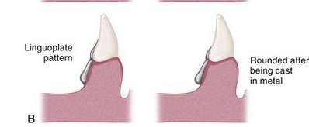
At the inferior border of the lingual bar connector, the limiting factor is the height of the moving tissue in the floor of the mouth. Because the connector must have sufficient width and bulk to provide rigidity, a linguo-plate is commonly used when space is insufficient for a lingual bar.

Slide 4
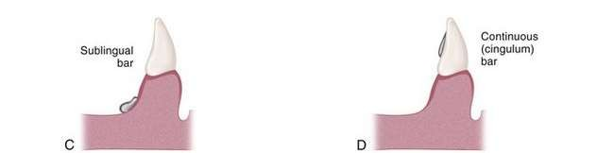
If less than 8 mm exists between gingival margins and the movable floor of the mouth,
A linguoplate, a sublingual bar, or a continuous bar is preferred as a major connector.
Relief is provided for soft tissue under all portions of the mandibular major connector and at any location where the framework crosses the marginal gingiva.
The inferior border of mandibular major connectors should
be gently rounded after being cast to eliminate a sharp edge.

Slide 5
4 types of Mandibular Major Connectors
Lingual bar Lingual plate Double lingual bar Labial bar

Slide 6
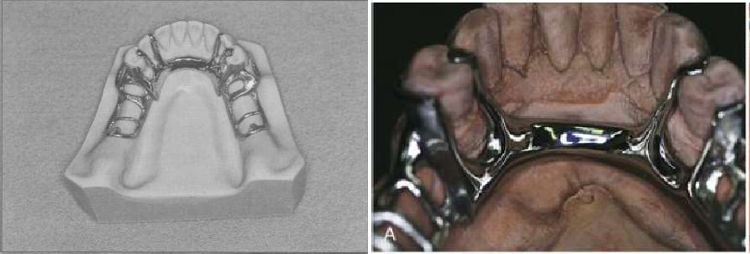
Lingual bar
◆ The lingual bar is perhaps the most frequently used mandibular major connector.

Slide 7


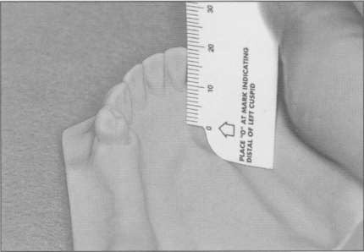
The basic form of a mandibular major connector is a half pear shape, located above moving tissue but as far below the gingival tissue as possible. It is usually made of reinforced, 6 gauge, half pear shaped wax or a similar plastic pattern.
Placement of a lingual bar requires at least 8 mm of space between the gingival margins and the floor of the
mouth. This permits the major
connector to have a
minimum height of 5 mm and allows 3 mm of space between the gingival margins
and the superior border of the
12/17/201
6
50
bar.

Slide 8
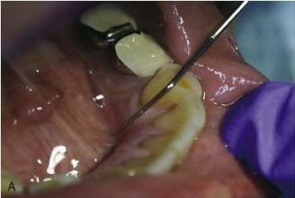
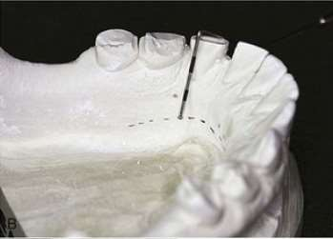
A periodontal probe may be used to measure from the gingival margins to the floor of the mouth.
The patient instructed to
should be elevate and
protrude the tongue so that
its tip touches the
the
vermilion upper lip. Intraoral
border of
measurements
may be transferred to the
corresponding dental cast.

Slide 9
The presence of mandibular tori complicates the design, fabrication, and placement of lingual bar major connectors. Surgical removal of mandibular tori usually is required for successful removable partial denture therapy.
Indicated in Kennedy’s Class III situation and its modifications.

Slide 10
Advantages:
Simple, easy to design and fabricate
Has no minimal contact with oral tissue
No contact with teeth, so no decalcification of teeth.
Disadvantages:
If extreme care is not taken in the design and construction of a lingual bar, the resultant framework may not be rigid.
Cause food entrapment and patient discomfort if it is placed over undercut
ifficult to used when tori are pre¹²s^{/1}e^{7/2}n⁰¹t
6

Slide 11
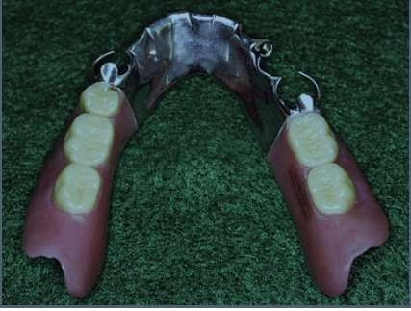
Lingual Plate/ Linguoplate
◆ The structure of a lingual plate is basically that of a half-pear-shaped lingual bar with a thin, solid piece of metal extending from its superior border.
.

Slide 12
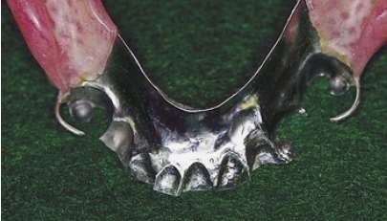
The inferior border of a lingual plate should be positioned as low in the floor of the mouth as possible, but should not interfere with the functional movements of the tongue and soft tissues.
A linguoplate
should be
as is and
to
made as thin
technically feasible should be contoured
follow the contours of the teeth and the embrasures

Slide 13
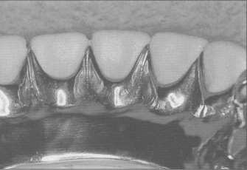
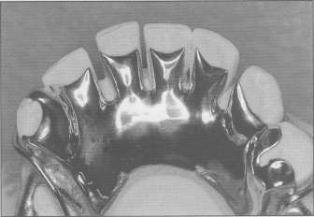
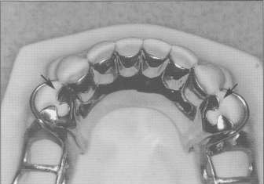
This thin projection of metal is carried on to the lingual surfaces of the teeth and presents a scalloped appearance
A lingual plate may include "step backs" to minimize or eliminate the appearance of metal.
A lingual plate must be supported by rests (arrows) located no farther posterior than the mesial surface of
^{Dr Mu}t^{jt}h^{aba}e^{Ash}f^{ra}i^{f} rst premolars.
56

Slide 14
Indications:
When lingual frenum is high or space available for lingual bar is insufficient
Kennedy Class I where residual ridges have undergone excessive vertical resorption.
For stabilizing periodontally weak teeth.
When future replacement of one or more anterior teeth is predicted.
Presence of inoperable mandibular tori.

Slide 15
Advantages:
Most rigid and provides good support and stabilization.
Provides indirect retention with rest on premolars.
Disadvantages:
Extensive coverage of teeth may cause decalcification. Soft tissue irritation

Slide 16

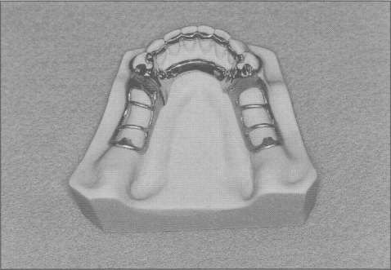
Double Lingual Bar/ Kennedy bar
◆ A double lingual bar displays characteristics of both lingual bar and lingual plate major connectors

Slide 17
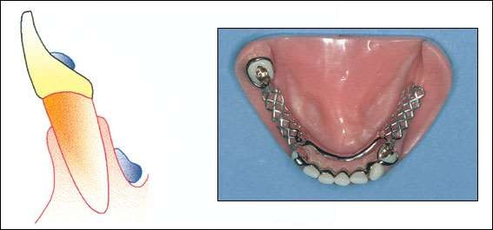
It differs
portion is
from
lingual plate in the middle
removed and the remaining is
superior and inferior bar.
The lower bar is similar to a lingual bar, pear- shaped in cross-section, 2-3mm high and 1mm thick

Slide 18
Just like the lingual plate upper bar should dip into the embrasures and if diastema is present, a step-back design is used.
Indications
When a lingual plate in otherwise indicated but axial alignment of anterior teeth entails excessive block out, eg crowding
Periodontal disease resulting in large interproximal embrasures
Wide diastema in lower anteriors_{12/17/201}
6
61

Slide 19
Advantages:
Provides good indirect retention Horizontal stabilization
As gingival tissues are not covered, marginal gingival receives natural stimulation
Disadvantages:
More annoyance to tongue than lingual plate Food entrapment and debris

Slide 20

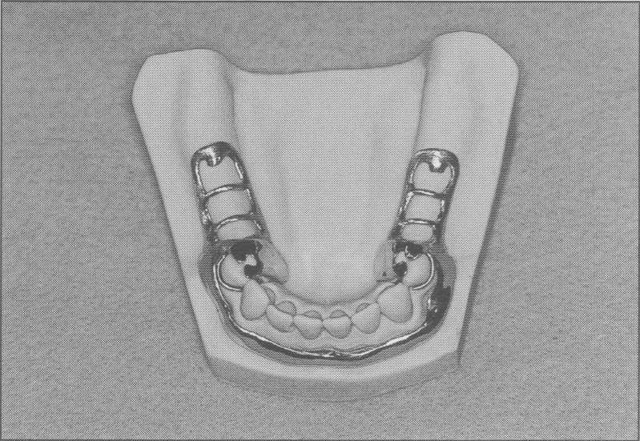
Labial Bar
◆ A labial bar runs across the mucosa on the facial surface of the mandibular arch

Slide 21
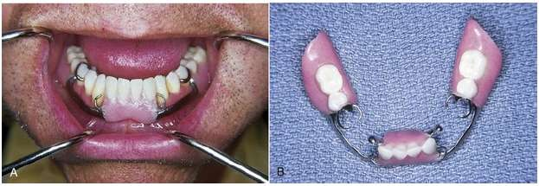
Like other mandibular major connectors, a labial bar displays a half-pear shape when viewed in cross section.
But, because of its placement on the external curvature of the mandible, a labial bar is longer than other mandibular major connector.

Slide 22
The only justification for using a labial bar is the presence of a gross uncorrectable interference that makes the placement of a lingual major connector impossible.
Interferences that commonly lead to the selection of a labial bar are
malposition or lingually inclined teeth and
large mandibular tori that preclude the use of a lingual bar or lingual plate.

Slide 23
Advantages
When the remaining mandibular teeth are tipped so far lingually that a more conventional major connector cannot be used, a labial bar may be considered.
Disadvantages
Unaesthetic
Fullness in lower lips Patient discomfort

Slide 24
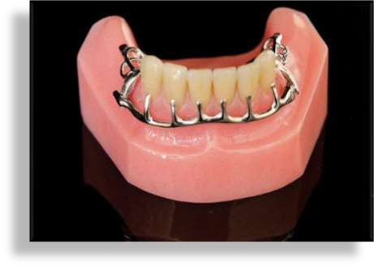
A modification of the labial bar is the hinged continuous labial bar.
This concept is incorporated in the Swing Lock* design, which consists of a labial or buccal bar that is connected to the major connector by a hinge at one end and a latch at the other end.

Slide 25
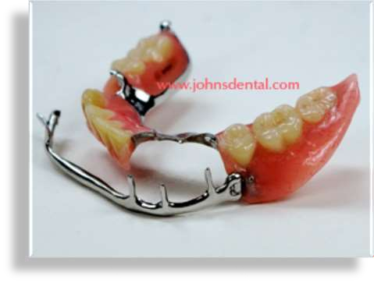
In this application, the labial component does not serve as a major connector. Instead, the modified labial bar has a hinge at one end and a locking device at the opposite end. This permits an opening and closing action similar to a gate.

Slide 26

Review of indications for mandibular major connectors
◆ 1. For a tooth-supported removable partial denture, the lingual bar normally is the mandibular major connector of choice.
◆ 2. When there is insufficient room between the floor of the mouth and the gingival margins (< 8 mm), a lingual plate should be used. This major connector also is indicated for patients with large inoperable tori and patients with high lingual frenum attachments.

Slide 27
When the anterior teeth have reduced periodontal support and require stabilization, a lingual plate is recommended.
When the anterior teeth exhibit reduced periodontal support and large interproximal spaces, a modified lingual plate (step-back design) or double lingual bar should be used.
When a removable partial denture will replace all mandibular posterior teeth, a lingual plate should be used.
A labial bar is rarely indicated.

