Slide 1
Dentoalveolar Injuries
Dr.Mohammed Alaraji

Slide 2
The term 'dentoalveolar injury' describes trauma that is localized to the teeth and the supporting structures of the alveolus. These injuries can occur in isolation, or as part of a more serious maxillofacial injury

Slide 3
Classification
1-Injuries to the hard dental tissue and pulp
2- Injuries to the periodontal tissue.
3-Injuries to the supporting bone.
4- Injuries to the gingiva and oral mucosa.
5-Combination

Slide 4
Injuries to the hard dental tissue and pulp
a. Crown infraction (crack of enamel or incomplete fracture)
b. Crown fracture – Enamel only
c. Crown fracture – Enamel + dentine
d. Crown fracture – Enamel + dentine + pulp
e. Crown – root fracture (vertical fracture)
f. Crown – root fracture (oblique fracture)
g. Root fracture.

Slide 6
✓ Intrusive luxation; (central dislocation) is displacement of the tooth into the alveolar bone with comminution or fracture of the alveolar socket.
Extrusive luxation; (peripheral dislocation or partial avulsion) is partial displacement of the tooth out of the alveolar socket.
Avulsion; is a complete displacement of a tooth out of the alveolar socket.

Slide 7
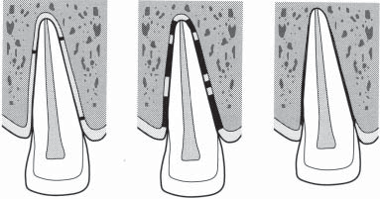
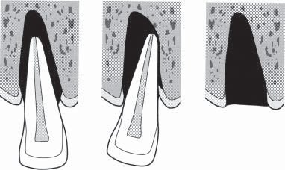

Slide 8
Injuries to the supporting alveolar bone
a. Intrusion of tooth with comminution of socket.
b. Fracture of single wall of socket or alveolus.
c. Fracture of both walls of socket or alveolus.
d. Fracture of mandible or maxilla involving the alveolus and/or tooth socket.

Slide 9
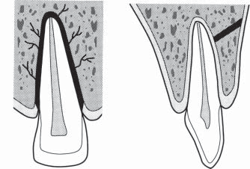
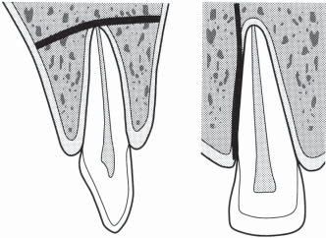

Slide 10
Injuries to the gingiva or oral mucosa
Contusion of Gingiva or Mucosa; a bruise is usually produced by impact from a blunt object and results in submucosal hemorrhage without a break in the mucosa.
Abrasion of Gingiva or Oral Mucosa; a superficial wound produced by scraping of the mucosa, leaving a raw, bleeding surface.
Laceration of Gingiva or Oral Mucosa; a shallow or deep wound in the mucosa results from a tear and is usually produced by a sharp object.

Slide 11
Radiographic evaluation
A single radiograph may not be sufficient to demonstrate dentoalveolar injuries, most commonly a combination of occlusal and periapical radiographs is used, it should provide the following information: ✓ Presence of root fractures ✓ Degree of extrusion or intrusion ✓ Extent of root development ✓ Size of the pulp chamber and root canal ✓ Tooth fragments and foreign bodies lodged in soft tissue.

Slide 12
Treatment
Several factors need to be considered:
> Age of patient
► If the injury involves primary or permanent teeth
► Location and extent of injury.
► Residual bone support.
► Periodontal health of the remaining teeth.
► Vitality of the teeth.
► Concomitant injuries.
Time between trauma and treatment.

Slide 13
Injuries to the periodontal tissue
Concussion usually no treatment ,in some cases relieving the tooth from occlusal forces by grinding of the opposing tooth may be required
Subluxation Treatment includes soft diet or occlusal adjustment Splinting for 7-10 days is necessary.
Extrusive luxation The tooth that is partially displaced out of the alveolar socket should be manipulated digitally into proper position and should be splinted for 1 to 2 .
Avulsion (exarticulation) is an urgent situation requiring ......immediate action.

Slide 14
• The length of storage outside the mouth.
The medium used and correct handling and splinting; storage media include: saliva, saline, milk, which is considered the best medium because of its availability, pH compatibility to vital cells, freedom from bacteria, and function of maintaining the vitality of the periodontal ligament cells 3 hours in the postavulsion period. Water is the least desirable storage medium because of its hypotonic environment, which can cause cell lysis.
Immediate replacement is still the ideal treatment. The involved tooth should be splinted with a semirigid splint for 7 to 10 days. Rigid splinting of reimplanted teeth increases the extent of root resorption; thus, a minimum of 1 week is sufficient. If there has been a notable concomitant alveolar fracture, a rigid splint should be used for 3 to 4 weeks.
Replanted teeth should be followed up regularly.

Slide 15
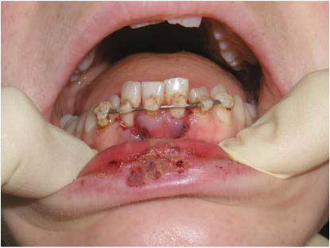
Splinting techniques
1-Etch wire composite splint.

Slide 16
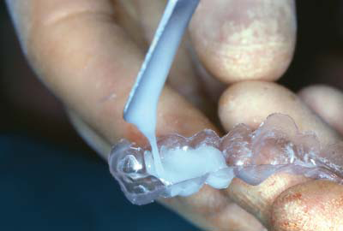
2-Vacuum-formed plastic splints

Slide 17
3-Interdental wiring techniques

Slide 18
