Slide 1
Part Two
2023 / 2024

Slide 4
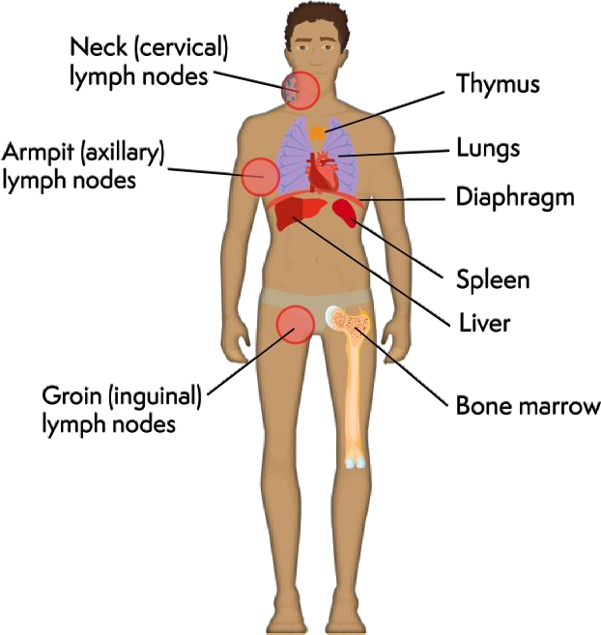
Definition:
Lymphoma is a broad term refers to types of cancer that begins in cells of the lymphatic system (the various lymph glands around the body) when abnormal white blood cells grow.

Slide 5
Types of lymphomas:
>70 types of lymphoma.
Some are slow-growing (also called low-grade
or indolent) while others are fast-growing (also called high-grade or aggressive).
Causes = unknown; Certain factors increase the risk of developing the lymphoma.

Slide 6
•1..Hodgkin Lymphoma [HL]:
Malignant cancers of B-lymphocytes
=Primary Sites= Lymph Nodes
+
Characteristic Tumor Cells
called=Reed-Sternberg [ RS] cells.

Slide 7
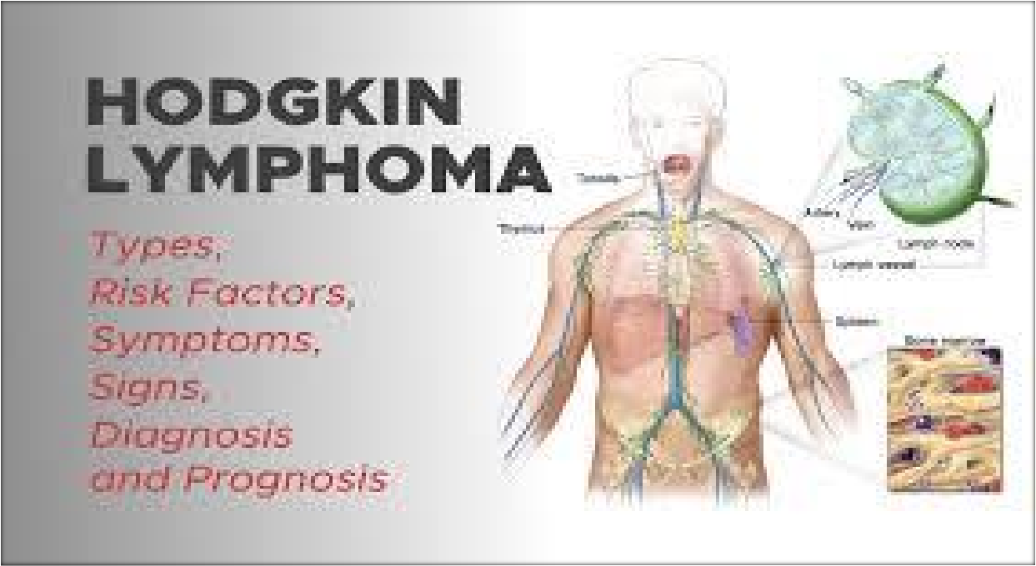

Slide 9
Staging of Hodgkin Lymphoma
Stage 1 - lymphoma in only one group of affected lymph nodes
+ only on one side of the diaphragm
Stage 2 - lymphoma in two or more groups of affected lymph nodes + only on one side of the diaphragm
Stage 3 - lymphoma in lymph nodes both above and below the
diaphragm.
Stage 4 - the most advanced stage of lymphoma= started in the lymph nodes and spread outside the lymph nodes to at least one body organ outside the lymphatic system (for example: liver, lungs or bone marrow or solid bones).

Slide 10
Staging of Hodgkin Lymphoma= (Hodgkin Disease)

Slide 13
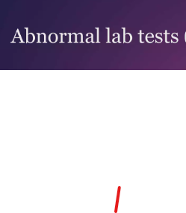
Hodgkin lymphoma

Slide 14
Hodgkin lymphoma

Slide 15
•2..Non-Hodgkin lymphoma [NHL]:
All types of lymphoma
except Hodgkin's
lymphomas.
B or T cell malignant neoplasms [ But most are of B cell lineage]
Many Types
Many Locations.
No= Reed-Sternberg [ RS] cells =
No=Characteristic Tumor Cells of Hodgkin lymphoma

Slide 18
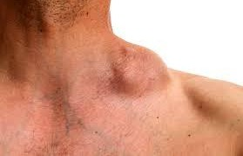
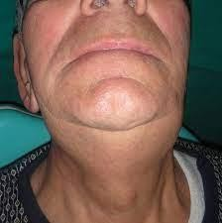
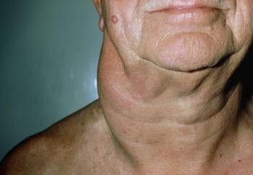
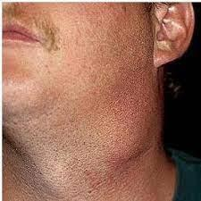
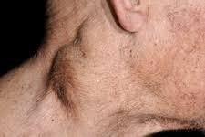
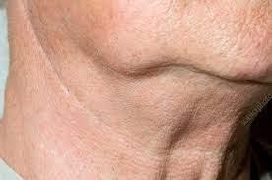
Non-Hodgkin lymphoma

Slide 19
Non-Hodgkin lymphoma
4 VIRAL CAUSES +
1 BACTERIAL CAUSE

Slide 22
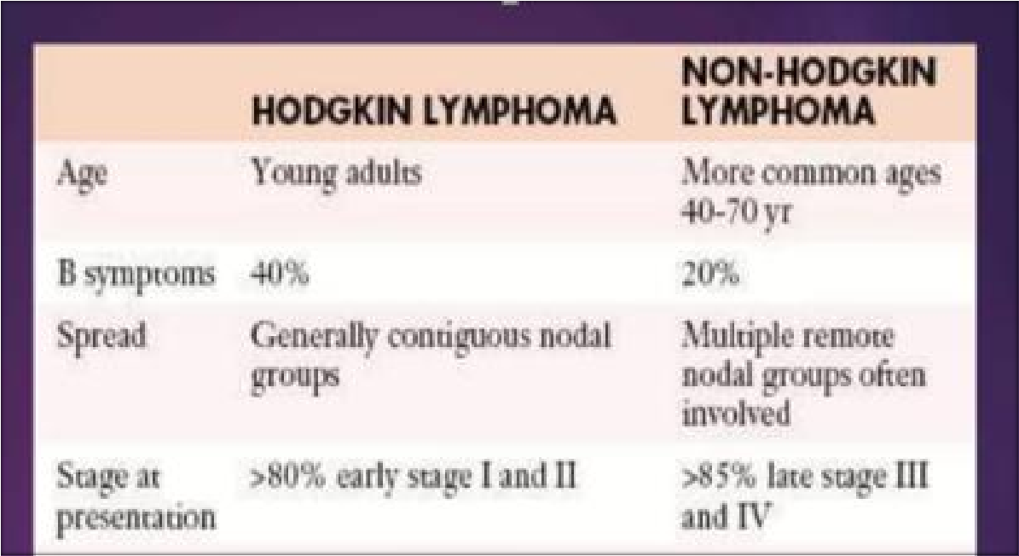

Slide 24
3..Burkitt lymphoma [BL]:
•
•Aggressive
non-Hodgkin
B cell lymphoma
•Involving bone and lymph nodes.

Slide 25
1) Epstein Barr virus (EBV)= Africa
Burkitt lymphoma [BL]: is associated with:
2) Human immunodeficiency virus (HIV)= AIDS= Outside of Africa
3) Chromosomal translocations
in Burkitt lymophoma involves chromosome 8, the site of the Myc gene = cause the overexpression of oncogene c-myc.
4) Most common in regions with high incidence of
malaria = Africa.

Slide 26
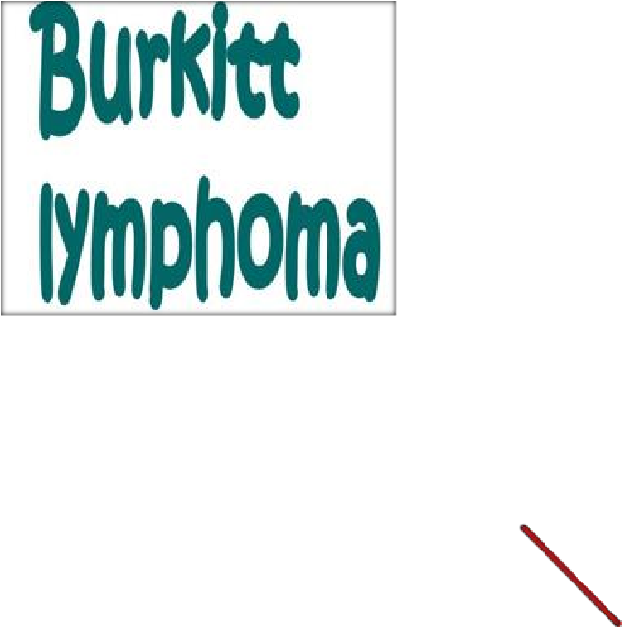
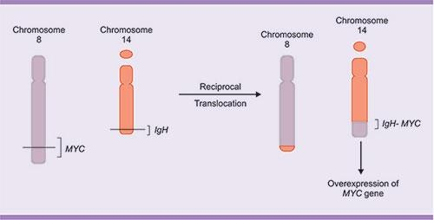
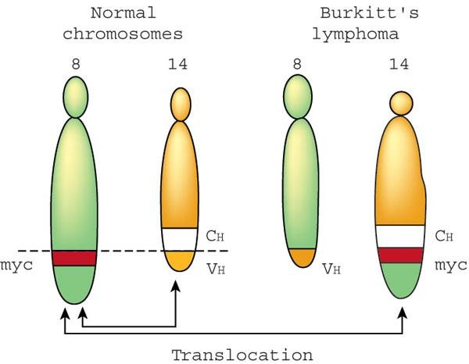

Slide 27
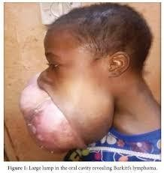
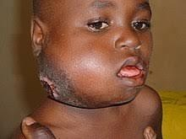
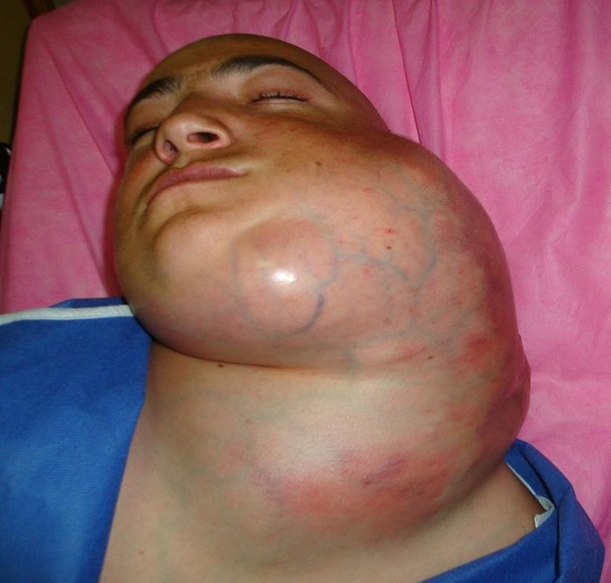
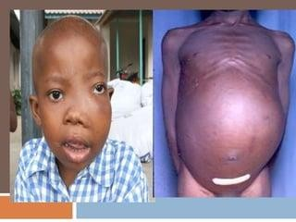
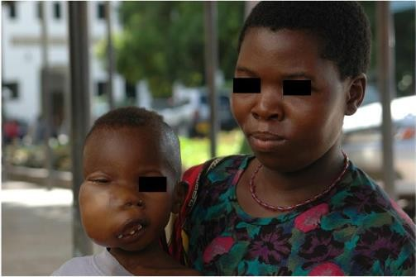

Slide 28
•4..Multiple Myeloma [MM]:
•Overproduction of
malignant plasma cells
•Results in multiple tumorous masses scattered in the skeletal system.

Slide 29
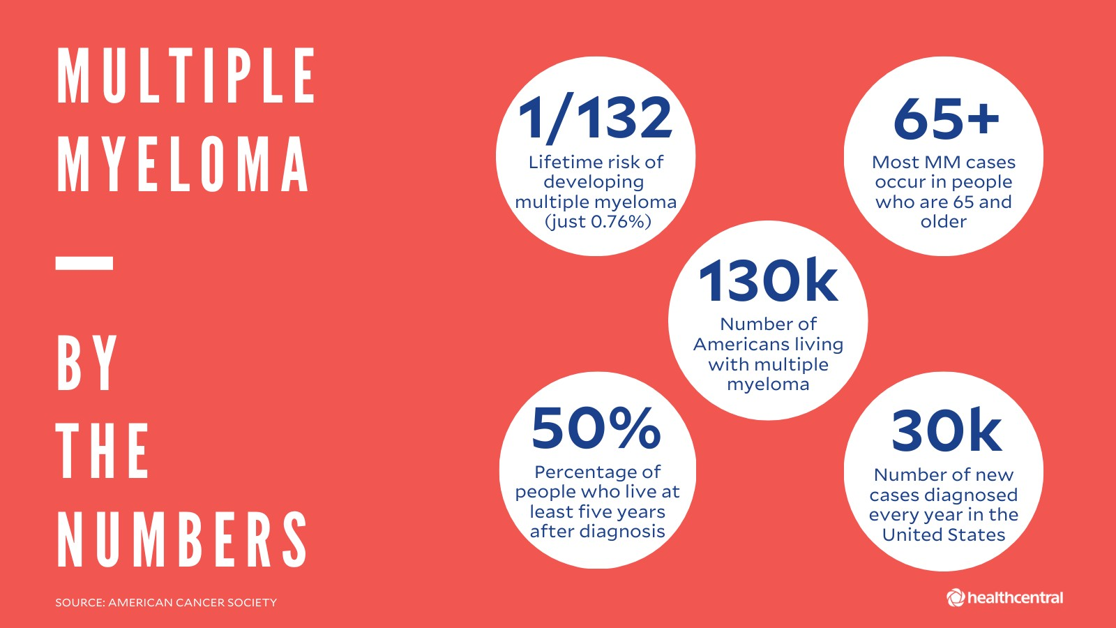

Slide 30
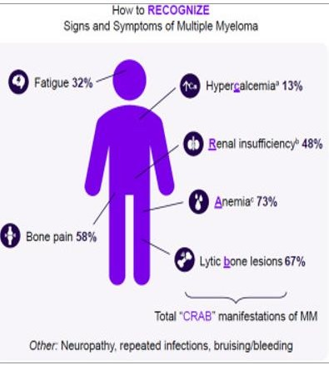

Slide 31
Most Common Treatments for Leukemia and Lymphoma=depend on type and stage of cancer :
Radiation therapy= high-energy radiation to killing cancer cells+ shrink tumors
Chemotherapy= drugs to kill cancer cells
>>>>>Chemotherapy paired with radiation therapy<<<<<< 3) Stem cell transplants= by replacing diseased bone marrow with healthy stem cells to help growing new bone marrow
4) Targeted therapy= drugs inhibiting the specific features
which are important for abnormal behavior of cancer cells 5) Immunotherapy= help patient’s immune system to recognize and destroy cancer cells

