Slide 1
Clinical Chemistry
SAFETY IN THE LABORATORY
Msc . Tholfikar Ahmed

Slide 2
SAFETY IN THE LABORATORY
Virtually all experiments conducted in a biochemistry laboratory present a potential risk to the well-being of the investigator. In planning any experiment it is essential 35 1.5 Safety in the laboratory that careful thought be given to all aspects of safety before the experimental design is finalized. Health hazards come from a variety of sources:

Slide 3
SAFETY IN THE LABORATORY
1 - Chemical hazards: All chemicals are, to varying extents, capable of causing damage to the body. They may be irritants and cause a short-term effect on exposure. Alternatively they may be corrosive and cause severe and often irreversible damage to the skin. Examples include strong acids and alkalis

Slide 4
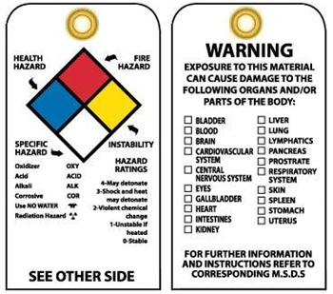
SAFETY IN THE LABORATORY
National Fire Protection Association NFPA Chemical label ‘Square Safety’

Slide 5
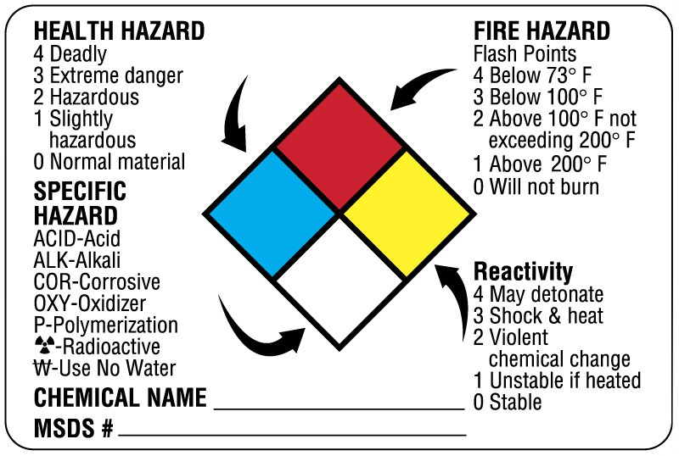
SAFETY IN THE LABORATORY

Slide 6
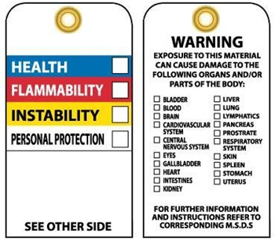
SAFETY IN THE LABORATORY

Slide 7
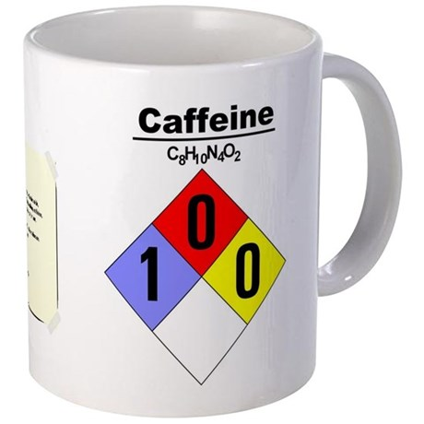
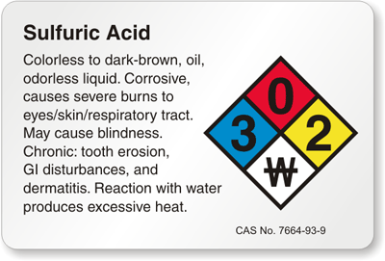
SAFETY IN THE LABORATORY

Slide 8
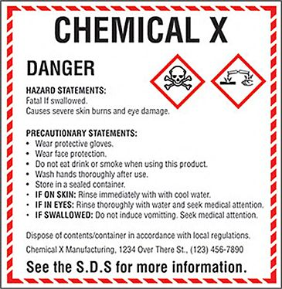
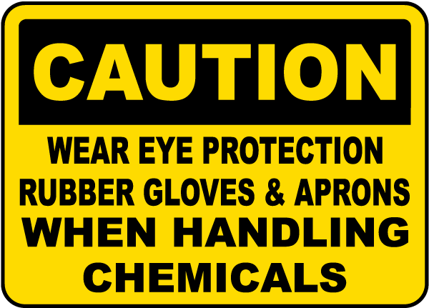
SAFETY IN THE LABORATORY

Slide 9
SAFETY IN THE LABORATORY

Slide 10
SAFETY IN THE LABORATORY

Slide 11
SAFETY IN THE LABORATORY
2 - Biological hazards: Examples include human body fluids that may carry infections such as HIV, laboratory animals that may cause allergic reactions or transmit certain diseases, pathogenic animal and cell tissue cultures, and all microorganisms including genetically engineered forms.

Slide 12
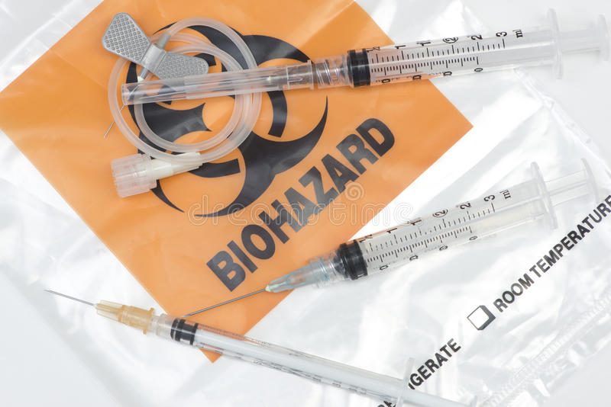
SAFETY IN THE LABORATORY

Slide 13
SAFETY IN THE LABORATORY

Slide 14
SAFETY IN THE LABORATORY
3 - Electrical and mechanical hazards: All electrical apparatus should be used and maintained in accordance with the manufacturers’ instructions. Electrophoresis equipment presents a particular potential for safety problems. Centrifuges, especially high-speed varieties, also need careful use especially in the correct use and balance of the rotors.
4 - General laboratory hazards: Common examples include syringe needles, broken glassware and liquid nitrogen flasks.

