Slide 1
Celiac Disease
Practical
Immunology
Lect- 5

Slide 2
Celiac Disease
Celiac disease is a multifactorial, autoimmune disorder that occurs in genetically susceptible individuals.
Trigger is an environmental agent-gliadin component of gluten. The enzyme tissue transglutaminase (tTG) has been discovered to be the autoantigen against which the abnormal immune response is directed.
What is gliadin? A glycoprotein present in wheat and other grains such as rye, barley and to some degree, oats.
What is gluten? A composite of the proteins
gliadin and glutenin which comprise about 80 of
the protein contained in wheat seed.

Slide 3
pathogensis
The pathogenesis of the celiac lesion is thought to be an abnormal permeability allowing the entry of gliadin peptides not entirely degraded by the intraluminal and brush-border bound peptides.
The most toxic amongst the many fractions of gliadin that have shown to cause the most mucosal damage are very resistant to digestion by gastric, pancreatic, and mucosa-associated enzymes.
Normally, intestinal epithelium acts as a barrier to the passage of these macromolecules however in CD there is well documented loosening of the tight junctions which then leads to increased permeability to macromolecules.

Slide 4
pathogenesis
1st phase of T cell involvement reveals a marked increase of HLA-DR (human leukocyte antigen) expression on both the epithelium and the adjacent lamina propria macrophages
overexpression of the intercellular adhesion
molecule 1 (ICAM-1) CD8 Tcells invade
epithelial cells (intraepithelial lymphocytes).
There are three distinct patterns of mucosal
changes that can be recognized

Slide 5
pathogenesis
Type 1 infiltrative lesion. Seen in latent phase characterized by morphologically normal mucosa.
GI symptoms are usually absent. Intraepithelial lymphocytes are increased followed by infiltration of the lamina propria with plasma and lymphocytes.
Type 2 hyperplastic lesion is similar to type 1, but with elongation of crypts due to an increase in undifferentiated crypt cells.
Type 3 destructive lesion is the most advanced pathologic change. Synonymous with total or subtotal villous atrophy, i.e., the classical lesion originally considered the landmark of CD.

Slide 6
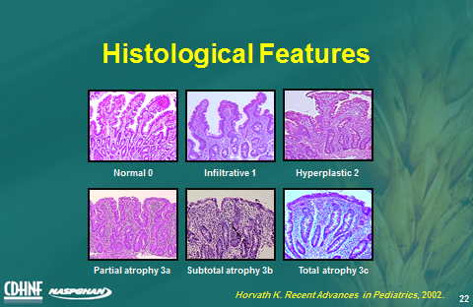

Slide 7
immunopathogenesis
Gluten peptides can be transported across the intestinal epithelium. Deamidation by TG2 leads to the production of deamidated gluten that are taken up and presented by antigen-presenting cells (APCs) of HLADQ2/HLA-DQ8 molecules. This presentation leads to activated gluten-reactive CD4+ Th1 cells that produce high levels of pro-inflammatory cytokines, with aTh1 cytokine pattern dominated by IFN-γ. Activated CD4+ T cells drive the activation and clonal expansion of B cells, which differentiate into plasma cells and produce anti-gliadin and anti-TG antibodies. Gluten peptides induce epithelial and APC cells to secrete IL-15, resulting in an increase in the number of IELs. IFN-γ production, and stimulating cytotoxic effects on epithelial cells

Slide 9
Autoantibodies
Dysregulated activation of intraepithelial lymphocytes (IELs) is a characteristic of CD that is implicated in the development of villous atrophy and epithelial cell injury. IELs constitute a population of antigen presentation like “innate” T cells that reside between enterocytes in the intestinal epithelium and can be activated by innate signals, acquiring a natural killer-like phenotype and cytotoxic effector functions

Slide 10
Diagnosis of celiac disease
1- Serology
2- Serum immunoglobulin A (IgA) endomysial antibodies and IgA tissue transglutaminase (tTG) antibodies. Sensitivity and specificity gt 95.
3- Testing for gliadin antibodies is no longer recommended because of the low sensitivity and specificity for celiac disease.
4- The tTG antibody test is less costly because it uses an enzyme-linked immunosorbent assay it is the recommended single serologic test for celiac disease screening in the primary care setting.
5- IgA deficiency can give false negative.

Slide 11
Serological Tests
1- Antigliadin antibodies (AGA)
2- Antiendomysial antibodies (EMA)
3- Anti tissue transglutaminase antibodies (TTG)
- first generation (guinea pig protein)
- second generation (human recombinant)
4-HLA typing

Slide 12
