Slide 1
Fluid Chapter 4
Fluid dynamic

Slide 11
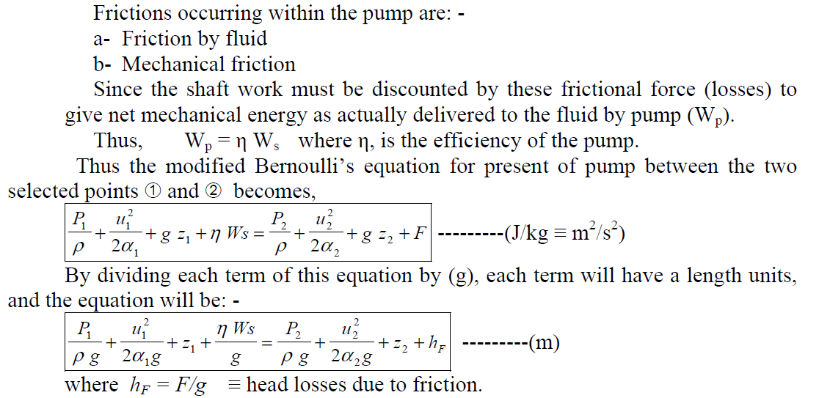

Slide 12
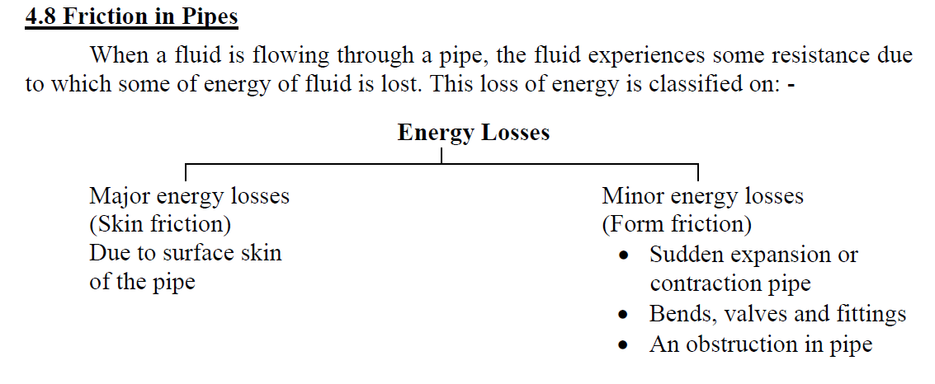

Slide 13
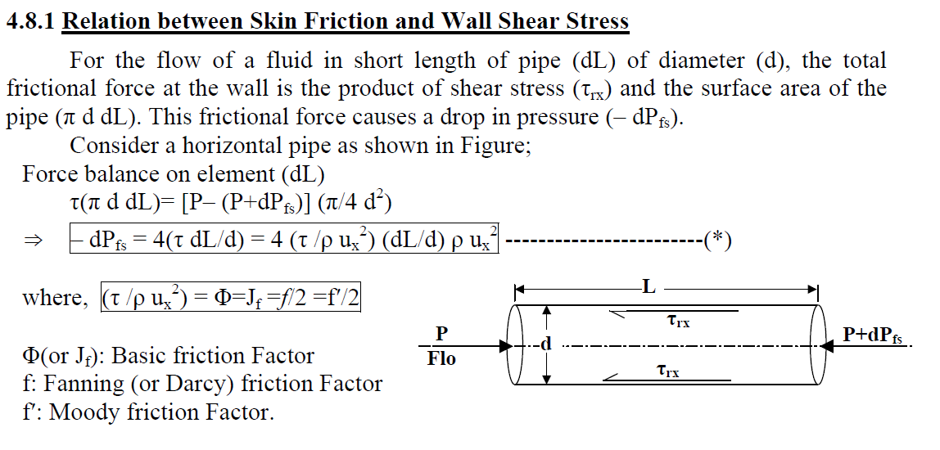

Slide 14
4.2 The Nature of Fluid Flow
When a fluid is flowing through a tube or over a surface, the pattern of flow will vary with the velocity, the physical properties of fluid, and the geometry of the surface. This problem was first examined by Reynolds in 1883. Reynolds has shown that when the velocity of the fluid is slow, the flow pattern is smooth. However, when the velocity is quite high, an unstable pattern is observed in which eddies or small packets of fluid particles are present moving in all directions and at all angles to the normal line of flow.
The first type of flow at low velocities where the layers of fluid seen to slide by one another without eddies or swirls being present is called “laminar flow” and Newton’s law of viscosity holds.
The second type of flow at higher velocities where eddies are present giving the fluid a fluctuating nature is called “turbulent flow

