Slide 1
Heat conduction through wall
Majed H Majeed

Slide 2
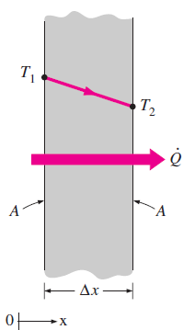
Heat conduction in the wall
Heat conduction through Plane wall
Fourier Equation is
$Q=kA\frac{T_{1}−T_{2}}{∆x}$
The heat flux
$q=\frac{Q}{A}=k\frac{T_{1}−T_{2}}{∆x}$

Slide 3
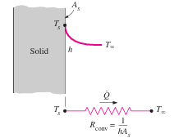
Heat Conduction in a wall
$$\dot{Q}=\frac{T_{1}−T_{2}}{\frac{∆x}{kA}}=\frac{T_{1}−T_{2}}{R_{th}}$$
$$R_{th}=\frac{∆x}{kA}$$
$$Convection Resistance$$
$$\dot{\begin{aligned}Q=Ah\left(T_{s}−T_{∞}\right) \\ \dot{Q=\frac{T_{s}−T_{∞}}{\frac{1}{Ah}}=\frac{\left(T_{s}−T_{∞}\right)}{R_{conv}}}\end{aligned}}$$
$R_{conv}=\frac{1}{Ah}$

Slide 4
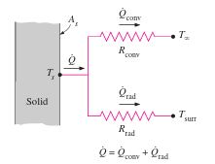
Conduction in a wall
Radiation and convection combination.
$\dot{Q}={\dot{Q}}_{conv}+{\dot{Q}}_{rad}$
$\dot{Q=Ah_{conv}\left(T_{s}−T_{∞}\right)+Ah_{rad}\left(T_{s}−T_{∞}\right)}$
$\dot{Q}=A\left(h_{conv}+h_{conv}\right)\left(T_{s}−T_{∞}\right)$
$\dot{Q}=Ah_{comb}\left(T_{s}−T_{∞}\right)$
$h_{comb}=h_{conv}+h_{rad}$

Slide 5
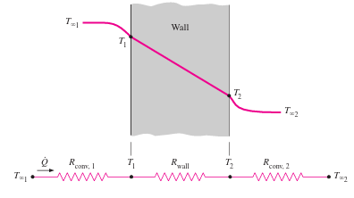
Thermal Resistance Network

Slide 6
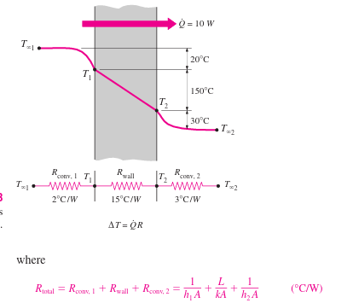
Conduction in a wall

Slide 7
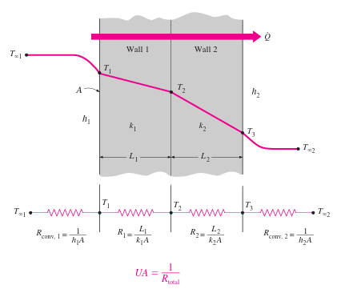
Conduction in a wall
The over all heat transfer coefficient is U
$$UA=\frac{1}{R_{total}} → U=\frac{1}{AR_{total}}$$

Slide 8
Conduction in a wall

Slide 9
examples
Example.1. Determine the heat transfer across a plane wall of (20cm) thickness and a constant thermal conductivity of (10W/m.K). The temperatures of surface are steady at (${120}^{o}$C) and (${20}^{o}$). The area of the wall is (2$m^{2}$). Also determine the temperature gradient in the direction of flow and the temperature at the midpoint of the wall.

Slide 10
Examples
Solution: heat transfer by conduction through the wall of thickness Δx=20cm=0.2m and area A=2$m^{2}$. The surface temperatures are ($T_{1}$=${120}^{o}$C) and ($T_{2}$=${20}^{o}$C)
Property: constant thermal conductivity, k=10W/m.K
Assumption: Steady-state and one dimensional heat conduction
Analysis: The heat transfer through the wall can be determined by Fourier's law of conduction.

Slide 11
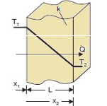
Examples

Slide 12
Examples
Example 2. The temperature of gases in a furnace is (500K). The temperature of inside surface of the furnace is (400K). The heat transfer between the gases and the surface of the furnace occurs by convection and radiation. The convection coefficient is (20W/$m^{2}.^{o}C$). The furnace surface emissivity is (0.9). Find the combined heat transfer coefficient and the heat transfer rate per unit area.

Slide 13
Examples
Solution: heat transfer by convection and radiation between furnace surface and the hot gases $T_{s}$=400K, and $T_{∞}$=500K
Property: constant property h=20W/$m^{2}.^{o}C$and ε=0.9
Assumption: steady-state radiation and convection
Analysis: the heat transfer coefficient of radiation can be determined by

Slide 14
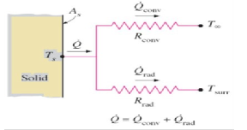
Examples:

Slide 15
Examples
Example 3 A wall of thickness (3cm) and thermal conductivity of (24W/${m.}^{o}$C). The wall is exposed to heat transfer by convection on both sides. The temperature and coefficient of heat transfer on the inner face are (${100}^{o}$C) and (10W/$m^{2}.^{o}$C) respectively. The temperature and coefficient of heat transfer on the other surface are (${25}^{o}$C) and (20W/$m^{2o}$C) respectively. If the wall area is (4$m^{2}$), find the heat transfer rate. Determine the temperatures at the two sides of the wall.

Slide 16
Examples

Slide 17
Examples

Slide 18
Examples
Example 4. A multilayer wall is made of three layers. Layer (1) is of thickness (4cm) with thermal conductivity of (24W/${m.}^{o}$C). Layer (2) is of thickness (6cm) with thermal conductivity of (12W/${m.}^{o}$C). Layer (3) is of thickness (2cm) and thermal conductivity (0.8W/${m.}^{o}$C). The layer (1) and layer (3) are exposed to convection heat transfer at the outer faces. The temperatures and heat transfer coefficients are (${120}^{o}$C) and (20W/$m^{2o}C$) and (${10}^{o}$C) and (60W/$m^{2o}C$). Determine the heat transfer through the wall for area of 4.5$m^{2}$, the two sides temperatures and the interface temperatures.

Slide 19
Examples
Solution: multilayer plane wall consists of three layers with $∆x_{1}$=4cm, $k_{1}=$24W/${m.}^{o}$C, ${∆x}_{2}$=6cm, k2=12W/$m^{2o}$C, ${∆x}_{3}$=2cm k=0.8W/$m^{2o}$C, $h_{∞1}$=20W/$m^{2o}C$, $h_{∞2}$=60W/$m^{2o}$C, $T_{∞1}$=${120}^{o}$C, T2=10oC, A=4.5$m^{2}$
Property: Constant thermal conductivities Assumption: Steady state heat transfer by conduction through a plane wall
Analysis: firstly we calculate the thermal resistance of every layer and convection resistance on the two sides:

Slide 20
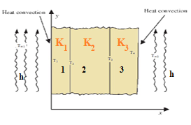
Examples

Slide 21
Examples

Slide 22
Examples
Example5 Consider a (1m) high and (1.5m) wide double glassing window consisting of two ( thick layers (6mm) of glass (k=0.8W/${m.}^{o}$C) separated by a stagnant air space (k=0.025W/$m^{o}$C) of (8mm) wide. Determine the steady rate of heat transfer through this double-pane window and the temperature of its inner surfaces for a day during which the room is maintained at (${25}^{o}$C) while the temperature of the outdoor is (${45}^{o}$C). Take the convection heat transfer coefficients on the inner and outer surfaces of the window to be (10W/$m^{2o}C$) and (40W/$m^{2o}C$) which include the effects of radiation.

Slide 23
Examples
Solution: a double pane window of two glass layers separated by stagnant air space, L=1m, w= 1.5m, glass layer ${∆x}_{g}$=6mm, $k_{g}$=0.8W/${m.}^{o}$C, stagnant air ${∆x}_{a}$=8mm, $k_{a}$=0.025W/${m.}^{o}$C, $T_{i}$=${25}^{o}$C, $T_{o}$=${45}^{o}$C, $h_{i}$=10W/$m^{2}.^{o}C$, $h_{o}$=40W/$m^{2}.^{o}C$.
Property: constant property for air and glass
Assumption: steady state heat transfer and one-dimensional
Analysis: There are five resistance as shown in Fig. We determine these thermal resistance. The area of the window A=Lxw=1.5x 1=1.5$m^{2}$.

Slide 24
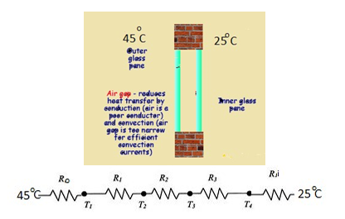
Examples

