Slide 1
الفحوصات الشعاعية الخاصة المرحلة الثالثة
جامعة المستقبل
كلية التقنيات الصحية والطبية
قسم تقنيات الاشعة
Lecture 6
MRI of the Spine
اعداد
د. مهند احمد صاحب م.م. مرتضى عبد الامير محمد

Slide 2
MRI Scan of the Spine
Magnetic resonance imaging (MRI) is a highly sensitive and specific imaging technique that yields comprehensive images of the structure, function, and composition of tissues in the body. The technique uses a strong magnet, radio waves, and a computer to generate detailed images of the body. In the spine, an MRI scan can reveal thorough details of the joints, muscles, tendons, ligaments, spinal discs, spinal nerve roots, and the spinal cord.

Slide 3
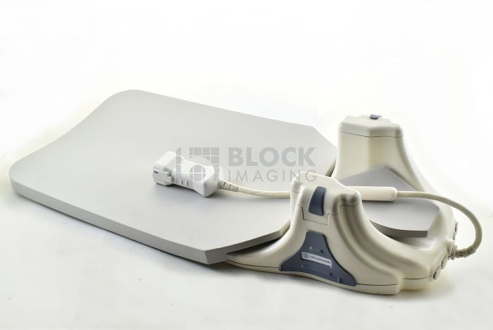
MRI produces detailed images without the use of ionizing radiation, making it a safer option compared to standard imaging techniques, like x-rays or computed tomography (CT) scans.
Spinal coil of the MRI

Slide 4
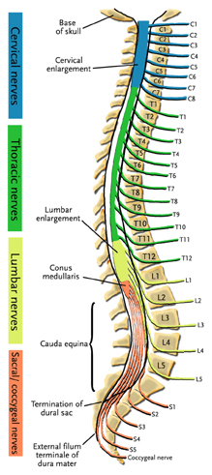
MRI may be recommended when the following conditions are suspected:
Spinal cord compression in the neck due to conditions such as cervical stenosis with myelopathy
Spinal cord compression in the lower back, leading to conditions such as cauda equina syndrome
Primary or secondary spinal tumors
Herniated disc
In these conditions, MRI is considered the gold standard for imaging and investigating the underlying cause of the specific condition and formulating the treatment plan.

Slide 5
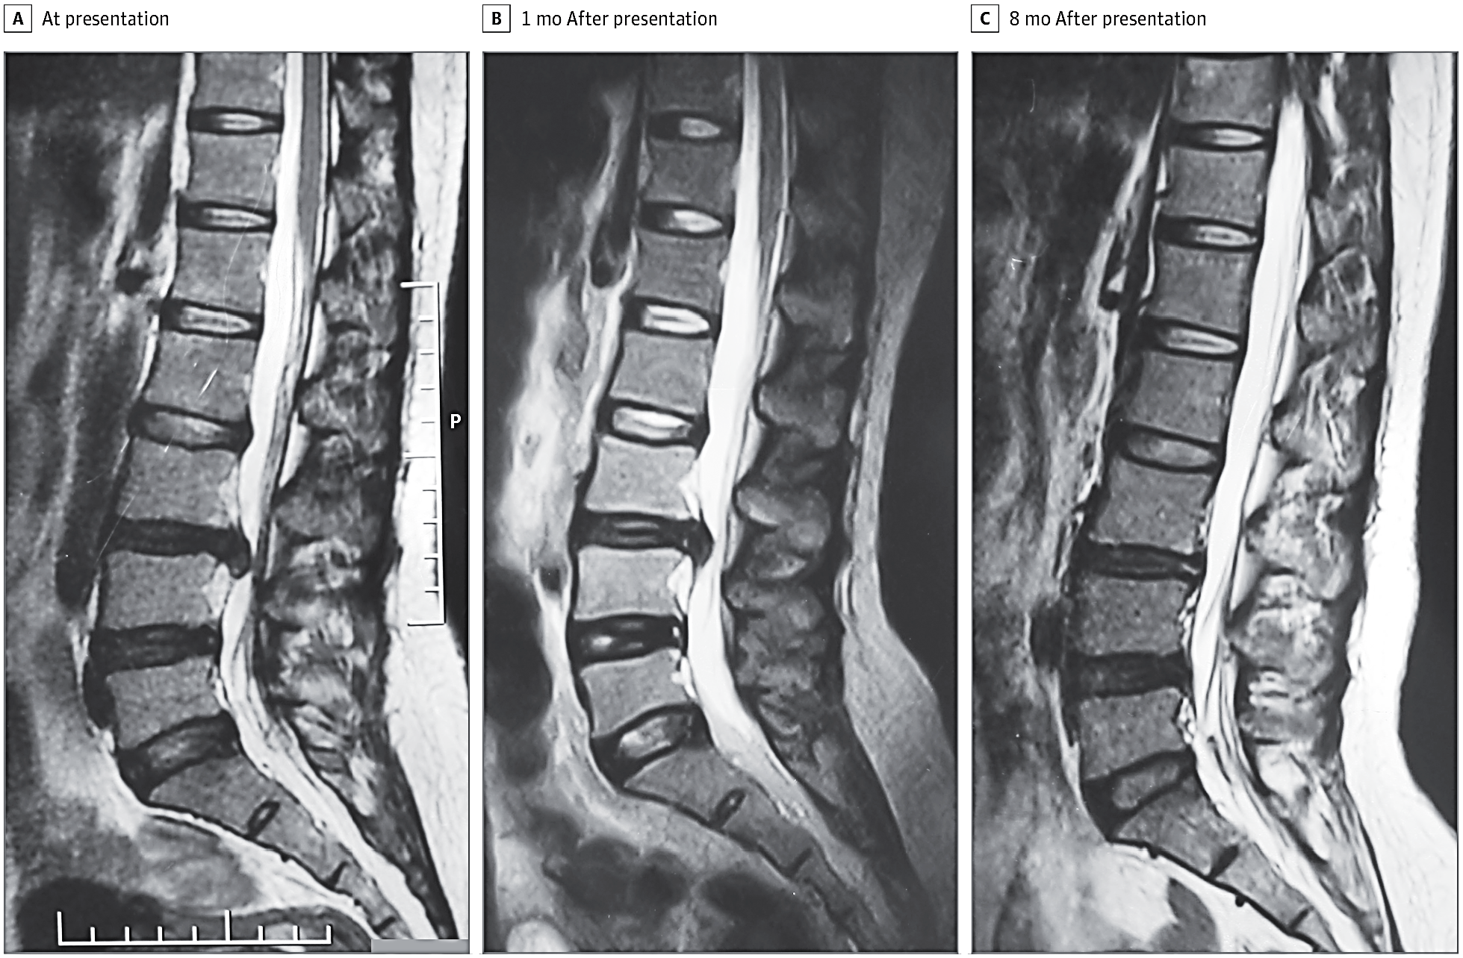
Do you know what is going on

Slide 6
Do you Tell what is going on

Slide 7
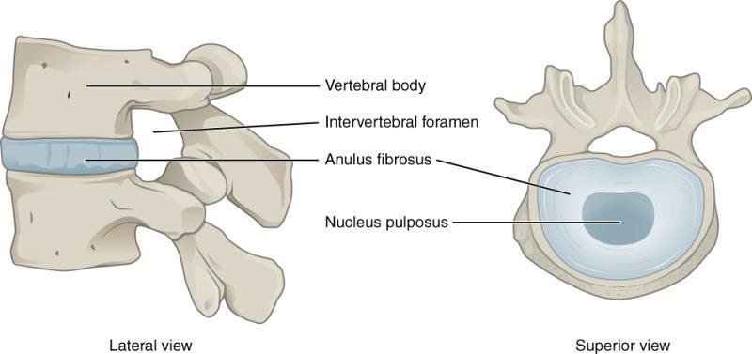
Intervertebral disc
Each vertebrae is separated and cushion by intervertebral disc, keeping the bones from rubbing together .
Disc are designed like a radical car tire .
The outer ring called the annulus, has criss-crossing fibrous bands, these bands attached between the body of each vertebrae. Inside the disc is a gel filled center called nucleus.

Slide 8
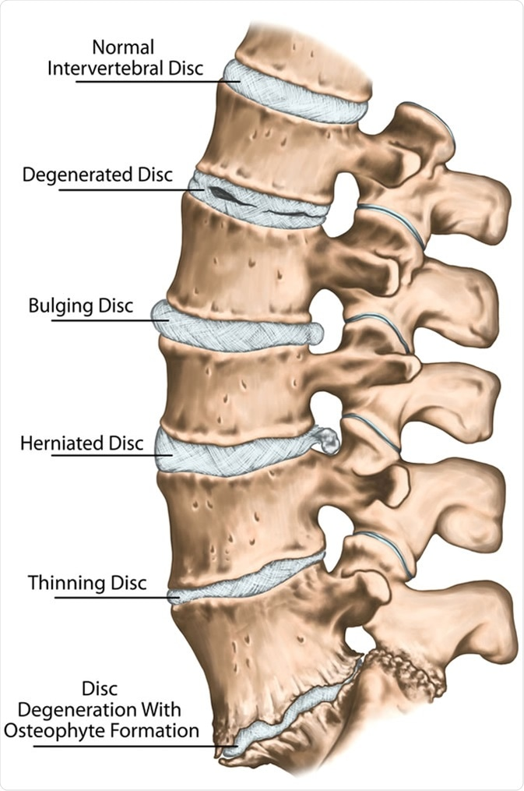
Spine problems can be more complex

Slide 9
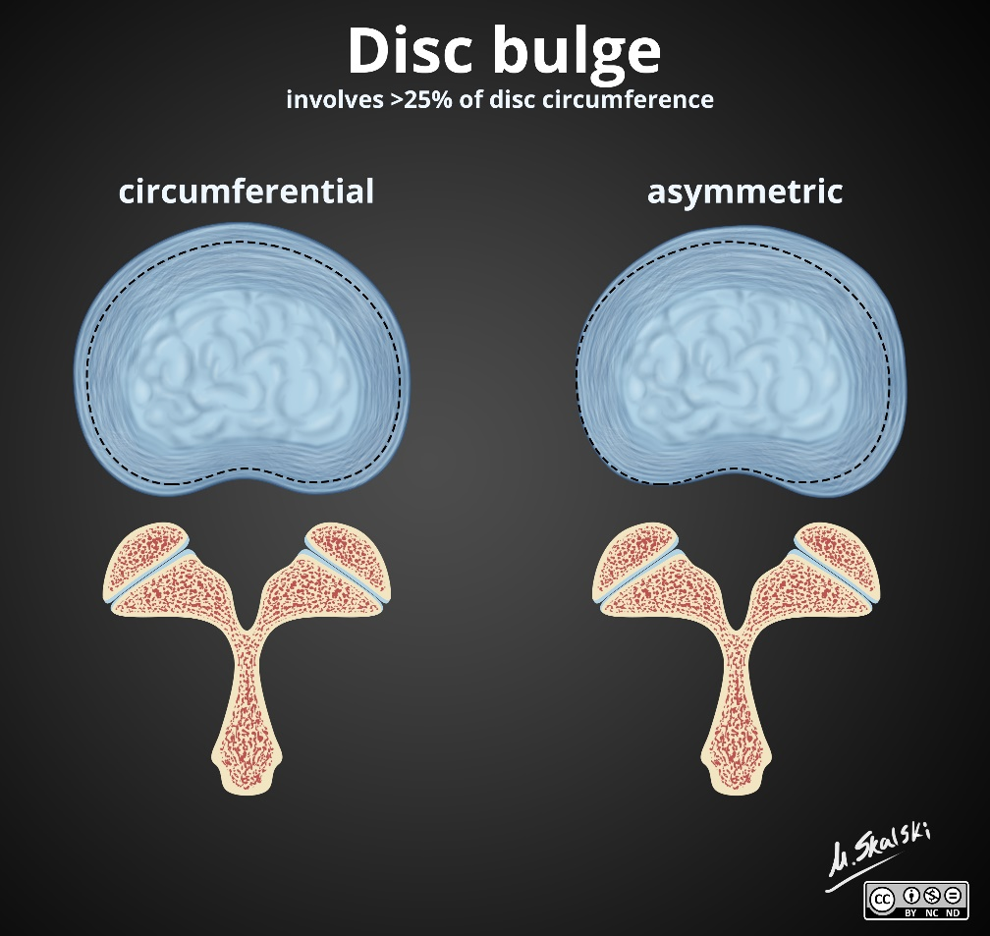
Disc prolapse levels
A
B

Slide 10
MRI DISC PROLAPSE LEVELS
C
D

Slide 11
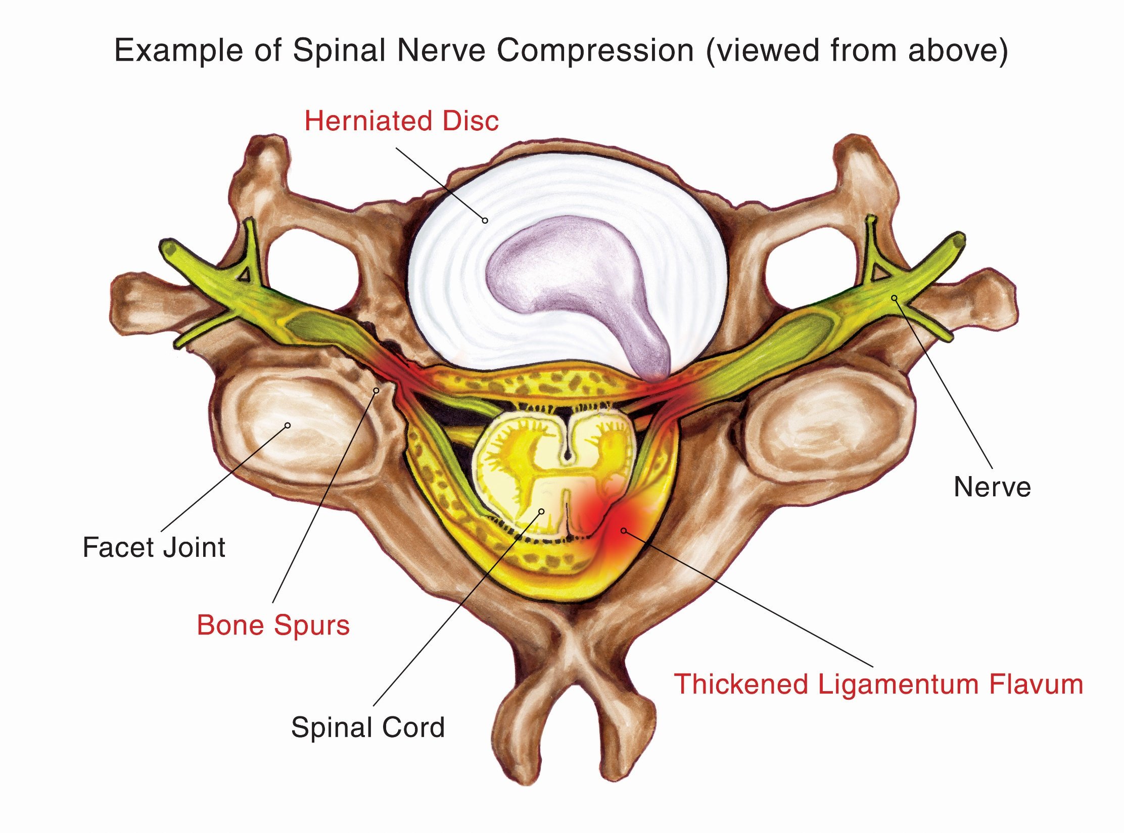
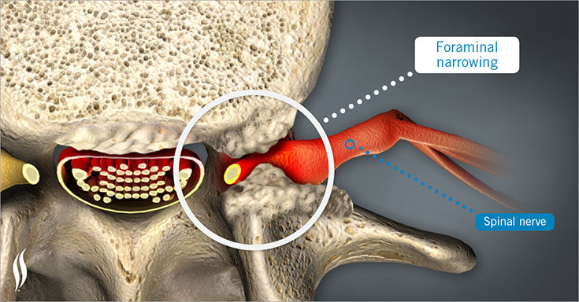

Slide 12
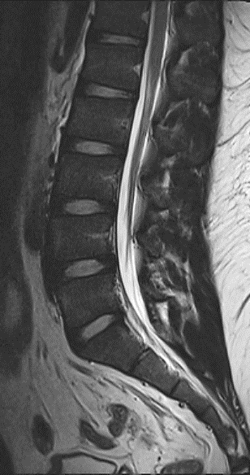
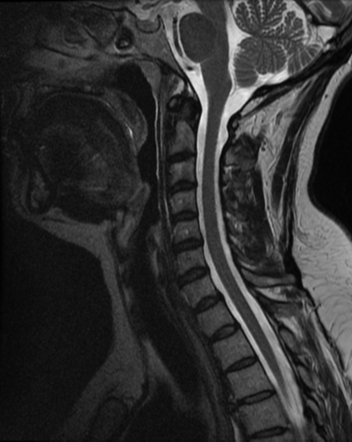
Normal MRI lumber spine
Normal MRI cervical spine

Slide 13
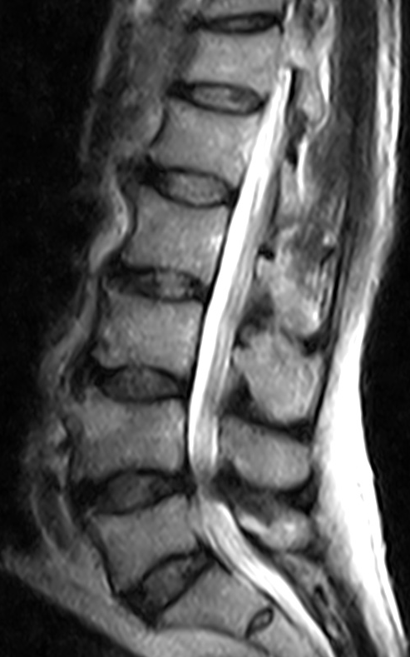
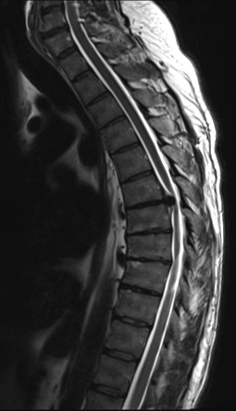
Spinal canal stenosis
Disc herniation (sequestration)

Slide 14
Spinal cord problem
A- T1 with contrast B- T2 without contrast

Slide 15
Ligamenta Flava hypertrophy

Slide 16
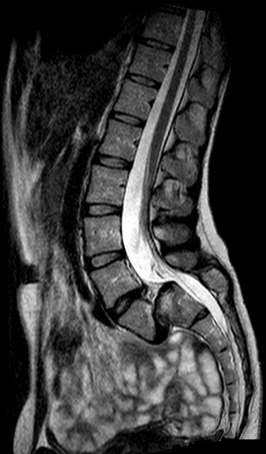
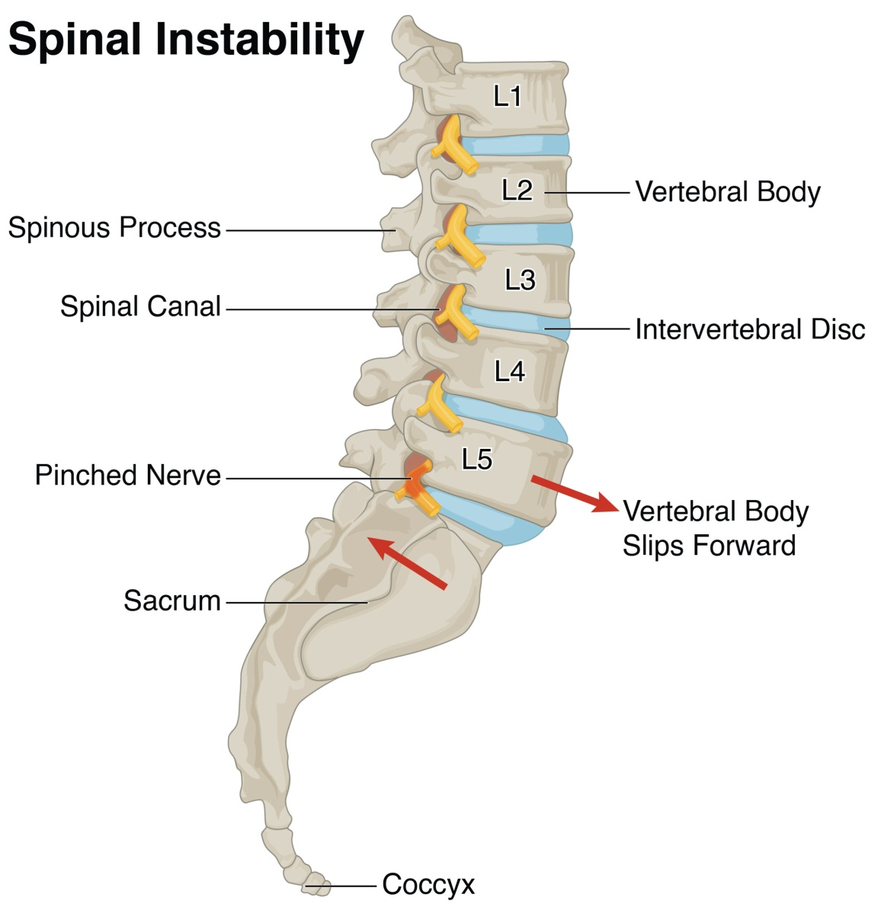
vertebral problem : spondylolisthesis

Slide 17
MRI with Contrast
For certain conditions, an additional MRI sequence using contrast can help more accurately determine the anatomy and pathology of the area of the spine being studied. These contrast agents make the abnormality in the tissues brighter and clearer on T1 helping doctors identify the pathology with greater precision.

Slide 18
MRI with Contrast
A- T1 with contrast B- T2 without contrast

Slide 19
Can you tell now what is happing ?

Slide 20
TO recapitulate Spinal MRI imaging
Degenerative diseases
1- spinal canal stenosis
2- Disk lesions
3- Bone marrow change
4- Spinal instability → spondylolisthesis (antrolisthesis , Retrolisthesis )
5- cord pathology
Loss of water→↓ T2 signal [MRI]
Loss of height → narrowing of disc space [X ray, MR, CT?]
Intradiscal air ( vacuum phenomena) [CT]

Slide 21
Myelography

Slide 22
Myelography
Myelography is a type of radiographic examination that uses a contrast medium to detect pathology of the spinal cord, including the location of a spinal cord injury, cysts, and tumors. Historically the procedure involved the injection of a radiocontrast agent into the cervical or lumbar spine, followed by several X-ray projections. Today, myelography has largely been replaced by the use of MRI scans, although the technique is still sometimes used under certain circumstances – though now usually in conjunction with CT rather than X-ray projections.

Slide 23
CERVICAL MYELOGRAPHY
This may be performed by introduction of contrast medium into the thecal sac by lumbar puncture and then run up to the cervical spine, or by direct cervical puncture at C1/2.
Indications
Suspected spinal cord pathology or root compression in patients unable or unwilling to undergo MRI imaging.

Slide 24
Lateral Cervical C1/2 Puncture Versus Lumbar Injection
cervical region to allow diagnostic quality radiographs, which were performed on the fluoroscopy table. Cervical myelography is therefore most easily, and safely, performed as a lumbar injection, at the level of the cauda equina, and then running the contrast up into the cervical region.
Cervical puncture is indicated where there is severe lumbar disease, which may restrict the flow of contrast medium and may make lumbar puncture difficult, and when there is thoracic spinal canal stenosis..

Slide 25
Contrast Medium
Non-ionic contrast medium is used with a total dose not exceeding 10 mL of contrast medium (a concentration of 300 mg mL−1).
Equipment
Tilting x-ray table with a C-arm fluoroscopic facility for screening and radiography in multiple planes.
Radiographic Views
After needle withdrawal, two antero-posterior (AP) radiographs are obtained, with the tube angulated cranially and caudally, in turn, along with both oblique views once again with cranial and caudal tube tilt. lateral views are needed to ensure full assessment of the cervico-thoracic junction.
Lastly, a further lateral view of the craniocervical junction is taken with mild neck flexion, because the extended neck position may prevent full visualization of the upper cervical cord up to the foramen magnum.

Slide 26
LUMBAR MYELOGRAPHY
This procedure is to look for the level of spinal cord disease such as lumbar nerve root compression , cauda equina syndrome, conus medullaris lesions, and spinal stenosis. This is done for those who are unwilling or unable to do MRI scan of the spine. Lumbar puncture is done before injected contrast into the thecal sac.
The lumbar thecal sac is punctured at L2/3, L3/4 or L4/5. The higher levels tend to be away from the most common sites of disc herniation and stenosis, and therefore puncture may be easier.

Slide 27
Indications
Suspected lumbar root or cauda equina compression, spinal stenosis and conus medullaris lesions in patients who are unable or unwilling to undergo MRI.
Contraindications
However, it is dangerous to do lumbar puncture in those who has raised intracranial pressure. For those who had recently done lumbar punctre in one week time, there may be some cerebrospinal fluid (CSF) accumulates in the subdural space. Thus needle maybe mistakenly inserted into subdural space rather than the targeted subarachnoid space.
Contrast Medium
The contrast medium is the same as that used for cervical myelography. The maximum dose is again the equivalent of 3 g of iodine, and may be given as 10 mL of contrast medium of 300 mg mL−1 concentration, or 12.5 mL of 240 mg mL−1.

Slide 28
Radiographic Views
1. AP and oblique views are obtained. (About 25 degrees of obliquity is typical
2. Lateral view with a horizontal beam is useful, but further laterals in the erect or semierect position on flexion and extension.

Slide 29
THORACIC MYELOGRAPHY
If the thoracic spine is the primary region of interest, the lumbar puncture injection is made with the patient lying on one side, and the patient’s head supported on a bolster or pad to prevent contrast medium from running up into the head.
When the injection is complete, lateral radiographs may be taken, and the patient is then turned to lie supine. Further AP views are then taken.

Slide 30
THANK YOU
For you attention

