Slide 1
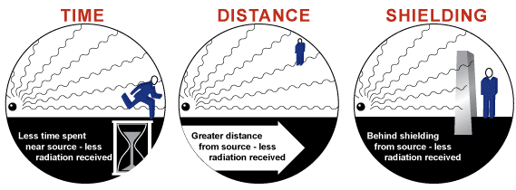
كلية المستقبل الجامعة
AL-Mustaqbal University College
Department of Medical Physics
The fourth Stage
قسم الفيزياء الطبية
المرحلة الرابعة
الوقاية من الاشعاع
Radiation Protection
6
LECTURE SIX :
Radiation protection rules
(Solutions to the Problems)
Aaat. prof . Dr Forat Hamzah Dr. Ameen Alwan

Slide 2
Radiation protection rules
قواعد الحماية من الإشعاع
Radiation Protection
Methods (rules) of Radiation Protection
الوقاية من الإشعاع
طرق (قواعد) الحماية من الإشعاع
Time (Limiting Time)
Distance
Shielding
الوقت
المسافة
التدريع
Shielding properties of Alpha particles
خصائص التدريع او الوقاية من جسيمات ألفا
Shielding properties of Beta particles
خصائص التدريع او الوقاية من جسيمات بيتا
Shielding properties of Gamma radiation & X-ray
خصائص الحماية من أشعة جاما والأشعة السينية
Principles of Radiation Protection
مبادئ الوقاية من الاشعاع

Slide 3
Radiation protection rules
Introduction
Fundamental to radiation protection is the avoidance or reduction of dose using the simple protective measures of time, distance and shielding. The duration of exposure should be limited to that necessary, the distance from the source of radiation should be maximized, and the source shielded wherever possible.
Radiation Protection
It is the science and practice of protecting people and the environment from the harmful effects of ionizing radiation.
Method of Radiation Protection
The three basic methods used to reduce the risk of external radiation are
One : Time (limiting time)
Two : Distance
Three : Shielding
Good radiation protection practices require optimization of these fundamental techniques.

Slide 4
Radiation protection rules
ONE : Time (Limiting Time)
كمية الإشعاع التي تتراكم في الجسم
This represent the amount of radiation that accumulates (pile up) in a individual (body) within a certain time, which depend on how long the body stays in the radiation field.
والتي تعتمد على مدة بقاء الجسم في مجال الإشعاع خلال وقت معين
الجرعة
معدل الجرعة
الوقت
Dose (mrem) = Dose Rate (mrem/hr) x Time (hr)
(1)
لذلك ، للحد من جرعة الشخص ، يمكن تقييد الوقت الذي يقضيه الشخص في المنطقة
Therefore, to limit a person’s dose, one can restrict the time spent in the area. How long a person can stay in an area without exceeding a prescribed (specified) limit of radiation is called the "stay time" and is calculated from the simple relationship:
يُطلق على المدة التي يمكن أن يبقى فيها الشخص في منطقة ما دون تجاوز حد محدد (محدد) للإشعاع "وقت البقاء" ويتم حسابه من العلاقة البسيطة
وقت البقاء
Stay Time = limit (mrem) / Dose Rate (mrem/hr)
(2)
Example: How long can a radiation worker stay in a 1.5 rem/hr radiation field if we wish to limit his dose to 100 mrem?
Answer : Stay Time = (100 mrem / 1500 mrem/hr) = 0.067 hr = 4 minutes

Slide 5
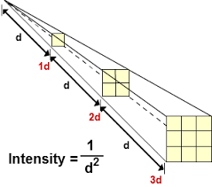
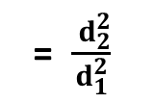
Radiation protection rules
TWO : Distance
The amount of radiation an individual (body) receives will also depend on how close the person is to the source. The relationship between radiation hazards and the distance from the source can be organized by the following relationship, which is called “ The Inverse Square Law ”
Point sources of X-ray and gamma radiation follow the inverse square law, which states that the intensity of the radiation (I) decreases in proportion to the inverse of the distance from the source (d) squared :
مدى قرب الشخص من المصدر
d
قانون التربيع العكسي
I α 1/d7777²
I α 1/d²
(Intensity) α 1/(distance) ²
قانون التربيع العكسي
Inverse Square Law
$\frac{I_{1}}{I_{2}}$
= $\frac{ d_{2}^{2}}{d_{1}^{2}}$

Slide 6
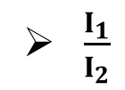
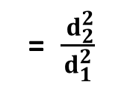
Radiation protection rules
I α 1/d²
This can be rewritten:
I = K ( 1/d² ) where K is a constant of unknown value.
So, for an intensity I₁ at distance d₁ , and another intensity I₂ at distance d₂:
I₁ = K(1/d₁²)
I₂ = K(1/d₂²)
Now solve for the relationship by eliminating K:
I₁ / I₂ = ( K /d₁²/k/d₂²)
I₁ / I₂ = d₂² / d₁²
Or I₁d₁²/I₂d₂²
$\frac{I_{1}}{I_{2}}$
= $\frac{ d_{2}^{2}}{d_{1}^{2}}$

Slide 7
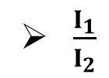
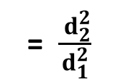
Radiation protection rules
Therefore, by knowing the intensity at one distance, one can find the intensity at other distance.
Example: The exposure rate one foot from a source is 500 mR/hr. What would be the exposure rate three feet from the source?
I₁ = 500 mR/hr
d₁ = 1 foot
d₂ = 3 feet
I₂ = I₁d₁² / d₂²
I₂ = (500*(1)²/(3)²)
I₂ = (500 / 9) = 55.6 mR/hr
$\frac{I_{1}}{I_{2}}$
= $\frac{ d_{2}^{2}}{d_{1}^{2}}$

Slide 8
Radiation protection rules
Gamma Constants
Gamma radiation levels (in R/hr) for one curie of many radionuclides at a distance of one meter have been measured. These gamma constants can be used to determine 1. The expected exposure rate at a given distance (using the inverse square law) for a known quantity of a radionuclide, or 2) the activity of a radionuclide from a measured exposure rate. . To determine the gamma radiation level in R/hr at one meter per curie, or equivalently, mR/hr at one meter per millicurie, you must divide the tabulated gamma constants (Γ) by 10.
Gamma Exposure Rate Formula
The exposure rate from a gamma point source can be approximated from the following expression:

Slide 9
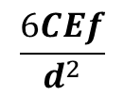
Radiation protection rules
mR/hr =
$$\frac{6CEf}{d^{2}}$$
Where C is the activity of the gamma emitter, in mill-curies
E is the gamma ray energy in MeV
$f$ is the fraction of disintegration yielding the gamma of energy E
d is the distance from the source in feet
If more than one gamma ray is emitted by the radionuclide of interest, then the contribution from each one must be calculated separately and summed. This expression is accurate to about 20% for gamma emitters with energies ranging from 0.07 MeV to 4 MeV.

Slide 10
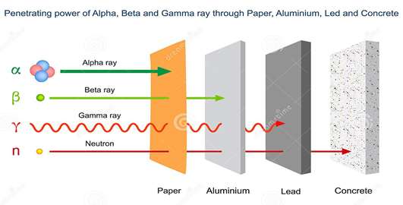
Radiation protection rules
THREE : Shielding
عندما لا يكون تقليل الوقت أو زيادة المسافة ممكنًا ، يمكن للمرء اختيار مادة التدريع لتقليل خطر الإشعاع الخارجي.
When reducing the time or increasing the distance may not be possible, one can choose shielding material to reduce the external radiation hazard. The material suitable for use as shields depends on the following
Type of radiation.
Its energy.
تعتمد المواد المناسبة للاستخدام كدروع على ما يلي
Shielding properties of Alpha particles
Alpha particles are easily shielded.
A thin piece of paper or several cm of air is usually enough to stop them.
Alpha particles present no external radiation hazard.
خصائص الحماية لجسيمات ألفا
يتم حماية جسيمات ألفا بسهولة
عادةً ما تكون قطعة رقيقة من الورق أو عدة سنتيمترات من الهواء كافية لإيقافها.
لا تمثل جسيمات ألفا أي خطر إشعاعي خارجي.

Slide 11
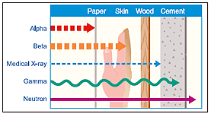
Radiation protection rules
Shielding properties of Beta particles
Beta particles are more penetrating than alpha particles.
Beta shields are usually made of aluminum
The range of beta radiation for various energies in air, plastic and various materials .
خصائص الحماية لجزيئات بيتا
جسيمات بيتا أكثر اختراقًا من جسيمات ألفا
تصنع دروع بيتا عادة من الالمنيوم
نطاق إشعاع بيتا لمختلف الطاقات في الهواء والبلاستيك والمواد المختلفة

Slide 12
Radiation protection rules
Shielding properties of Gamma radiation & X-ray
Gamma rays or X-ray are not easy to stop
Gamma rays or X-ray cannot be stopped by paper, wood, or the human body
Gamma rays stop using a lead wall.
خصائص الحماية من أشعة جاما والأشعة السينية
ليس من السهل إيقاف أشعة جاما او الاشعة السينية
لا يمكن إيقاف أشعة جاما او الاشعة السينية بالورق أو الخشب أو بجسم الإنسان
تتوقف أشعة جاما والاشعة السينية باستخدام جدار من الرصاص
Principles of Radiation Protection
مبادئ الحماية من الإشعاع
التبرير
يجب اتخاذ أي قرار يغير التعرض للإشعاع بعناية
Justification: Any decision that changes exposure to radiation must be made carefully.
Optimization of Protection: The dose of radiation must be kept as low account with any process.
Dose Limitation: The total dose to any person should not exceed the appropriate limit.
تحسين الحماية
يجب الحفاظ على جرعة الإشعاع منخفضة في أي عملية
تحديد الجرعة
يجب ألا تتجاوز الجرعة الإجمالية لأي شخص الحد المناسب

Slide 13
Q1- --------------- is the science and practice of protecting people and the environment from the harmful effects of ionizing radiation.
A- radiation B- radiation protection C- ionization process D- biological effect E- radioactive
Q2- --------------- is defined as the wavelengths that are visible to most human eyes, and it is a form of electromagnetic radiation with wavelength of 750nm–400nm and frequency of 1015 Hz.
A- radio waves B- microwaves C- infrared D- visible light E- x-ray

