Slide 1
كلية المستقبل الجامعة
AL-Mustaqbal University College
Department of Medical Physics
The fourth Stage
قسم الفيزياء الطبية
المرحلة الرابعة
الوقاية من الاشعاع
Radiation Protection
3
LECTURE THREE :
Radiation Sources
Aaat. prof . Dr Forat Hamzah Dr. Ameen Alwan

Slide 2
Sources of Radiation
Sources of Radiation
ONE : Natural Sources of Radiation
1- Cosmic Rays
الأشعة الكونية
2- Terrestrial Radiation
الإشعاع الأرضي
3- Exposure Through Ingestion
التعرض من خلال الابتلاع
4- Exposure Through Inhalation
التعرض للإشعاع عن طريق الاستنشاق
TWO : Manmade (Artificial) Sources of Radiation
1- Diagnostic Radiology
الأشعة التشخيصية
2- Radiation Therapy
العلاج الاشعاعي
3- Nuclear Medicine
الطب النووي
4- Nuclear Fuel Cycle (NPPs)
دورة الوقود النووي

Slide 3
Sources of Radiation
Introduction
الإشعاع موجود حولنا ، على الأرض وفي الماء والتربة في جميع الأوقات
Radiation is around us, on earth, in water and soil at all times .
The human body contains some radioactive materials.
Cosmic radiation from space also contributes to the background radiation around us.
The source of terrestrial radiation (radiation sources in the soil and water) are uranium , potassium and thorium .
The source of radiation is either natural or man-made.
يحتوي جسم الإنسان على بعض المواد المشعة
تساهم الاشعة الكونية القادمة من الفضاء في إشعاع الموجود من حولنا
مصدر الإشعاع الأرضي (مصادر الإشعاع في التربة والمياه) هو اليورانيوم والبوتاسيوم والثوريوم
مصدر الإشعاع إما طبيعي أو من صنع الإنسان

Slide 4
ONE : Natural Sources of Radiation
Natural sources of radiation
Radiation has always been present and is all around us in many forms. Life has evolved in a world with significant levels of ionizing radiation, and our bodies have adapted to it. Many natural sources produced during the formation of the solar system and through the interaction of cosmic rays with molecules in the atmosphere.
Natural sources of ionizing radiation
According to the United Nations Scientific Committee on the Effects of Atomic Radiation (UNSCEAR), there are four major sources of natural radiation: (1) cosmic radiation, (2) terrestrial radiation , (3) exposure through ingestion, and (4) ingestion.

Slide 5
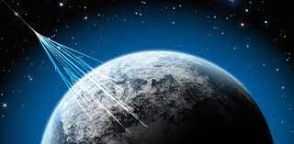
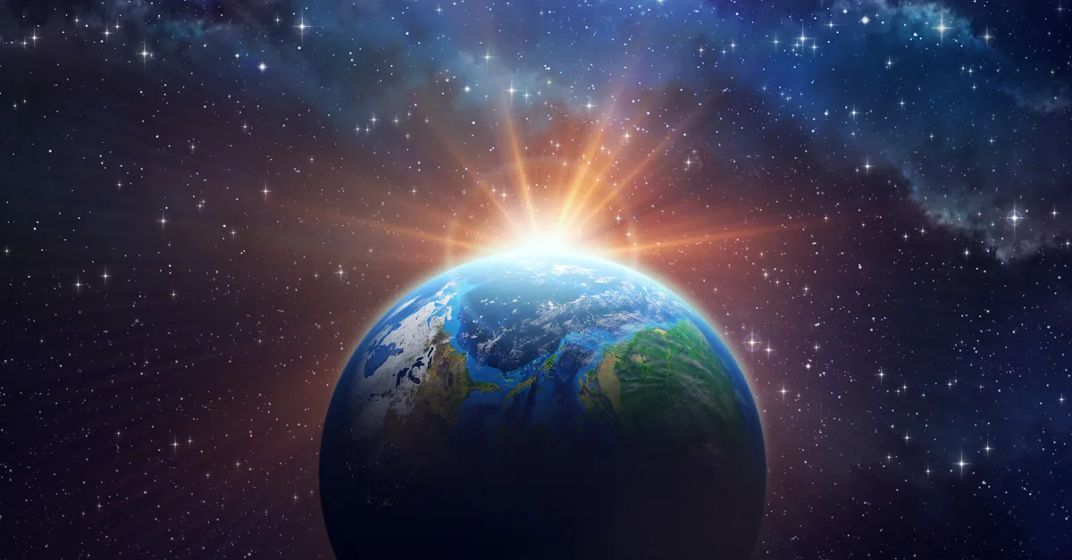
ONE : Natural Sources of Radiation
1- Cosmic Rays
الأشعة الكونية
توجد الأشعة الكونية في الفضاء وتتكون من مصادر مختلفة ، بما في ذلك الشمس والاجرام السماوية الأخرى في الكون
Cosmic rays are found in space and created from various sources, including the sun and other celestial events in the universe.
Cosmic rays are made up of protons but can be other particles or wave energy.
Some cosmic rays reach the Earth, while others interact with the atmosphere to create different types of radiation.
Some cosmic rays will penetrate the earth’s atmosphere and become absorbed by humans.
Radiation levels of cosmic rays increase as you get closer to the source
تتكون الأشعة الكونية من البروتونات ولكن يمكن أن تكون جسيمات أو طاقة موجية
Cosmic rays source is outside of the solar system
تصل بعض الأشعة الكونية إلى الأرض ، بينما يتفاعل البعض الآخر مع الغلاف الجوي لإنتاج أنواع مختلفة من الإشعاع
تخترق بعض من الأشعة الكونية الغلاف الجوي للأرض ويمتصها البشر
تزداد مستويات إشعاع الأشعة الكونية كلما اقتربت من المصدرلذلك تزداد كمية الإشعاع الكوني مع زيادة الارتفاع فوق سطح الأرض
Cosmic rays source is the sun
So the amount of cosmic radiation increases with the increase in the height above the earth's surface

Slide 6
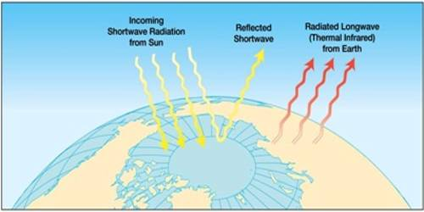
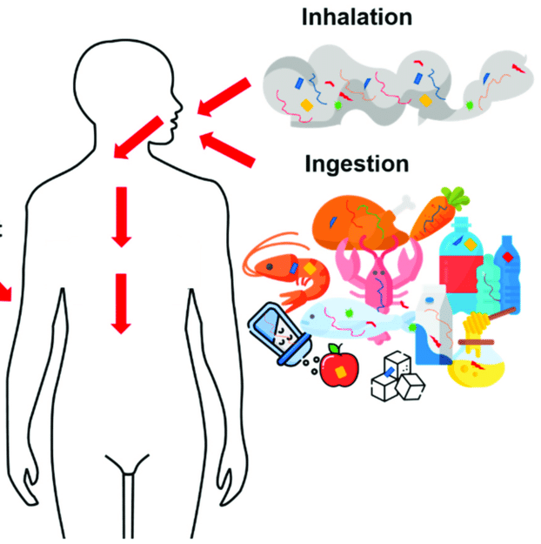
ONE : Natural Sources of Radiation
2 - Terrestrial Radiation
الإشعاع الأرضي
قشرة الأرض
The source of terrestrial radiation is the Earth’s crust (the hard outer layer of the Earth).
Earth’s crust contains deposits of Uranium, Potassium and Thorium which, during the natural decay process, will release small amounts of ionizing radiation.
Earth’s crust
Terrestrial Radiation from soil
3 - Exposure Through Ingestion
Exposure radiation occur through ingestion (eating) of food and drinking water.
The food and water contains amounts of radioactive materials and radioactive isotopes such as potassium-40 and carbon-14 , which come from groundwater.
المواد المشعة
النظائر المشعة
Exposure Through Ingestion & Inhalation

Slide 7
ONE : Natural Sources of Radiation
4 - Exposure Through Inhalation
التعرض للإشعاع عن طريق الاستنشاق
الغازات المشعة
Exposure radiation through inhalation is achieved through inhalation of radioactive gases emitted from the soil.
The radioactive gases emitted from soil are Radon gas and Thoron gas (²³⁸U, ²³⁵U, and ²³²Th).
Radon is produced by the decay of Uranium.
Thoron is produced by the decay of Thorium.
Radon gas and thoron gas levels differs depending location on the composition of soil due to the different composition of the soil.
These gases (Radon gas and Thoron gas ) are non-dangerous radioactive gases in the atmosphere , but inside the closed places become dangerous.
غاز الرادون وغاز الثورون
Radon gas
decay
Uranium
decay
Thorium
Thoron gas

Slide 8
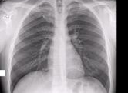
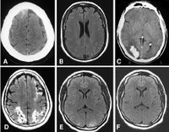
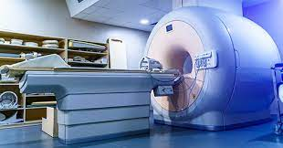
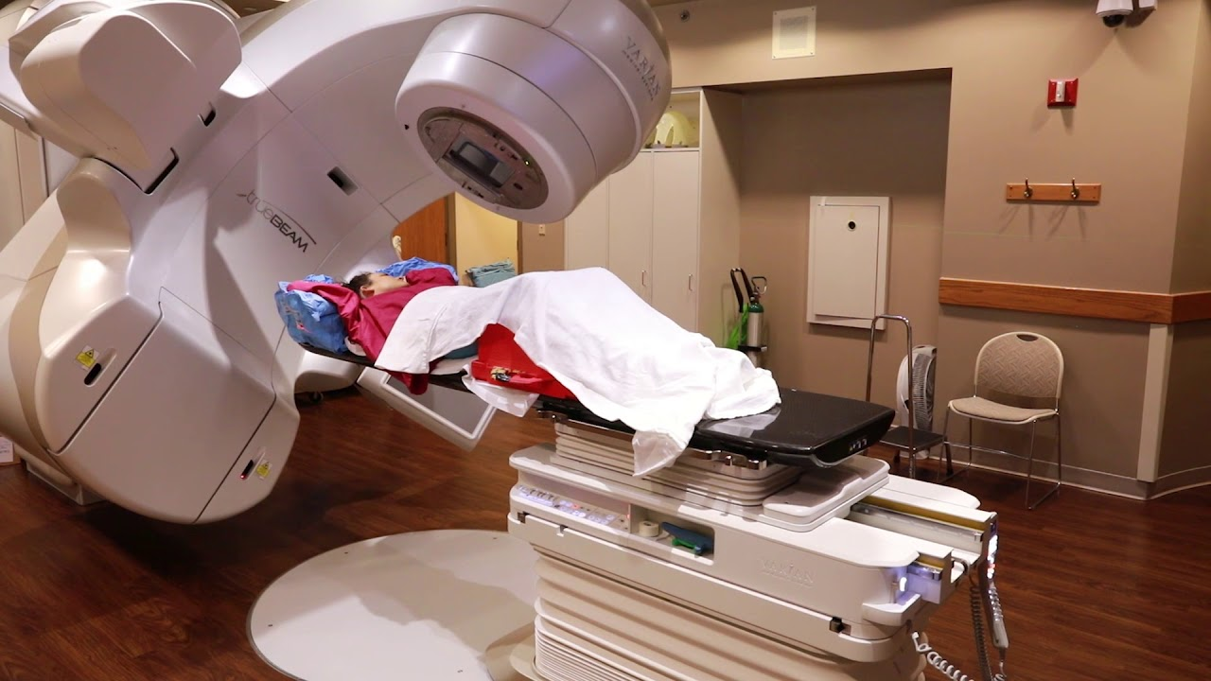
TWO : Man-made (Artificial) Sources of Radiation
The artificial (man-made) sources of ionizing radiation come from following :
1- Diagnostic Radiology
الأشعة التشخيصية
i ) Plain Radiograph/X-ray
ii) Computed Tomography (CT)
iii) Fluoroscopy
iv) Mammography
v) Angiography
2- Radiation Therapy
العلاج الاشعاعي
Radiation therapy is a type of cancer treatment that uses beams of energy to kill cancer cells. This treatment is carried out using the following :
Linear accelerator treatment
Proton beam therapy (charged particles)
علاج المعجل الخطي
العلاج الإشعاعي بالبروتونات (الجسيمات المشحونة)
Linear accelerator treatment
(LINAC)

Slide 9
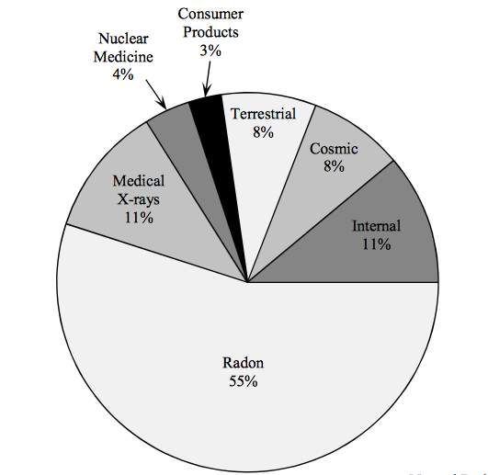
TWO : Manmade (Artificial) Sources of Radiation
3- Nuclear Medicine
الطب النووي
كميات صغيرة جدا من المواد المشعة
Nuclear medicine is a field of radiology that uses very small amounts of radioactive materials to examine organ function and structure.
4- Nuclear Fuel Cycle (NPPs)
دورة الوقود النووي
استخدام اليورانيوم لإنتاج سلسلة تفاعلات ينتج اثرها البخار
Nuclear fuel cycle is the processes that use uranium to produce a chain reaction that produces steam, which in turn drives turbines to produce electricity.
Diagram showing the proportions of
radiation sources in nature

Slide 10
Questions
1 - Choose the wrong sentence related to the Cosmic Rays
A- The main source of cosmic rays are sun and other celestial events
B- Cosmic radiation increases with the decrease in the height above the earth's surface
C- Some cosmic rays interact with the atmosphere to create different types of radiation
D-. It consists of protons or other particles and wave energy
A
B
C
D
2 - Choose the wrong sentence related to the Terrestrial Radiation
A- The main source of cosmic rays are sun and other celestial events
B- Terrestrial radiation occur through eating of food and drinking water
C- Earth’s crust contains deposits of Uranium, Potassium and Thorium
A
B
C

Slide 11
Questions
3 - Choose the wrong sentence related to the Radiation Therapy
A- Plain Radiograph/X-ray
B- Linear accelerator treatment
C- Proton beam therapy
D- It is a type of cancer treatment
A
B
C
D
4 - Choose the wrong sentence related to the Nuclear Medicine and Nuclear Fuel Cycle
A- It is drives turbines to produce electricity
B- It is is achieved through inhalation of radioactive gases
C- It is uses very small amounts of radioactive materials
D- It is uses very small amounts of radioactive materials
A
B
C
D

Slide 12
Questions
5 - Choose the wrong sentence related to the Exposure Through Inhalation
A- The radioactive gases emitted from soil
B- Radon is produced by the decay of Uranium
C- The radioactive gases are dangerous radioactive gases in the atmosphere
D- Thoron is produced by the decay of Thorium
A
B
C
D

