Slide 1
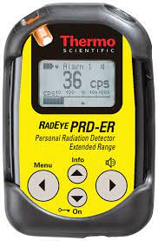
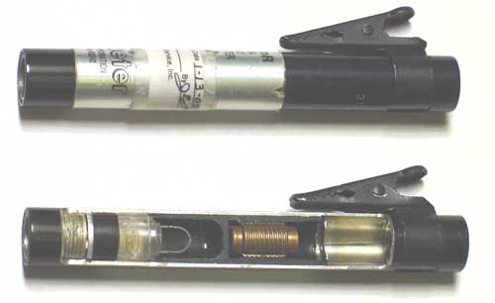
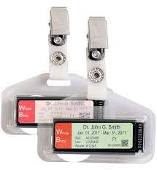
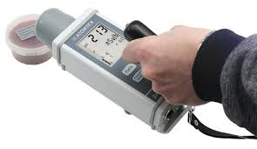
كلية المستقبل الجامعة
AL-Mustaqbal University College
Department of Medical Physics
The fourth Stage
قسم الفيزياء الطبية
المرحلة الرابعة
الوقاية من الاشعاع
Radiation Protection
LECTURE SEVEN :
Radiation Dosimeters
مقياس الجرعات الإشعاعية
Detectors for Radiation Protection
أجهزة الحماية من الإشعاع
Aaat. prof . Dr Forat Hamzah Dr. Ameen Alwan

Slide 2
LECTURE SEVEN : A Radiation Dosimeter
مقياس الجرعات الإشعاعية
هو الجهاز الذي يقيس امتصاص الإشعاع المؤين الخارجي
A radiation dosimeter : It is a device that measures does absorption of external ionizing radiation.
There are four major types of monitoring devices in use today are ;
One : Film badge
Two : Thermo-luminescent dosimeter (TLD)
Three : Optically stimulated luminescent (OSL) dosimeter
Four : Pocket dosimeter (PD)
الحامل ذو الفيلم الحساس
Film badge features
Film badge disadvantages
مقاييس الجرعات اللمعان الحراري
TLD features
TLD disadvantages
How TLD works ?
مقياس اللمعان المحفز بصريًا
OSL features
مقياس الجرعة الجيبي

Slide 3
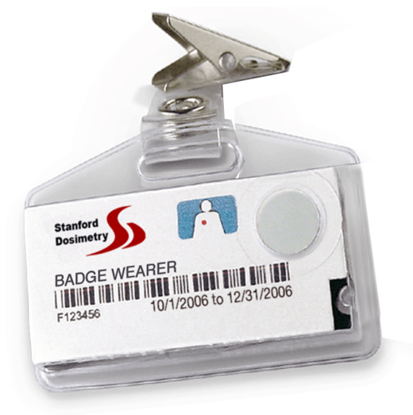
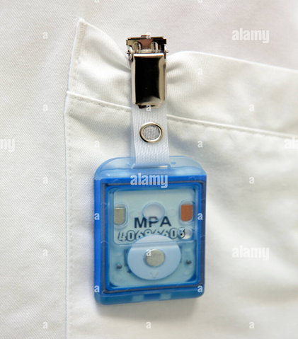
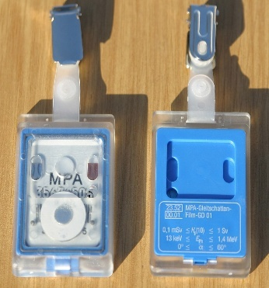
LECTURE SEVEN : Dosimeters
One : Film badge
Film badge features مميزات اشارة الفلم
يتم استخدامه كجهاز مراقبة شخصي للاشعة السينية وإشعاع غاما والجزيئات المشحونة
1) It is used as a personnel monitor device for X- and gamma radiation and charged particles
2) It consists of i) photographic film and ii) film holder
3) The film holder contains various filters (e.g. lead, tin, aluminum, plastic).
4) Radiation passing through the filters will produce a density distribution on the film from which the energy range and type of the radiation can be determined.مدى الطاقة , نوع الاشعاع) )
5) The effect of radiation exposure is a darkening of the film, and the amount of darkening is proportional to the dose absorbed by the film.
فيلم فوتوغرافي
حامل الفيلم
ستنتج المرشحات توزيعًا للكثافة على الفيلم
تأثير التعرض للإشعاع هو تعتيم الفيلم ، وكمية التعتيم تتناسب مع الجرعة التي يمتصها الفيلم
Film holder
Photographic film
& Various filters
Film badge dosimeter

Slide 4
LECTURE SEVEN : Dosi-meters
Film badge disadvantages مساوئ اشارة الفلم
الضباب
الضغط الميكانيكي
1) Fogging may result from mechanical pressure, high temperatures or exposure to light before development.(نمو)
2) Fading of the latent image can occur, which is dependent on the time interval between exposure and development.
يمكن ان تؤثر الاخطاء في عملية النمو على القراءة ولا يمكن تصحيحها
3) Errors in the development process can affect the reading, and cannot usually be corrected.
تمتلك طاقات بيتا اقل من حساسية الفلم
4) Isotopes such as H-3, C-14 or S-35 have beta energies below the sensitivity of the film and cannot be detected
تلاشي
الصورة الكامنة
الفاصل الزمني

Slide 5
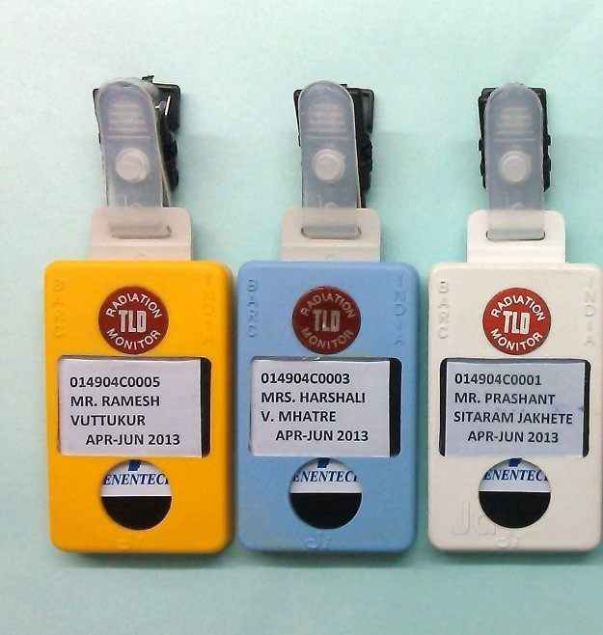
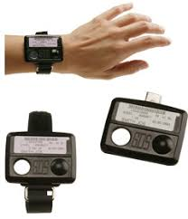
LECTURE SEVEN : Dosi-meters
Two : Thermo-luminescent dosimeters (TLD)
مقاييس الجرعات اللمعان الحراري
TLD features
1) Thermo-luminescent dosimeters, or "TLD's", are used for monitoring x-ray , beta, and gamma radiations.
2) The TLD is a better indicator of radiation exposure than film badge because it is composed of elements of low atomic number (human tissue also contains elements of low atomic number).
ظروف بيئية
3) TLD's are affected less than film badge by environmental conditions such as heat, light, and humidity , and are reusable.
4) The TLD crystals are available in many sizes and shapes, such as rods, ribbons, pellets and single crystals.
الرطوبة
إعادة الاستخدام
Thermo-luminescent dosimeter (TLD)

Slide 6
LECTURE SEVEN : Dosi-meters
TLD disadvantages
لا يمكن قراءتها إلا مرة واحدة ، لأن قراءتها تمحوها.
1) The TLD can only be read once, since reading it erases it. Thus, there is no permanent record of the dose, and errors in the measurement process may lose the reading.
2) Fading of the stored signal can occur, which is dependent on the time interval between exposure and development.
3) The accuracy of the reading depends on the i) light sensitivity of the reader and ii) heating rate of the TLD, but it can be difficult to maintain adequate reader constancy.
4) TLD’s do not give as much information about the energy of the incident radiation as do film badge and optically stimulated luminescent (OSL) dosimeter.
لا يوجد سجل دائم للجرعة
يمكن أن يحدث تلاشي للإشارة المخزنة
دقة القراءة تعتمد على
الحساسية للضوء
صعوبة ثبات القارئ معدل الحرارة
لا تعطي الكثير من المعلومات حول طاقة الإشعاع الساقط

Slide 7
LECTURE SEVEN : Dosi-meters
How TLD works ?
Energy absorbed from the incident radiation excites and ionizes the molecules of the thermoluminescent material. Some of the energy is trapped by impurities or deformations in the material, and remains trapped until the material is heated to a high temperature. Once heated, the trapped energy is released as an emission of light. The amount of light emitted is proportional to the energy absorbed within the thermoluminescent material, which is proportional to the radiation dose absorbed. The emitted light is measured with a photomultiplier tube, the output of which is applied to a readout instrument.

Slide 8
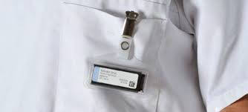
LECTURE SEVEN : Dosi-meters
Three : Optically Stimulated luminescent (OSL) dosimeter
مقياس اللمعان المحفز بصريًا
OSL features
اكثر حساسية لاشعة بيتا
OSL are more sensitive to a wider range of photon and beta particle energies
It provides more information about the energy of the incident radiation. This information is used to provide estimates of deep dose, dose to the lens of the eye, and shallow dose.
The good resolution of the detector also allows analysis of whether the exposure was dynamic or static .
OSL dosimeter are that it can be read multiple times without remove all the information and that the read-out process is faster and more accurate than with TLD’s.
OSL dosimeters are also relatively unaffected by environmental conditions such as heat, light, and humidity.
يعطي اكثر معلومات طاقة الاشعة الساقطة
الدقة الجيدة للكاشف
يمكن القراءة لعدة مرات دون إزالة جميع المعلومات
OSL dosimeter
لا يتأثر بالظروف البيئية

Slide 9
LECTURE SEVEN : Dosi-meters
Four : Pocket Dosimeters
مقياس جرعات الجيب هو حجم القلم ويتألف من غرفة تأين صغيرة (غرف أيونية)
The pocket dosimeter is the size of a pen and comprises a small ionization chamber (ion chambers)
It is used as a personnel monitor device for X- and gamma radiation
It is commonly worn in the pocket
يتم استخدامه كجهاز مراقبة شخصي
عادة ما يتم ارتداؤها في الجيب
Pocket Dosimeters
Pocket dosimeters (ion chambers) may be required to be worn in addition to the film badge if other types of monitors are unsuitable in the judgment of the Radiation Control Officer or the Radiation Control Committee. This shall apply where the investigator is working with high level radioactive materials or other ionizing radiations. When these devices are used, the Principal Investigator is responsible for maintaining daily pocket ion chamber records. Copies of these records shall be submitted monthly to the Radiation Control Office.

Slide 10
LECTURE SEVEN : Dosimeters
Use of Personnel Dosimeters
Personnel monitoring devices must be worn by personnel as specified below and/or in such instances as deemed necessary by the Radiation Control Department. يجب ارتداء أجهزة مراقبة الأفراد من قبل الموظفين
Wholeكل Body Luxel/Film/TLD Badges
Whole body badges shall be worn when:
working with beta emitters where the energy is 300 keV or higher and the quantity greater than 1 millicurie (37 MBq) in any month. العمل مع بواعث بيتا
2) working with any gamma emitters where the energy is 50 keV or higher and the quantity greater than 0.2 milliCuries (7.4 MBq) in any month. العمل مع أي بواعث جاما
3) working with neutron sources. Special neutron badges may be required in addition to other badges. العمل مع مصادر النيوترونات.

Slide 11
LECTURE SEVEN : Dosi-meters
4) working with any apparatus capable of producing or emitting ionizing radiation as deemed necessary by the Radiation Control Department. For example, x-ray equipment, high power amplifying tubes, accelerators, etc. العمل مع أي جهاز قادر على إنتاج أو إصدار إشعاع مؤين
5) specified by the Radiation Control Department, the Radiation Control Officer, and/or the Radiation Control Committee or the Human Use of Radionuclides and Radiation Committee . يحددها قسم التحكم في الإشعاع

