Slide 1
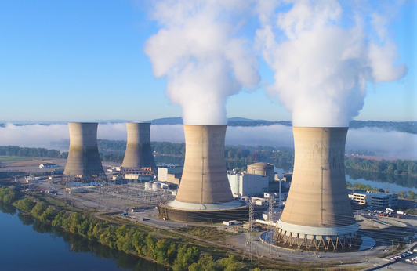
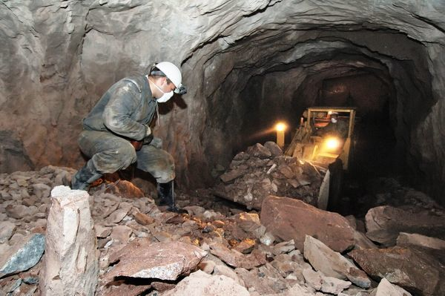
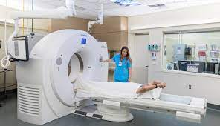
AL-Mustaqbal University College
Department of Medical Physics
The fourth Stage
كلية المستقبل الجامعة
قسم الفيزياء الطبية
المرحلة الرابعة
9
Radiation Protection
Nuclear Power Plants
Uranium Mines
LECTURE NINE :
Nuclear power plants
محطات الطاقة النووية
Environmental Radioactivity
النشاط الإشعاعي البيئي
Medical Imaging Systems
Asst. prof . Dr Forat Hamzah Dr. Ameen Alwan

Slide 2
LECTURE NINE
Nuclear power plants
Introduction
Places of Exposure to Radiation
Consumer products that are exposed to ionizing radiation
Technologically Enhanced Naturally Occurring Radioactive Materials (TENORM)
The major industrial sectors that generate TENORM
Food Irradiation
Airport Security Scanners

Slide 3
LECTURE NINE - Nuclear power plants
Places of Exposure to Radiation
أماكن التعرض للإشعاع
Some places of work that may expose a person to radiation, as follows :-
الأشخاص الذين يعملون في محطات الطاقة النووية
People who work in nuclear power plants may be exposed to higher levels of radiation than the general public, although their exposure levels are monitored carefully.
People who work in uranium mines are monitored because of their exposure to radiation in the form of radon.
People who work in health or dental care, especially those who work with x-ray (or other imaging test) equipment or who work with radioactive isotopes, may also be exposed to radiation at work. Radiation exposure may also occur at some research labs.
Nuclear Power Plants
لأشخاص الذين يعملون في مناجم اليورانيوم
Uranium Mines
الأشخاص الذين يعملون في مجال الرعاية الصحية
Medical Imaging Systems

Slide 4
LECTURE NINE - Nuclear power plants
Some consumer products contain small amounts of ionizing radiation, as follows :-
Tobacco products contain low levels of radiation, which may come from the soil it’s grown in or the fertilizer used to help it grow. Tobacco may account for a significant portion of the yearly radiation that smokers are exposed to.
Some building materials used in the home or other structures may contain low levels of naturally occurring radiation. The amount of radiation can vary depending on what they’re made of, but the levels are unlikely to contribute much to a person’s overall exposure to radiation, according to the EPA.
Many smoke detectors contain a small amount of a very low-level radioactive material that helps detect the smoke. This material is sealed in a container and does not pose a significant risk of radiation exposure.

Slide 5
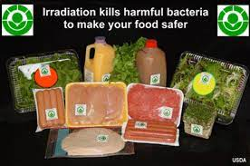
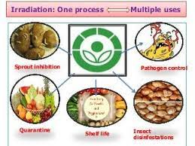
LECTURE NINE - Nuclear power plants
Food Irradiation
Ionizing radiation can be used to kill bacteria and other germs on certain foods, which may make them safer to eat and help them last longer. Some people may be concerned that irradiated food may itself contain radiation. It’s important to understand that the radiation does not stay in the food, irradiating food does not cause it to become radioactive and does not change nutritional value of the food any more than cooking or freezing it might.
Food Irradiation process

Slide 6
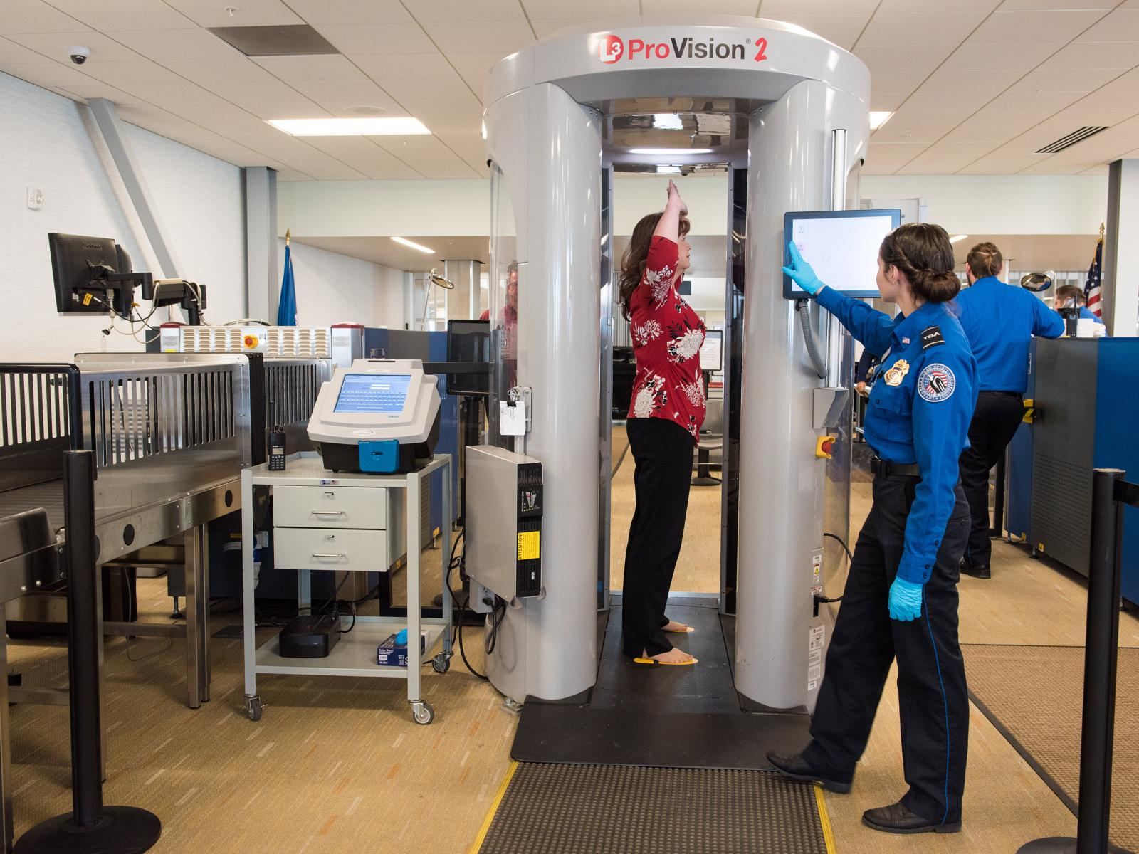
LECTURE NINE - Nuclear power plants
Airport Security Scanners
In recent years, some airports have begun to use whole body scanners as a way to detect objects hidden by clothing. These scanners are different from the metal detectors most people are familiar with. The type of body scanner currently in use is based on millimeter wave technology. Neither millimeter wave scanners nor metal detectors expose people to x-rays or gamma rays. Another type of body scanner, based on backscatter technology, used very weak x-rays aimed at the surface of the body to capture a whole body image. These scanners are no longer in use.
Airport security x-ray security system that scans baggage to check for dangerous items and full body x-ray scans.
Airport Security

Slide 7
LECTURE NINE - Nuclear power plants
Technologically Enhanced Naturally Occurring Radioactive Materials (TENORM)
Naturally Radioactive Materials
المواد المشعة الطبيعية
(TENORM) is defined as, "Naturally occurring radioactive materials that have been concentrated or exposed to the accessible environment as a result of human activities such as manufacturing, mineral extraction, or water processing.”
"Technologically enhanced" means that the radiological, physical, and chemical properties of the radioactive material have been concentrated or further altered by having been processed, or beneficiated, or disturbed in a way that increases the potential for human and/or environmental exposures

Slide 8
LECTURE NINE - Nuclear power plants
The major industrial sectors that generate TENORM are:
المواد المشعة الطبيعية
1. Mining
a) Hard Rock Metal Mining
b) Rare Earths Mining Wastes
c) Uranium Mining Wastes
d) Copper Mining and Production Wastes
e) Bauxite and Alumina Production Wastes
2. Energy production
a) Oil and Gas Production Wastes
b) Coal Combustion Residuals Wastes
Naturally Radioactive Materials
التعدين
تعدين الصخور الصلده
مخلفات تعدين الأرض
مخلفات تعدين اليورانيوم
مخلفات تعدين النحاس
مخلفات انتاج الالومينيا
إنتاج الطاقة
نفايات إنتاج النفط والغاز
نفايات الفحم

Slide 9
LECTURE NINE - Nuclear power plants
3. Water treatment
a) Drinking Water Treatment Residuals Wastes
b) Wastewater Treatment Residuals Wastes
4. Consumer products
a) Fertilizer and Fertilizer Production Wastes
b) Cigarettes
c) Building Materials
d) Granite Countertops Production
معالجة المياه
مخلفات معالجة مياه الشرب
مخلفات معالجة مياه الصرف الصحي
منتجات المستهلك
مخلفات الاسمدة وانتاجها
السجائر
مواد البناء
انتاج الجرانيت

