Slide 1
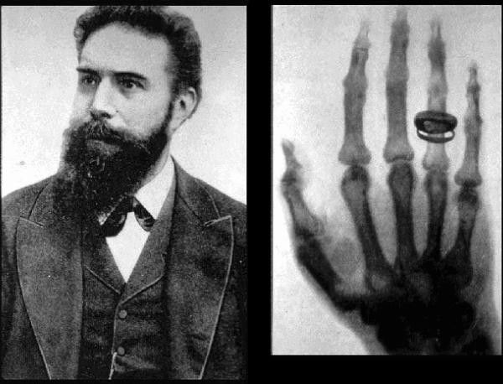
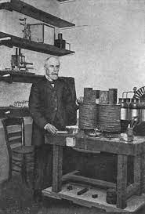
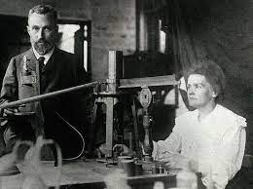
كلية المستقبل الجامعة
AL-Mustaqbal University College
Department of Medical Physics
The fourth Stage
قسم الفيزياء الطبية
المرحلة الرابعة
الوقاية من الاشعاع
Radiation Protection
1
Wilhelm Roentgen
LECTURE ONE :
Introduction (Radiation)
Henri Becquerel
Marie Curie and her husband
Aaat. prof . Dr Forat Hamzah Dr. Ameen Alwan

Slide 2
LECTURE ONE :
Introduction (Radiation)
Atom Structure
تركيب او بنية الذرة
Radiation and Radioactive Materials
الاشعاع والمواد المشعة
A Brief History of Radiation
تاريخ موجز للإشعاع
Radiation Applications or Uses
تطبيقات أو استخدامات الإشعاع
Types of Radiation
أنواع الإشعاع
Biological Effect of Radiation & its Protection
التأثير البيولوجي للإشعاع والوقاية منه

Slide 3
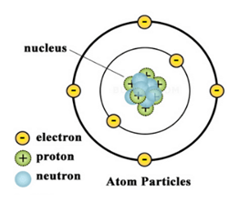
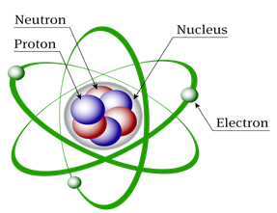
Atom Structure
تركيب او بنية الذرة

Slide 4
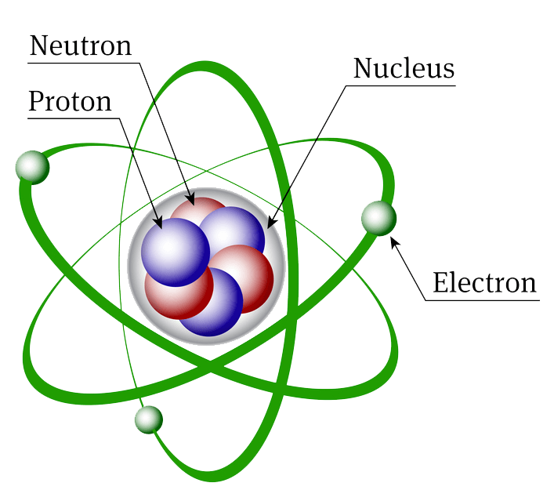
LECTURE ONE :
Introduction (Radiation)
Atom Structure
الذرة هي أصغر وحدة في المادة تشكل عنصرًا كيميائيًا
An atom is the smallest unit of matter that forms a chemical element.
All matter is composed of atoms.
Every solid, liquid, gas, and plasma is composed of neutral or ionized atoms.
An atom is composed of a positively charged nucleus (+), with a cloud of negatively charged electrons ($−$) surrounding it, bound together by electrostatic force.
A nucleus have a protons ( positive (+) charge) and neutron (neutral charge). So, the nucleus have positive charge
The electron ( negative ($−$) charge) travels in circular orbits around the nucleus
Thus, the total electric charge of the atom is therefore zero ( the atom is neutral).
كل مادة تتكون من مجموعة من الذرات
تتكون كل مادة صلبة اوسائلة اوغازية وبلازما من ذرات متعادلة أو مؤينة.
تتكون الذرة من نواة موجبة الشحنة (+) ، مع سحابة من الإلكترونات سالبة الشحنة (-) تحيط بها ، مرتبطة ببعضها البعض بواسطة القوة الكهروستاتيكية.
تحتوي النواة على بروتونات (شحنة موجبة (+)) ونيوترون (شحنة متعادلة). لذلك ، النواة لها شحنة موجبة
ينتقل الإلكترون (الشحنة السالبة (-)) في مدارات دائرية حول النواة
وبالتالي ، فإن إجمالي الشحنة الكهربائية للذرة هو صفر (الذرة محايدة).

Slide 5
LECTURE ONE :
Introduction (Radiation)
Radiation and Radioactive Materials
Radiation is energy that moves through space or matter at a very high speed.
This energy can be in the form of (i) particles ( alpha or beta particles) , or (ii) waves ( light, heat, radio-waves, micro-waves, x-rays and gamma rays).
Radioactive materials (radionuclides or radioisotopes ) are atoms that are unstable.
Unstable atoms try to transform into a stable form. This process releases radiation.
The radiation comes from both (i) cosmic radiation that product in outer space, and (ii) radioactive materials that occur naturally in the earth and in our own bodies.
Together, these are known as background radiation. Everyone is exposed to background radiation daily. In addition, radiation and radioactive materials are produced by many human activities. Radiation is produced by x-ray equipment and by particle accelerators used in research and medicine. Radioactive materials are produced in nuclear reactors and particle accelerators.

Slide 6
LECTURE ONE :
Introduction (Radiation)
A Brief History of Radiation
تم اكتشاف الإشعاع لأول مرة في عام 1895 بواسطة وليم روتجن , أطلق عليه اسم الأشعة السينية ، والذي يمكن استخدامه للنظر في جسم الإنسان
.
Radiation were discovered for the first time in 1895 by Wilhelm Roentgen , which called X-rays, that could be used to look into the human body.
Wilhelm Roentgen
اكتشف هنري في عام 1896أن أملاح اليورانيوم تصدر إشعاعًا يمكن تسجيله على لوحة فوتوغرافية
.
When Henri Becquerel investigated the discovered X-rays in 1896, it led to studies of how uranium salts are affected by light, where he discovered that uranium salts spontaneously emit a penetrating radiation that can be registered on a photographic plate.
Henri Becquerel
In 1898, Marie Curie and her husband discovered that uranium emits radiation, and it turned into other elements polonium and another they called radium.
في عام 1898 ، اكتشفت ماري كوري وزوجها أن اليورانيوم ينبعث منه إشعاع ، وتحول إلى بولونيوم وأخرى أطلقوا عليها الراديوم
.
Marie Curie and her husband

Slide 7
LECTURE ONE :
Introduction (Radiation)
Radiation Applications or Uses
Radiation is used (applications) in various fields such as;
Medical imaging
Treat diseases such as cancer
Airport security
Biological research
Industry (produces heat that is used to generate electricity in nuclear power reactors)
Farming
Geology
Number of consumer product
Gas detectors (sensors)
Kill harmful bacteria
Extend the life of fresh produce.
التصوير الطبي
علاج الأمراض مثل السرطان
أمن المطار
البحث البيولوجي
الصناعة
الزراعة
علم الجولوجي
عدد المنتجات الاستهلاكية
متحسسات الغازية
قتل البكتيريا الضارة
إطالة عمر المنتجات الطازجة

Slide 8
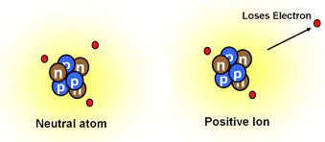
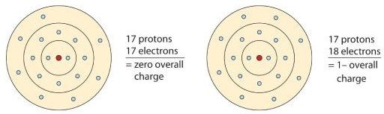
LECTURE ONE :
Introduction (Radiation)
Types of Radiation
تقسم الاشعة حسب قدرتها على التاين
According to ability or inability to events the ionization process, The radiation can be divided into ionizing radiation and nonionizing radiation
عملية التناين
Ionization process : It is the gaining or losing process an electron from an atom or a molecule, which will turn into a negative or positive charge.
إنه الإشعاع الذي لا يمكن أن يحمل طاقة كافية لإنتاج الأيونات
Non-ionizing radiation : It is the radiation that is cannot carry enough energy to produce ions.
Non-ionizing radiation includes visible , infrared , ultraviolet light ; microwaves ; radio waves ; and radiofrequency energy from cell phones. Most types of non-ionizing radiation have not been found to cause cancer.
إنه الإشعاع الذي يحمل طاقة كافية لإنتاج الأيونات
Ionizing radiation : It is the radiation that is carry enough energy to produce ions.
Alpha particles, beta particles, x-rays and gamma rays are forms of ionizing radiation.
X⁺
X⁻
X
X

Slide 9
LECTURE ONE :
Introduction (Radiation)
Biological Effect of Radiation & Protection
يعتمد التأثير البيولوجي للإشعاع المؤين على عدة عوامل
The biological effect of ionizing radiation depends on several factors, including :
(i) Type of radiation
(ii) Method of exposure to the body ( external or internal )
(iii) Person's age
(vi) Type of organ
(v) The body's ability to store radiation.
نوع الإشعاع
طريقة التعرض للجسم (خارجي أو داخلي)
عمر الشخص
نوع العضو
قدرة الجسم على تخزين الإشعاع
الوقاية من الإشعاع
هي علم وممارسة لحماية الناس والبيئة من الآثار الضارة للإشعاع المؤين
Radiation protection is the science and practice of protecting people and the environment from the harmful effects of ionizing radiation.

Slide 10
Questions
1- Choose the correct sentence
A- Every solid, liquid, gas, and plasma is composed of negative charge
B- Every solid, liquid, gas, and plasma is composed of positive charge
C- Every solid, liquid, gas, and plasma is composed of positive or negative charge
D- Every solid, liquid, gas, and plasma is composed of neutral or ionized atoms
E- Every solid, liquid, gas, and plasma is composed of positive or negative or neutral charge
A
B
C
D
E
2- Choose the correct sentence
A- The radiation can be in the form of positive or negative
B- The radiation can be in the form of particles or waves
C- The radiation can be in the form of ionizing or non-ionizing radiation
A
B
C

Slide 11
Questions
3- The radiation can be divided according to ability or inability to events the ionization process to ----------------
A- Particle or wave
B- Dangerous and non-dangerous
C- Ionizing radiation and non-ionizing radiation
A
B
C
4- Choose the wrong sentence related to the biological effect of ionizing radiation
A- Method of exposure to the body
B- Type of organ
C- Type of radiation
D- The body's ability to store radiation
E- The weight of the exposed body
A
B
C
D
E

