Slide 1
The Orbit
Dr Zaid Al-Nasrawi

Slide 2
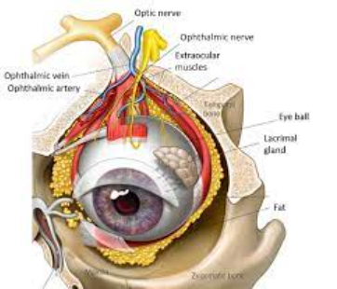
The orbit
is the cavity or socket of the skull in which the eye and its appendages are situated.
The orbital contents :
The eye, fascia, extraocular muscles, cranial nerves II, III, IV, and VI, blood vessels, fat, the lacrimal gland with sac and duct,ligaments, and the eyelids.

Slide 3
The borders and anatomical relations of the bony orbit
The orbit is pyramidal structure, the apex pointing posteriorly and the base situated anteriorly.
The boundaries of the orbit are formed by seven bones.

Slide 4
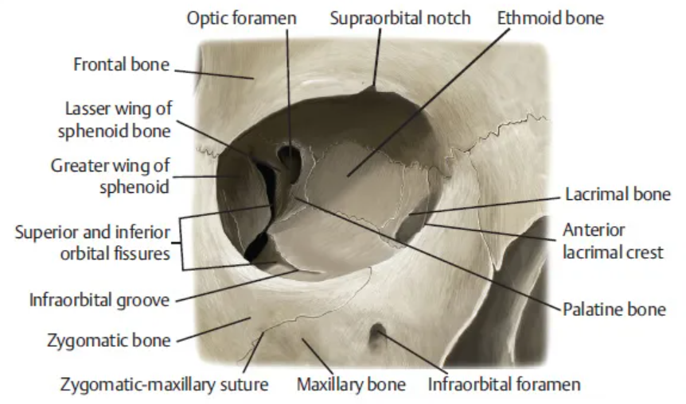
Roof (superior wall)
Formed by the frontal bone and the lesser wing of the sphenoid. The frontal bone separates the orbit from the anterior cranial fossa.

Slide 5
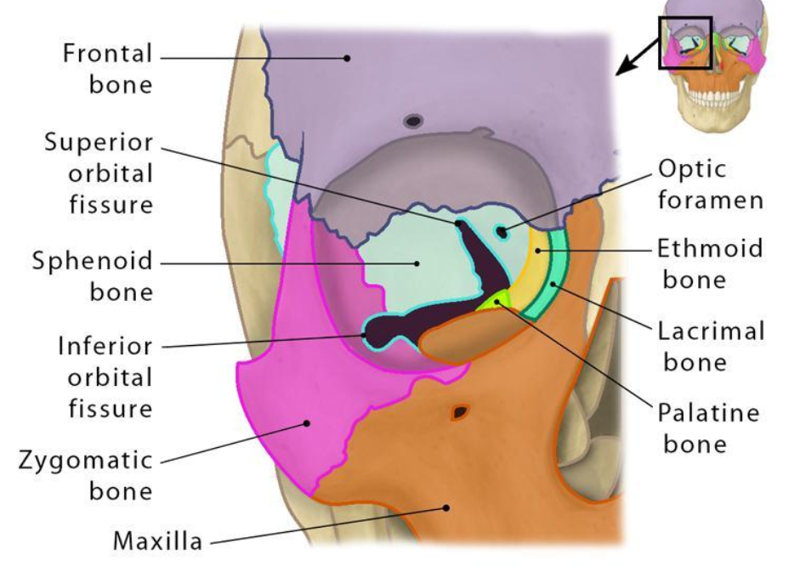
Floor (inferior wall)
Formed by the maxilla, palatine and zygomatic bones.
The maxilla separates the orbit from the underlying maxillary sinus.

Slide 6
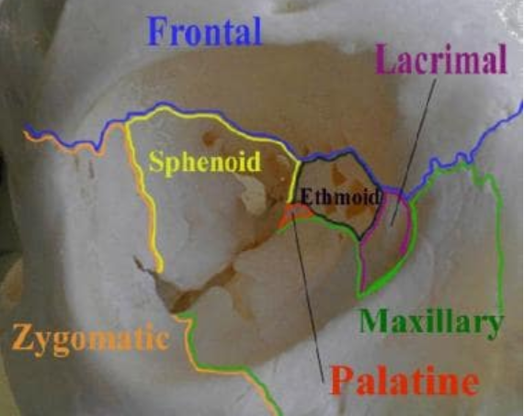
Medial wall
Formed by the ethmoid, maxilla, lacrimal and sphenoid bones. The ethmoid bone separates the orbit from the ethmoid sinus.

Slide 7
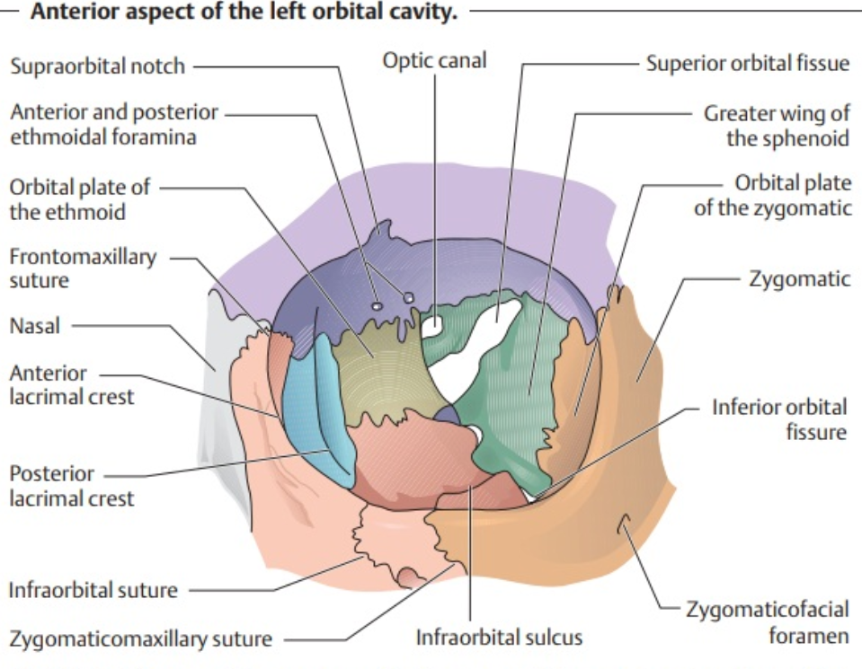
Lateral wall – Formed by the zygomatic bone and greater wing of the sphenoid.
Apex – Located at the opening to the optic canal, the optic foramen.
Base – Opens out into the face, and is bounded by the eyelids. It is also known as the orbital rim.

Slide 8
Orbit Content
Extra-ocular muscles –They are responsible for the movement of the eyeball and superior eyelid.
Eyelids – These cover the orbits anteriorly.
Nerves: Several cranial nerves supply the eye and its structures; optic II, oculomotor III , trochlear IV , trigeminal V and abducens VI nerves.
Blood vessels: The eye receives blood primarily from the ophthalmic artery. Venous drainage is via the superior and inferior ophthalmic veins.
Any space within the orbit that is not occupied is filled with orbital fat. This tissue cushions the eye, and stabilises the extraocular muscles.

Slide 10
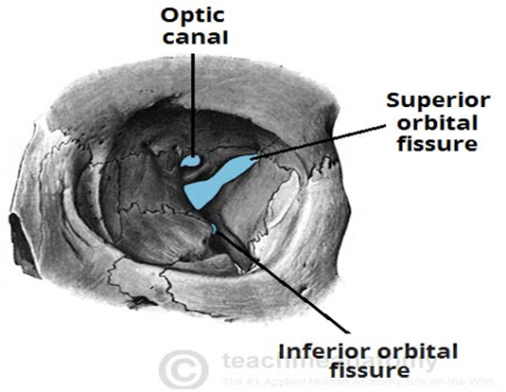
Orbital foramens
There are three pathways in orbit
Optic canal – transmits the optic nerve and ophthalmic artery.
Superior orbital fissure – transmits the lacrimal, frontal N, trochlear (CN IV), oculomotor N (CN III), abducens N (CN VI) nerves.
Inferior orbital fissure – transmits the zygomatic branch of the maxillary nerve, the inferior ophthalmic vein, and sympathetic nerves.

Slide 11
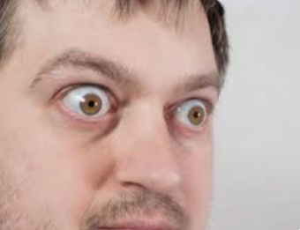
Clinical significance
Exophthalmos (also called , proptosis,) is a bulging of the eye anteriorly out of the orbit. Exophthalmos can be either bilateral (as is often seen in Graves' disease) or unilateral (as is often seen in an orbital tumor).

Slide 12
Enlargement of the lacrimal gland, located superotemporally within the orbit, produces protrusion of the eye inferiorly and medially Lacrimal gland may be enlarged…from inflammation (e.g. sarcoid)or neoplasm
(e.g. lymphoma ).
Tumors (e.g. glioma and meningioma of the optic nerve) produce axial protrusion (bulging forward) of the eye.

Slide 13
Fractures
Orbital rim fracture:- fracture of the bones forming the outer rim of the bony orbit.
‘Blowout’ fracture – This refers to partial herniation of the orbital contents through one of its walls. The medial and inferior walls are the weakest, with the contents herniating into the ethmoid and maxillary sinuses respectively.
Any fracture of the orbit will result in raising the pressure in the orbit, causing exophthalmos (protrusion of the eye). There may also be involvement of surrounding structures, – e.g haemorrhage into one of the neighboring sinuses.

Slide 14
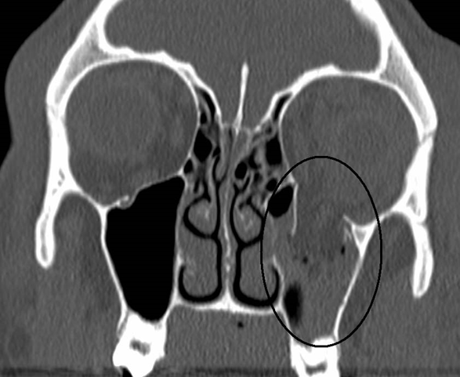
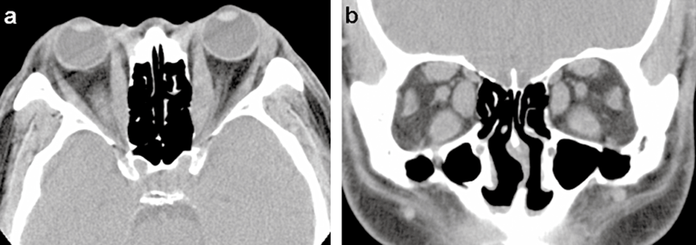
‘Blowout’ fracture
Thyroid eye disease

Slide 15
The three main imaging techniques for the brain and orbit are
First:- X-rays We use the skull X-ray examine patients with a suspicion for metallic foreign body prior to MR studies. As a general rule, patients who have an indication for orbital imaging should undergo a CT or an MR study, if not contraindicated, for improved bone or soft-tissue resolution.
Second:- CT scanning is sufficient for many orbital conditions e.g. thyroid eye disease and orbital tumors .
Third:- MRI provides better soft-tissue discrimination of intracranial anatomy (e.g. meninges, cavernous sinus, posterior fossa and dural venous sinuses).Even After CT, follow-up MR scan may still be required for optimal evaluation of pathology.

Slide 16
INDICATION FOR emergent orbital CT. scan include the following:
acute orbital trauma (e.g. suspected orbital fracture, orbital- hematoma, metallic or wooden foreign bodies, or traumatic optic neuropathy);
acute proptosis (e.g. orbital cellulitis, , thyroid eye disease ,compressive optic neuropathy, retrobulbar haemorrhage);

Slide 17
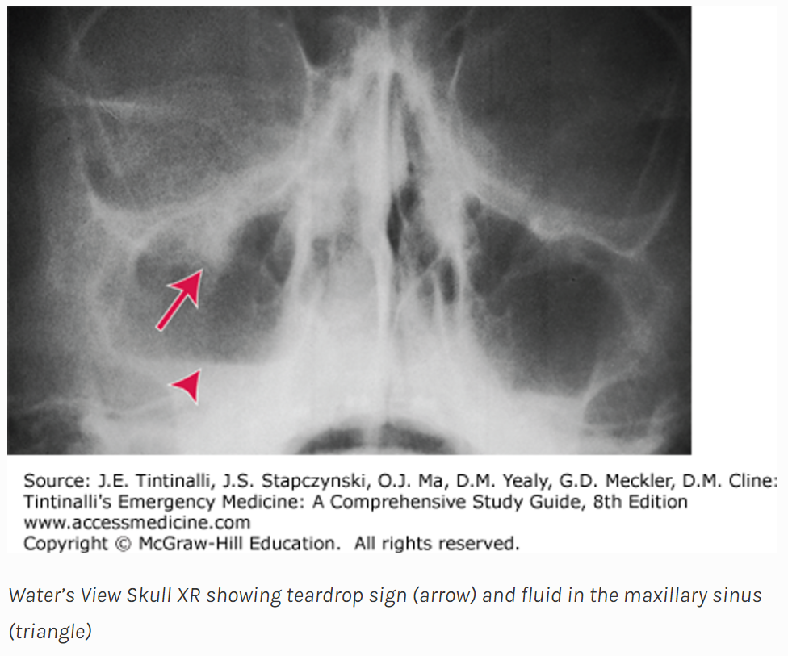

Slide 18
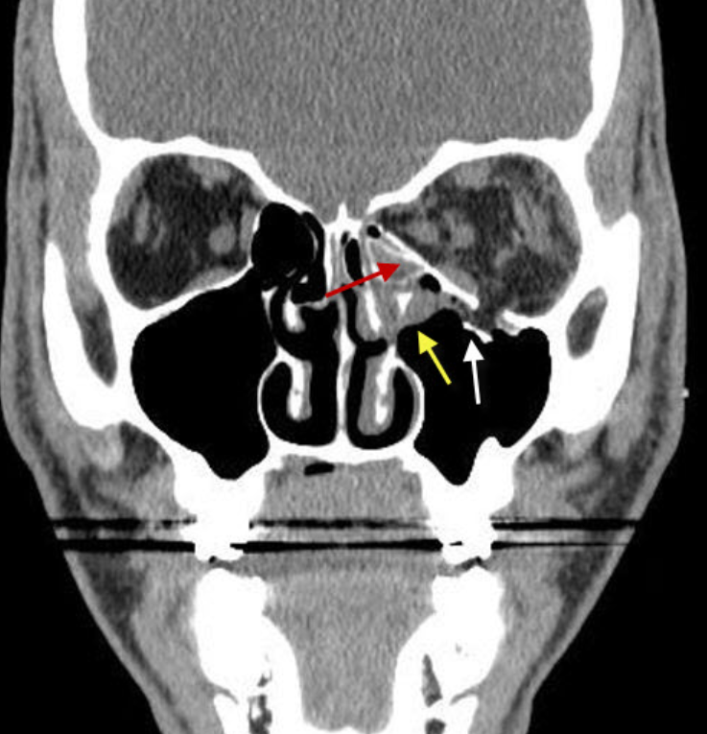

Slide 19
