Slide 1
جامعة المستقبل قسم تقنيات البصريات
الاجهزة البصرية 1
Optical Equipment 1
عملي محاضرة 1
Introduction And General Information
م. كرار عيدان رشيد

Slide 2
Introduction

Slide 3
Introduction
Optical instruments: instruments that reflect and refract light in order to form images by using mirrors, lenses and light.

Slide 4
Applications of Optical Instruments:
There are many optical devices that are used to diagnose eye diseases or the rate of refractive error in the eye, including:
Retinal camera
Phoropter
Ophthalmoscope
Manual keratometer
Tonometer
Slit lamp
Snellen chart
Retinoscope

Slide 5
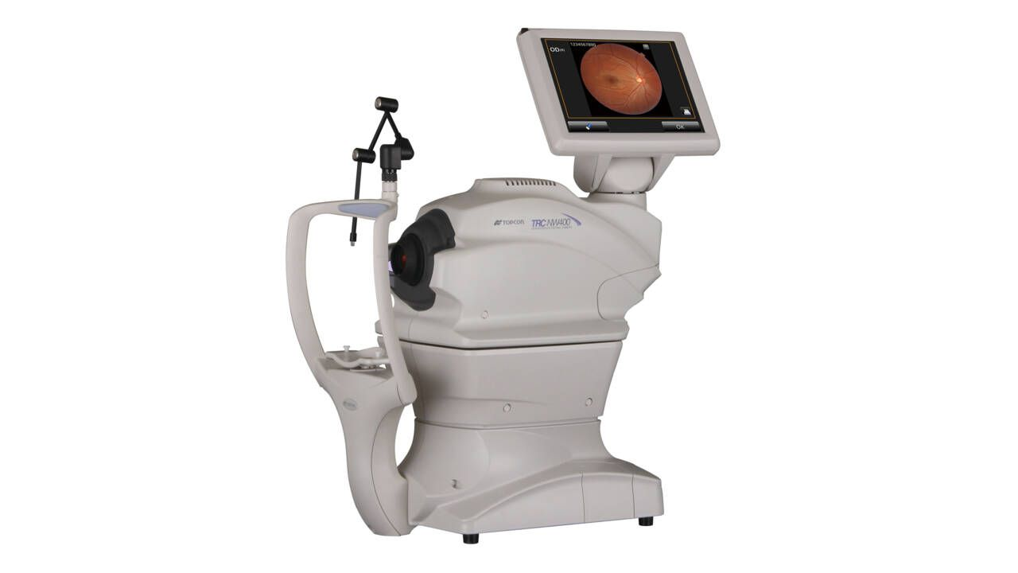
Retinal camera
Retinal Cameras or Digital Fundus Cameras are used to capture images of the interior surface of the eye. It allows the diagnosis of many eye conditions like diabetes-related retinopathy, glaucoma and macular degeneration.

Slide 6
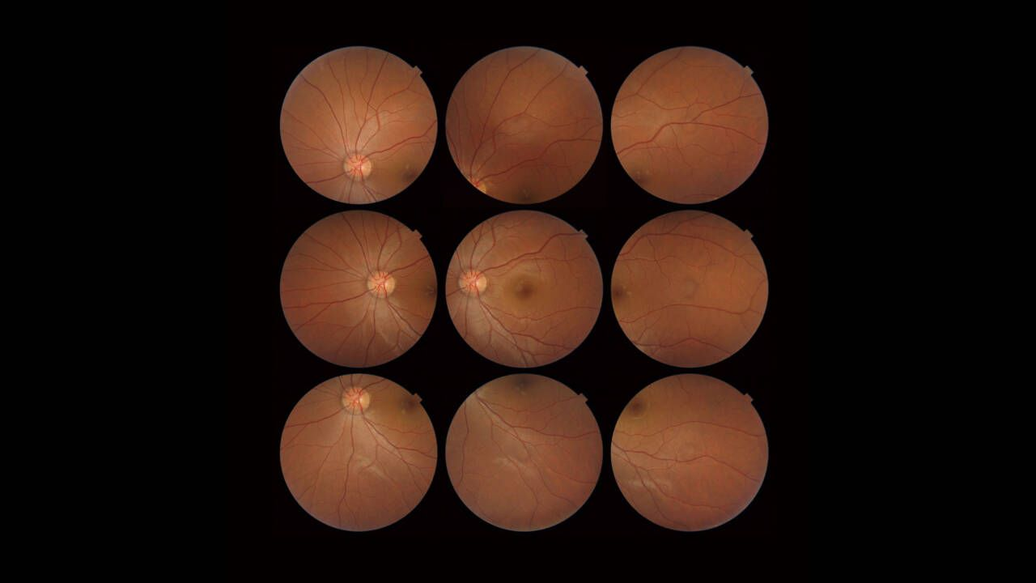
Retinal camera

Slide 7
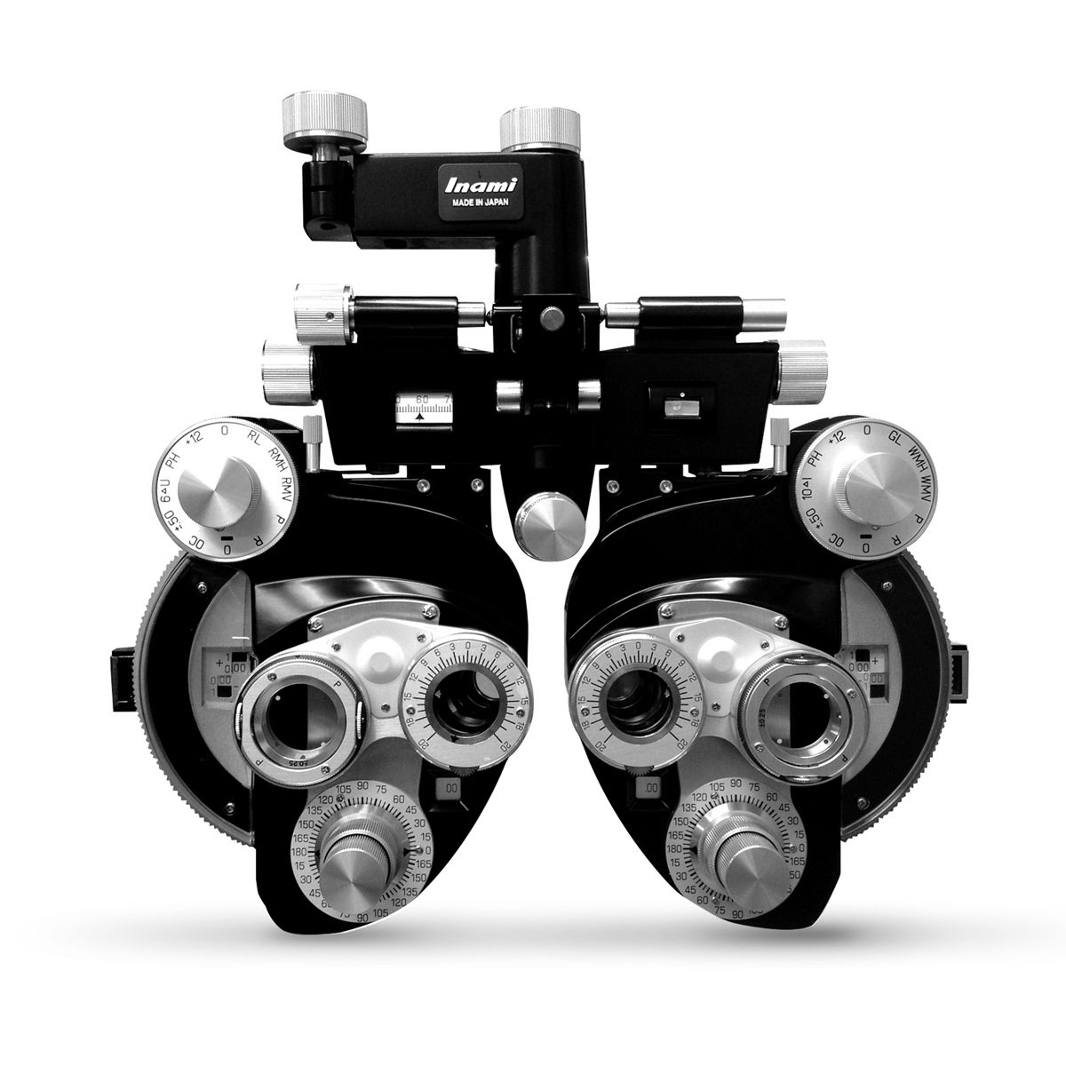
Phoropter
phoropter: is an instrument comprised of cylinders, prisms, and lenses that measures the eye's refractive error to help determine and eye prescription.

Slide 8
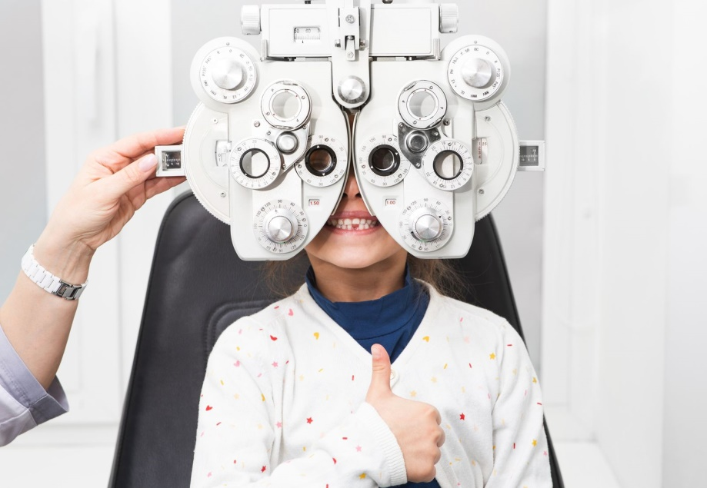
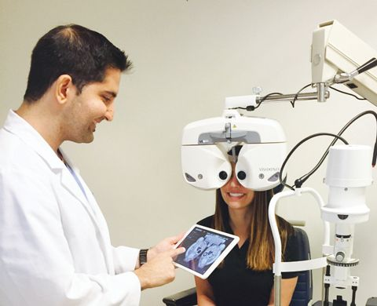
Phoropter

Slide 9
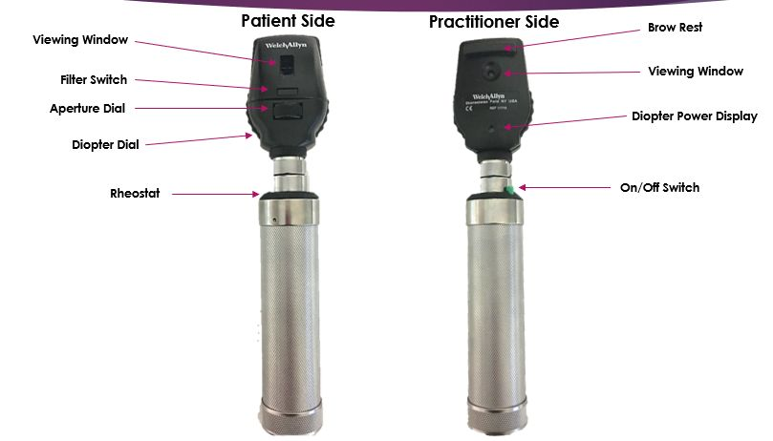
Ophthalmoscopy
Ophthalmoscopy: also called funduscopy, is a test that allows to see inside the fundus of the eye and other structures. It is determining the health of the retina, optic disc, and vitreous humor.

Slide 10
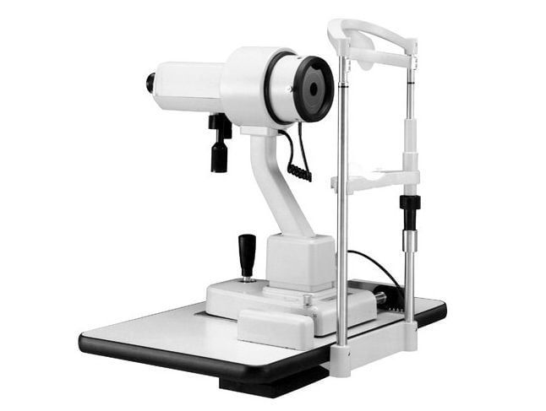
Manual keratometer
This instrument can give a precise examination of the radius of curvature of the anterior corneal surface.
This measurement is used to fit contact lenses and to measure corneal changes.

Slide 11
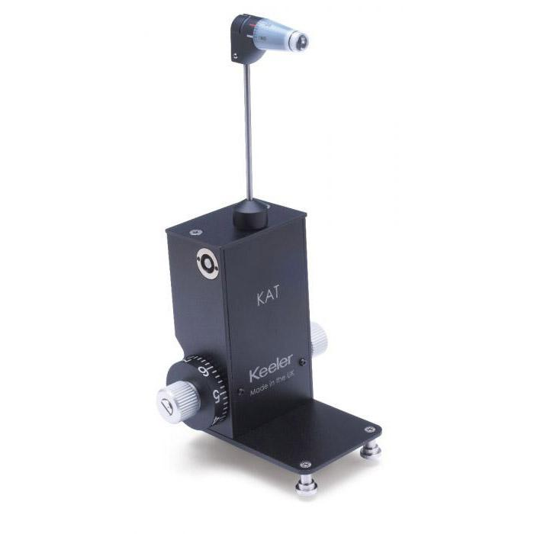
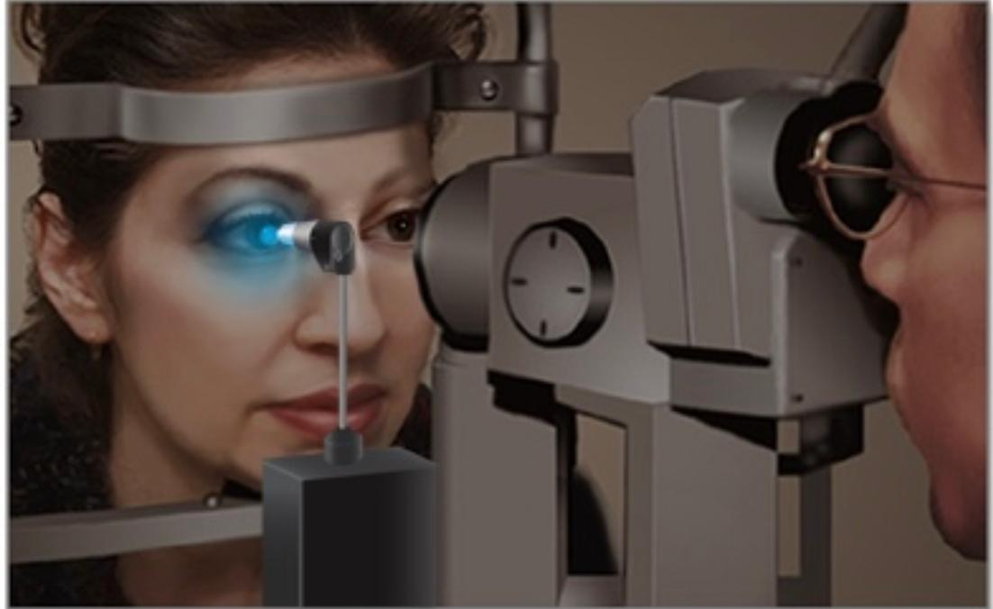
Tonometry
Tonometry: is a test to measure the pressure inside your eyes. The test is used to screen for glaucoma.

Slide 12
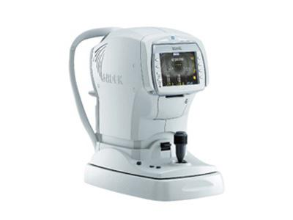
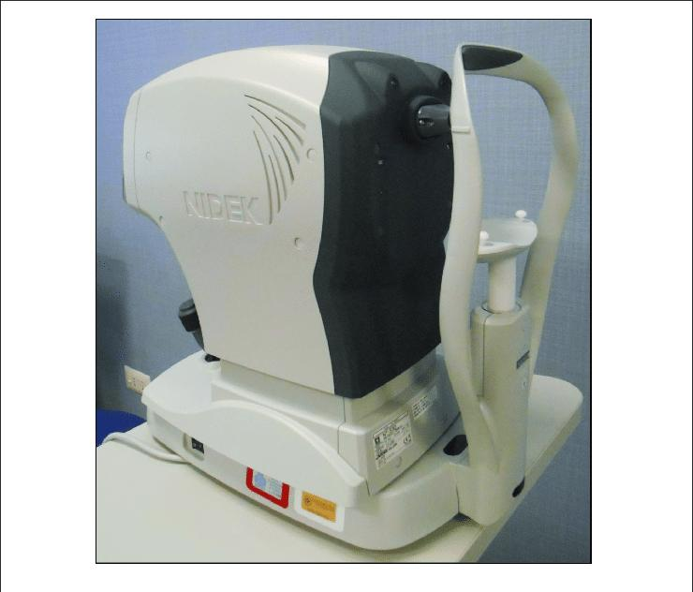
Tonometry

Slide 13
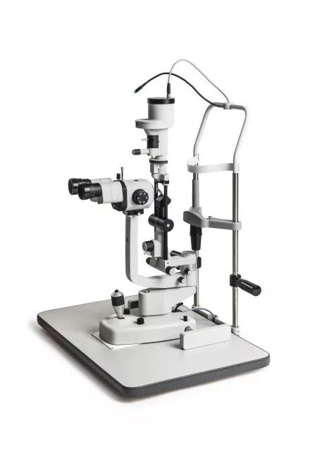
slit lamp
A slit lamp: is a microscope with a bright light used during an eye exam. It gives the different structures at the front of the eye and inside the eye. It’s determining the health of eyes and eye disease. can see The sclera, cornea, lens, retina.

Slide 14
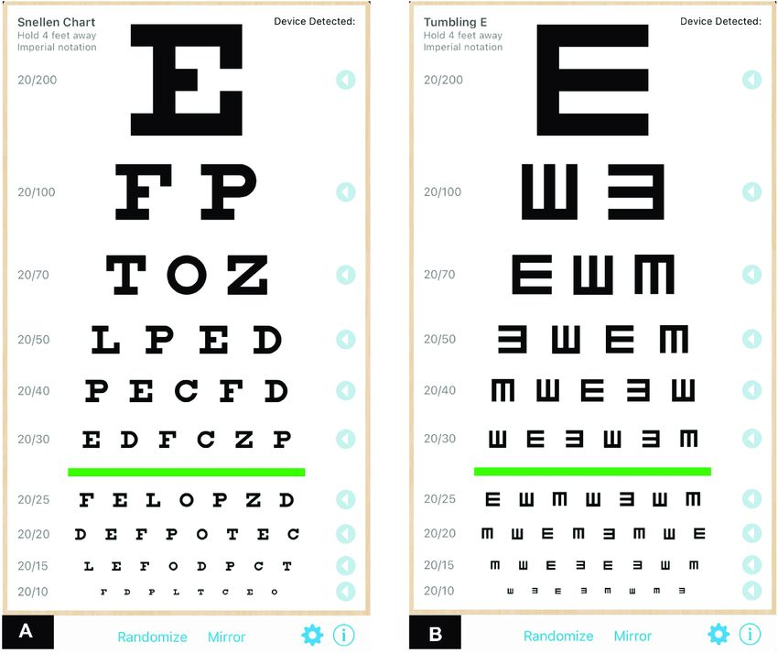
Snellen chart
Snellen chart: is an eye chart that can be used to measure visual acuity.

Slide 15
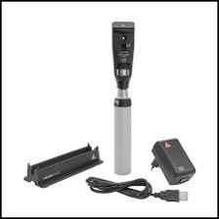
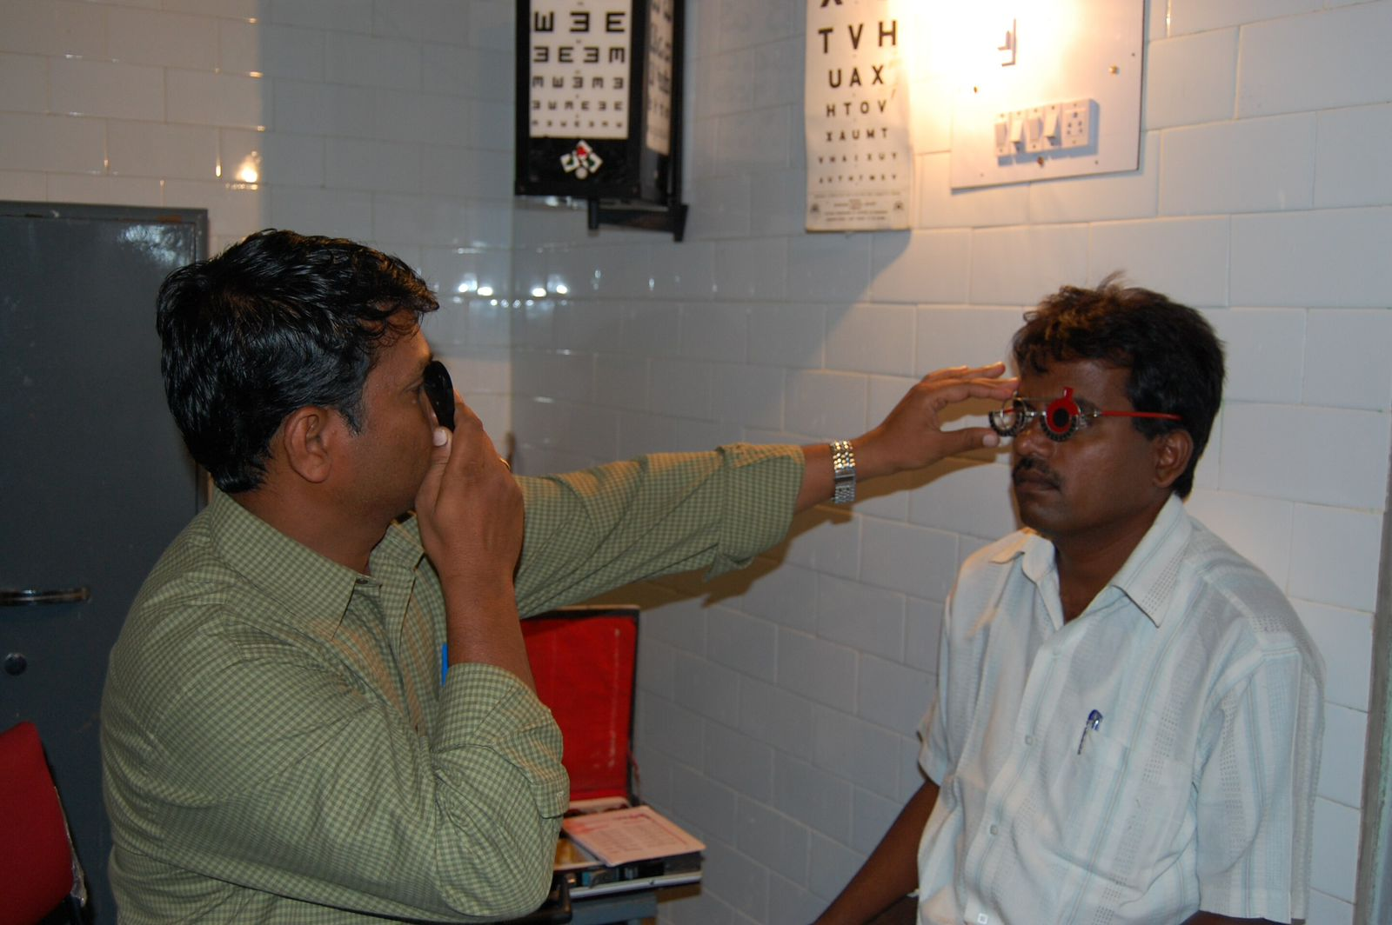
Retinoscopy
Retinoscopy: is a technique to obtain an objective measurement of the refractive error of a patient's eyes.

Slide 16
THANK YOU

