Slide 1
المرحلة الثانية 2023-2024 Medical Terminology Lecture :10th Medical terminology denoting The Endocrine System
Dr. Ali Hussein Al-Nasrawi
Otorhinolaryngologist specialist

Slide 2
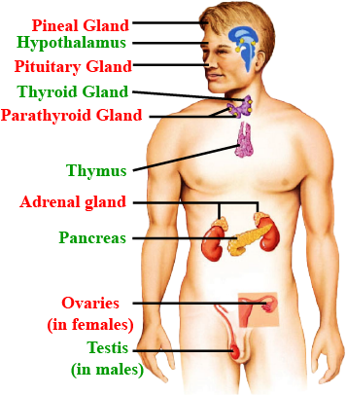
The Endocrine System: A Conductor of Hormones
The endocrine system is a complex network of glands that
secrete hormones,
chemical messengers that regulate various bodily
functions:
It plays a crucial role in maintaining
homeostasis,
growth,
development,
metabolism,
reproduction, and
response to stress.

Slide 3
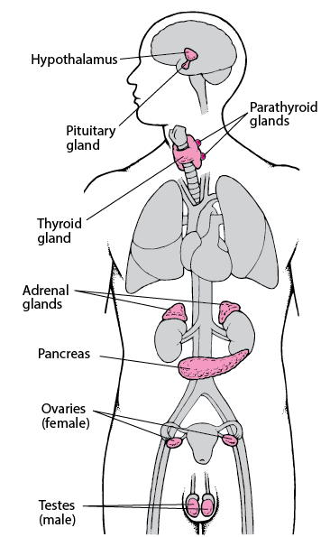
Major Endocrine Glands
endocrine glands include:
Pituitary gland: Often referred to as the "master gland," it controls the activity of other endocrine glands.
Thyroid gland: Regulates metabolism and energy production.
Parathyroid glands: Maintain calcium and phosphorus levels in the blood.
Adrenal glands: Produce hormones that respond to stress and regulate blood pressure and electrolyte balance.
Pancreas: Produces insulin and glucagon, hormones crucial for blood sugar regulation.
Gonads (ovaries and testes): Produce sex hormones responsible for sexual development and reproductive function.
Hormones: The Messengers of the Endocrine System
Hormones in Action: The Language of Chemical Communication
Hormones are chemical messengers that travel through the bloodstream to reach target cells and exert their effects.
They bind to
specific receptors on cell surfaces,
triggering a cascade of events within the cell.

Slide 4
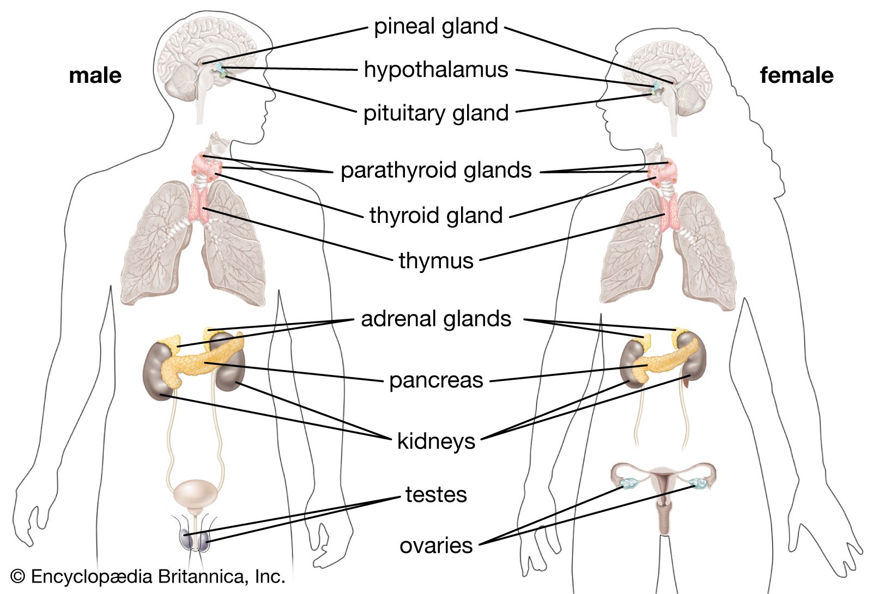
Endocrine System Functions: A Symphony of Regulation
The endocrine system regulates a wide range of bodily functions,
including:
•Growth and development: Hormones like
growth hormone and
thyroid hormones promote growth and development
during childhood and adolescence.
•Metabolism: Hormones like
insulin,
glucagon, and
thyroid hormones regulate the body's metabolism,
influencing energy production and utilization.
•Reproduction: Hormones like
estrogen, progesterone, and
testosterone control the development of secondary sex
characteristics, menstrual cycles, and spermatogenesis.
•Stress response: Hormones like
cortisol and
adrenaline help body adapt to stress by increasing heart rate, blood pressure, and energy levels.
•Fluid and electrolyte balance: Hormones like
aldosterone and
antidiuretic hormone (ADH) regulate fluid and electrolyte levels in the body, (hydration and electrolyte balance).

Slide 5
The Language of Endocrine Disorders
Medical terminology provides precise language for discussing endocrine disorders. Common terms include:
•Endocrine gland disorders: These refer to abnormalities in the
structure or
function of endocrine glands,
leading to hormone imbalances and related symptoms.
•Hormone imbalances: These occur when hormone levels are
too high (hypersecretion) or
too low (hyposecretion), causing various health problems.
•Endocrine disorders: These are broad terms encompassing various conditions affecting the endocrine system,
such as
diabetes,
thyroid disorders, and
adrenal gland disorders.

Slide 6
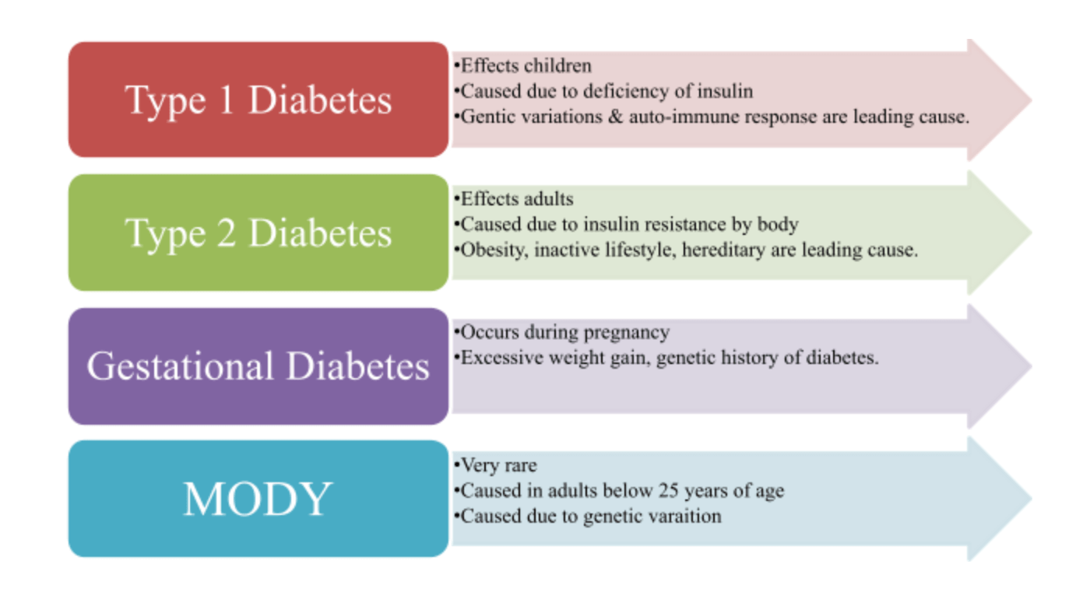
Diabetes Mellitus: A Metabolic Disorder of Insulin Deficiency
Diabetes Mellitus: When Insulin Can't Orchestrate Glucose Metabolism
Types of diabetes include:
•Type 1 diabetes: An autoimmune disorder where the
body attacks insulin-producing cells in the pancreas.
•Type 2 diabetes: Most common form, characterized by insulin resistance and relative insulin deficiency.
•Gestational diabetes: Develops during pregnancy due to hormonal changes affecting glucose metabolism.
Diabetes mellitus
is a metabolic disorder characterized by elevated blood glucose (hyperglycemia) due to
insulin deficiency or
impaired insulin action.

Slide 7
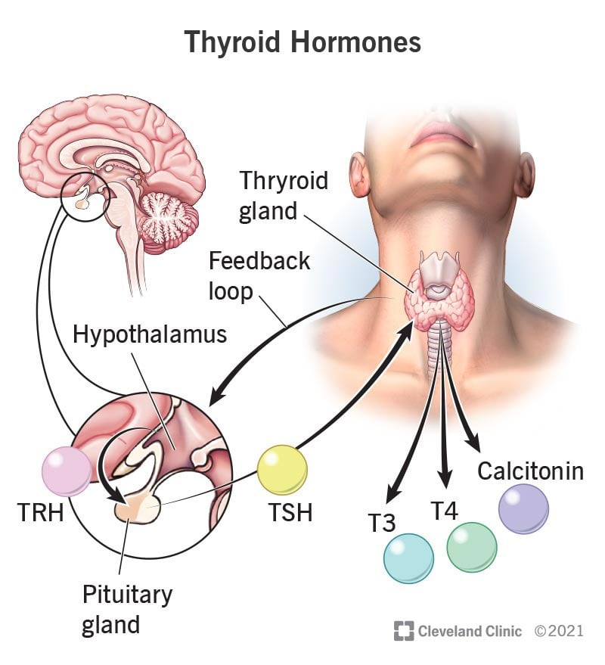
Thyroid Disorders: A Symphony Disrupted by Hormone Imbalances
Thyroid Disorders:
When the Thyroid's Rhythm Goes Off-Key
An illustration of the thyroid gland and thyroid hormones
Thyroid disorders arise from imbalances in thyroid hormone
production.
Common types include:
•Hyperthyroidism: Excess thyroid hormone production, causing symptoms
like rapid heart rate, weight loss, and anxiety.
•Hypothyroidism: Insufficient thyroid hormone production,
leading to symptoms like fatigue, weight gain, and sensitivity to cold.
•Goiter: Enlargement of the thyroid gland, often due to
iodine deficiency or autoimmune disorders.
Your body controls your thyroid hormone (T3 and T4) levels through a complex feedback loop. Your hypothalamus releases thyrotropin-releasing hormone (TRH), which triggers your pituitary gland to release thyroid-stimulating hormone (TSH), which stimulates your thyroid to release T3 and T4.

Slide 8
Adrenal Gland Disorders: A Disruption of Stress Hormone Regulation
Adrenal Gland Disorders
Adrenal Gland Disorders: A Disruption of Stress Hormone Regulation
When Stress Hormones Go Off-Balance
Adrenal gland disorders affect the production of hormones like cortisol and aldosterone,
crucial for stress response and electrolyte balance.
Common disorders include:
•Cushing's syndrome: Excess cortisol production,
leading to symptoms like muscle weakness, weight gain, and high blood pressure.
•Addison's disease: Insufficient cortisol production, causing symptoms like fatigue, weakness, and low blood pressure.
•Aldosterone deficiency: Impairs sodium retention and potassium excretion, leading to
electrolyte imbalances and muscle weakness.

Slide 9
Pituitary Gland Disorders: A Symphony Disrupted at Its Core
Pituitary Gland Disorders: When the "Master Gland" Misses a Beat
Pituitary gland disorders arise from imbalances in the production of various hormones, affecting multiple bodily functions.
Common disorders include:
•Acromegaly: Excess growth hormone production,
leading to enlarged
bones, hands, and feet.
•Dwarfism: Insufficient growth hormone production,
resulting in shorter stature than expected.
•Prolactinoma: A tumor of the pituitary gland that produces excess prolactin,
causing breast milk production in non-pregnant women and
menstrual irregularities.

Slide 10
Gonadal Disorders: A Disruption of Sex Hormone Regulation
Gonadal Disorders: When Sex Hormones Lose Their Harmony
Gonadal disorders affect the production of sex hormones, influencing sexual development and reproductive function.
Common disorders include:
•Polycystic ovary syndrome (PCOS): A hormonal disorder in women characterized by
excess androgen production,
irregular periods, and
polycystic ovaries.
•Congenital adrenal hyperplasia (CAH): An inherited disorder causing
excessive production of androgens, affecting sexual development and fertility.
•Turner syndrome: A genetic disorder in females characterized by
one missing X chromosome, leading to
short stature,
ovarian insufficiency, and other
health problems.

Slide 11
Medical terminology provides precise language for discussing endocrine disorders.
Additional common terms include:
•Hormone assays: Laboratory tests to measure hormone levels in the
blood or
urine, aiding in diagnosis and monitoring of endocrine disorders.
•Endocrine imaging: Specialized imaging techniques like ultrasound,
CT scans, and
MRI scans to visualize endocrine glands and detect abnormalities.
•Endocrine therapy: Medical treatment of endocrine disorders,
including hormone replacement therapy,
medications to regulate hormone levels, and
surgical interventions.

