Slide 1
ICU
L2
BCS. anesthesia and ICU
-Karrar Nader AL-Taie

Slide 2
oxygen delivery system
oxygen delivery system is a device used to administer, regulate, and supplement oxygen to a subject to increase the arterial oxygenation. In general, the system entrains oxygen and air to prepare a fixed concentration required for administration

Slide 3
FiO2: is the concentration of oxygen in the gas mixture .normally there is oxygen in the air at 21%
SpO2 :Oxygen saturation measures the percentage of oxyhemoglobin (oxygen-bound hemoglobin) in the blood, and it is represented as arterial oxygen saturation
PaO2 : the oxygen pressure in arterial blood. The PaO2 reflects how well oxygen is able to move from the lungs to the blood
dead space : in the average adult, approximately 150 mL of the air that is inhaled with each breath never reaches the alveoli. It fills the nose, mouth, larynx, trachea, bronchi, and bronchioles, a volume known as the “dead space.” This air is not available for gas mixing and exchange

Slide 5
Hypoxia :Hypoxia is low levels of oxygen in the body tissues. It causes symptoms like confusion, restlessness, difficulty breathing,

Slide 8
nasal cannula / nasal prongs
A nasal cannula is a medical device to provide supplemental oxygen therapy to people who have lower oxygen levels. There are two types of nasal cannulas: low flow and high flow. The device has two prongs and sits below the nose

Slide 9
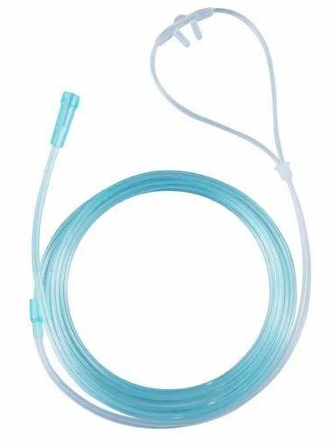

Slide 12
The simple face mask (SFM)
is a basic disposable mask, made of clear plastic, to provide oxygen therapy for patients who are experiencing conditions such as chest pain (possible heart attacks), dizziness, and minor hemorrhages

Slide 13
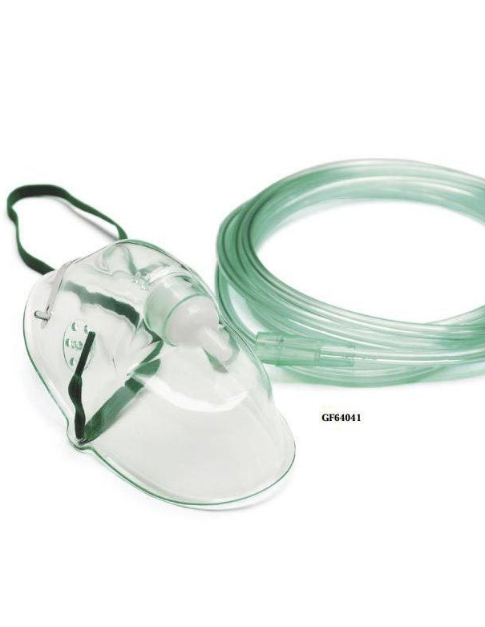

Slide 15
non-rebreather mask
is a special medical device that helps provide you with oxygen in emergencies. These masks help people who can still breathe on their own but need a lot of extra oxygen. Non-rebreather masks are used to treat several conditions

Slide 16
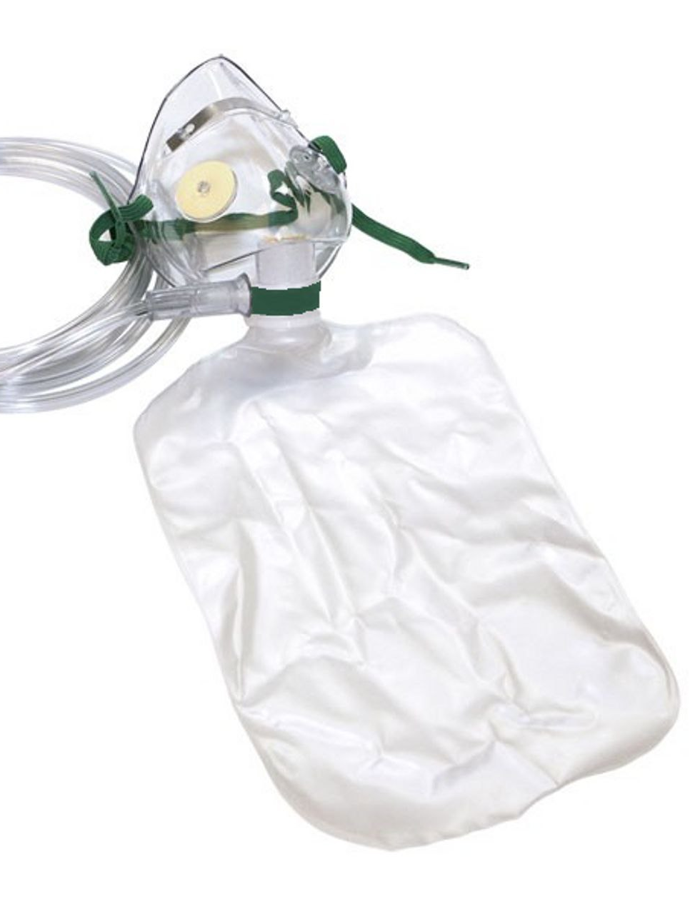

Slide 20
The Venturi mask
is a medical device to deliver a known oxygen concentration to patients on controlled oxygen therapy. The mask was invented by Moran Campbell at McMaster University Medical School as a replacement for intermittent oxygen treatment

Slide 25
AMBU-bag
Bag Valve Mask (AMBU-bag). Used for manual ventilation of the patient in case of a respiratory emergency

