Slide 1
ICU
L1
BCS. anesthesia and ICU
-Karrar Nader AL-Taie
-Nada Shakir kadim

Slide 2
Intensive care unit
An intensive care unit (ICU), also known as an intensive therapy unit or intensive treatment unit (ITU) or critical care unit (CCU), is a special department of a hospital or health care facility that provides intensive care medicine.

Slide 3
intensive care medicine
Intensive care medicine, also called critical care medicine, is a medical specialty that deals with seriously or critically ill patients who have, are at risk of, or are recovering from conditions that may be life-threatening. It includes providing life support, invasive monitoring techniques, resuscitation, and end-of-life care.
Patients may be referred directly from an emergency department or from a ward if they rapidly deteriorate, or immediately after surgery if the surgery is very invasive and the patient is at high risk of complications.

Slide 4
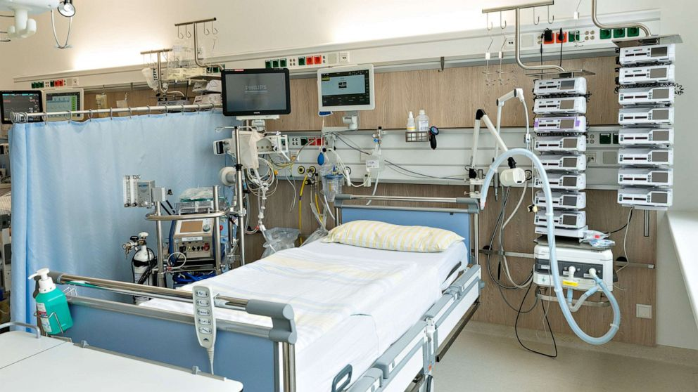

Slide 6
Most Common Type Of ICU
Neonatal intensive care unit (NICU).
Pediatric intensive care unit (PICU).
Coronary care unit (CCU)
Neurological Intensive Care Unit (NeuroICU).
Post-anesthesia care unit (PACU)
High dependency unit (HDU)

Slide 7
Neonatal intensive care unit (NICU)
This specialty unit cares for neonatal patients who have not left the hospital after birth. Common conditions cared for include prematurity and associated complications, congenital disorders such as congenital diaphragmatic hernia, or complications resulting from the birthing process.
Notes:
specializes solely in the treatment of newborns
neonates, 0 to 1 month; infants, 1 month to 2 years; children, 2 to 12 years; and adolescents, 12 to 16 years.

Slide 8
Pediatric intensive care unit (PICU)
Pediatric patients are treated in this intensive care unit for life-threatening conditions such as asthma, influenza, diabetic ketoacidosis, or traumatic neurological injury.
Notes:
PICU cares for infants and children up to age 17

Slide 9
Coronary care unit (CCU)
Also known as Cardiac Intensive Care Units (CICU) or Cardiovascular Intensive Care Unit (CVICU), this ICU caters to patients specifically with congenital heart defects or life-threatening cardiac conditions such as a myocardial infarction or a cardiac arrest.

Slide 10
Neurological Intensive Care Unit (NeuroICU)
Patients are treated for brain aneurysms, brain tumors, stroke, and post surgical patients who have undergone various neurological surgeries performed by experienced neurosurgeons require constant neurological exams. Nurses who work within these units have neurological certifications.

Slide 11
Post-anesthesia care unit (PACU)
Also known as the post-operative recovery unit, or recovery room, the PACU provides immediate post-op observation and stabilization of patients following surgical operations and anesthesia

Slide 12
High dependency unit (HDU)
most acute hospitals have a transitional high dependency unit (HDU) for patients who require close observation, treatment and nursing care that cannot be provided in a general ward, but whose care is not at a critical stage to warrant an (ICU) bed

Slide 13
Equipment and systems
Common equipment in an ICU includes mechanical ventilators to assist breathing through an endotracheal tube or a tracheostomy tube; cardiac monitors for monitoring Cardiac condition; equipment for the constant monitoring of bodily functions; a web of intravenous lines, feeding tubes, nasogastric tubes, suction, drains, and catheters, syringe pumps; and a wide array of drugs to treat the primary condition(s) of hospitalization. analgesics, and induced sedation are common ICU tools needed and used to reduce pain and prevent secondary infections.

Slide 14
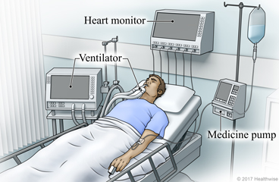
Pump infusion

Slide 15
Mechanical ventilation

Slide 16
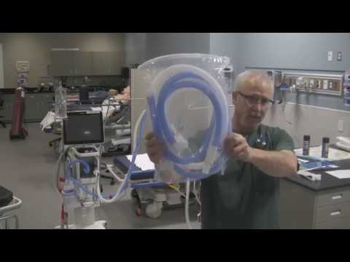
disposable breathing circuit ( the connection between the ventilator and ETT)

Slide 17
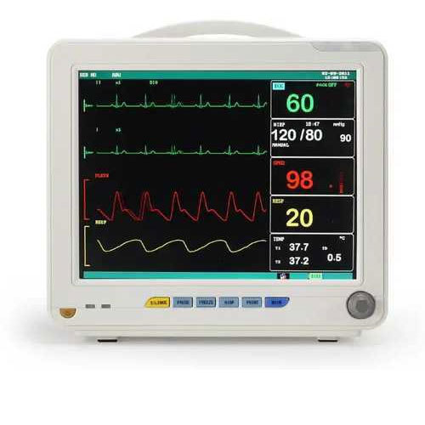
The most basic monitors show your heart rate, blood pressure, and body temperature. More advanced models show respiratory rate and how much carbon dioxide you're breathing out.

Slide 18
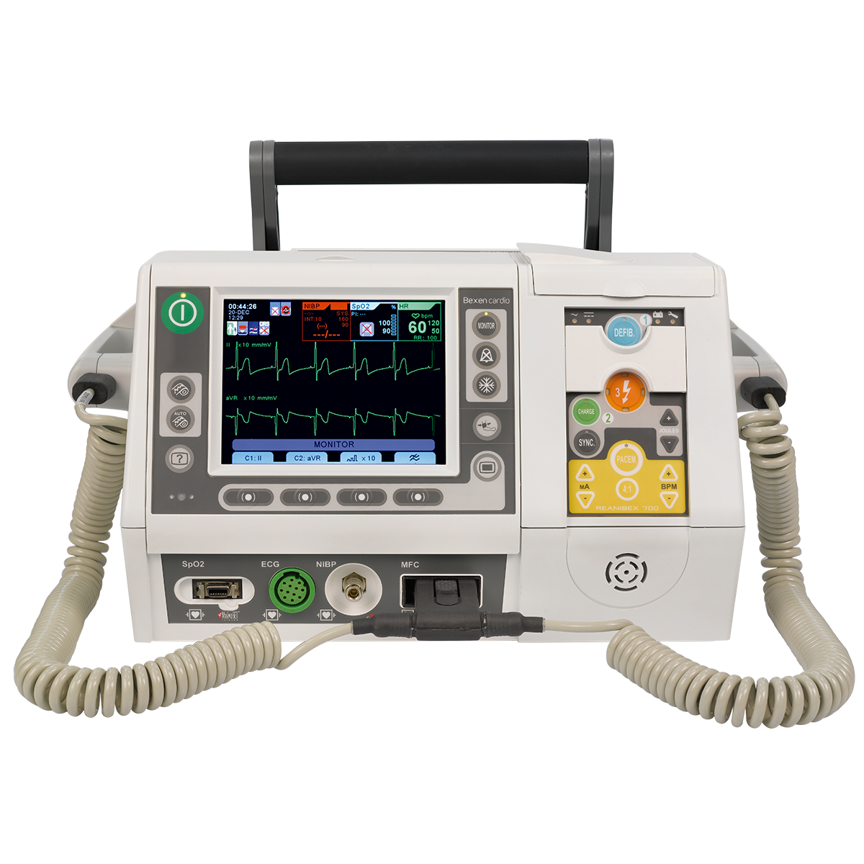
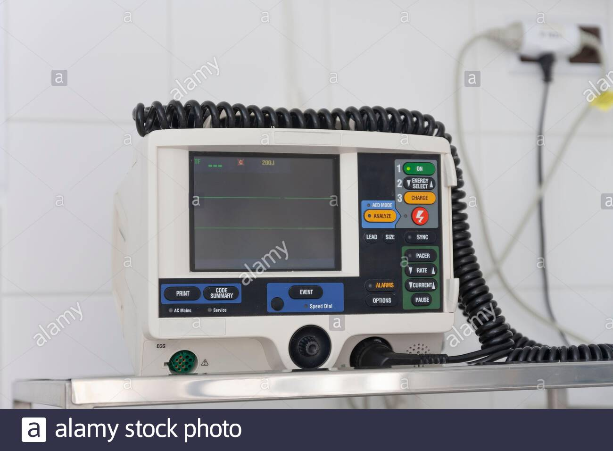
DC shock used for patients with VT, VF, SVT ….

Slide 19
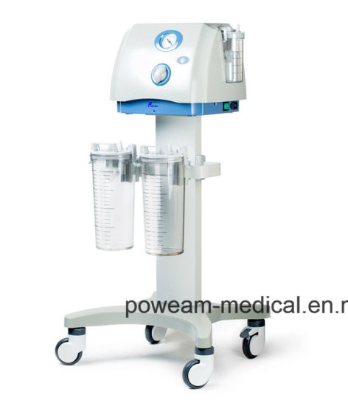
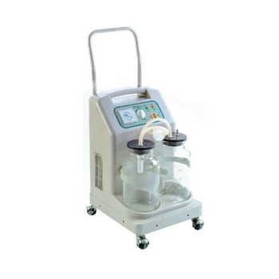
suction machine

Slide 20
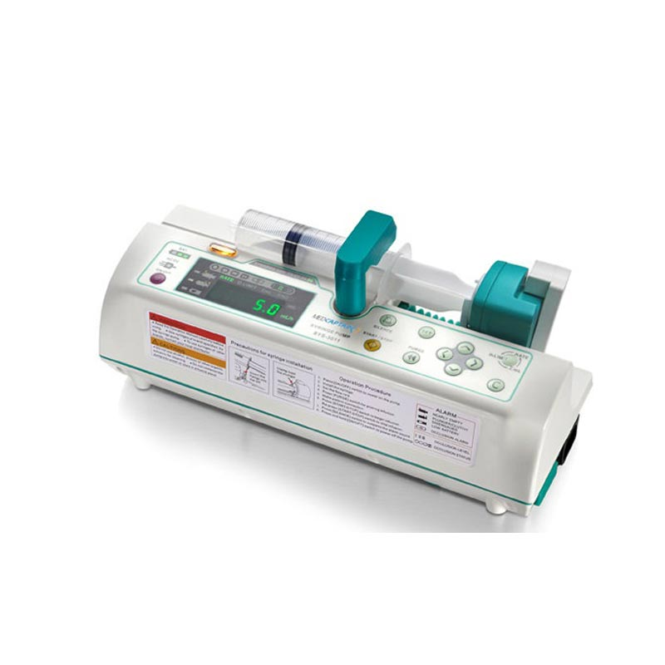
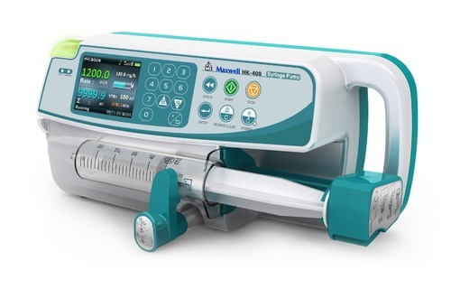
syringe pump used to given bolus dose ( not for infusion) like 10 mg midazolam in every 6 hours

Slide 21
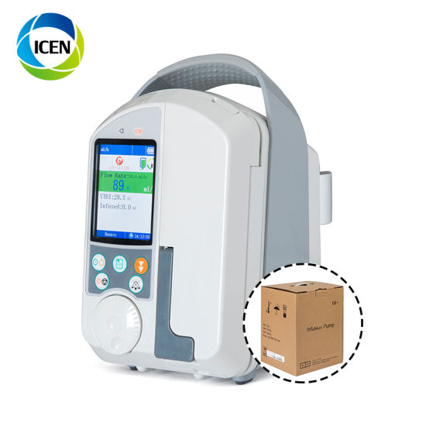
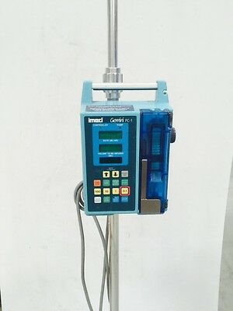
Pump infusion used for infusion doses drugs like dopamine 10 mcg/kg/min (not for bolus dose)

Slide 22
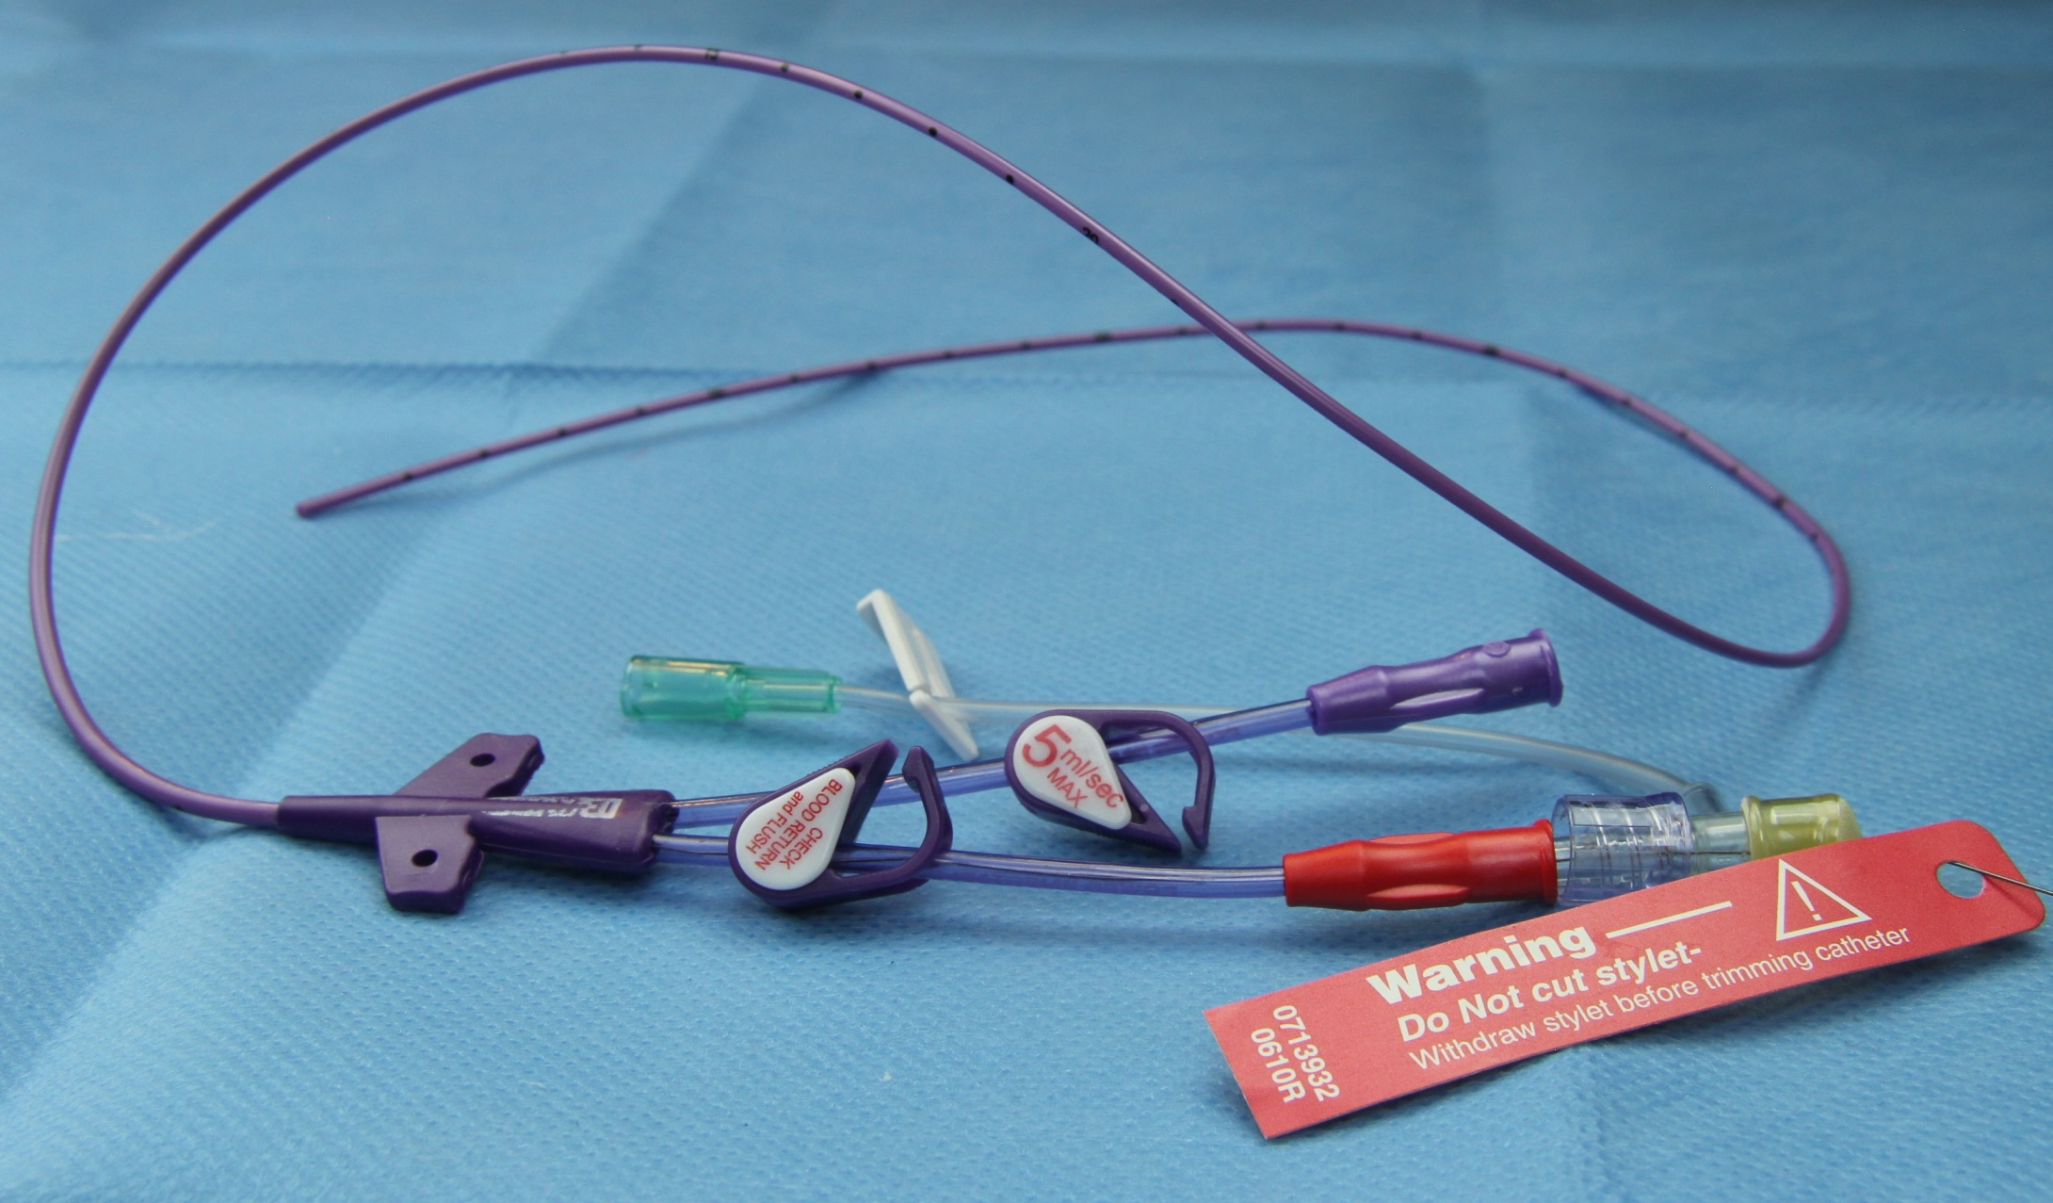
CV line (center venous line)

Slide 23
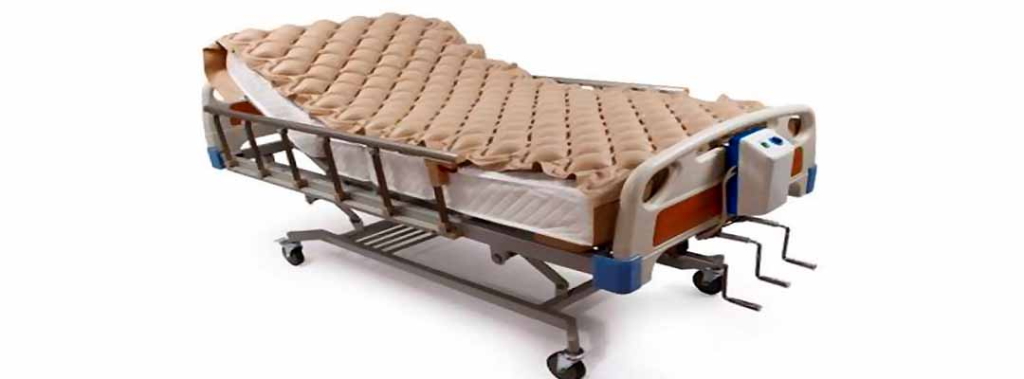
Air bed used to prevention sores

Slide 24
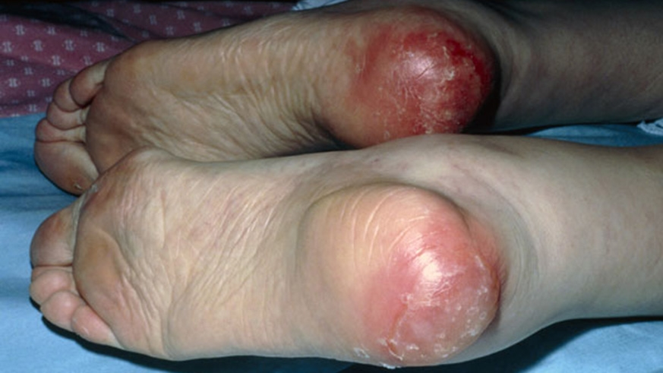
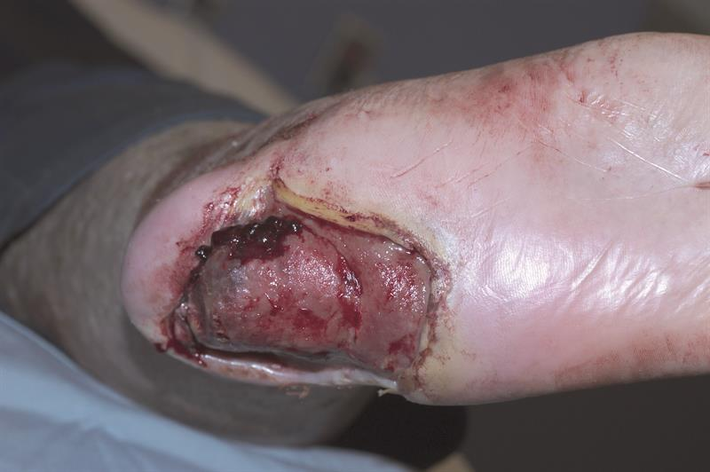
Bed sores

Slide 25
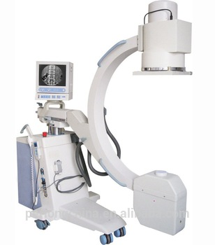
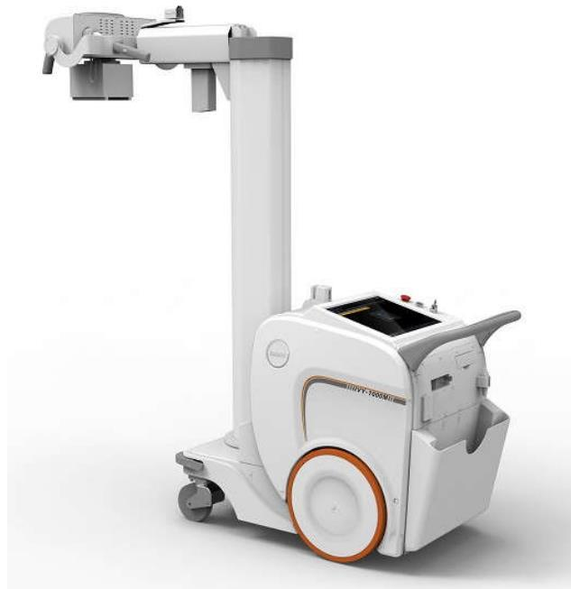
Portable X-RAY

Slide 26
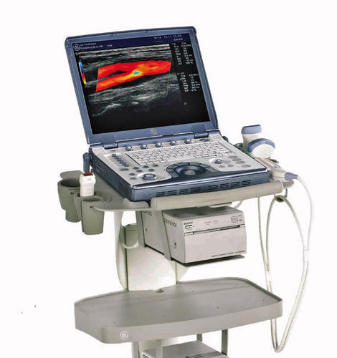
Portable Ultra sound

