Slide 1
Lecture 02: Exploring the Network
Computer Networking
Dr. Muamer Mohammed
Notes:
Cisco Networking Academy program
Computer Networking
Chapter 1: Exploring the Network

Slide 2
Chapter 2: Objectives
After completing this chapter, students will be able to:
Explain the topologies and devices used in a small- to medium-sized business network.
Explain the basic characteristics of a network that supports communication in a small- to medium-sized business.
Notes:
2

Slide 3
Chapter 2
1.1 Client & Server
1.2 The Network as a Platform
1.3 Network Devices
1.4 Summary
Notes:
Chapter 1 Sections

Slide 4
1.1 Globally Connected
Notes:
Cisco Networking Academy program
Introduction to Networks
Chapter 1: Exploring the Network

Slide 5
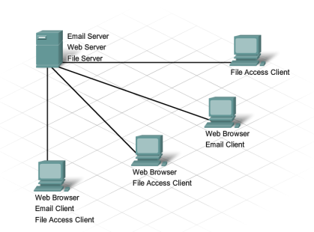
Providing Resources in a Network Clients and Servers
Notes:
1.1.2.2 Clients and Servers
1.1.2.3 Clients and Servers (Cont.)

Slide 6
Providing Resources in a Network Peer-to-Peer
Notes:
1.1.2.4 Peer-to-Peer

Slide 7
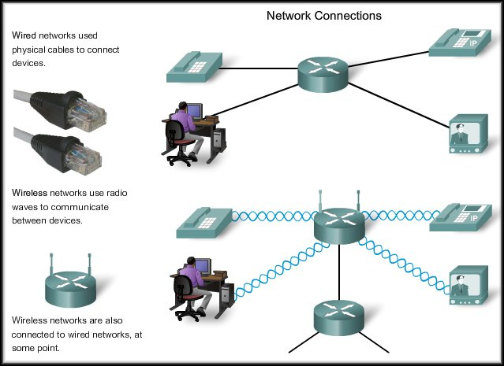
Network As A Platform
Media on a network can be varied.

Slide 8
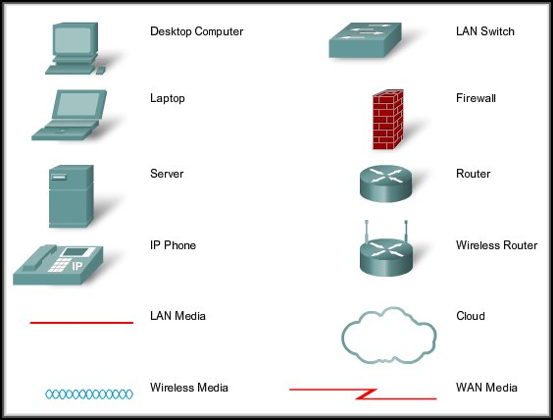
Network As A Platform
Devices on a network – Common Symbols

Slide 9
Intermediary Devices
Manage data as it flows through the network.
Some use the destination host address and network interconnection information to find the best path through the network.
Routers
Switches
Firewalls
Access Points
Hubs
Multiplexers

Slide 10
Intermediary Devices
Regenerate and retransmit data signals.
Maintain information about what pathways exist through the network and internetwork.
Notify other devices of errors and communication failures.
Direct data along alternate pathways when there is a link failure.
Classify and direct messages according to QoS priorities.
Permit or deny the flow of data, based on security settings.

Slide 11
Converged Networks Planning for the Future
Notes:
1.3.1.2 Planning for the Future

Slide 12
Reliable Network Supporting Network Architecture
As networks evolve, we are discovering that there are four basic characteristics that the underlying architectures need to address in order to meet user expectations:
Fault Tolerance
Scalability
Quality of Service (QoS)
Security
Notes:
1.3.2.1 The Supporting Network Architecture

Slide 13
Network Trends New trends
Some of the top trends include:
Bring Your Own Device (BYOD)
Online collaboration
Video
Cloud computing
Notes:
1.4.1.1 New Trends

Slide 14
Network Trends Online Collaboration
Notes:
1.4.1.3 Online Collaboration

Slide 15
Network Trends Video Communication
Notes:
1.4.1.4 Video Communication

Slide 16
Network Trends Cloud Computing
Cloud computing offers the following potential benefits:
Organizational flexibility
Agility and rapid deployment
Reduced cost of infrastructure
Refocus of IT resources
Creation of new business models
Notes:
1.4.1.5 Cloud Computing

Slide 17
Networking Technologies for the Home Technology Trends in the Home
Notes:
1.4.2.1 Technology Trends in the Home

Slide 18
Exploring the Networking Summary
In this chapter, you learned:
Networks and the Internet have changed the way we communicate, learn, work, and even play.
The Internet is the largest network in existence. In fact, the term Internet means a ‘network of networks. The Internet provides the services that enable us to connect and communicate with our families, friends, work, and interests.
Notes:
Chapter I Summary

Slide 19
Thank you
Notes:
1.1.2.4 Peer-to-Peer

