Slide 1
English Vowels 1. Monophthong [ˈmɒnəfˌθɒŋ]: A. Short Vowel Sounds: Short vowels are vowel sounds that are pronounced in a short form. { a, u,e,I,o}

Slide 2
English Vowels 1. Monophthongs: B. Long Vowel Sounds: Long vowels are those in which the sounds of the letters A, E, I, O, and U match the spoken name of the letter.

Slide 3
English Vowels 2. A diphthong [dɪfθɒŋ]: is a type of vowel sound that is made up of a combination of two single vowel sounds but within the same syllable.

Slide 4
English Vowels 3. A triphthong [trɪfθɒŋ]: is a monosyllabic sound which functions as a single phoneme.

Slide 5
Sounds in English 4. Consonant Sounds

Slide 6
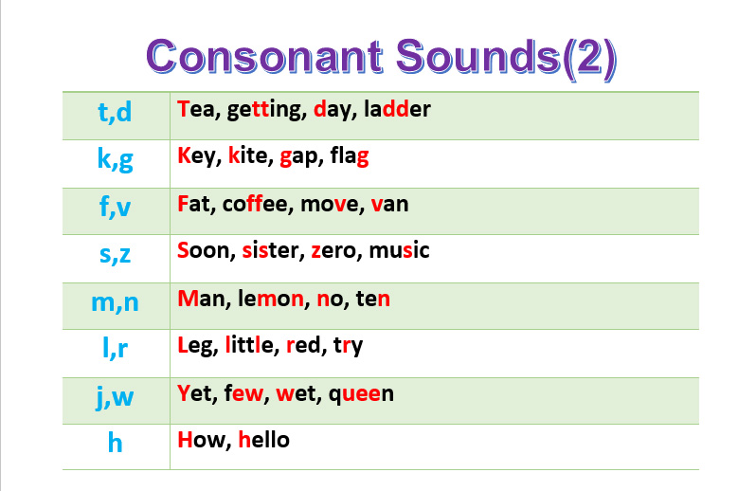
Sounds in English Consonant Sounds

Slide 7
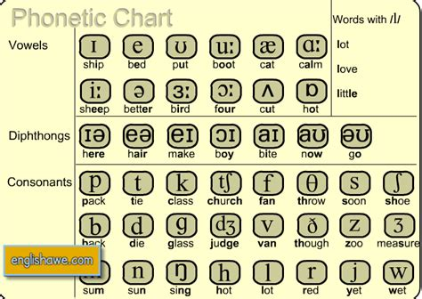
Sounds in English

