Slide 1
Pharmaceutical chemistry
Cholinergic Drugs
College of pharmacy

Slide 3
Neurotransmitters (NT)
Neurotransmitters (NT) are endogenous (produced by body) chemicals that transmit signals across a synapse from sending presynaptic neuron to the target postsynaptic neuron
They are synthesized and stored in neuron itself
There are many NTs eg: Acetylcholine, Adrenaline, serotonin, dopamine, GABA
The process of transmission of signal along a neuron and over the synapse is called neurotransmission. Signal can pass over the synapse by either chemically or electrically
One neurons interacts with many other neurons in all possible directions.

Slide 4
Cholinergic Drugs and Related Agent
The peripheral nervous system consists of those nerves outside the cerebrospinal axis and includes :
Somatic motor nerves system
Autonomic motor nervous system.

Slide 5
Cholinergic Drugs and Related Agents
Autonomic motor NS:
Carry messages from the CNS to smooth muscle, cardiac muscle and adrenal medulla.
Two subsystems:
1. Parasympathetic nerves:
From CNS to smooth muscles.
Acetylcholine is the N.T.
2.Sympathetic nerves:
To the cardiac muscles and most of internal
organs.
Using Noradrenalin and Acetylcholine as N.T

Slide 6
Drugs and chemicals that cause the parasympathetic division to react are termed para sympathomimetic, whereas those blocking the actions are called para sympatholytic.
Agents that mimic the sympathetic division are sympathomimetic, and those that block the actions are sympatholytic.
3. Enteric NS:
Located in the wall of intestine. Use serotonin, neuropeptide, Acetylcholine and Dopamine are among many other neurotransmitters take part in this system
.

Slide 7
Cholinergic receptors
There are two distinct receptor types for ACh that differ in composition, location, and pharmacological function and have specific agonists and antagonists. Cholinergic receptors have been characterized as nicotinic and muscarinic on the basis of their ability to be bound by the naturally occurring alkaloids nicotine and muscarine, respectively.
Receptor subtypes that differ in location and specificity to agonists and antagonists have been identified for both the nicotinic and muscarinic receptors.

Slide 9
Cholinergic receptors
Nicotinic Receptors
Nicotinic receptors are coupled directly to ion channels and, when activated by Ach, mediate very rapid responses.
Ion channels are responsible for the electrical excitability of nerve and muscle cells and for the sensitivity of sensory cells.

Slide 10
Neuromuscular nicotinic ACh receptors are of interest as targets for autoimmune antibodies in myasthenia gravis and for muscle relaxants used during the course of surgical procedures.
Nicotinic receptors in autonomic ganglia, when blocked by drugs, can play a role in the control of hypertension.
(N1)-nicotinic receptors. Are found in neuromuscular junctions.
N2-nicotinic receptors are found in autonomic ganglia.

Slide 11
Muscarinic receptors
Muscarinic receptors play an essential role in regulating the functions of organs innervated by the autonomic nervous system to maintain homeostasis of the organism.
The action of ACh on muscarinic receptors can result in stimulation or inhibition of the organ system affected.
ACh stimulates secretions from salivary and sweat glands, secretions and contraction of the gut, and constriction of the airways of the respiratory tract. It inhibits contraction of the heart and relaxes smooth muscle of blood vessels.

Slide 12
Muscarinic receptor subtypes
Evidence from both pharmacological and biochemical studies shows that subtypes of muscarinic receptors are located in the CNS and peripheral nervous system.
The cloned receptors have been identified as M1 to M5.

Slide 13
ACH Receptors

Slide 15
The instability of acetylcholine
Acetylcholine is prone to hydrolysis. This is explained by considering one of the conformations that the molecule can adopt .
In this conformation, the positively charged nitrogen interacts with the carbonyl oxygen and has an electron withdrawing effect. To compensate, the oxygen atom pulls electrons from the neighbouring carbon atom and makes that carbon atom electron deficient and more prone to nucleophilic attack.
Water is a poor nucleophile, but, because the carbonyl group is more electrophilic, hydrolysis takes place relatively easily. This influence of the nitrogen ion is known as neighbouring group participation or anchimeric assistance .

Slide 17
Physio-Chemical property of Ach
1. It is ester of acetic acid and choline
2. It is soluble in water due to salt form at Nitrogen
3. In solid form it is stable but in solution, the ester group gets hydrolyzed (ie ester group turns into acid and alcohol).
4. If acid or base is present, as in stomach, then rate of hydrolysis is so fast that it prevents oral dosing of Ach
5. Even if we prepare it’s solution in neutral water and inject in blood so as to bypass the acidic stomach, an ester hydrolyzing enzyme called butrylcholinesterase significantly degrades it that the pharmacological response is very weak.

Slide 18
Even if it was administered in stable form, It’s ionic ammonium group prevents good penetration across the lipophillic cell wall .
This chemical property makes it a weak agonist plus since it is non-selective agonist of Muscarinic and Nicotinic
(Thus having no ester group and no ionic amine is an approach for making more stable and strong Ach agonist. However selectivity is a different issue).
2 problems prevent it from being a good drug Unselective Unstable (Easy to hydrolyze)
Solution:
Ethylene group control selectivity
Acyloxy group controls stability

Slide 19
Acetylcholine

Slide 27
Mech. Of action of Ach at nicotinic receptors
When the neurotransmitter ACh binds to the nicotinic receptor,
it causes a change in the permeability of the membrane to allow passage of small cations Ca⁺⁺ , Na⁺, and K⁺. the receptor needs exactly two molecules of ACh to open.
Opening of the channel allows positively charged ions to move across it; in particular, sodium enters the cell and potassium exits.
The net flow of positively charged ions is inward.
The physiological effect is to temporarily depolarize the end plate. This depolarization results in muscular contraction at a neuromuscular
junction or, as occurs in autonomic ganglia, continuation of the nerve
impulse.
Neuromuscular nicotinic ACh receptors are of interest as targets for
autoimmune antibodies in myasthenia gravis and for muscle relaxants
used during the course of surgical procedures.
Nicotinic receptors in autonomic ganglia, when blocked by drugs, can play a role in the control of hypertension.

Slide 28
When an agonist binds to the site, all present subunits undergo a conformational change and the channel is opened.
The activation of receptors by nicotine modifies the state of neurons through two main mechanisms.
On one hand, the movement of cations causes a depolarization of the plasma membrane (which results in an excitatory postsynaptic potential in neurons) leading to the activation of voltage-gated ion channels.
On the other hand, the entry of calcium acts, either directly or indirectly, on different intracellular cascades. This leads, for example, to the regulation of activity of some genes or the release of neurotransmitters.

Slide 29
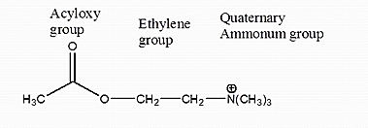
SAR of cholinergics as Muscarinic agonist
Based on above informations we can make simple changes to Ach hopefully design derivatives to improve stability and cell penetration.
Cholinergic drugs mimic action of Ach on Muscarinic or nicotinic receptors and produce the same effect as Ach but in greater magnitude. A general strategy of making an agonist is to use the original compound, in this case Ach, as a framework
1. Modification of quaternary Ammonium group

Slide 30
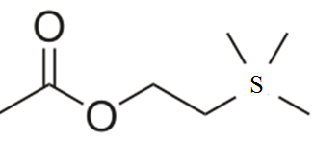
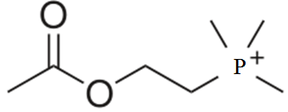
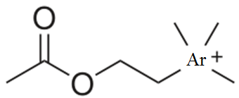
Replacement with sulphur removes the +ve charge and causes reduced activity
Replacement with Arsenic or Phosphorous maintains + charge but still reduces activity
Conclusion
1) positive charge needed
2) Positive charge should be on Nitrogen only
3) Charge on Nitrogen only possible when it bonded to 4 atoms ie quaternary form needed

Slide 31
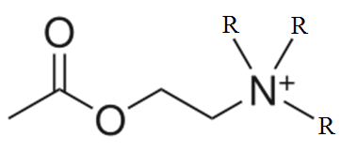
If R = methyl,(CH3) --> active
If R = ethyl (C2H5) --> antagonist!
If R = propyl (C3H9) and higher alkyls --> inactive
If only one of the R = ethyl or propyl active but less potent than Ach
If any or all R = H activity goes on decreasing

Slide 32
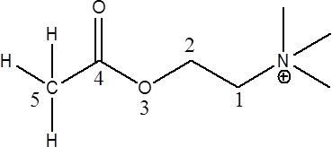
2. Change in the ethylene group
A “rule of five” idea states that there should be no more than 5 atoms between the Nitrogen and the terminal Hydrogen
As the chain length increased from two, activity
is rapidly lost. This tells us about the relative size of binding site

Slide 33
*For maximal muscarinic activity, the quaternary ammonium group should be followed by a chain of five atoms; this has been referred to as the five-atom rule.
*Shortening or lengthening the chain of atoms that
separates the ester group from the onium moiety reduces muscarinic activity.
An α- substitution on the choline moiety decreases both nicotinic and muscarinic activity, but muscarinic activity is decreased to a greater extent.
Substitution on the β-carbon nicotinic activity is decreased to a greater degree

Slide 34
*Hydrolysis by AChE is more affected by substitutions on the β- than the α-carbon.
The hydrolysis rate of racemic acetyl β -methyl acetylcholine is about 50% of that of Ach.
Racemic acetyl α-ACh is hydrolyzed about 90% as fast.

Slide 35
Methacholine
Methyl group in Beta carbon
As potent as Ach
Selective to Muscarinic receptor
Used clinically
Methyl group in alpha carbon
Not As potent as Ach
Selective to Nicotinic receptor
Not Used clinically

Slide 36
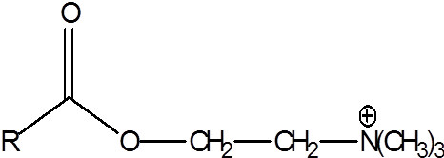
3. Modifications to the Acetoxy group
Substituting the Acetyl with higher homologous group such as propionyl or butyryl reduces activity.
The ester group isn’t mandatory as quanternary amine group but an oxygen atom is required in this region
Since ester group makes it liable to hydrolysis, alternate groups were included and found that replacing the ester with carbamate, ether or ketone function resists hydrolysis while maintaining activity.

Slide 37
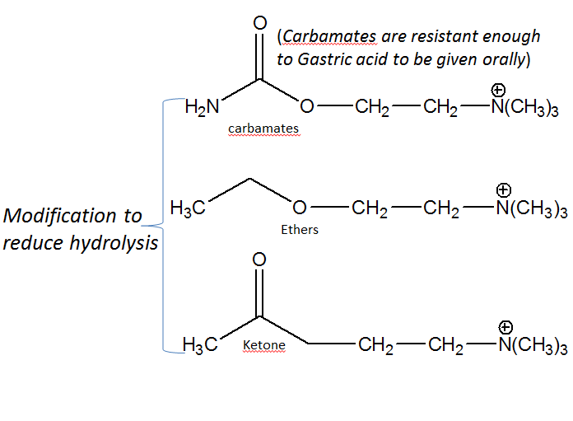

Slide 39
Uses of cholinergic agonists
Nicotinic selective agonists
Treatment of myasthenia gravis
- lack of acetylcholine at skeletal muscle causing weakness
Muscarinic selective agonists
Treatment of glaucoma
Switching on GIT and urinary tract after surgery
Treatment of certain heart defects.
Decreases heart muscle activity and decreases heart rate

Slide 40
Design of acetylcholine analogues :Ach Derivatives

Slide 41
(Muscarinic agonists)
Oxotremorine
Oxotremorine is a drug that acts as a selective muscarinic acetylcholine receptor agonist. It has been regarded as a CNS muscarinic stimulant. It increases ACh brain levels in rats up to 40% and has been studied as a drug in the treatment of Alzheimer disease.
Comparison of the geometries of oxotremorine and muscarine shown below:
oxotremorine
muscarine

Slide 42
Oxotremorine is a full agonist at muscarinic M3 receptors mediating contraction in several gastrointestinal tract smooth muscles but a partial agonist in urinary bladder smooth muscle, attributable to differences in receptor reserve in the various tissues. It is concluded that oxotremorine acts directly on muscarinic receptors and not by releasing acetylcholine.

Slide 43
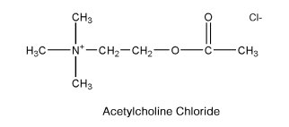
Acetylcholine Chloride
A powerful stimulant effect on the parasympathetic nervous system.
Attempts have been made to use it as a cholinergic agent, but its duration of action is too short for sustained effects, because of rapid hydrolysis by esterases and lack of specificity when administered for systemic effects.

Slide 44
Methacholine chloride
Methacholine chloride acetyl β-methyl chloride or (2-hydroxy propyl) trimethylammonium chloride acetate, is the acetyl ester of β- methylcholine. It is a muscarinic selective cholinergic agonist.
Unlike ACh, Methacholine has sufficient stability in the body to give sustained parasympathetic stimulation. Methacholine can exist as (S) and (R) enantiomers. Although the chemical is used as the racemic mixture, its muscarinic activity resides principally in the (S)-isomer.

Slide 45
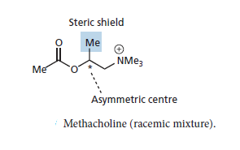
Here, an extra methyl group has been placed on the ethylene bridge as a steric shield to protect the carbonyl group. The shield hinders the approach of any potential nucleophile and also hinders binding to esterase enzymes, thus slowing down chemical and enzymatic hydrolysis. As a result, methacholine is three times more stable to hydrolysis than acetylcholine.

Slide 46
Carbachol.
Choline chloride carbamate is not selective to muscarinic or nicotinic receptor, non specific in its action on muscarinic receptor subtypes.
The pharmacological activity of carbachol is similar to that of ACh. It is an ester of choline and thus possesses both muscarinic and nicotinic properties by cholinergic receptor stimulation. It can also act a- indirectly by promoting release of ACh and b-by its weak anti cholinesterase activity. Carbachol forms a carbamyl ester in the active site of AChE, which is hydrolyzed more slowly than an acetyl ester.
The use of electronic factors to stabilize functional groups
was used in the design of carbachol

Slide 47
Here, the acyl methyl group has been replaced by NH2 which
means that the ester has been replaced by a urethane or carbamate group. This functional group is more resistant to hydrolysis because the lone pair of electrons on nitrogen can interact with the neighbouring carbonyl group and lower its electrophilic character.
Although the NH2 group is equivalent in size to the methyl group, the former is polar and the latter is hydrophobic, and it was by no means certain that a polar NH2 group would be accepted into a hydrophobic pocket in the binding site.
Fortunately, it is and activity is retained, which means that the amino group acts as a bioisostere for the methyl group.
A bioisostere is a group which can replace another group without affecting the pharmacological activity of interest .

Slide 48
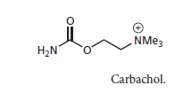
Carbachol differs chemically from ACh in its stability to hydrolysis. The carbamyl group of carbachol decreases the electrophilicity of the carbonyl and, thus, can form resonance structures more easily than ACh can.
The result is that carbachol is less susceptible to hydrolysis and, therefore, more stable in aqueous solutions.

Slide 49
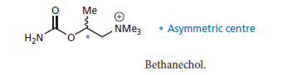
Combining steric and electronic effects
Bethanechol Chloride
(Urecholine), is selective to muscarine nonspecific in its action on muscarinic receptor subtypes but appears to be more effective at eliciting pharmacological action of M3 receptors. It has pharmacological properties similar to those of methacholine.
Both are esters of β -methylcholine and have feeble nicotinic activity. Bethanechol is inactivated more slowly by AChE in vivo than is methacholine. It is a carbamyl ester and is expected to have stability in aqueous solutions similar to that of carbachol.
Bethanechol is both stable to hydrolysis and selective in its action.

Slide 50
Muscarinic agonists Pilocarpine Hydrochloride
It is a plant derived alkaloid whose structure does not match the established SAR but still acts like an cholinomimetic
Muscarinic agonist used in the treatment of glaucoma,
Unlike other muscarine agonists, it can penetrate the eye well following topical application it is assumed that the drug is protonated before it interacts with the muscarinic receptor.
Molecular modelling shows that pilocarpine can adopt a conformation having the correct pharmacophore for the muscarine receptor; i.e. a separation between nitrogen and oxygen.

Slide 51
Pilocarpine is also being considered for the treatment of Alzheimer's disease, as are other muscarinic agonists such as oxotremorine and various arecoline analogues.
At present, anticholinesterases are used clinically for the treatment of this disease

Slide 53
Nicotinic agonists
Nicotinic receptors get their name from nicotine which does not stimulate the muscarinic acetylcholine receptors but selectively binds to the nicotinic receptors instead
Nicotinic agonists are used in the treatment of myasthenia gravis. This is an autoimmune disease where the body has produced antibodies against its own cholinergic receptors. As a result, the number of available receptors drops and so fewer messages reach the muscle cells. This leads to severe muscle weakness and fatigue.
Administering an agonist increases the chance of activating what few receptors remain. An example of a selective nicotinic agonist is varenicline. This agent is very similar in structure to methacholine, and differs only in the position of the methyl substituent.

Slide 54
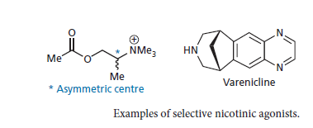
Varenicline (Chantix) is a selective alpha4-beta2 neuronal nicotinic acetylcholine receptor partial agonist approved in 2006 as an aid to smoking cessation therapy. This receptor is believed to play a significant role in reinforcing the effects of nicotine and in maintaining smoking behaviors.

Slide 55
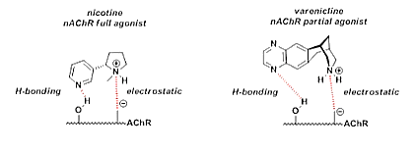
Notice that varenicline has a larger space between the two bond locations than nicotine or acetylcholine. This may explain when varenicline is a partial agonist while nicotine is a full agonist.

Slide 56
Anticholinesterase
Acetyl cholinesterase (AchE) is a enzyme that hydrolyzes Ach into Acetic acid and Choline.
MOA: Anticholinesterase drugs work by inhibiting the enzyme Acetyl cholinesterase which prevents hydrolysis of Ach thus increasing their concentration in the synapse which promotes more Ach action.
Since they promote Ach activity without binding to any receptor they are also called indirectly acting cholinergic agonists.

Slide 59
Applications
Improve muscle strength in Myasthenia gravis
Glaucoma
Alzheimer's
Insecticides
Chemical weapon (serine gas)
There are two types: Reversible and Irreversible

Slide 60
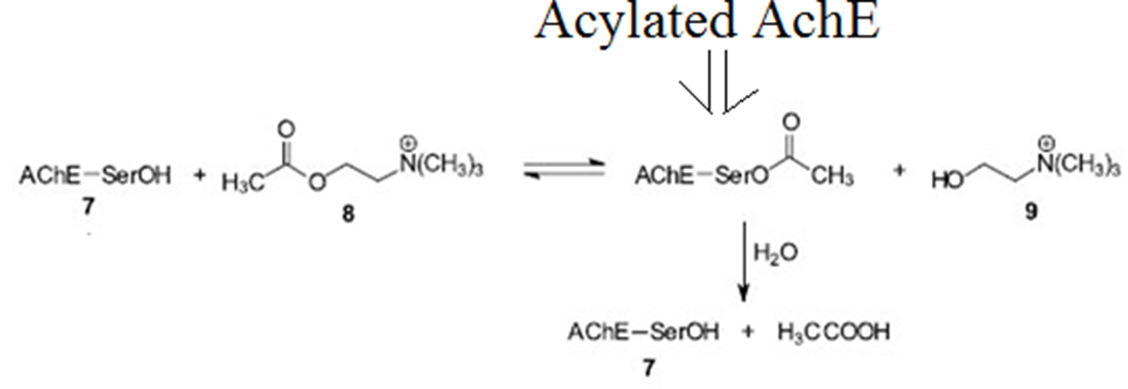
Theory of AchE inhibitors
During hydrolysis of Ach, the AchE gets acylated. It needs to be hydrolyzed by water to be regenerated in free from or else it can’t function again.

Slide 61
AChE attacks the ester substrate through a serine hydroxyl, forming a covalent acyl-enzyme complex.
Choline is released, leaving the acetylated serine residue on the enzyme.
The acetyl-enzyme intermediate is cleaved by a general base catalysis mechanism to regenerate the free enzyme. If instead of acetyl group there is carbamate group then hydrolysis will be resisted.
The AchE which is not hydrolyzed cannot be used again. Thus goal of AchE inhibitor is to provide such hydrolysis resistant functional group such as carbamates or phosphate ester.

Slide 64
Reversible Anticholinesterase
These are compounds can act by two ways:
They bind but don’t react with AchE with greater affinity than Ach .
These compounds that bind and react with AchE to form acylate AchE which is more stable form but still capable of being easily hydrolyzed
Reversible means that they inhibit AchE for short time (only few mins).
These compounds have more therapeutic uses than irreversible ones like Physostigmine and Neostigmine

Slide 65
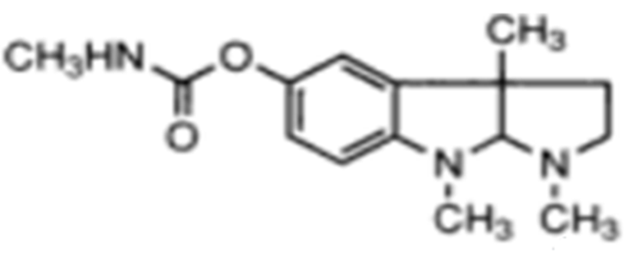
Physostigmine
It is an alkaloid type anticholinesterase obtained from the seeds of calabar beans.
It has no charged amine and is more lipophillic and can thus penetrate the blood brain barrier.
It has very great affinity for AchE but that can only in charged form. Thus there is pH limitation in it’s activity. Physostigmine is a relatively poor carbamylating agent of AChE and is often considered a reversible inhibitor of the enzyme.
Uses : Glaucoma
Counter CNS poisoning by atropine and tricyclic depressents
MOA – It inhibits AchE by binding and reacting to it and carbamylating it. This carbamylated enzyme is slow to hydrolysis

Slide 68
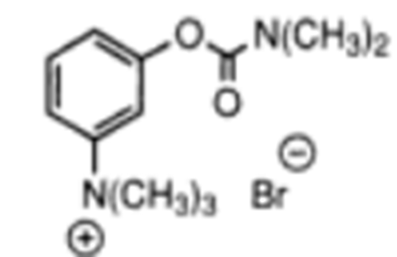
Neostigmine
It is a synthetic anticholinesterase based on Physostigmine.
It resembles the aromatic features of physostigmine and also the distance between the ester and ammonium is same but since it has charge on Nitrogen, it cannot cross the CNS like physostigmine does,
Its half life is shorter than physostigmine
Uses:
Myasthenia gravis
To counter Urinary retention
MAO – It inhibits AchE by binding and reacting to it and carbamylating it. This carbamylated enzyme is slow to hydrolysis

Slide 71
Ambenonium Chloride.
Ambenonium chloride is used for the treatment of myasthenia gravis in patients who do not respond satisfactorily to neostigmine or pyridostigmine.
This drug acts by suppressing the activity of AChE.
It possesses a relatively prolonged duration of action and causes fewer side effects in the GI tract than the other anticholinesterase agents.
The dosage requirements vary considerably, and the dosage must be individualized according to the response and tolerance of the patient. Because of its quaternary ammonium structure, ambenonium chloride is absorbed poorly from the GI tract.

Slide 72
In moderate doses, the drug does not cross the blood-brain barrier. Ambenonium chloride is not hydrolyzed by cholinesterases.
Ambenonium chloride

Slide 73
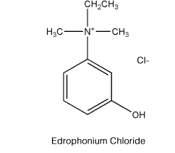
Edrophonium Chloride
Edrophonium Chloride
Ethyl (hydroxyphenyl) dimethyl ammonium
chloride (Tensilon),
is a reversible anticholinesterase agent.
It is bitter and very soluble in water and alcohol.
Edrophonium has a more rapid onset and shorter duration of action than neostigmine, pyridostigmine, or ambenonium.
It is a specific anticurare agent and acts within 1 minute to alleviate overdose of d-tubocurarine, dimethyl d -tubocurarine, or gallamine triethiodide.

Slide 76
Irreversible Anticholinesterase
These compounds act by only one way: that bind and react with AchE to AchE with greater affinity than Ach to form acylated enzyme which strongly resist hydrolysis
Irreversible means that they inhibit AchE for very long time(many hours)
These compounds have less therapeutic uses than reversible ones.
Serine gas and organophosphate insecticides are based on this concept.
They cause cholinergic crisis
Their common structural feature is the presence of Phosphate ester bond which strongly resist hydrolysis

Slide 77
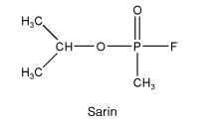
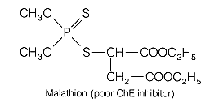
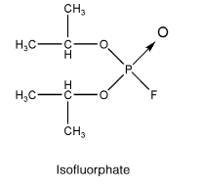
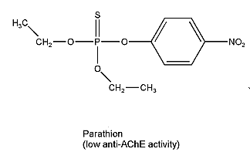
The compounds belong to a class of organophosphorous esters. A general formula for such compounds follows:

Slide 79
Cholinergic crisis
A cholinergic crisis is an over-stimulation at a neuromuscular junction due to an excess of acetylcholine (ACh). This happens due to inactivity (perhaps even inhibition) of the AChE enzyme, which normally breaks down acetylcholine.
This is a consequence of some types of nerve gas, (e.g. sarin gas) or insecticides.
It causes muscle paralysis and respiratory failure

Slide 80
Aging
Irreversible Anticholinesterase containing Phosphate ester
resist hydrolysis very strongly. They also undergo a feature
called aging which increases this resistance even more.
When AchE becomes acylated for a long time with, one of the ester bond is broken. This creates a negative charge that oppose nucleophillic attack on phosphorous and in this state it resists hydrolysis even more. At this stage antidotes against Irreversible anticholinesterase such as PAM doesn’t work.
Thus regeneration of AchE is blocked for even longer periods
leading to cholinergic crisis

Slide 81
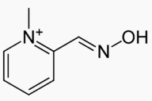
Antidote to insecticides (Pralidoxime)
Because insecticides can lead to chloinergic crisis, antidotes were designed to hydrolyze the acylated AchE. A successful antidote was PAM
It has a quaternary ammonium and a very strong nucleophile called oxime group and both work together to free AchE from the phosphate ester compounds
Anti-dote PAM

Slide 82
Organophosphate poisoning
Most insecticides use concept of irreversible AchE inhibition to kill pesticides. These compounds contain phosphate ester bond that strongly resist hydrolysis. They are very lipophillic and volatile also.
They can quickly enter the blood stream and inhibit AchE for a many hours. This promotes Ach activity in the synapse which leads to ‘cholinergic crisis’. When this happens muscles stop responding to Ach causing paralysis and respiratory failure (death)

Slide 83
How PAM reverses poisoning by organophosphate or serine gas ?
There are two sites in the binding pocket of AchE. One is a anionic site which is empty and other is the Esteric site where the phosphate compound sits.
The charged ammonium of PAM binds to the anionic site. From there PAM’s strong nucleophillic oxime group can be in close distance to attack the ester bond between Phosphorous and serine amino acid of AchE.
This form free AchE and phosphorylated PAM
Limitation: For PAM to work, it must be used immediately following exposure to insecticides or serine gas or no more than 36 hrs of exposure or else aging will occur and it wont be able to dislocate the phosphate form the receptor

Slide 85
Cholinergic receptor antagonists
Anticholinergic action by drugs and chemicals apparently depends on their ability to reduce the number of free receptors that can interact with ACh.
A blocking agent that has high affinity for the receptor may decrease the number of available free receptors and the efficiency of the endogenous neurotransmitter
What is muscarinic antagonist ?
- An agent that have high binding affinity for the muscarinic receptor but have no intrinsic activity.
- They are competitive (reversible) antagonists of acetylcholine
- Their pharmacological actions are opposite to that of the muscarinic agonists

Slide 86
Muscarinic Antagonists
Clinical Effects
• Decrease of saliva and gastric secretions
• Relaxation of smooth muscle
• Decrease in motility of GIT and urinary tract
• Dilation of pupils
Uses
• Shutting down digestion for surgery
• Ophthalmic examinations
• Relief of peptic ulcers
• Treatment of Parkinson’s Disease
• Anticholinesterase poisoning
• Motion sickness

Slide 87
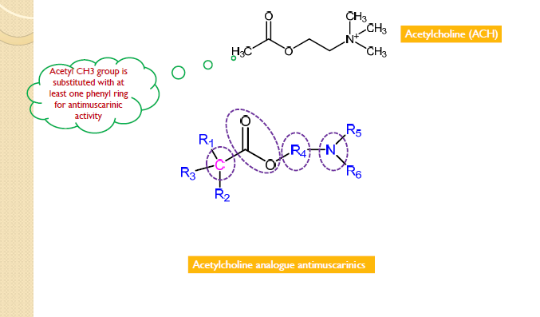
Structure Activity Relationship (SAR) Studies

Slide 88
Substitutions at α-carbon with respect to ester group

Slide 89
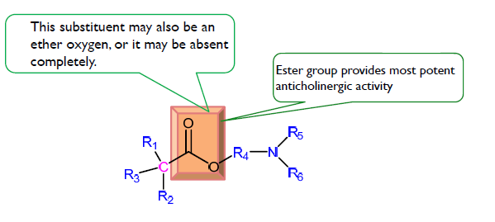
Changes at ester group

Slide 94
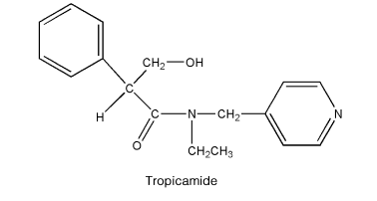
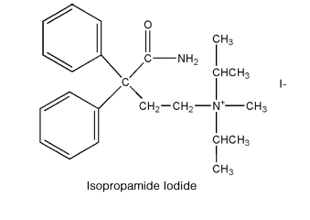
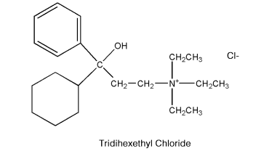
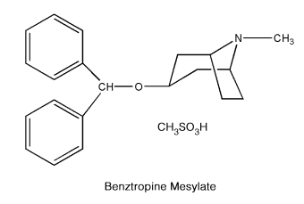

Slide 96
Specific anti muscarinic drugs

Slide 97
The nitrogen atom in atropine must be protonated and charged when it binds to the cholinergic receptor.
If we superimpose the acetylcholine skeleton on to the atropine skeleton, the distance between the ester and
the nitrogen groups is similar in both molecules
Atropine has two important binding features
shared with acetylcholine—a charged nitrogen
when protonated and an ester group. It is able to bind to the receptor, but why is it unable to switch it on?
Because atropine is a larger molecule than acetylcholine, it is capable of binding to other binding regions within the binding site which are not used by acetylcholine itself. As a result, it interacts differently with the receptor and does not induce the same conformational changes (induced fit) as acetylcholine.
This means that the receptor is not activated.

Slide 99
Anti muscarinic drugs used in the treatment of urinary incontinence

Slide 103
Anti muscarinic drugs used in the treatment of bronchial asthma
*Ipratropium Hydrobromide
*Tiotropium bromide
In order to reduce CNS side effects, quaternary salts of atropine and atropine analogues are used clinically. Ipratropium is used as a bronchodilator in chronic obstructive pulmonary disease. Atropine methonitrate acts at the intestine to relieve spasm.
A large number of different analogues of atropine were synthesized to investigate the SAR of atropine, revealing the importance of the aromatic ring, the ester group, and the basic nitrogen (which is ionized).
M3 receptors: Bronchiole constriction
Therapeutic use: block cholinergic bronchiole constriction
(anti cholinergics) and allow adrenergic bronchiole dilation to help overcome the pulmonary constriction associated with asthmatic attack.

Slide 104
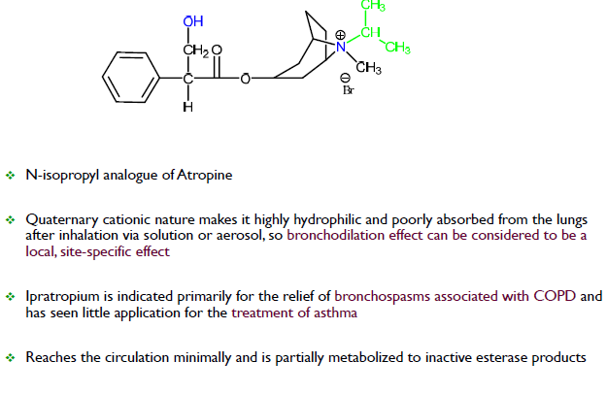
Ipratropium Hydrobromide (Atrovent®)

Slide 105
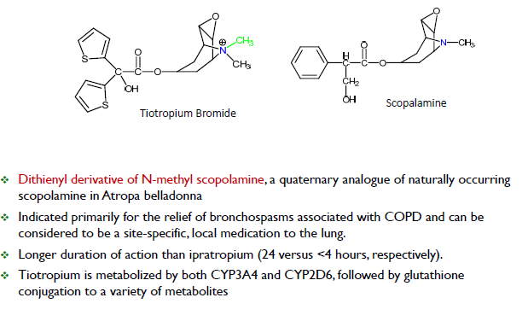
Tiotropium Bromide (Spiriva®)

Slide 106
Nicotinic Antagonists
Compounds that bind to cholinergic nicotinic receptors
with no intrinsic efficacy (competitive antagonists with
Ach)
Two subclasses of nicotinic antagonists
◦ Skeletal neuromuscular blocking agents
◦ Ganglionic blocking agents
DO NOT confuse with skeletal muscle relaxants that
produce their effects through the CNS

Slide 107
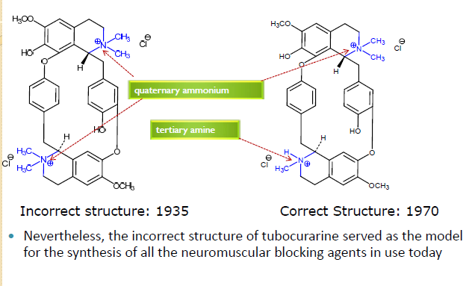
Tubocurarine structure

Slide 108
Rationale for designing new compounds
Bis‐quaternary ammonium compound having two quaternary ammonium salts separated by 10 to 12 carbon atoms (similar to the distance between the nitrogen atoms in tubocurarine) was a requirement for neuromuscular blocking activity
The rationale for this structural requirement was that nicotinic receptors possessed two anionic‐binding sites, both of which had to be occupied for a neuromuscular blocking effect.
Nicotinic antagonist may be :
◦ Depolarizing neuromuscular blocker
◦ Non‐depolarizing neuromuscular blocker

Slide 109
Depolarizing agents

Slide 110
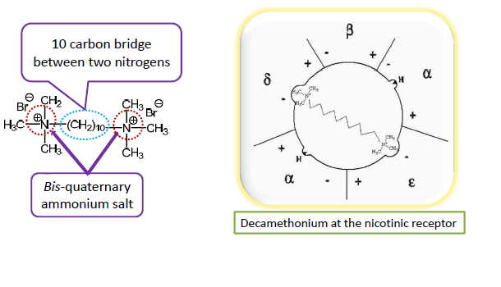
Decamethonium Bromide

Slide 112
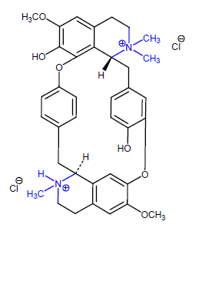
Tubocurarine – the first neuromuscular blocker
The neuromuscular
blocking effects of extracts
of curare were first reported
as early as 1510
It was demonstrated that
curare extracts prevented
skeletal muscle contractions
by an effect at the
neuromuscular junction

Slide 114
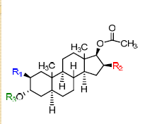
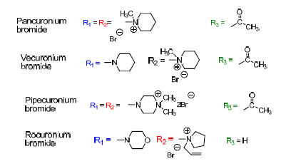
Amino steroid NM blocking agents

Slide 117
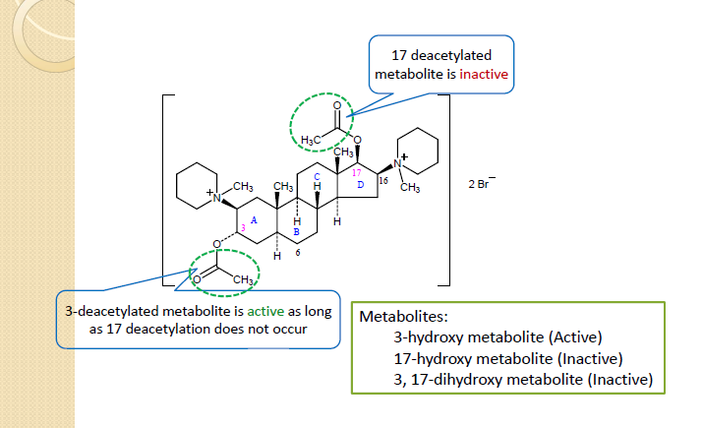
Pancuronium Bromide (Pavulon)

Slide 118
Tetrahydroisoquinolines

Slide 119
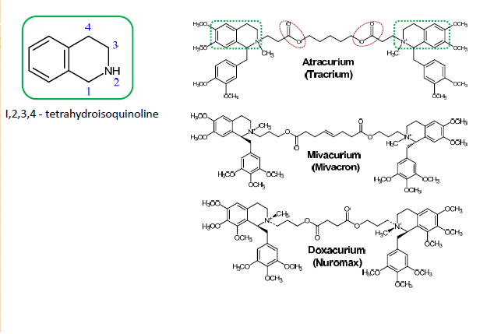
Tetrahydroisoquinolines

Slide 120
Structure Activity Relationships

