Slide 1
Artificial Intelligence
College of Engineering & Technology
Computer Techniques Engineering Department
Artificial Intelligence – Stage 3
Lecture 3
Intelligent Agents

Slide 2
Task Environment?
Task environment is the problem to which rational agents are the solutions.
Task environment (PEAS) : Performance, Environment, Actuators, Sensors)
Specify the task environment is the first step in designing an agent.
The following figure is an example of automated taxi task environment.

Slide 3
Task Environment?
Performance measure: desirable qualities include getting to the correct destination.
Minimizing fuel consumption and wear and tear.
Minimizing the trip time or cost.
Minimizing violations of traffic laws and disturbances to other drivers.
Maximizing safety and passenger comfort.
Maximizing profits
Some of these goals conflict, so tradeoffs will be required

Slide 4
Task Environment?
Environment: what is the driving environment that the taxi will face?
Variety of roads (rural lanes, urban alleys, 12-lane freeways)
The roads contain other traffic.
Pedestrians
Animals
Road work
Police cars
Puddles and potholes.
Passengers
Weather conditions.

Slide 5
Task Environment?
Actuators:
Accelerator
Steering
Braking
Display screen (Talk back to the passengers)
Voice (Talk back to the passengers)
Way to communicate with other vehicles.

Slide 6
Task Environment?
Sensor:
Cameras (see the road)
Infrared or sonar sensors to detect distances and obstacles
Speedometer
Global Positioning System (GPS)
Keyboard or Microphone for passenger to request destination.

Slide 7
Properties of task environments?
The range of task environments that might arise in AI is vast.
Therefore small dimensions along which task environments can be categorized.
These dimensions determine the appropriate agent design.
And the principle of techniques for agent implementation.

Slide 8
Properties of task environments?
Fully observable vs. partially observable
Agent sensors give it access to the complete state of the environment at each point in time.
Sensors detect all aspects that are relevant to the choice of action, relevance, in turn, depends on the performance measure.
Agent need not to maintain any internal state to keep track of the world.
Partially observable environment because of noisy and inaccurate sensors.
Or part of the state are simply missing for the sensor data.
For example:
an automated taxi cannot see what other drivers are thinking.

Slide 9
Properties of task environments?
Single agent vs multiagent
An agent solving a crossword puzzle by itself is clearly in a single-agent environment.
An agents playing chess is in two agent environment.
Competitive Multiagent Environment (Ex. Chess agent): the opponent entity B is trying to maximize its performance measure, which mean minimized agent A’s performance measure.
Partially Cooperative Multiagent Environment (Taxi driving): avoiding collisions maximizes the performance measures of all agents.

Slide 10
Properties of task environments?
Deterministic vs. stochastic.
Deterministic if the next state of the environment is completely determined by the current state and the action executed by the agent. Otherwise, it is stochastic.
Fully observable ------------------- Deterministic
Partially observable ------------- Stochastic
For example:
Taxi driving is stochastic because one can never predict the behavior of traffic exactly.

Slide 11
Properties of task environments?
4. Episodic vs. sequential:
Agent is divided into atomic episode
Each episode the agent receive a percept and then perform a single action.
The next episode does not depend on the actions taken in previous episodes.
For example: agent that spot defective parts on an assembly line bases each decision on the current part, regardless of previous decision, and the current decision does not affect the part decision.
On the sequential environments, current decision could affect all future decisions.
Chess and Taxi driving are sequential.
Episodic is simple than sequential because agent dose not need to think ahead.

Slide 12
Properties of task environments?
5. Static vs. Dynamic
If the environment change while an agent is deliberating (preparing an action) then the environment is dynamic, otherwise it is static.
Static is easy, agent not need to look at the world while deciding on an action.
Nor need it worry about the passage of time.
Dynamic environment, on the other hand, are continuously asking the agent what it wants to do.
Taxi driving agent is dynamic.
Crossword puzzles are static.

Slide 13
Properties of task environments?
5. Discrete vs. continuous:
The discrete/continuous applies to the state of the environment, the way time is handled, the percepts and actions of the agent.
For example : Chess has a discrete set of percepts and actions
Taxi driving is continuous-state and continuous time problem.
The speed and location of the taxi and other vehicles sweep through a range of continuous values smoothly over time.

Slide 14
The Structure of Agents?
The job of AI is to design an agent program that implements the agent function.
Mapping from percepts to Actions
The program run on computing device with physical sensors and actuator: Architecture
agent = architecture + program

Slide 15
Agent Programs?
Agent program take the current percept as input for the sensors and return an action to the actuators.
Agent program takes the current percept as input.
The agent function takes the entire percept history.
If the agents actions need to depend on the entire percept sequence, the agent will have to remember the percepts.

Slide 16
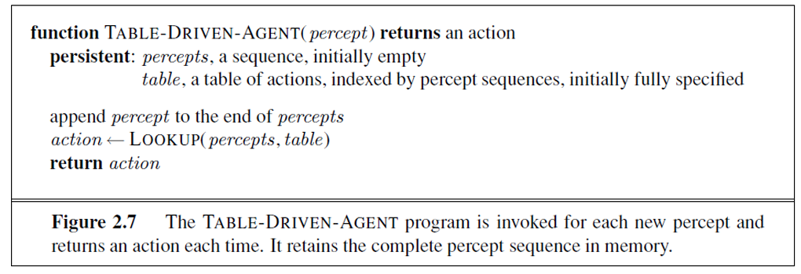
Agent Programs?

Slide 17
Agent Programs?
To build an agent program in this way, must construct table that contains the appropriate action for every possible percept sequence
Taxi driving agent for an hour of driving approximate ${10}^{250,000,000,00}$ table entries.
For chess would have at lest ${10}^{150}$ entries.
The table size lead to the following challenges
Storage limitation
Time to create table
Agent to learn the right entries
Guidance on how to fill table entries.

Slide 18
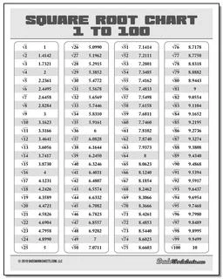
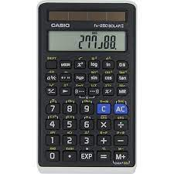
Agent Programs?
The key challenge for AI is to find out how to write program that produce rational behavior from smallish program rather than from a vast table.
Square root table ------------------→ five line program in any calculator

Slide 19
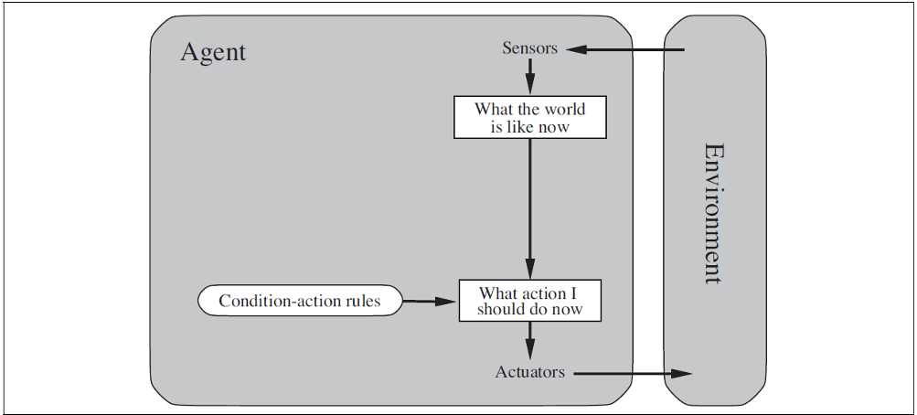
Basic Kinds of Agent Programs?
Simple reflex agents:
Take action on the baes of the current percept, ignoring the rest of the percept history.
For example, in automated taxi:
If car-in-front-is-braking then initiate-breaking

Slide 20
Basic Kinds of Agent Programs?
2. Model-based reflex agents:
The agent keep track of the part of the world it can’t see.
The agent maintain some sort of internal state depends on the percept history and reflects some of the unobserved aspects.
The agent need information about how the work evolves independently of the agent.
This knowledge about “how the world work” is called a model of the world.
Agent uses such a model is called a model-based agent.

Slide 21
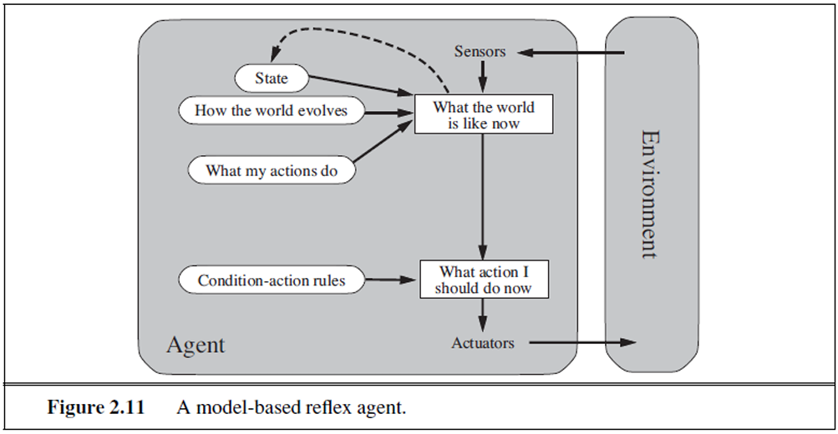
Basic Kinds of Agent Programs?

Slide 22
Basic Kinds of Agent Programs?
3. Goal-based Agents:
The agent needs some sort of goal information that describes situations that desirable.
For example the passenger destination, in the automated taxi.
The agent combine information about the goal the model to choose action to achive the goal.

Slide 23
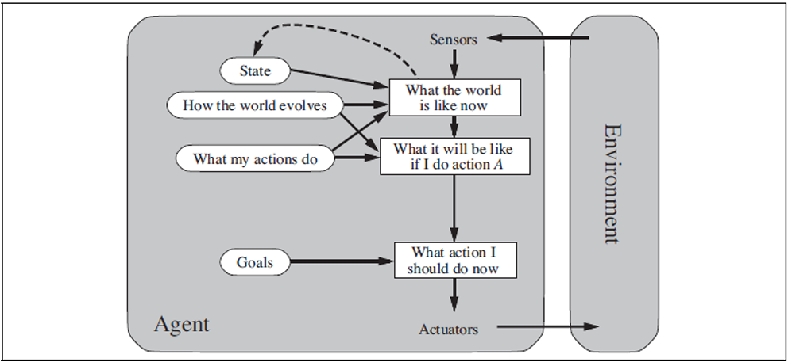
Basic Kinds of Agent Programs?

Slide 24
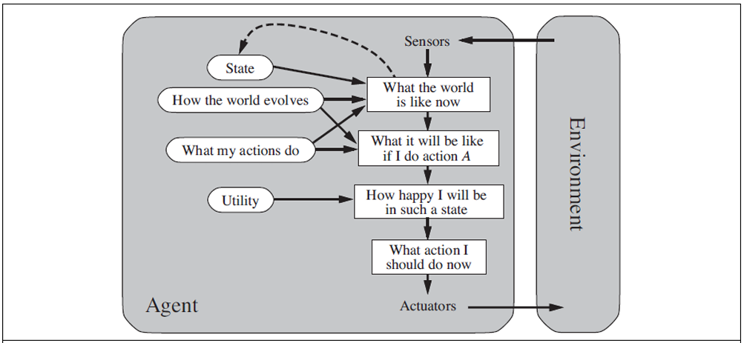
Basic Kinds of Agent Programs?
4. Utility-based agents:
An Agent Utility Function is essentially an Internalization of the Performance measure

Slide 25
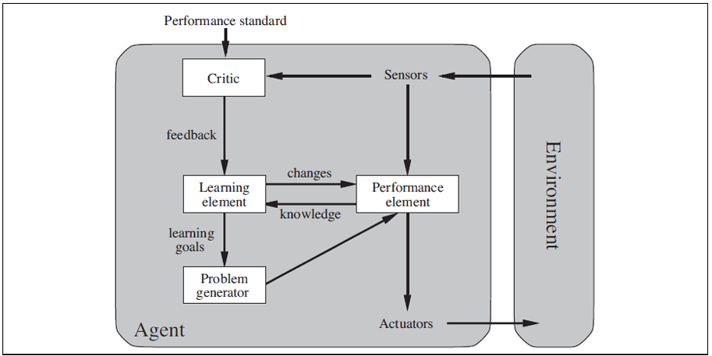
Learning agents?
Learning agent can be divided into four components, as shown in figure below:

Slide 26
Learning agents?
Learning element : responsible for making improvements.
Performance Element: responsible for selection external actions. It takes in percepts and decides on actions.
Critic: learning element used feedback from the critic on how the agent is doing and determines how the performance element should be modified to do better in the future.
Problem generator: it is responsible for suggesting actions that will lead to new informative experiences. The problem generators job is to suggest these exploratory actions which may lead to discover much better actins for the long run.

Slide 27
Summary?
An agent is something that perceives and acts in an environment. The agent function specifies the action taken by the agent in response to any percept sequence.
The performance measure evaluates the behavior of the agent in an environment. A ration agent acts so as to maximize the expected value of the performance measure, given the percept sequence it has been so far.
A task environment specification includes the performance measure, the external environment, the actuators and the sensors. In designing an agent, the first step must always be to specify the task environment as fully as possible.

Slide 28
Summary?
Task environments vary along several significant dimensions. They can be fully or partially observable, single-agent or multiagent, deterministic or stochastics, episodic or sequential, static or dynamic, discrete or continuous, and known or unknown.
The agent program implements the agent function. There exists a variety of basic agent-program designs reflecting the kind of information made explicit and used in the decision process. The designs vary in efficiency. Compactness, and flexibility. The appropriate design of the agent program depends on the nature of the environment.

Slide 29
Summary?
Simple reflex agents respond directly to percepts, whereas model based reflex agents maintain internal state to track aspects of the world that are not evident in the current percept. Goal-based agents act to achieve their goals, and utility-based agents try to maximize their own expected “happiness (utility)”.
All agents can improve their performance through learning.

Slide 30
Thanks for Your Attention

